Slide 1
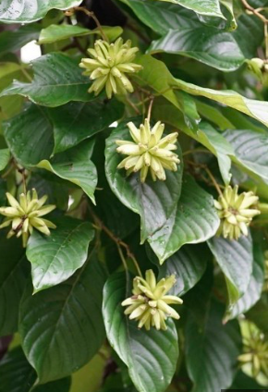
Camptothecin
Camptothecin and its derivatives are obtained from the Chinese plant Camptotheca acuminata (Nyssaceaea). The seeds provide about 0.3% camptothecin, the roots 0.2% and the leaves more than 0.4%. It is found only in Tibet and Western China.
It has a broad-spectrum antitumor activity but its toxicity and low solubility constitute major obstacles for its introduction into therapy.

Slide 2
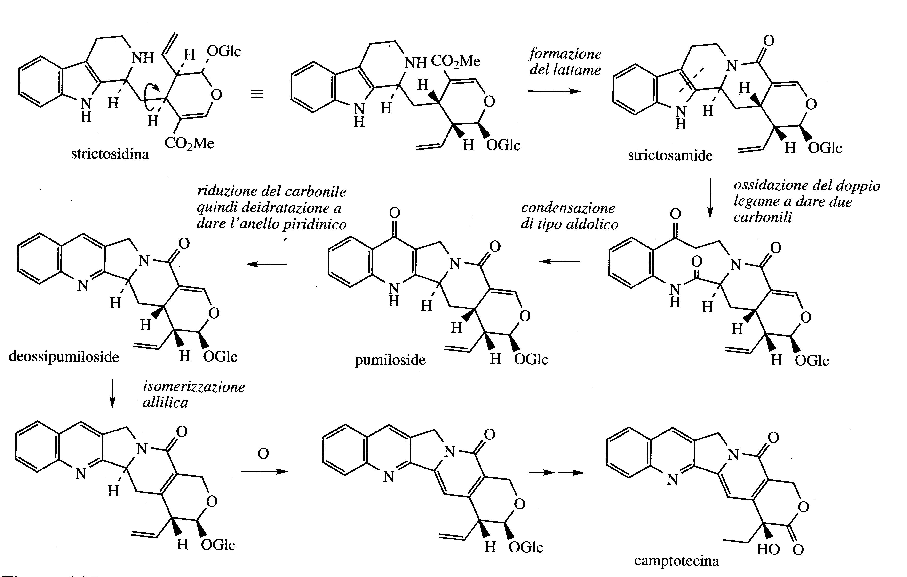
Camptothecin is an example of an alkaloid with a quinoline structure which derives from a modification of an indole system.
Strictosidin is the starting molecule.

Slide 3
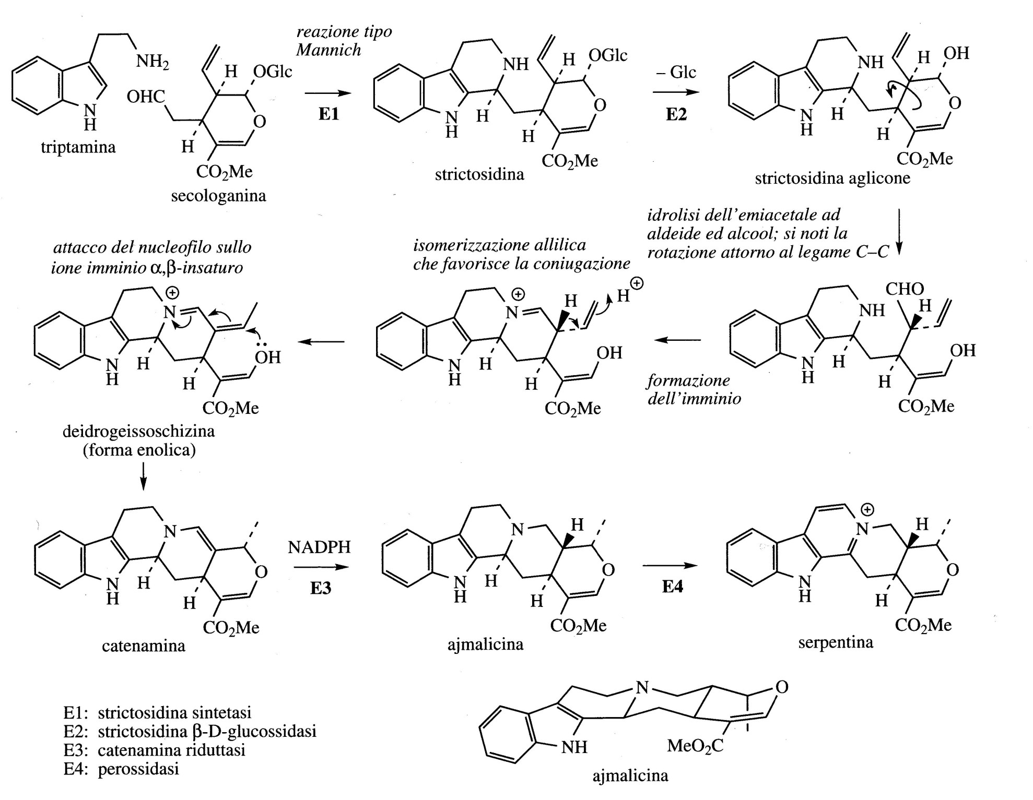

Slide 4
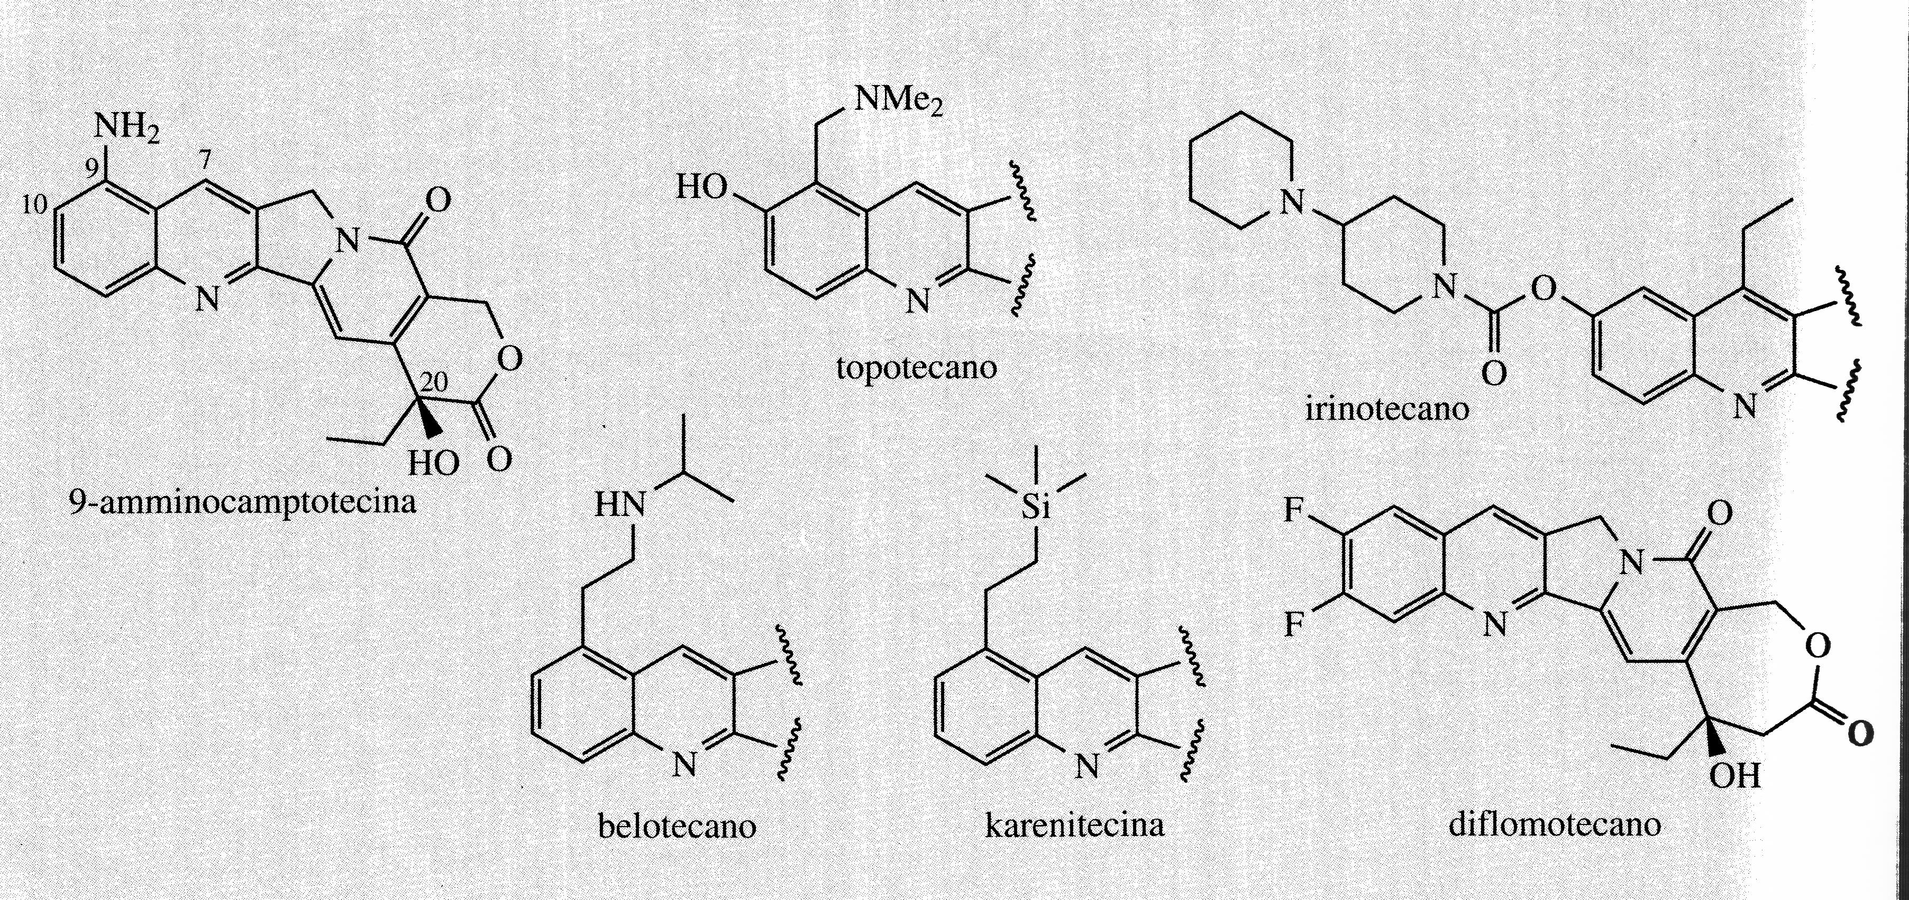
There are semi-synthetic compounds, shown in the figure, now used for some tumors. These drugs are obtained from natural camptothecin.
These molecules act by inhibiting the topoisomerase I enzyme which allows the transition of DNA molecules from one topoisomer to another by modifying the degree of supercoiling of the molecule. They control the proper condensation of DNA in cells.
These molecules promote the formation and stabilization of a covalent complex with DNA-topoisomerase.

Slide 5
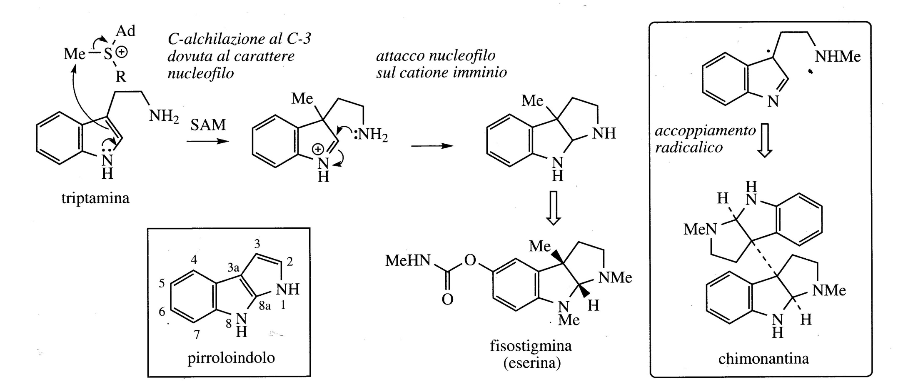
Pyrroloindole alkaloids
An example of a pyrroloindole alkaloid is physostigmine (exerine).
Its biosynthesis involves a C3 methylation of tryptamine, followed by the formation of the ring thanks to the attack of the primary amino function on the imino ion.
Other substitutions are subsequently required.

Slide 6
Pyrroindole alkaloids are quite rare even if they have been isolated in some plants (also amphibians and marine algae).
Dimeric structures containing this skeleton have also been isolated, such as the chimonathin from Chimonanthus fragransa (Calycanthaceae) in which the two units are coupled via the C-3 of the indole, probably through a reaction with a radical mechanism.

Slide 7
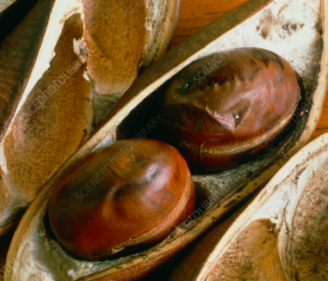
Physostigmine has been isolated from the seeds of Physostigma venesosum (Leguminosae/Fabaceae) and is important in pharmacology due to its anticholinesterase activity. The seeds contain various alkaloids (1.5%) of which the most abundant (more than 0.3%) is phytostigmine.
The active portion of the structure is the carbamate group rather than the heterocyclic system and this has led to the development of a number of synthetic bioactive products.
Phytostigmine is a reversible inhibitor of acetylcholinesterase, inhibiting the normal breakdown of acetylcholine and thereby increasing cholinergic activity.
Although it is rarely used as a drug, it has played a fundamental role in the study of the function of acetylcholine as a neurotransmitter.

Slide 8
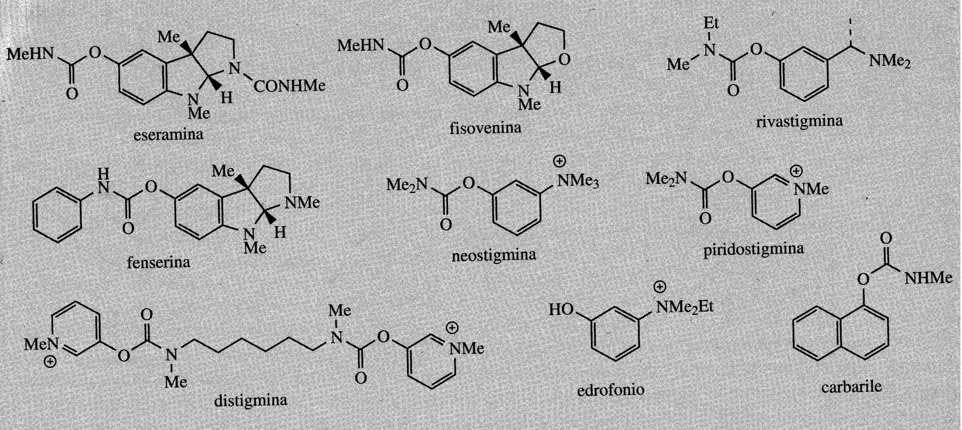
Its main function is as a miotic, to contract the pupil of the eye.
Acetylcholinesterase inhibitor drugs may offer benefits in the treatment of Alzheimer's disease, which is characterized by an enormous decrease in the function of the central cholinergic system.
The use of acetylcholinesterase inhibitors can result in a significant increase in patients' memory and currently phytostigmine analogues are in use, rivastigmine, or in clinical trials, fenserin.
These analogues have a longer duration of action, less toxicity and better bioavailability than physostigmine. Rivastigmine is also used to treat mild to moderate dementia associated with Parkinson's disease.

Slide 9
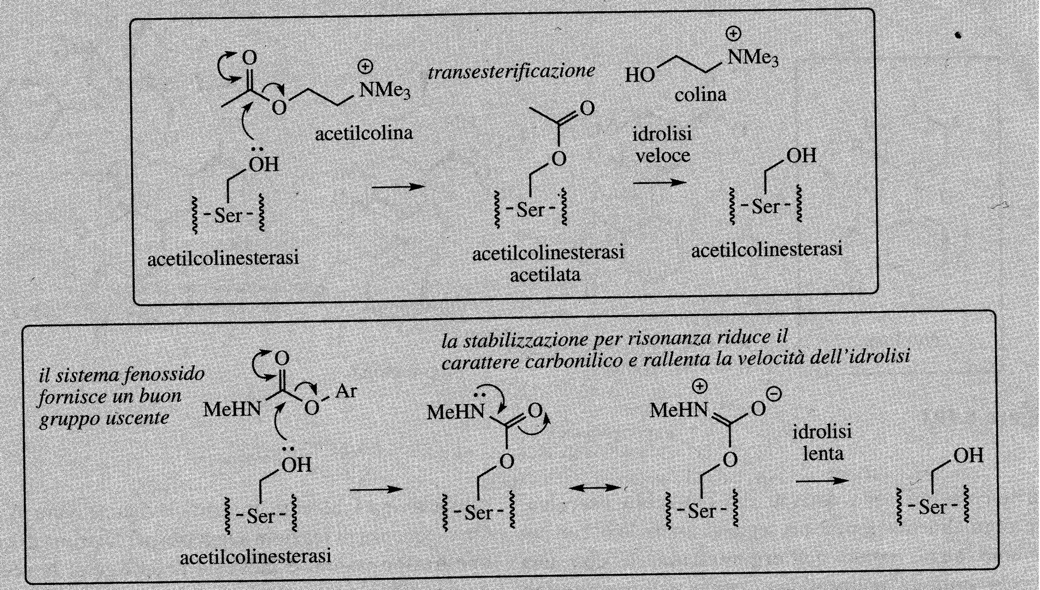
The biological activity of physostigmine is mainly due to the carbamate group reacting with the hydroxyl group of a serine in the active site of the enzyme.
The resulting carbamoyl-enzyme intermediate is then hydrolyzed very slowly (minutes instead of microseconds), effectively blocking the active site.
The carbamate functional group is slower than the ester group of the intermediate acyl-derivative of acetylcolinestarase in the hydrolytic process.

