Slide 1
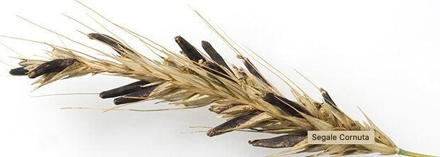
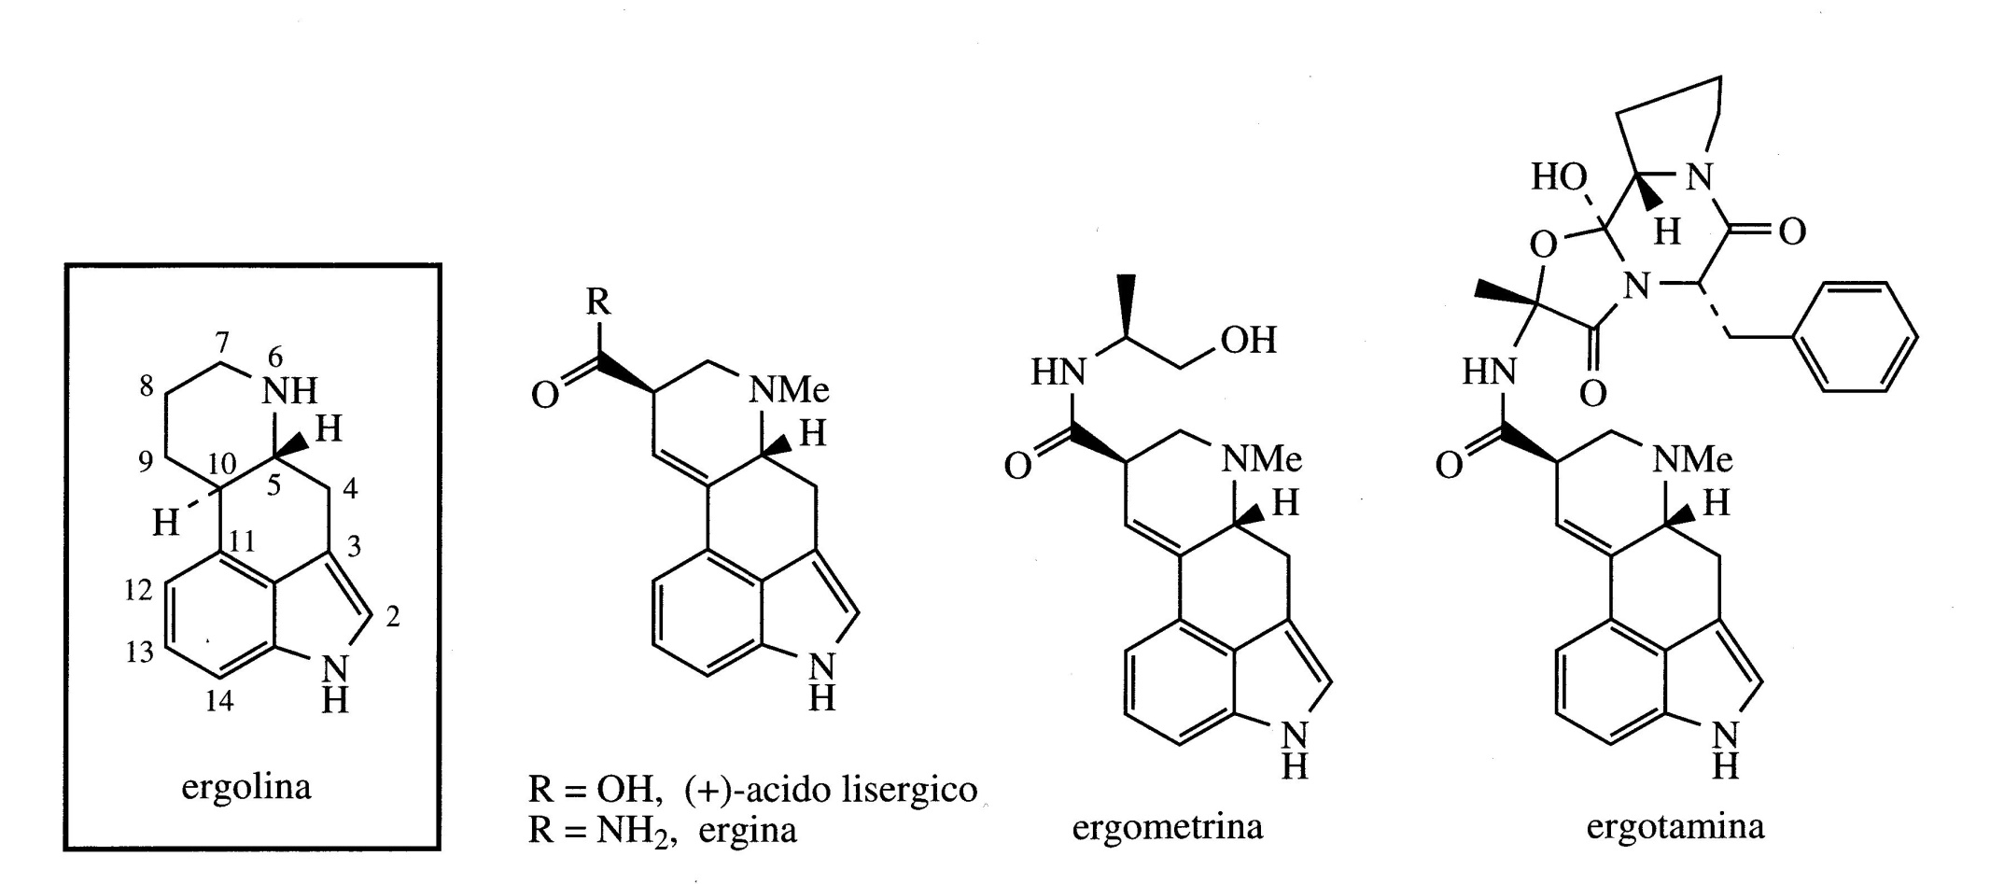
Ergot alkaloids
Ergot occurs on plants of the Graminaceae and is caused by fungi belonging to the Claviceps species. Instead of the normal seeds from the plant, ergots occur which are the sclerozium, a resting state of the fungus.
The toxicity of ergot for human and consumption have long been recognized and the toxic principle is a group of alkaloids known as ergot alkaloids or ergolines.

Slide 2
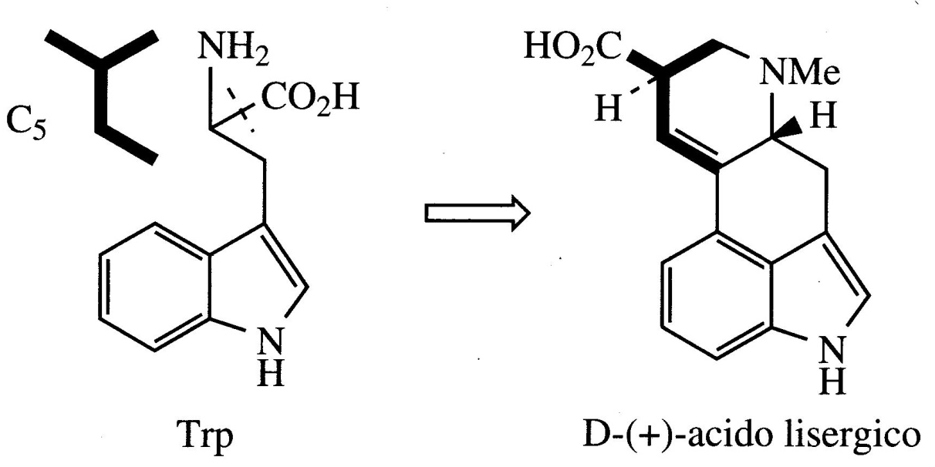
Alkaloids are produced by a combination of mushroom and plant metabolism but can also be synthesized by the fungus Claviceps alone.
Despite their toxicity, ergoline alkaloids have important pharmacological properties and are used in clinical practice. The pharmacologically interesting ones are lysergic acid derivatives.
The basic units for the formation of lysergic acid are tryptophan and an isoprene unit.

Slide 3
Ergine is the amide of lysergic acid
Ergometrine is the amide with 2-aminopropanol
Ergotamine is formed by the sequential addition of amino acids to lysergic acid

Slide 4
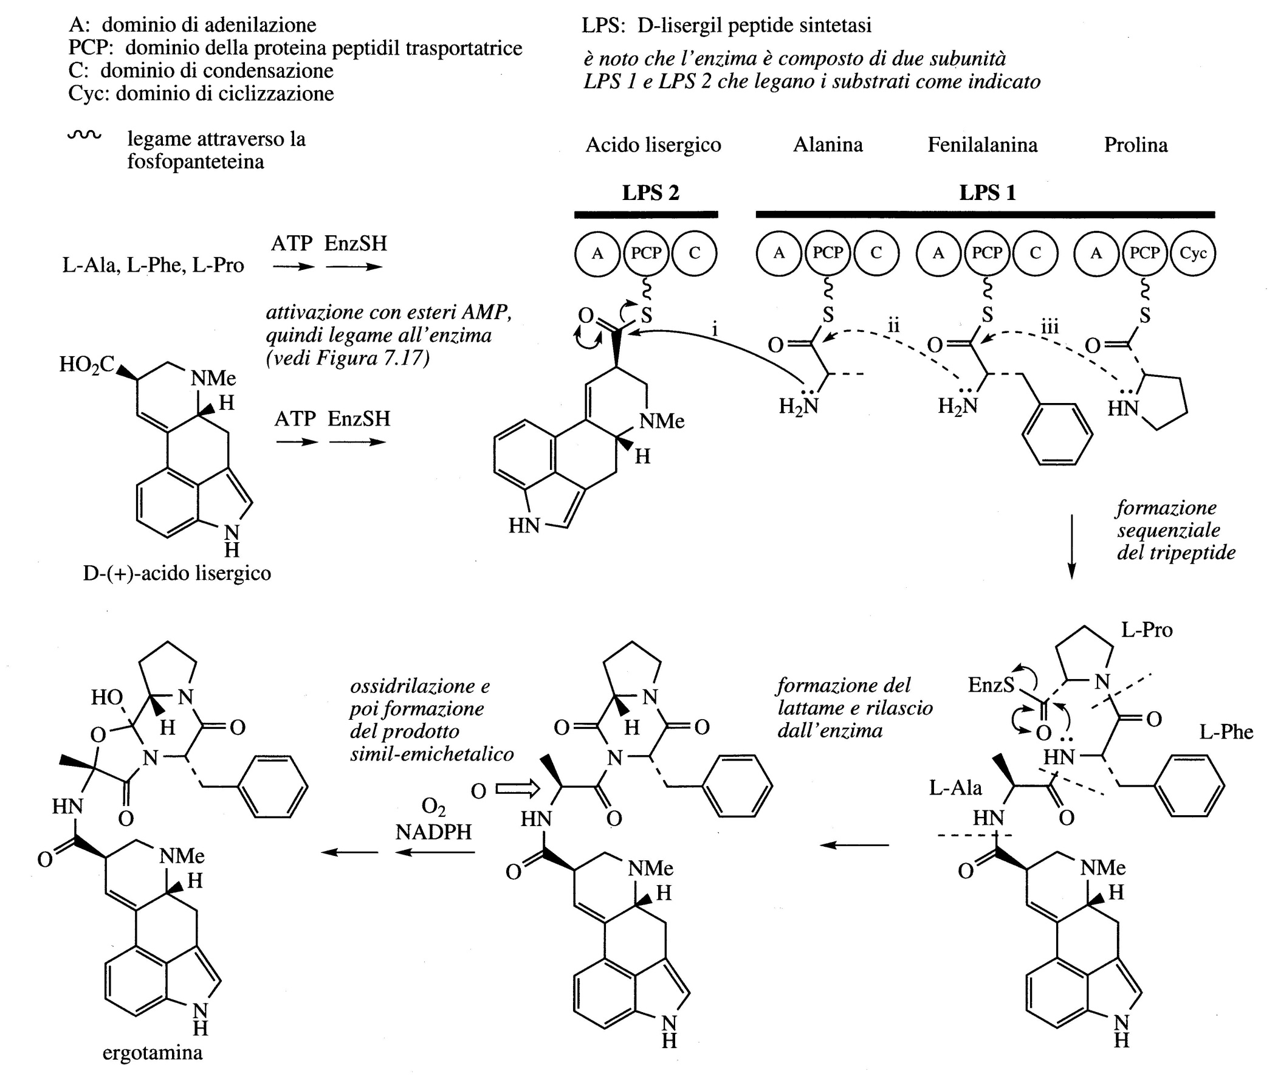

Slide 5
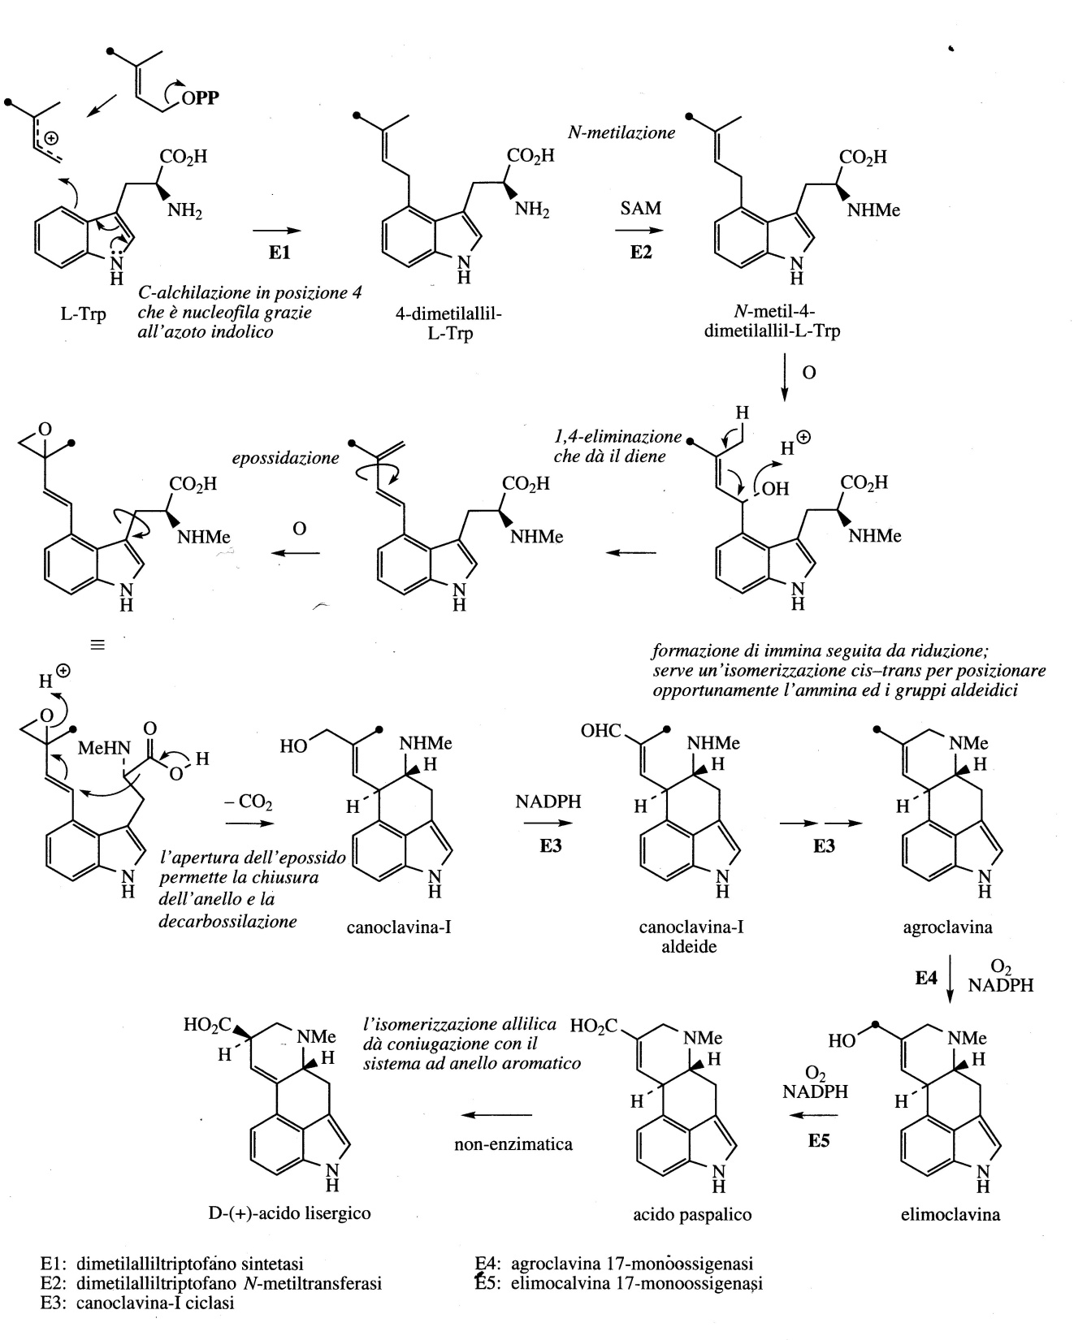
Alkylation of tryptophan with dimethylallyl pyrophosphate gives 4-dimethylallyl-L-tryptophan which then undergoes N-methylation.
Formation of the lysergic acid heterocyclic system proceeds via cyanoclavin-I and agrocalvine, although the details of the reactions and enzymes involved are not yet fully understood.
Lysergic acid originates from a spontaneous allylic isomerization.

Slide 6
Ergot is the dried sclerotia of the fungus Claviceps purpurea which develops in the ovary of the rye, Secale cereale (Graminaceae/Poaceae).
It is a fungal pathology of various wild and cultivated Graminaceae and initially affects the flowers.
A dark scleorotium corresponding to the quiescent stage of the fungus develops in place of the normal seed; this formation comes out from the head of the seed.
Ergot can be collected together with the cereal and thus contaminate flour and food for animals and humans.
The consumption of infected segal results in the disease ergotism.
Ergot poisoning: gastrointestinal problems, circulatory problems (vasoconstriction) and neurological symptoms including seizures, psychotic disorders and hallucinations.

Slide 7
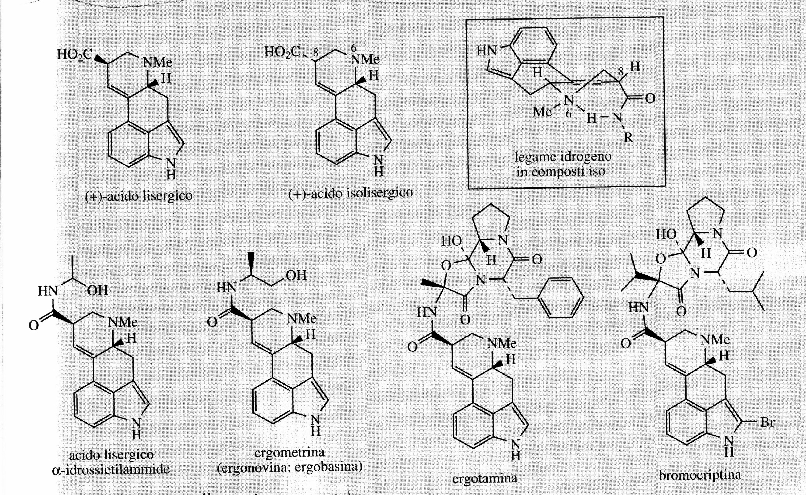
Lysergic acid derivatives
Ergot sclerotia contain 0.15 to 0.5% alkaloids, more than 50 molecules have been characterized.
Medically useful compounds are those derived from lysergic acid.
For medicinal purposes, ergot is grown in the Czech Republic, Germany, Hungary, Switzerland, Austria and Poland.
Ergot alkaloids are also produced by mushroom crops, also by semi-synthesis, currently 60% is produced by fermentation.

Slide 8
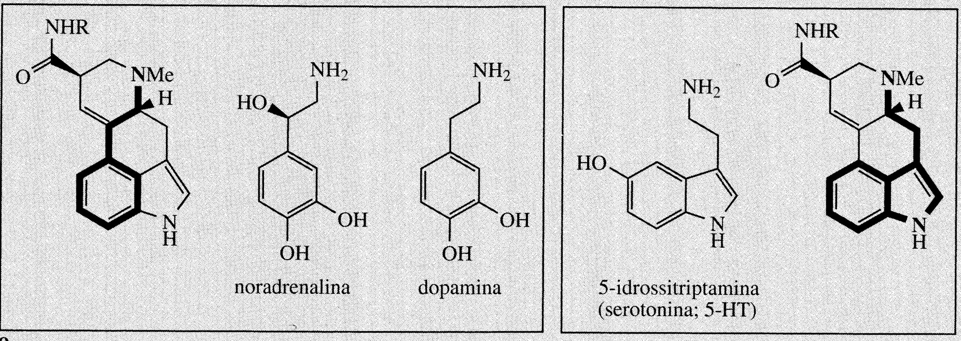
Ergot alkaloids owe their pharmacological activity to their ability to interact with α-adrenergic, dopaminergic and serotonergic receptors.
The resulting pharmacological response is very complex and depends on the receptor interacting with the alkaloid. All receptors are involved and the alkaloids can act as an agonist and antagonist.
They have been used since the sixteenth century to induce uterine contractions during childbirth and to reduce postpartum bleeding.
Ergometrine (ergonovine) is used as an oxytocic and administered together with oxytocin. It is also injected after childbirth especially if bleeding occurs, thanks to its vasoconstrictor effect.
Ergotamine is not used for obstetric use because it also produces a strong peripheral vasocotriction. It is used for acute treatment of migraine.

Slide 9
The most famous lysergic acid derivative is lysergide, lysergic acid diethylamide, or LSD.
Hallucinogen, agonist-antagonist of the serotonin receptor, strongly interfering with its physiological activity.
It was synthesized starting from lysergic acid and even the small traces absorbed during its handling caused very strong hallucinations in the chemist who synthesized it (Hoffman, 1943).
It can lead to schizophrenia, with great danger of serious bodily harm when the user is under its influence.

