Slide 1
Alkaloids derived from antranilic acid
Anthranilic acid is an intermediate in the synthesis of tryptophan and then is involved in the synthesis of indole alkaloids.
During this conversion it is decarboxylated and its C₆N backbone is used.
In mammals tryptophan can be degraded to anthranilic acid, not in plants

Slide 2
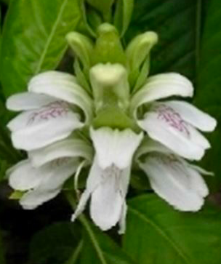
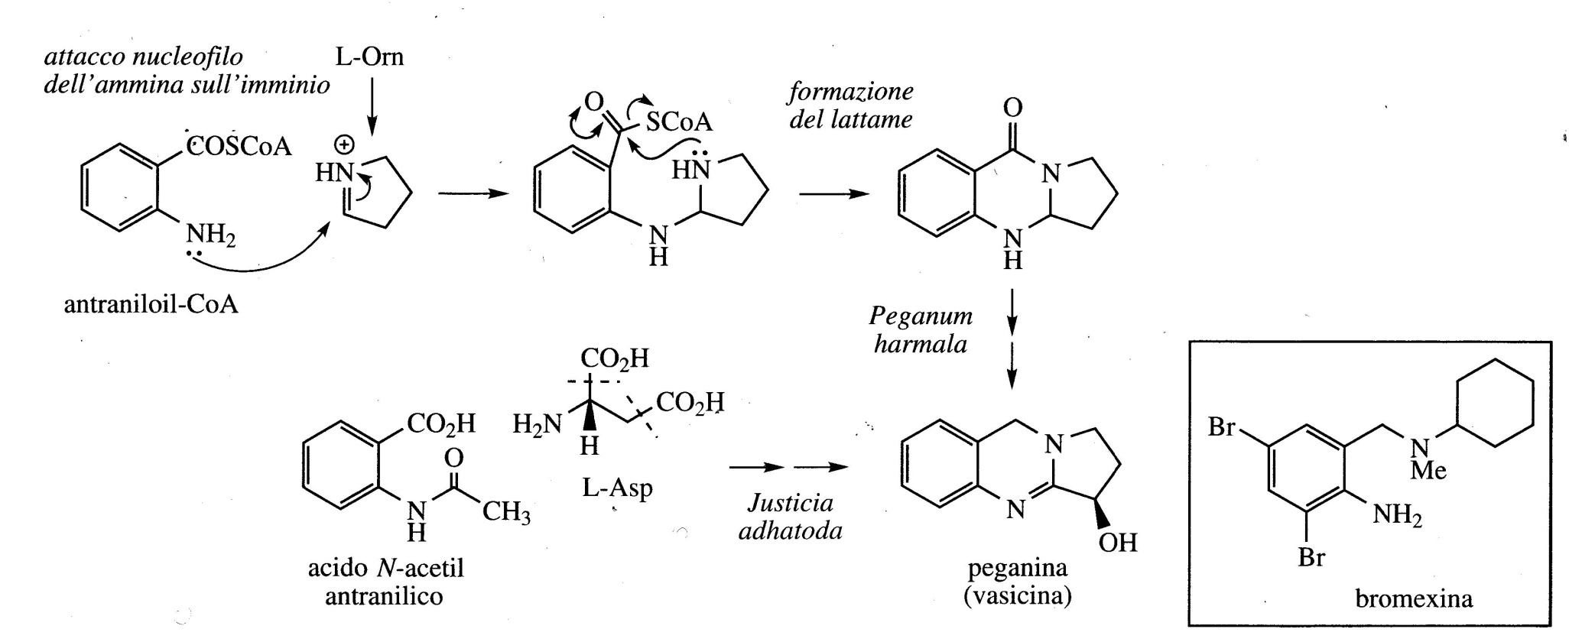
Quinazoline alkaloids
Peganin is a quinazoline alkaloid isolated from Peganum harmala (Zygophyllaceae).
It is responsible for the bronchodilator activity of Adhatoda vasica (Acanthaceae, Hymalaya), a plant used in the treatment of respiratory disorders (also called vascina).
Bromomexine is an expectorant used in veterinary practice synthesized on the structure of pegamine.
pyrrolinium ion
Adhatoda vasica

Slide 3
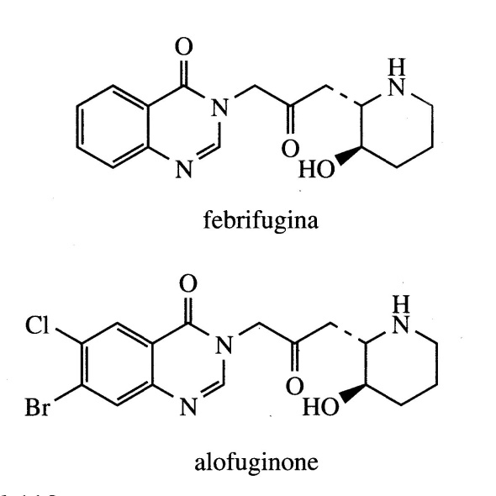
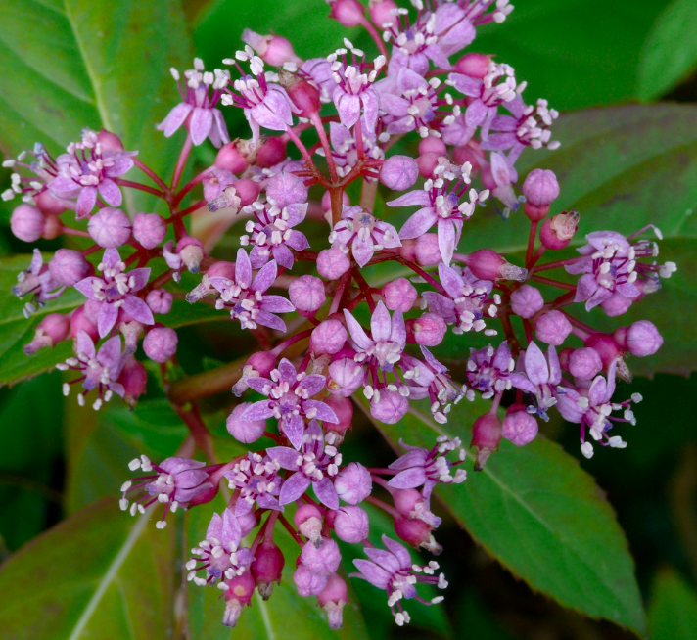
Dichroa febrifuga
Febrifugine is a quinazolinic akaloid, biosynthetic pathway not yet fully known.
This alkaloid was isolated from the root of the Chinese plant Dichroa febrifuga (Saxifragaceae) traditionally used in the treatment of malarial fevers.
More powerful than quinine but with unacceptable side effects such as liver toxicity and emetic properties which prevented its use as a drug.
It is used as a model to produce non-toxic synthetic analogues (halofuginone)

Slide 4
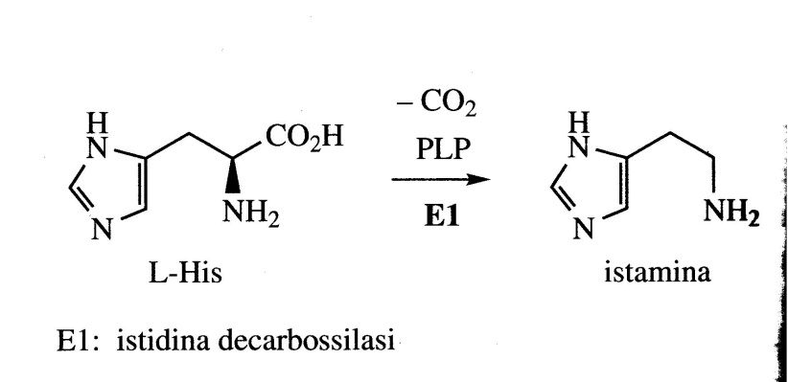
Alkaloids derived from histidine
Imidazole alkaloids
Histamine is the product of the decarboxylation of histidine and is among the main responsible for allergic reactions in humans, for example in response to insect bites or pollen. Events of this type stimulate the action of the enzyme histidine decarboxylase and the histamine produced by it is released by mast cells.
It interacts with H1 receptors which are associated with inflammatory and allergic responses. The term antihistamine is used for H1 receptor agonists, prescribed for allergies such as allergic rhinitis.
Among the main effects of histamine are the dilation of blood vessels, inflammation and swelling of the tissues and the occlusion of the respiratory system.

Slide 5
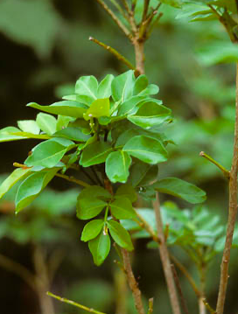
Probably also the imidazole alkaloids pilocarpine and pilosin derive from histidine even if experimental data are lacking.
They are found in the leaves of Pilocarpus microphyllus and P. jaborandi (Rutaceae), small shrubs native to Brazil and Paraguay.
Pilocarpine is the main alkaloid (0.5-1%), it is used in ophthalmic practice in the form of eye drops as a miotic and for the treatment of glaucoma.
Pilocarpine is a cholinergic agent and stimulates muscarinic receptors present in the eye causing contraction of the pupil.
Pilocarpus microphyllus

Slide 6
Alkaloids deriving from amination reactions
Most alkaloids derive from amino acid precursors thanks to processes which incorporate the nitrogen atom together with a large part of the amino acid skeleton in the final structure.
Many alkaloids do not fit this scheme and are mainly synthesized from non-amino acid precursors and the nitrogen atom is inserted into the structure in a final step of the synthesis.
The term pseudoalkaloid is also used to identify this class of molecules.
These structures are frequently based on complex terepenoid or steroid-type skeletons. The nitrogen atom is obtained from an amino acid source through a transamination reaction with the appropriate aldehyde or ketone.

Slide 7
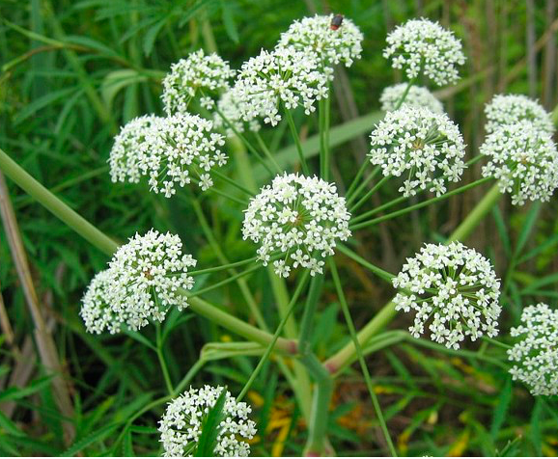
Alkaloids deriving from acetate
Hemlock (Conium maculatum, Umbelliferae/Apiaceae), a well-known poison, produces a series of simple piperidine alkaloids, such as conine and γ-coniceine.
The plant is native to Europe and imported to North and South America.
All parts of the pinat are poisonous due to their alkaloid content, although the highest concentration is found in the green fruits (more than 1.6%). The main alkaloid is coniine.
Conium maculatum

Slide 8
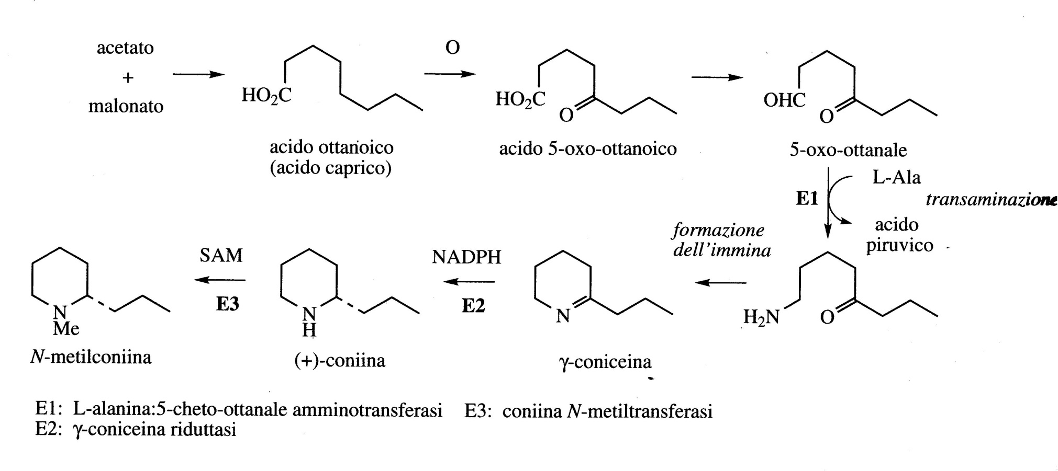
The precursor is a fatty acid, caprylic acid (octanoic) which is transformed into 5-oxo-octalal thanks to successive steps of oxidation and reduction.
The following is a transamination reaction with an amino group donated by L-alanine.
Subsequent transformations are the formation of the imine which gives the heterocyclic ring of γ-conicein, the reduction which gives the conniin and the methylation which gives the N-methylconiine.

Slide 9
Alkaloids derived from phenylalanine
While the aromatic amino acid L-tyrosine is an important and widespread direct precursor of alkaloids, L-phenylalanine is much less frequently used and normally its structure provides only the carbon atoms without the nitrogen atom of the amino group.
Ephedrine, the major alkaloid in several species of Ephedra (Ephedraceae), an important nasal decongestant and bronchodilator, is an example of this class of alkaloids.
Although ephedrine contains the backbone of phenylalanine, both in terms of carbon and nitrogen atoms, this amino acid has been shown to provide only seven carbon atoms as a C₆C₁ fragment for the bisosynthesis.

Slide 10
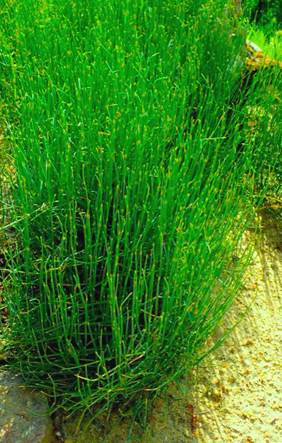
Ephedra or Ma Huang is one of the oldest drugs, having been used by the Chinese for at least five thousand years.
There are several species of Ephedra including Ephedra sinica, Ephedra equisetina native to China, Ephedra geriardriana, Ephedra intermedia, and Ephedra major from India and Pakistan.
The plants are small bushes with thin stems and small leaves.
Plants normally contain 0.5-2% alkaloids, depending on the species.
There are three pairs of optically active diastereoisomeric alkaloids: (-)-ephedrine and (+)-pseudoephedrine, (-)-methylephedrine and (+)-methylpseudoephedrine , (-)-norephedrine and (+)-norpseudoephedrine.
Ephedrine normally accounts for more than 50% of the total alkaloids.
Ephedra
Ephedra sinica

Slide 11
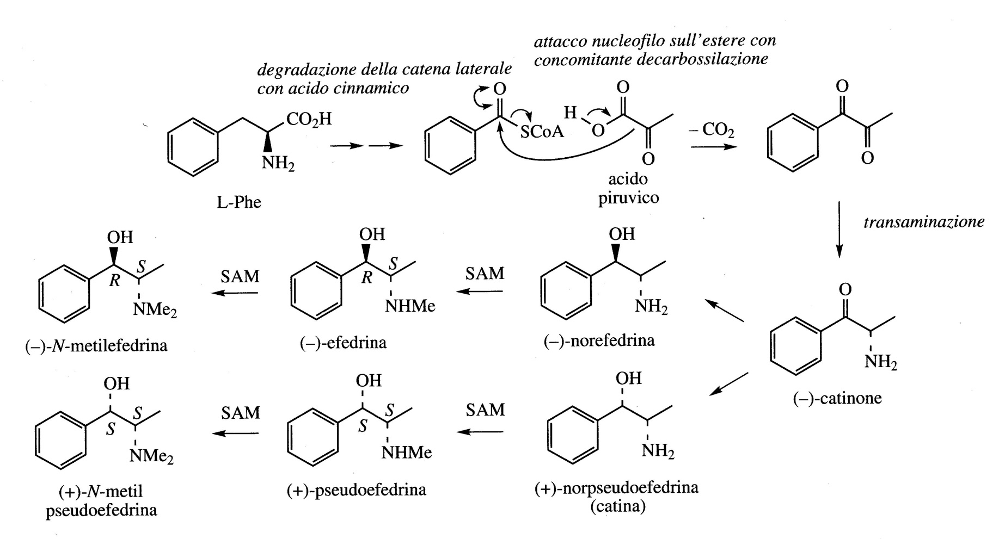
Alkaloids derived from phenylalanine
Riduzione da chetone ad alcool

Slide 12
Although ephedrine lacks the phenolic groups typical of catecholamines, it interacts with both α and β adrenergic receptors with effects similar to those of adrenaline and with a longer duration of action.
It is orally active and has a bronchodilatory activity offering relief in cases of asthma and a vasoconstrictor activity on the mucous membranes, thus acting as an effective nasal decongestant.
Pseudoephedrine is also used as a decongestant for coughs and colds.
The ephedrine and pseudoephedrine used in medicine are synthetic.
The commercial production of ephedrine involves the use of strains of S. cerevisiae starting from benzaldehyde.

