Slide 1
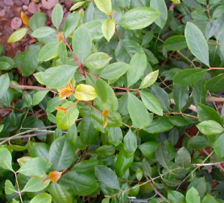
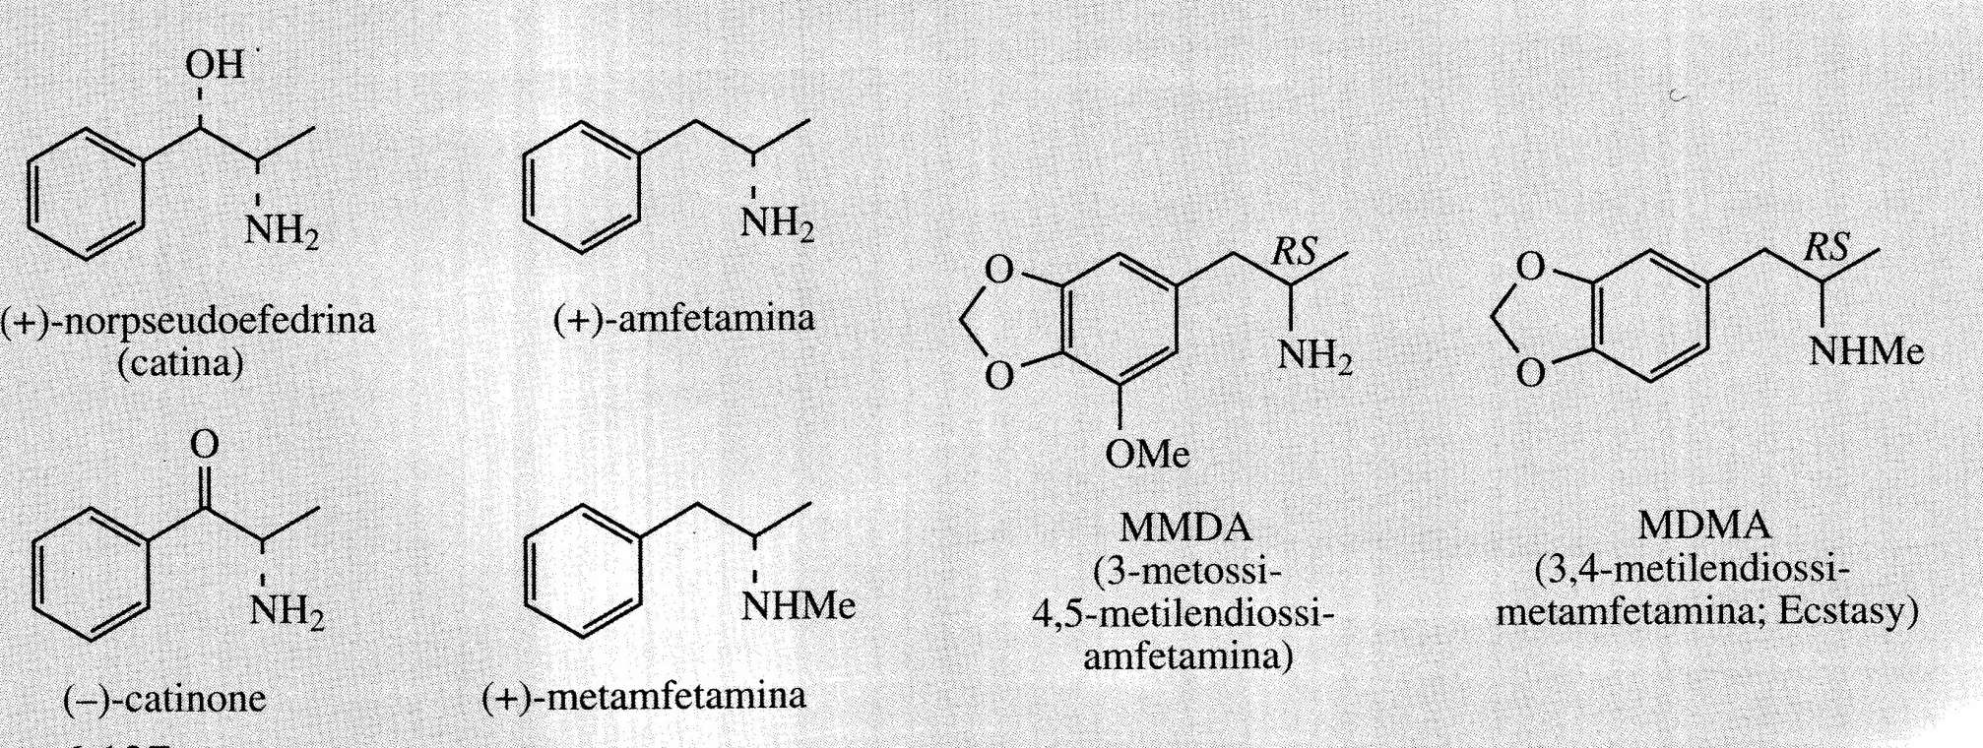
Catha edulis
Khat or tea from Abyssinia consists of the fresh leaves of Catha edulis (Celastraceae), a small tree grown in Ethiopia, East and South Africa and Yemen. The leaves are used by the local population and are chewed for their stimulating effects.
The main stimulant of the central nervous system of fresh and young leaves is (-)-cathinone, present in quantities of 0.1-0.3%.
Cathinone has pharmacological properties similar to those of other synthetic central nervous system stimulants such as (+)-amphetamine.
Both acts by inducing the release of catecholamines.
Other synthetic derivatives are methamphetamine and MMDA (methoxymethylenedioxyamphetamine) and MDMA (methylenedioxymethamphetamine).
MDMA is the illegal drug called Ecstasy.
MDMA promotes the release of the amino nerotransmitter serotonin, norepinephrine, and dopamine in the brain resulting in various short- and long-term neuropsychiatric effects with several deaths caudes by excessive dehydration.

Slide 2
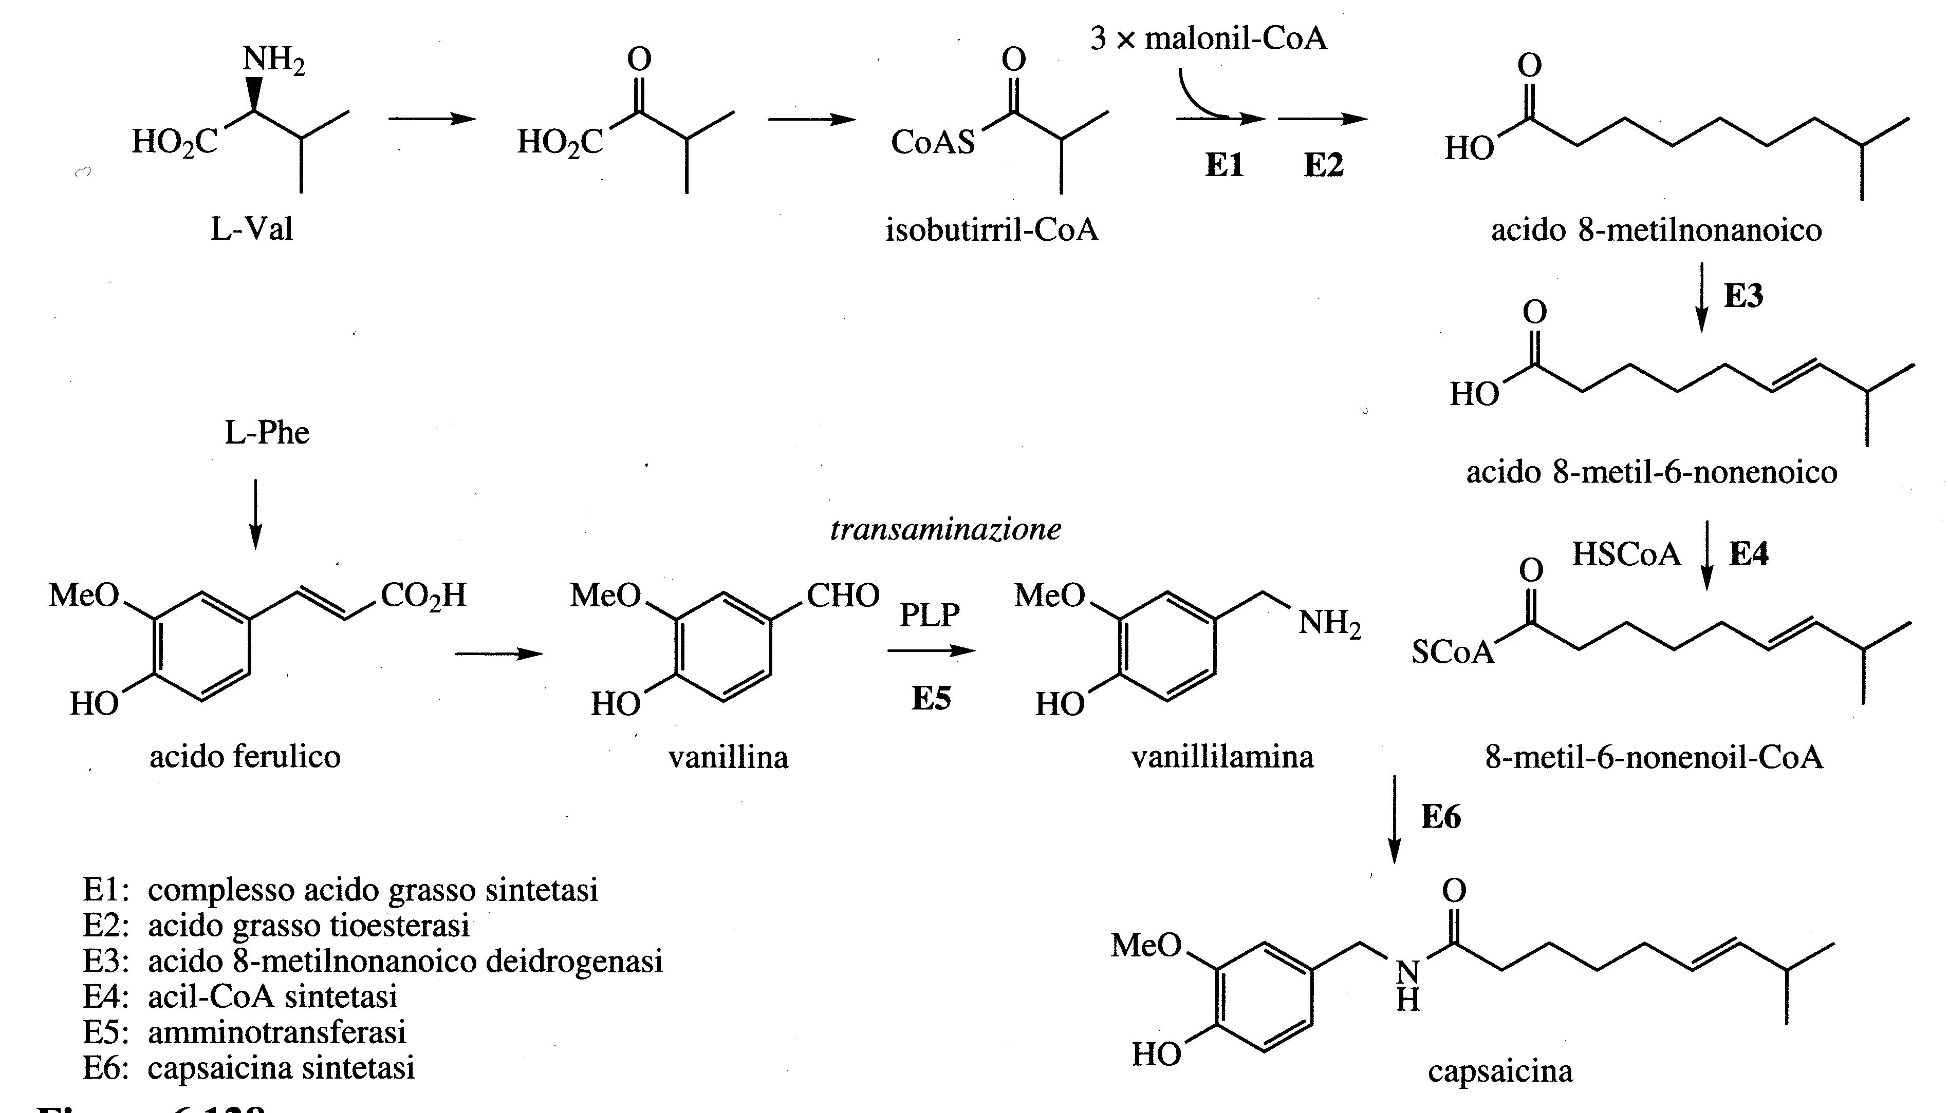
Capsaicin (Capsicum) has an aromatic moiety that is derived from phenylalanine via ferulic acid and vanillin aldehyde.
Vanillin is the substrate of a transamination that gives vanillylamine.
The acidic portion of the amide structure is a molecule of polyketide origin, with a branched-chain fatty acid which is produced by elongation of the isobutyryl-CoA chain.
This starter unit is a derivative of valine.

Slide 3
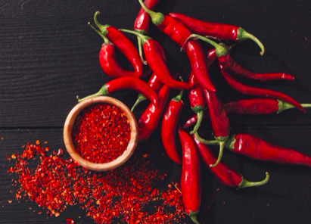
The spicy aroma depends on the presence of capsaicinodes, amides of branched-chain fatty acids with vanillylamine.
The capsaicinod content can even reach 1%.
Capsaicin causes a burning sensation in the mouth, the receptor is the capsaicin binds to the TRPV1 receptor (also known as vanilloid receptor due to vanillyl group of capsaicin).
TRPV1 is a non-specific cation channel and is activated not only by capsaicin but also by heat or acids, in both cases causing pain.
TRPV1 activation causes long-lasting desensitization, a particular form of analgesia in which only pain sensitivity is lost.
Birds are the primary dispersal agents of capsicum seeds and as they lack a functional receptor they are insensitive to the presence of capsaicin.
Capsaicin also used in the form of pain-relieving preparations for neuralgia caused by Herpes infections.

Slide 4
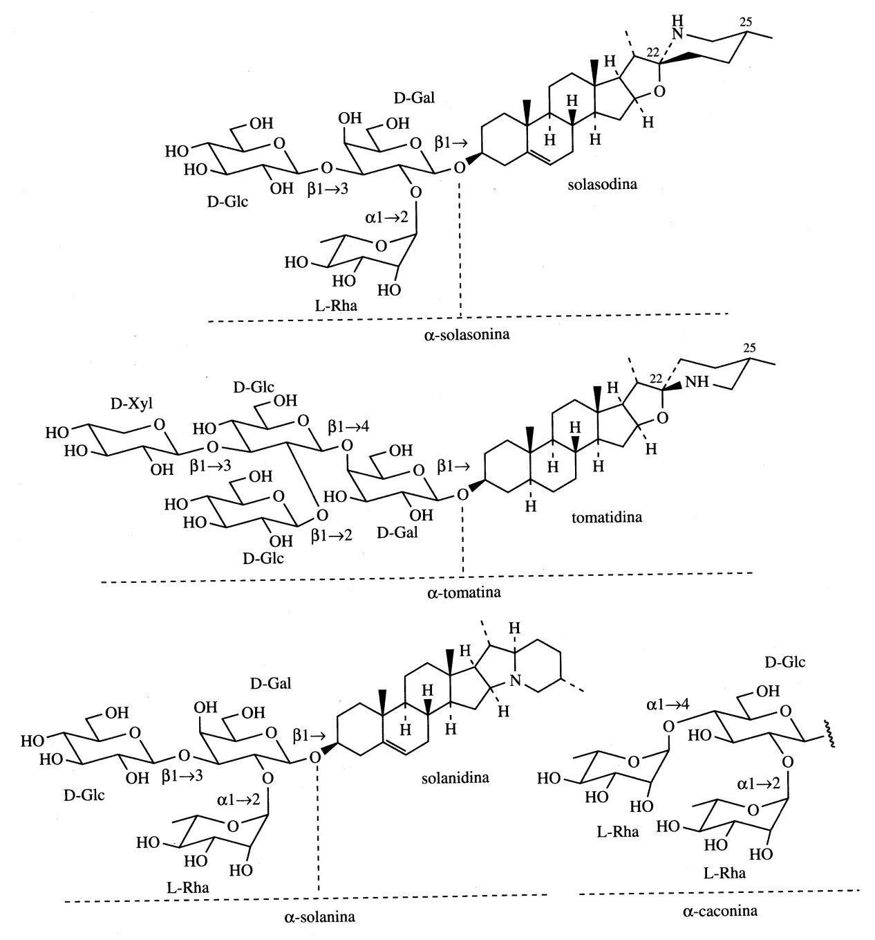
Steroidal alkaloids
Many Solanaceae plants produce steroidal alkaloids based on a C₂₇ ​​Cholestanic skeleton such as, for example, Solasodine and Tomatidine. These are nitrogenous analogues of steroid saponins.
These compounds are normally present as glycosides.
They have surfactant and hemolytic properties (as saponins) and are also toxic by ingestion.
Typical examples are α-Solasonin from Solanum species and α-Tomatina from tomato (Lycopersicon esculent).
They derive from cholesterol and it seems that the nitrogen atom is from L-arginine.

Slide 5
Steroidal alkaloids
Solanidine is found in potatoes (Solanum tuberosum) usually in the form of the glycosides α-Solanine and α-Chaconine.
Apparently the toxicity increases if the glycoside chain is lengthened.
Plants rich in Solasodine or Tomatidine can be a valid alternative for the commercial production of steroids for pharmaceutical use.

Slide 6
Different types of food plants accumulate toxic steroid alkaloid glycosides. Tomatoes, peppers and expecially potatoes contain glycolakaloids. α-Solanine and α-Chaconine account for up to 95% of the glycoalkaloids in the potato and α-Chaconine is considered the most toxic compound. Alkaloids inhibit acetylcholinesterase and butyrylcholinesterase, disrupt cell membranes and can have teratogenic effects.
The highest level of glycoalkaloids in potato plants is found in the flowers and shoots, followed by the leaves, while the lowest amounts are in the stem and tubers.
The glycoalkaloid content in tubers increases as a result of bruising and exposure to light: the green tubers have a higher alkaloid content and are not suitable for human consumption.
The main alkaloid in many species of the Solanum genus is Solasodine which is present as a glycoside in the leaves and especially in the immature fruits. Solasodine can be converted into progesterone for use in pharmaceuticals.

Slide 7
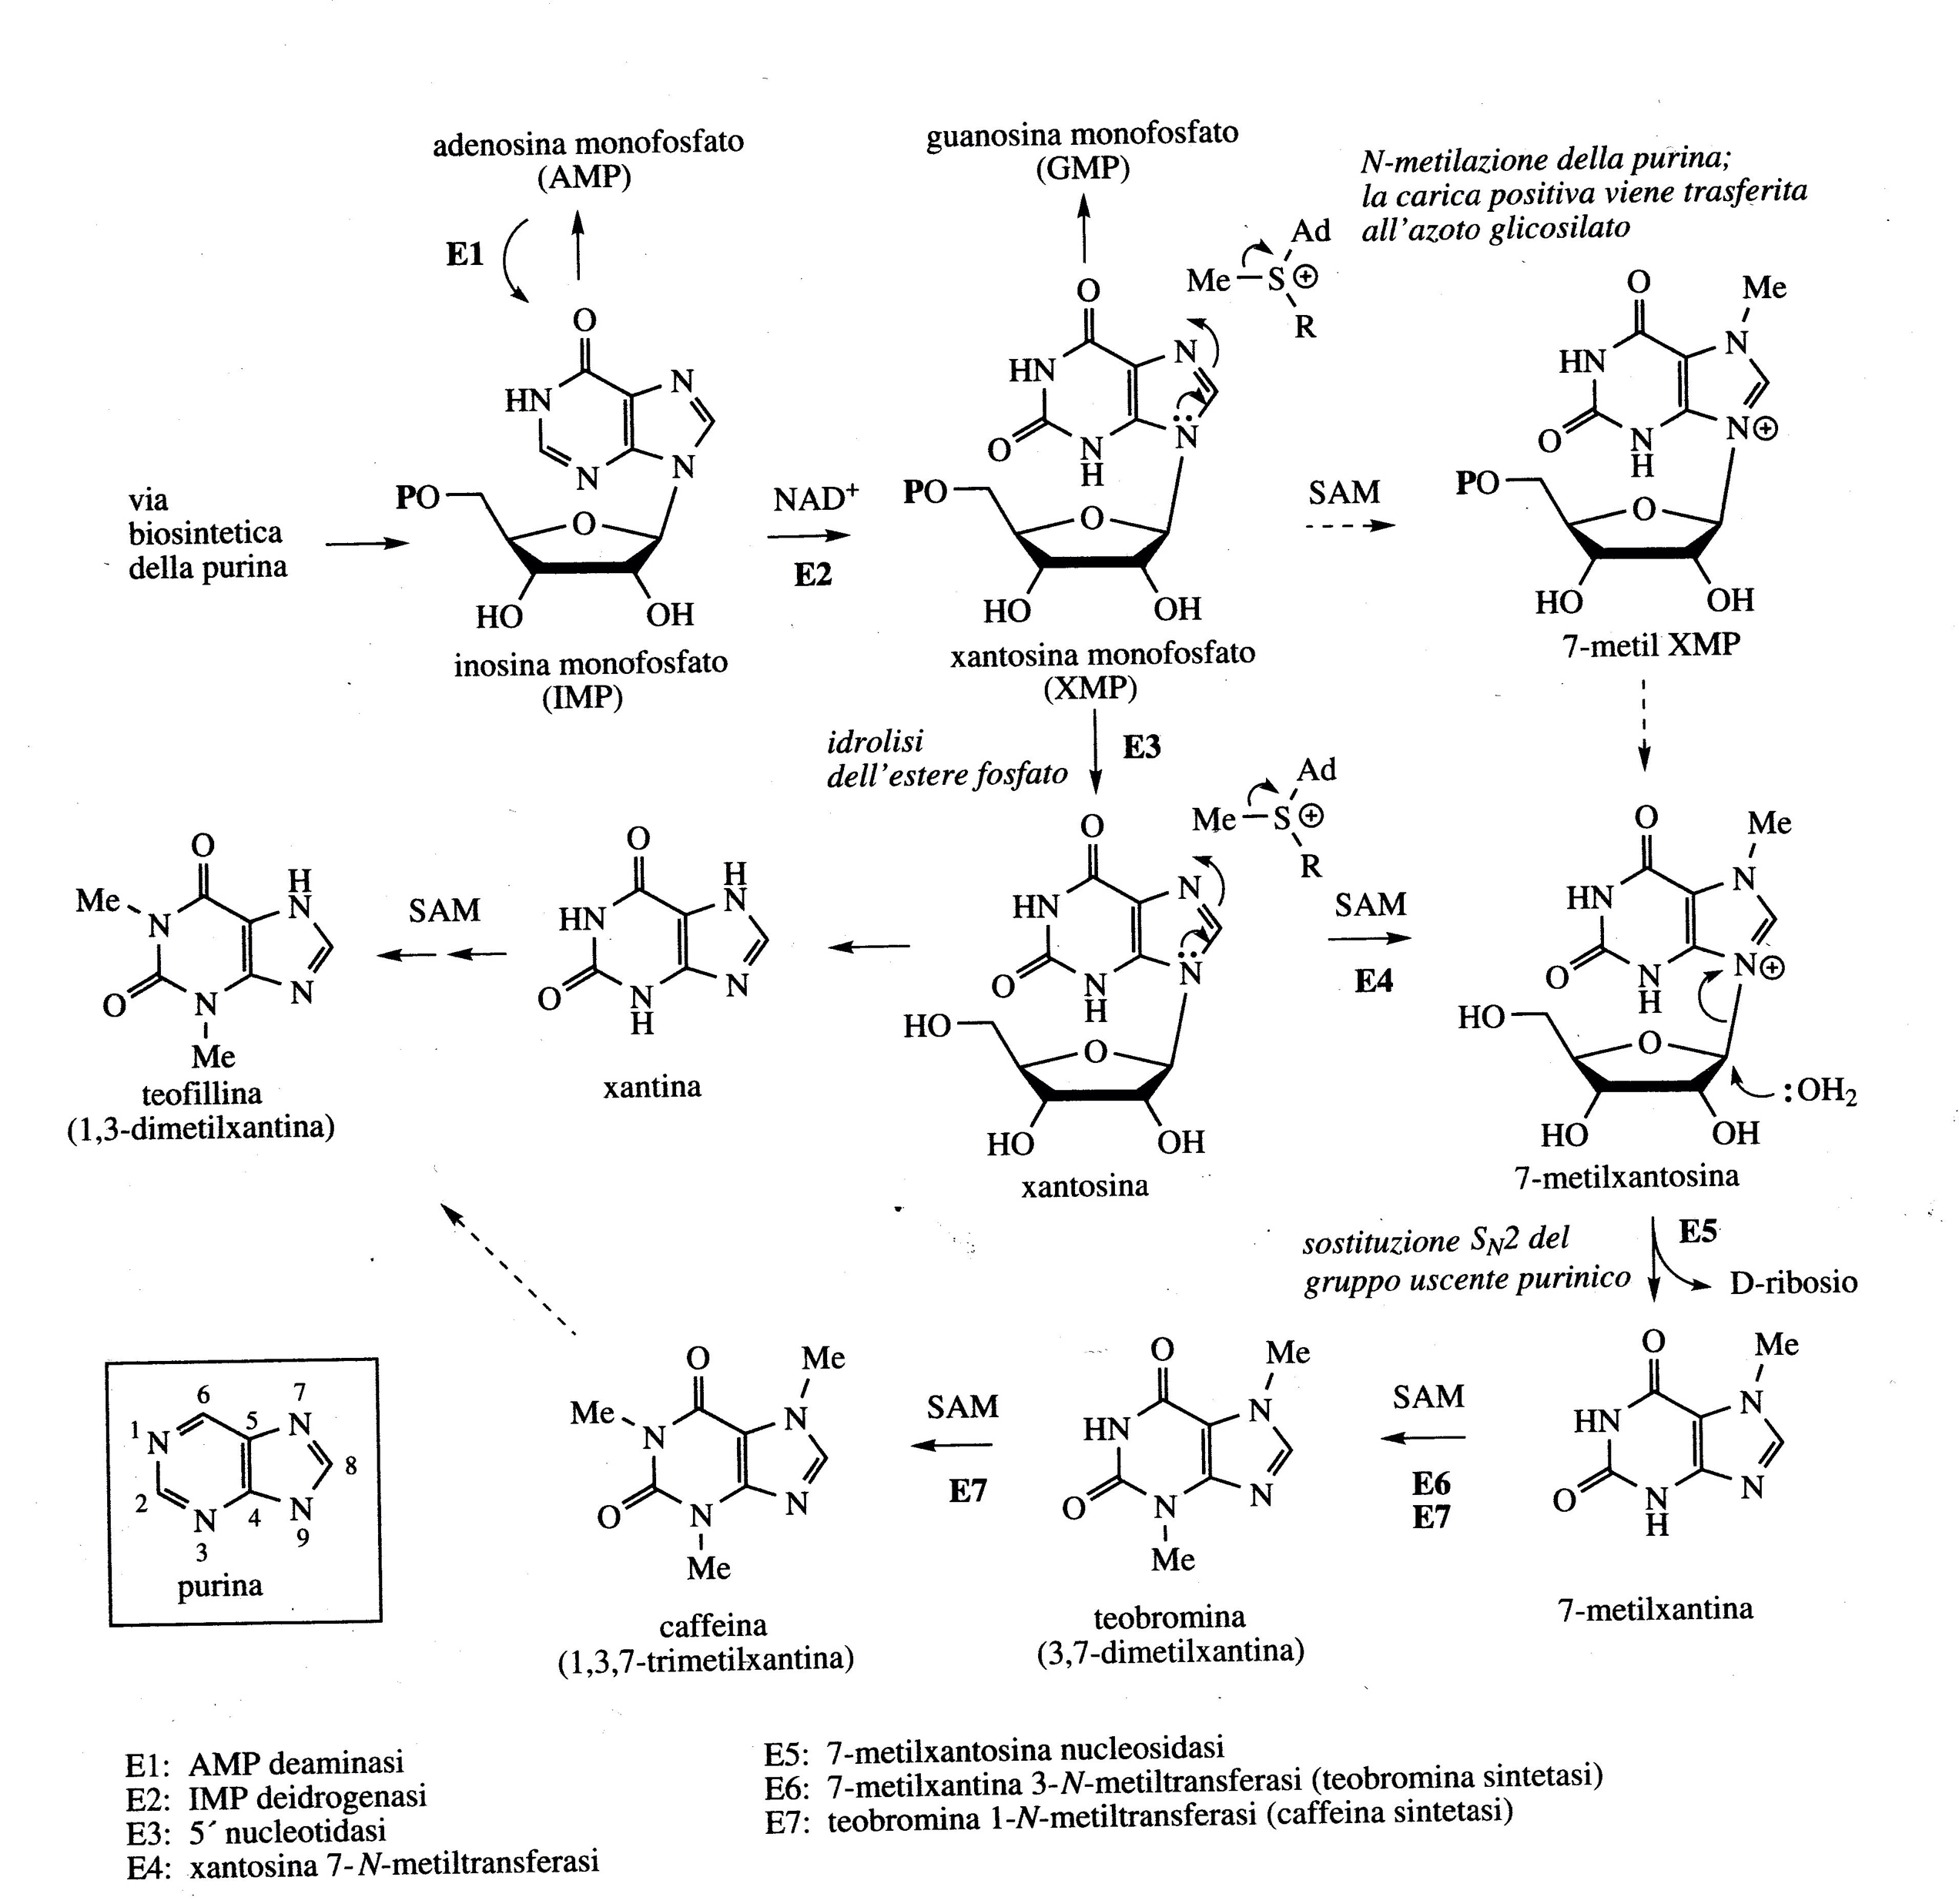
Purine alkaloids
Caffeine, theobromine and theophylline are purine alkaloids.
Their synthesis is related to that of the purine bases adenine and guanine.

Slide 8
The purine alkaloids caffeine, theobromine and theophylline are all methyl derivatives of xanthine and are normally present together in plants.
They competitively inhibit the enzyme phosphodiesterase which degrades cyclic AMP resulting in stimulation of the central nervous system, relaxation of bronchial smooth muscle and induction of diuresis.
Theophylline has a pharmaceutical action thanks to its muscle relaxant properties, used for example in bronchial asthma.
Theobromine has muscle relaxant properties. Theobromine is one of the main components of cocoa.
Caffeine is used with other therapeutic agents in analgesic preparations in medicine.

Slide 9
Coffee plants (Coffea arabica, C. iberica and other species, Rubiaceae) are grown in Brazil, South America and Kenya. The seeds of the fruit are dried and toasted, contain 1-2% caffeine and traces of theophylline and theobromine.Theophylline and theobromine are present in combination with chlorogenic acid in green seeds which is degraded in caffeic acid and quinic acid during coffee roasting.
Volatile oils and tannins give the typical smell and aroma of coffee.
Tea, made from leaves of Camelia sinensis or Tea sinensis (Theaceae) is grown in China, India, Japan and Sri Lanka. Contains 1-4% caffeine and small amounts of theophylline and theobromine.
Its astringent flavour, including the aroma, is given by the tannins and volatile oils (monoterpenes). Epigallocatechin gallate (flavonoid) has strong antioxidant properties.
Caffeine is also present in seeds of Cola nitida or Cola acuminata (Sterculiaceae, West Africa and West India).
The seeds of the Brazilian Paullinia cupana plant (Sapinadaceae) have stimulating properties. The main constituent contains guaranine which has the same structure as caffeine, the seeds can contain 3-5%.

