Slide 1
Bioactive compounds in seaweeds
https://doi.org/10.1016/j.fct.2019.111013
Seaweeds are among the significant currently exploited marine plant resources which are gaining full applications in culinary, cosmetic, pharmaceutical, and biotechnological processes.
The global phytonutrients/nutraceutical market value, regarding value, is projected to reach $4.63 Billion in 2020, with a compound annual growth rate CAGR of 7.2% from 2015 to 2020.
Likewise, the global market for the botanical and plant-derived drug was estimated $29.4 billion in 2017 and is projected to escalate to 39.6 billion in 2022 with a compound annual growth rate (CAGR) of 6.1%.
Marine life offers 70% of earth's surface with the vast diversity of life and biodiversity in the seas is only partially explored although marine represents a rich source of novel metabolites with various applications includes cosmeceutical, nutraceuticals, agrochemicals, pharmaceuticals and other industrially relevant chemicals. Seaweeds or marine macroalgae reside in the littoral zone and are now considered as primary resources of the oceans in terms of economic and ecological significance.

Slide 2
Taxonomically, seaweeds are grouped into three major phyla:
Phaeophyceae (brown algae), which are primarily brown in color due to its fucoxanthin content
Chlorophyceae (green algae) - primarily dominated by chlorophyll ‘a’ and ‘b’, and other specific xanthophyll pigments;
Rhodophyceae (red algae) primarily comprised of phycocyanin and phycoerythrin.
Approximately more than 1500 brown, 900 green and 4000 red seaweeds are available worldwide.
The subtropical and tropical waters are entirely occupied by red and green seaweeds, while cold temperate waters are predominantly occupied by brown seaweeds

Slide 3
The biological properties of various bioactive metabolites from marine algae have been recently extensively reviewed by a number of studies including phlorotannins, polysaccharides, protein hydrolysates and bioactive peptides, alkaloids, halogenated terpenoids and pigments.
Polysaccharides
Seaweeds or marine macroalgae contain a wide range of polysaccharides which are described to possess a plethora of pharmacological activites including anticancer, antiinflammatory, and excellent antioxidant activities.
The significant polysaccharides found in marine algae are alginates, agarans, carrageenan, fucoidan, laminarin, and ulvans .

Slide 4
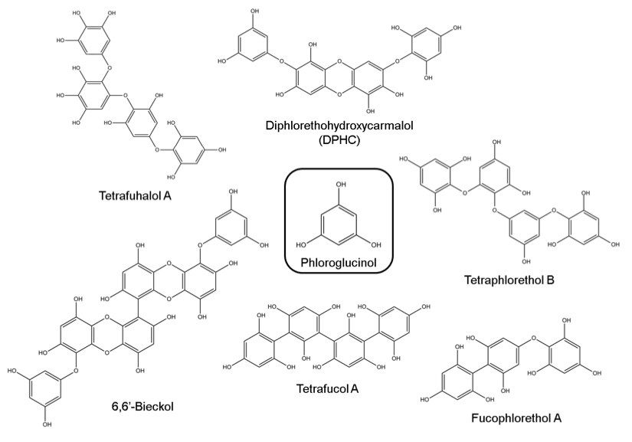
Phlorotannins
Phlorotannins, more commonly known as algal polyphenols, are polymers of phloroglucinols which comprise up to 15% of dry weight of brown algae.
Laminariacea have been documented to be the most abundant source of phlorotannins in marine algae.
Phlorotannins have been found to possess antimicrobial, antioxidant, anti-HIV, antiproliferative, anti-inflammatory, antidiabetes and neuroprotective properties

Slide 5
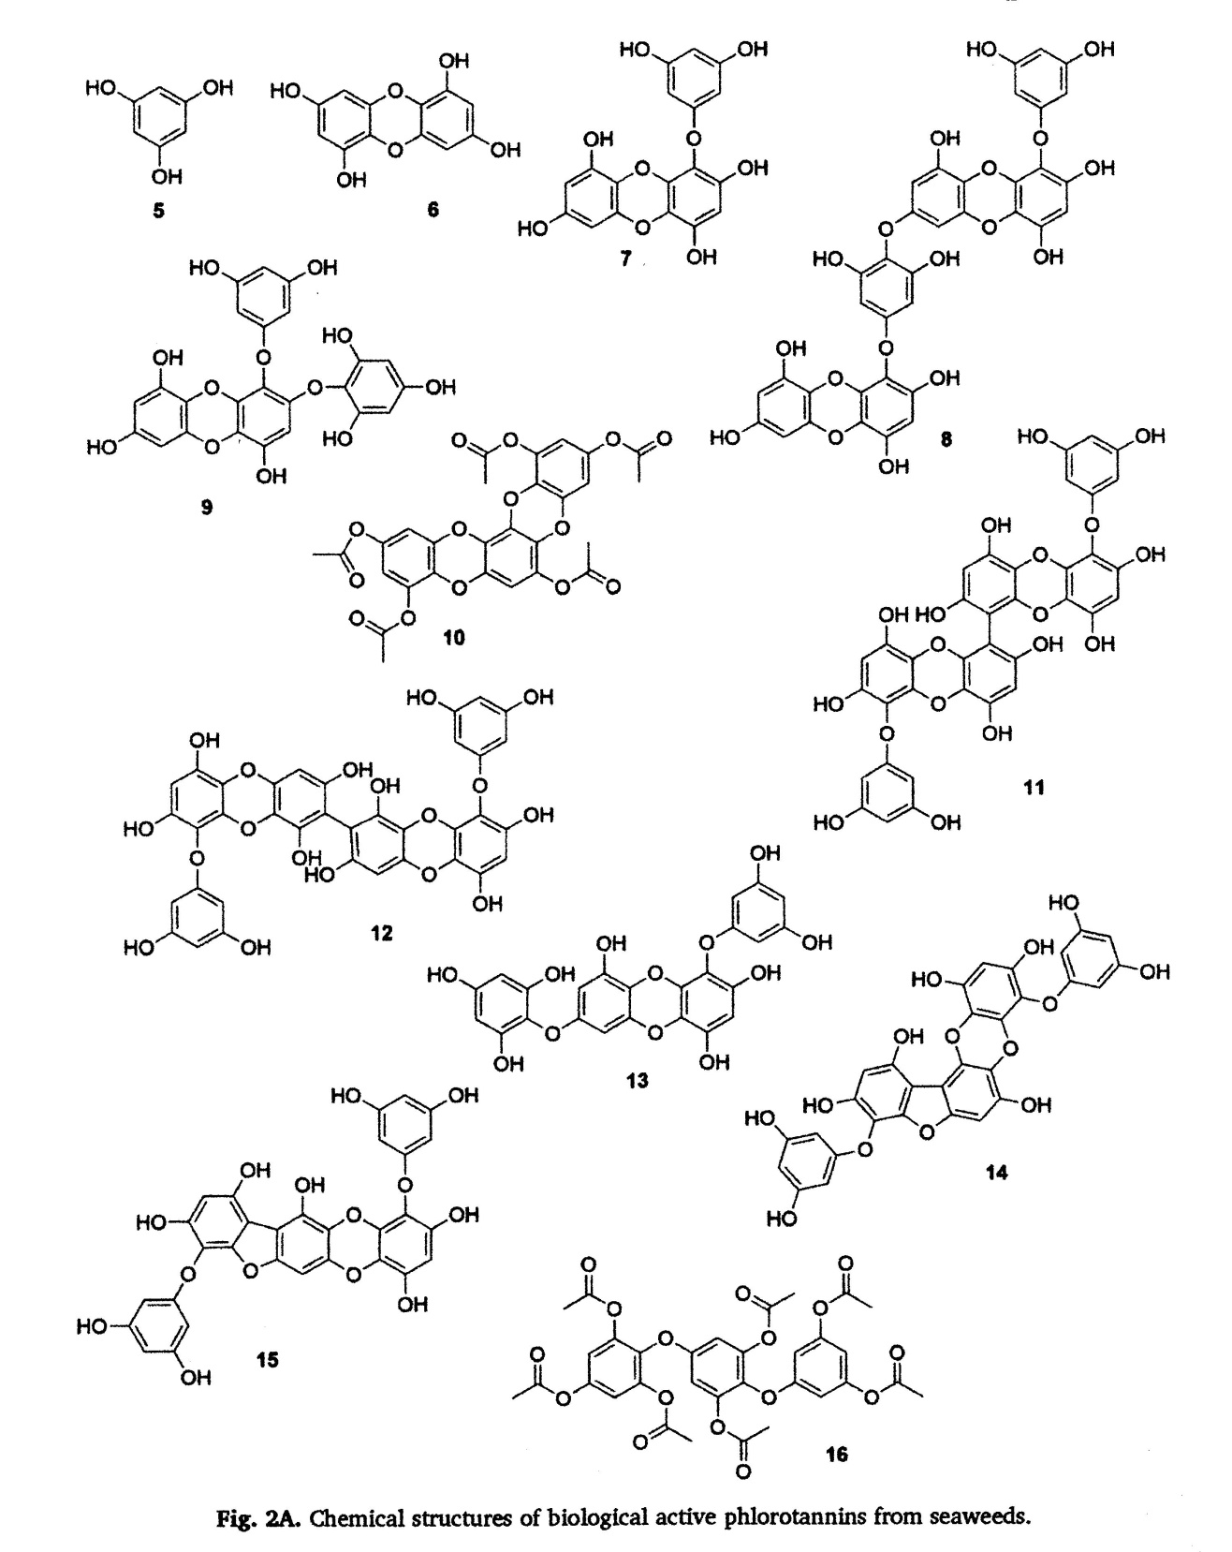
8: Dieckol: anti-diabetic, anti-aging, antibacterial, anti-diabetic, matrix metalloproteinases inhibition.
14: Phlorofucofuroeckol-A:
algicidal, anti-hypertension, anti-diabetic, anti-inflammatory, anti-
oxidant.

Slide 6
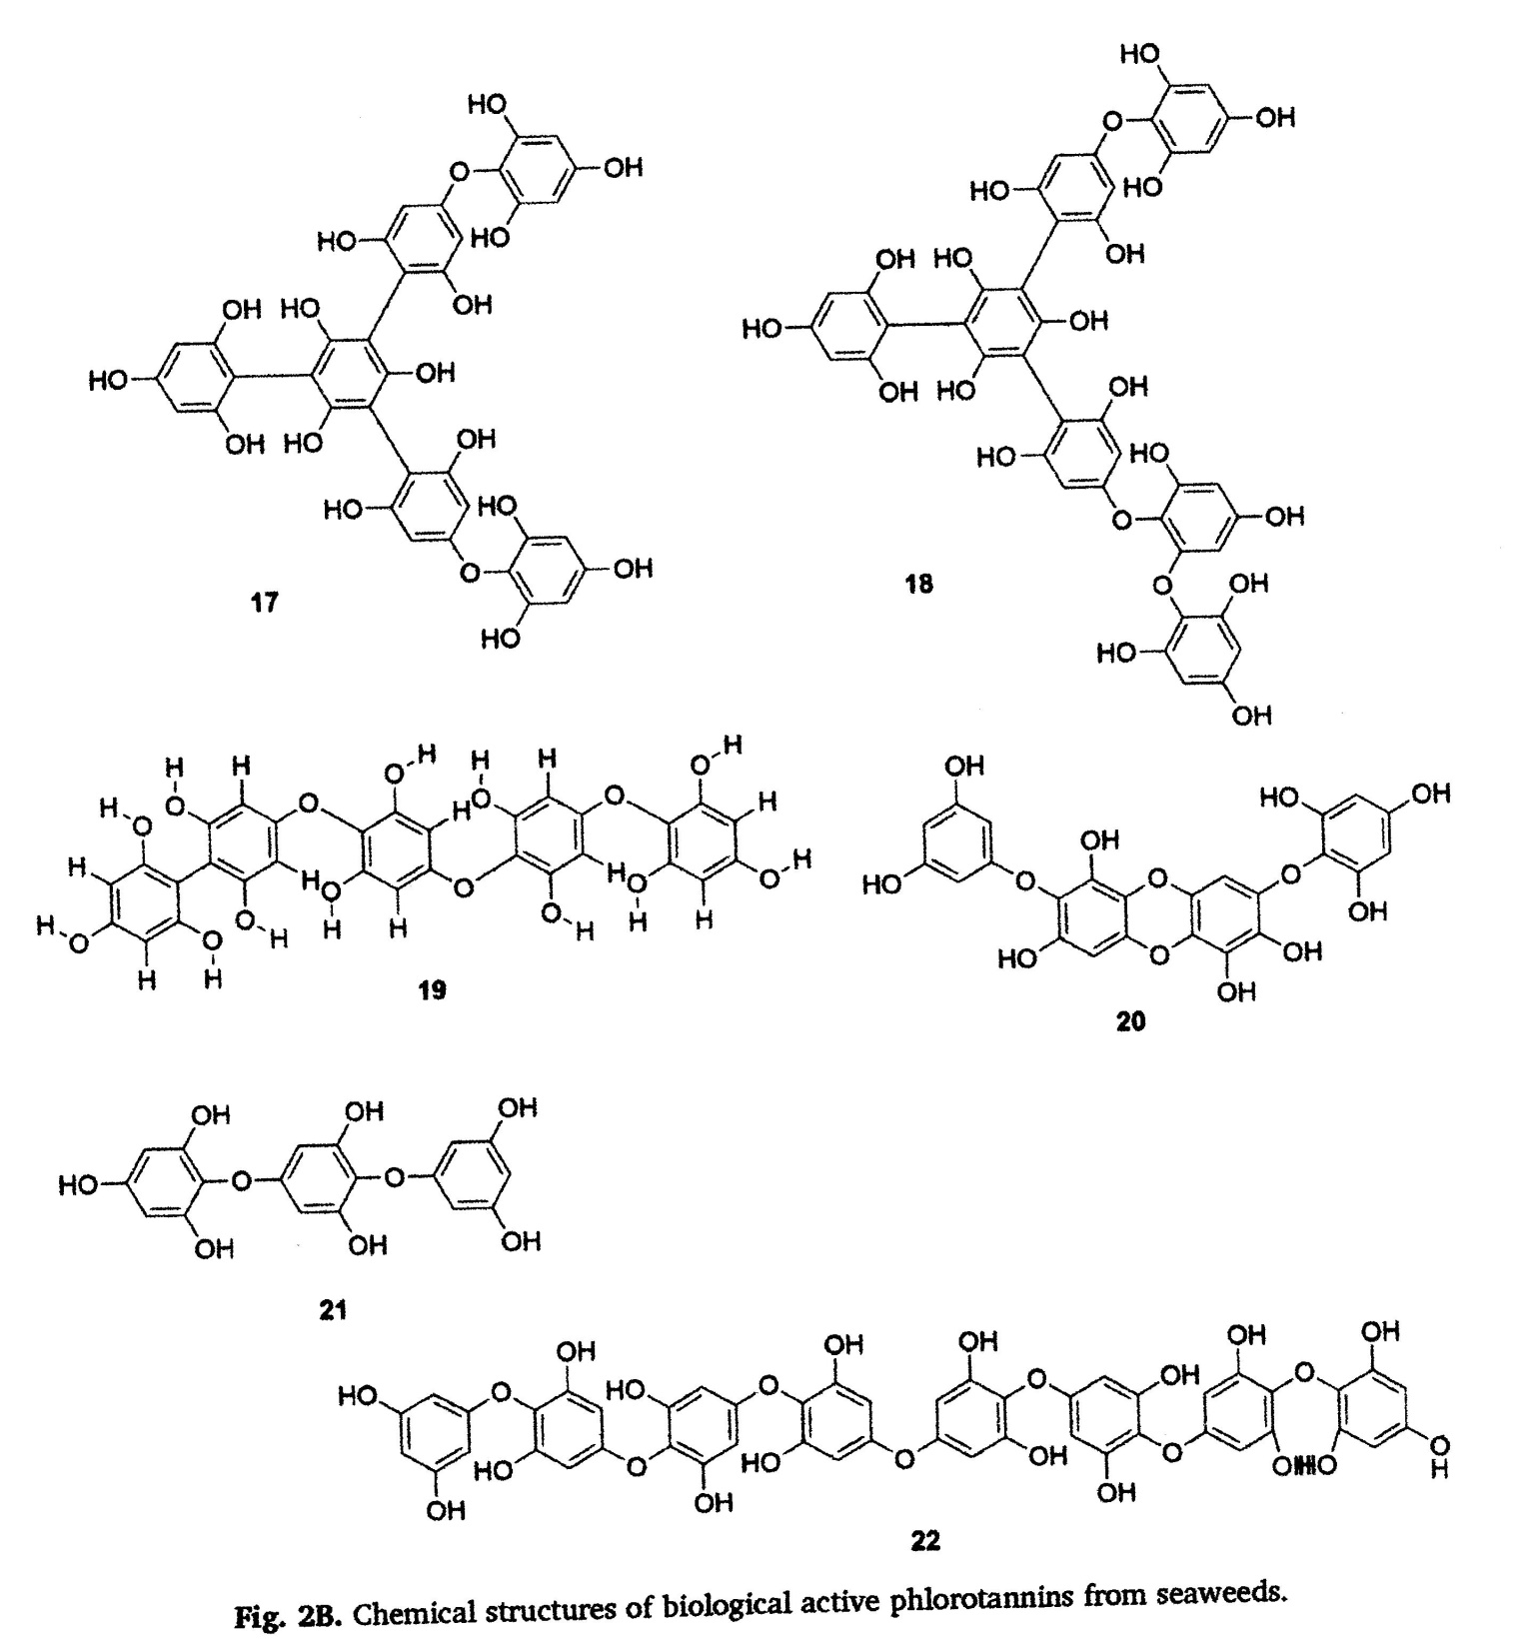
20) Diphloretoxydroxycarmalol
Anti-diabetic, anticancer,
antioxidant

Slide 7
Terpenoids
Marine organisms are well-known to be a reservoir of terpenes which have been documented to have numerous pharmacological properties.
Seaweeds or marine macroalgae are a vast source of structurally diverse terpenoids especially red seaweeds,
which are reported to have high amount.

Slide 8
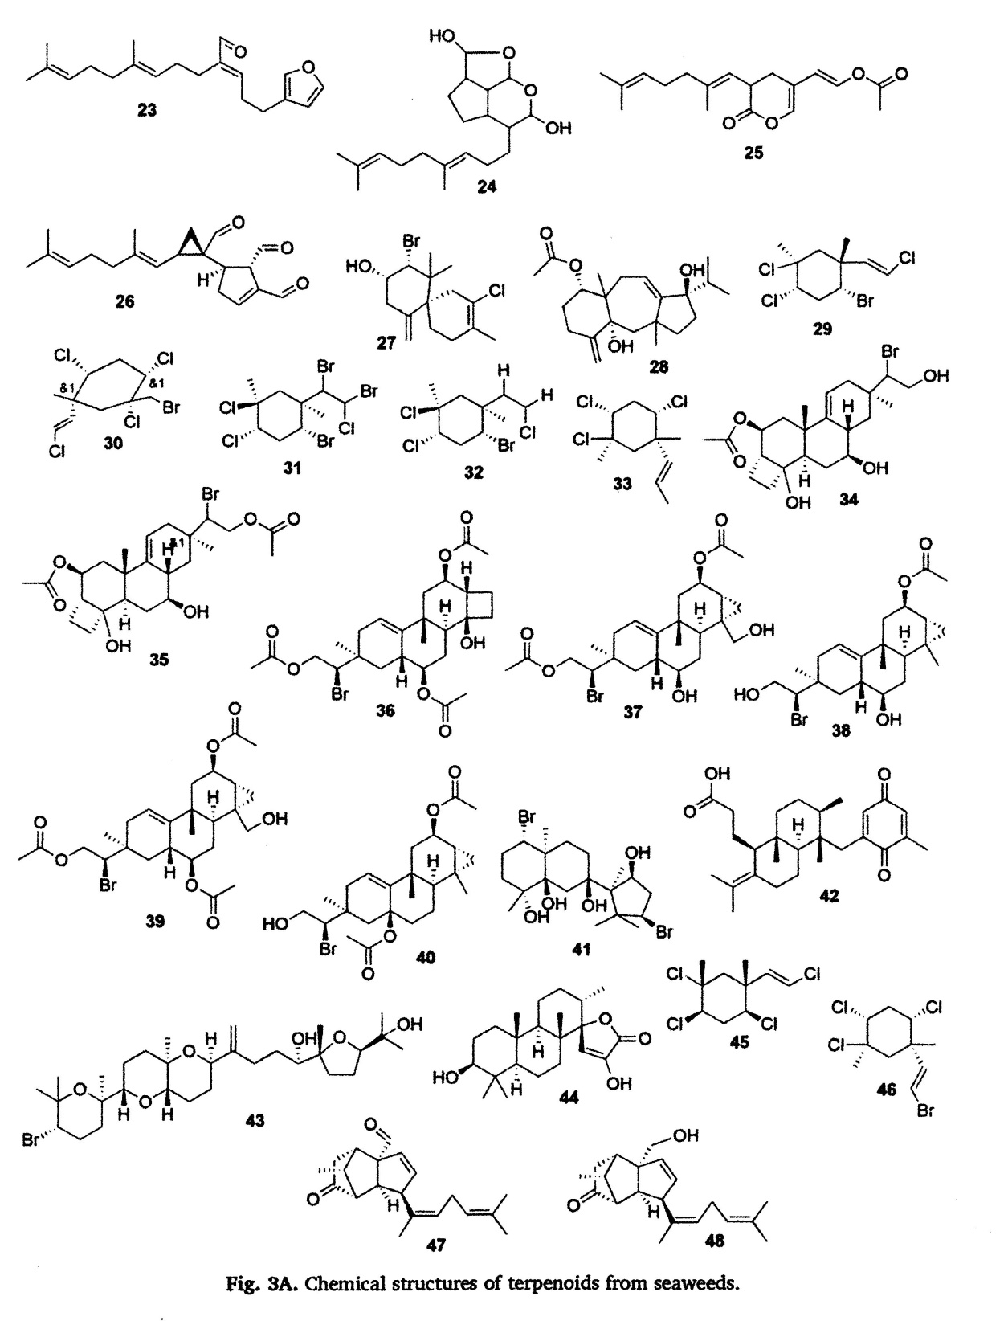
27) Elatol: acaricidal, anti-tumor
41) Neoirietetraol: Anti-bacterial,
tyrosine kinase inhibitor, antitumor

Slide 9
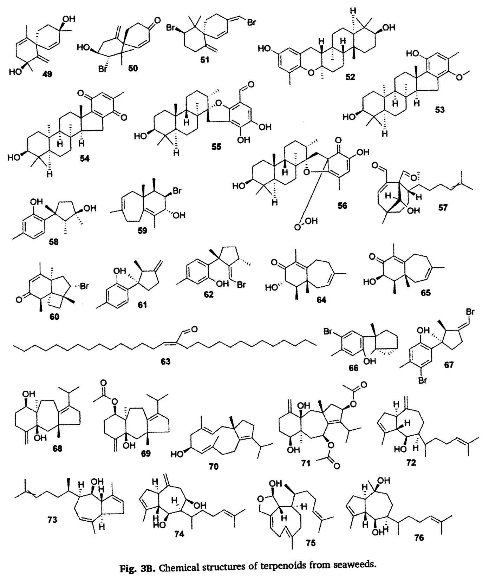

Slide 10
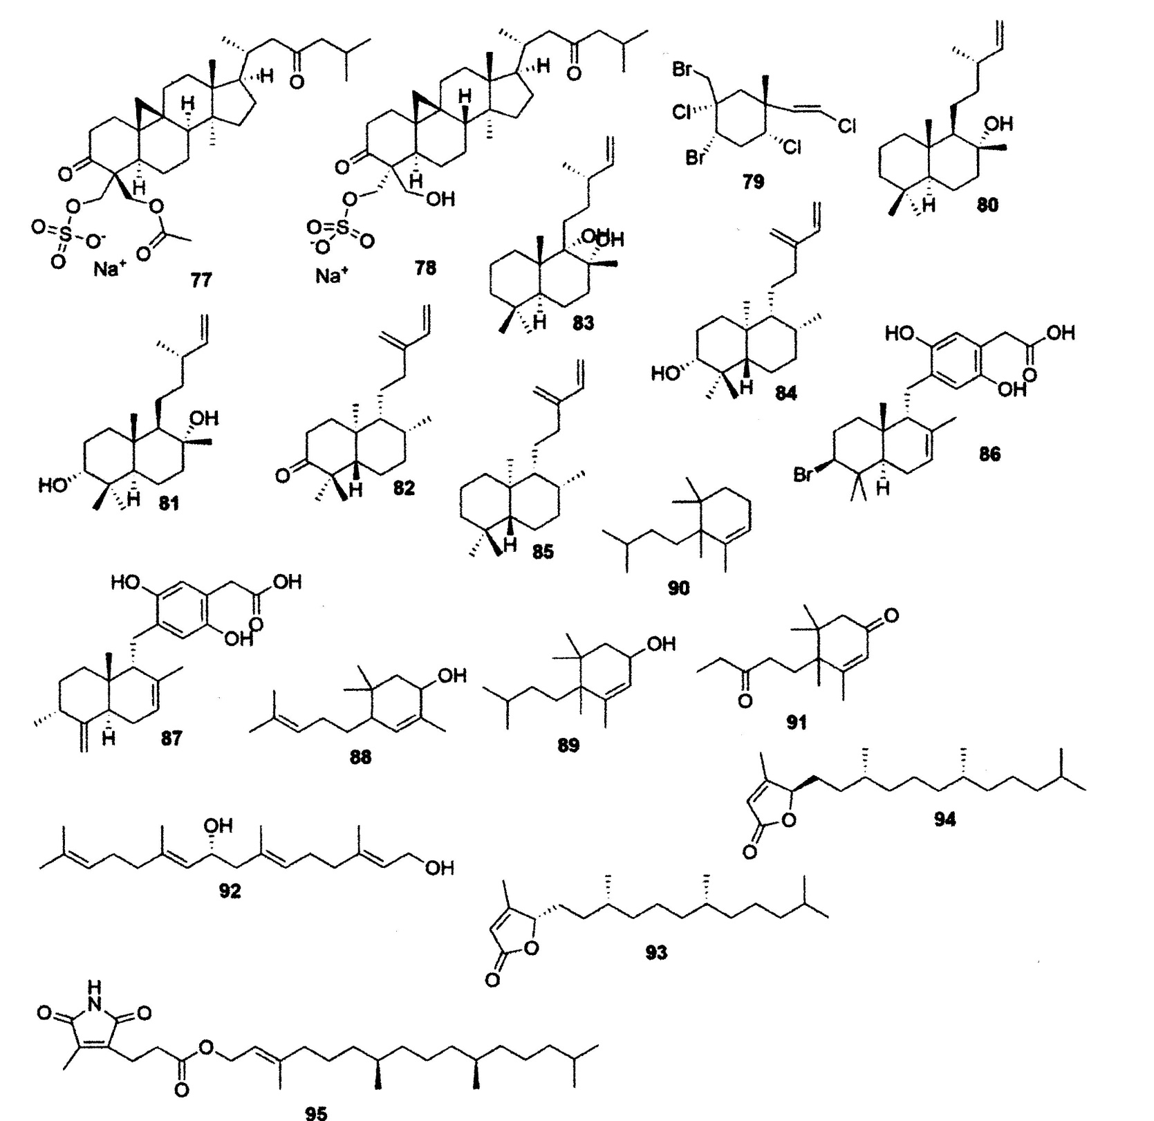
92) Crinitol: antibacterial

Slide 11
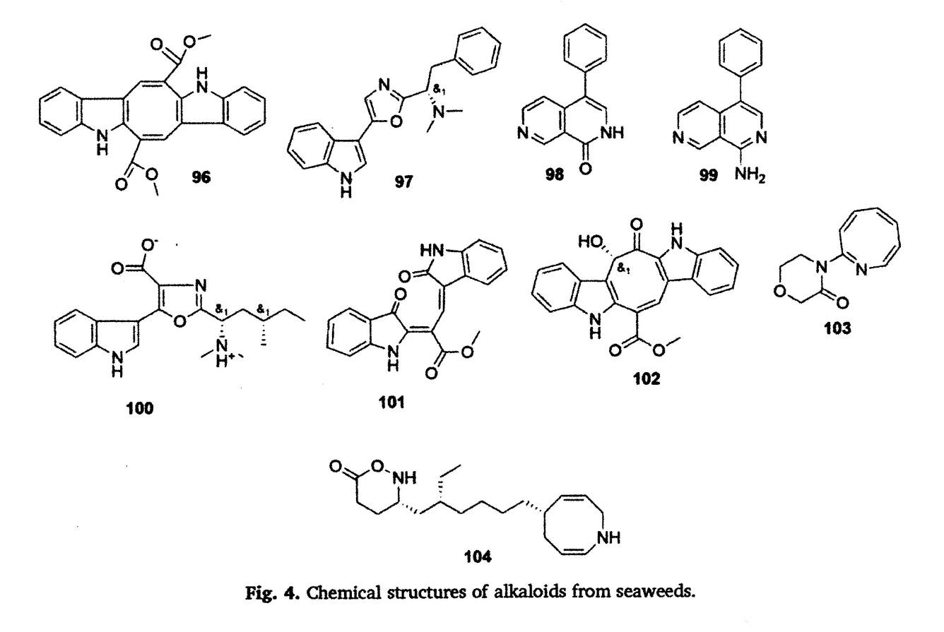
Alkaloids
Although alkaloids are extensively studied, research on marine algal-based alkaloids is still under-explored.
The first alkaloid molecule was isolated from marine red algae Phyllophora nervosa in 1969.
96) Caulerpin. Anti-viral
antibacterial, anticancer

Slide 12
Photosynthetic pigments
Plants possess various photosynthetic pigments such chlorophylls, carotenoids, anthocyanins, betains, and research on the biological properties of these colourful pigments is gaining much attention due to its health-promoting effects.
Like other terrestrial plants, marine macroalgae are listed as one of the primary resources of these beneficial health pigments including carotenoids, fucoxanthin (xanthophyll pigments found in brown seaweeds), phycocyanin and phycoerythrin (found in red seaweeds).
Fucoxanthin is contributing to 10% of the total carotenoid production globally. In recent years, scientific research on fucoxanthin have attracted considerable interest owing to their potential pharmacological properties including antimicrobial, antimalarial activities, antioxidant, anti-obese, antidiabetic, anti-inflammatory, anticancer, antiangiogenic.

Slide 13
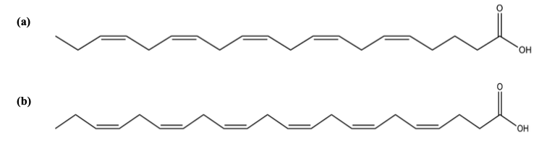
Fatty acids
Macroalgae are rich in polyunsaturated fatty acids (PUFAs), mainly eicosapentaenoic (EPA; 20:5n-3, figure a) and docosahexaenoic (DHA; 22:6n-3, figure b) acids.
EPA and DHA are considered to be the two most important PUFAs of marine lipids, since they are intricately related to important biological effects, such as cardiovascular protection, anti-inflammatory and anticancer.
Owing to the high concentrations of PUFA, especially “omega thre” fatty acids, seaweeds are excellent candidates for the development of nutracetuticals/dietary supplements for human health.

Slide 14
Bioactive Compounds from Macroalgae in the New Millennium: Implications for Neurodegenerative Diseases
Mar. Drugs 2014, 12, 4934-4972; doi:10.3390/md12094934

Slide 15
Neuroprotective Compounds from Macroalgae
Phlorotannins
Among several classes of algal polyphenols, phlorotannins are pharmacologically prominent compounds. They are composed of several phloroglucinol (1,3,5-trihydroxybenzene) units, linked to each other by different ways.
According to the nature of the structural linkages between phloroglucinol units and the number of hydroxyl groups present, phlorotannins can be subdivided into six specific groups: phlorethols, fuhalols, fucols, fucophlorethols, eckols and carmalols

Slide 17
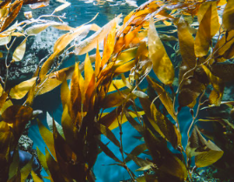
The distribution of phlorotannins in nature is limited to brown algae and their amounts can vary among species, being affected by algae size, age, tissue type, salinity, season, nutrient levels, intensity of herbivory, light intensity and water temperature.
As other polyphenolic compounds, phlorotannins exhibit numerous remarkable properties on biological systems, namely antioxidant, anti-inflammatory , anti-allergic, antimicrobial and antidiabetic activities.
Moreover, phlorotannins also display an important role in neuroprotection through different action mechanisms.

Slide 18
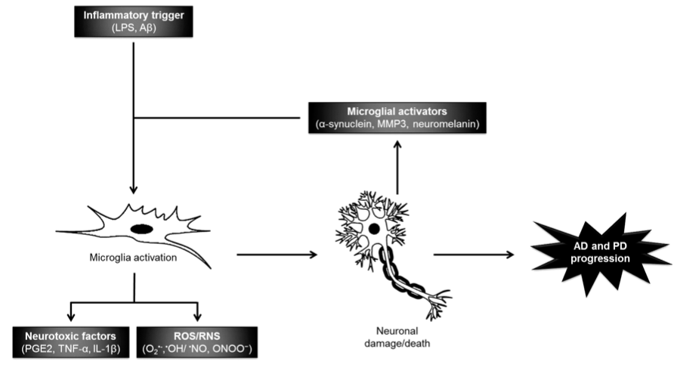
In the case of AD, the presence of Aβ deposits has neurotoxic effects by inducing the generation of pro-inflammatory cytokines, ROS and RNS, leading to neuronal dysfunction and eventually cell death.
In PD, the release and accumulation of α-synuclein aggregates induce the activation of microglial cells, resulting in the production of pro-inflammatory mediators, which can also lead to neuronal death.
Oxidative and nitrosative stress markers are also important in neurodegeneration and progression of both AD and PD, leading to the activation of surrounding glia and development of a robust glia-mediated inflammatory response.

Slide 19
A common pathological hallmark of various neurodegenerative diseases is the loss of particular subsets of neurons.
Cholinergic denervation is recognized as a pathological hallmark of AD and in vivo neuroimaging studies revealed the loss of cerebral cholinergic markers in parkinsonian dementia.
A decline of acetylcholine (Ach) levels is observed in both neurodegenerative disorders.
Two types of cholinesterase (ChE) are found in the CNS: acetylcholinesterase (AChE) and butyrylcholinesterase (BuChE, expressed in neuroglia and found in the intestine, liver, kidney, heart, lung and serum).
AChE degrades Ach (to give choline and acetate) in cholinergic synapses. Studies have already shown that ChE inhibitors not only increase the levels of ACh in the brain, but also reduce and prevent the formation of β-amyloid (Aβ) deposits, protecting neurons from neurodegeneration.

Slide 20
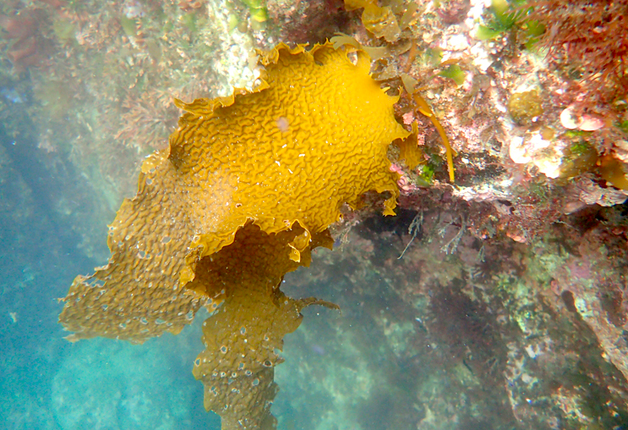
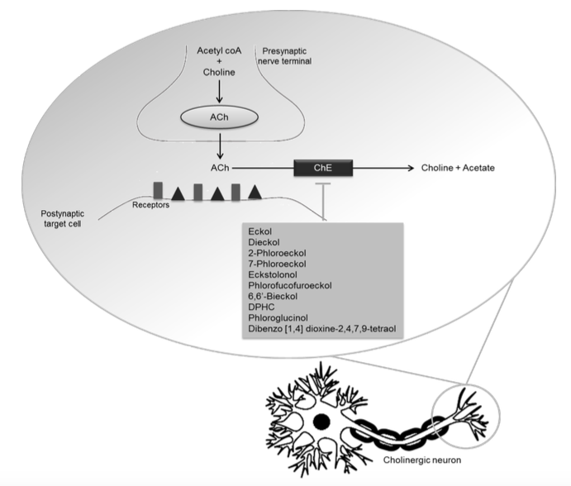
Polyphenols with ChE inhibitory activity
Eckol, dieckol, 2-phloroeckol and 7-phloroeckol isolated from Ecklonia stolonifera exhibit a selective dose-dependent inhibitory activity against AChE.
Ecklonia stolonifera is a brown alga belonging to the Laminariaceae family and is found mainly in the sea forests off the coasts of Korea and Japan.

Slide 21
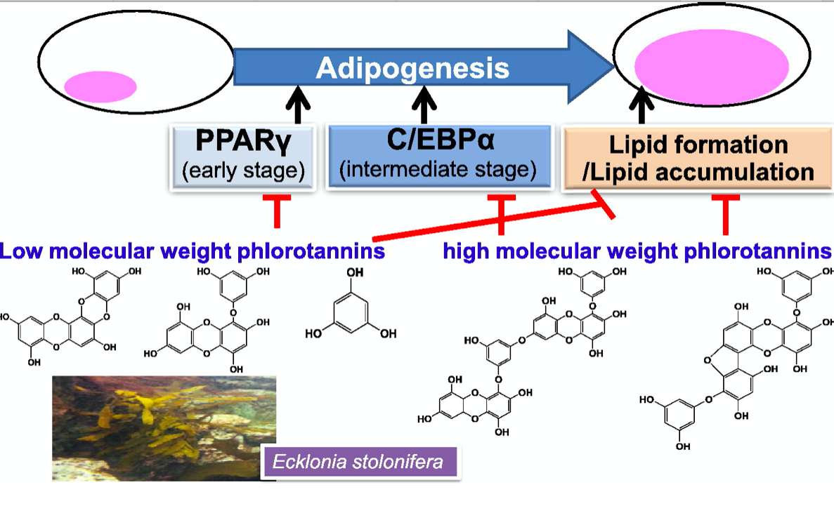
Polyphenols inhibit lipid accumulation
Adipokines, such as peroxisome proliferator activated receptor γ (PPARγ) and CCAAT/enhancer binding protein (C/EBPα), exert direct influences on the development of fat cells.
In particular, PPARγ is highly expressed in adipose tissue, where it plays essential roles in adipogenesis and lipid homeostasis.
https://doi.org/10.1016/j.fitote.2013.12.003

Slide 22
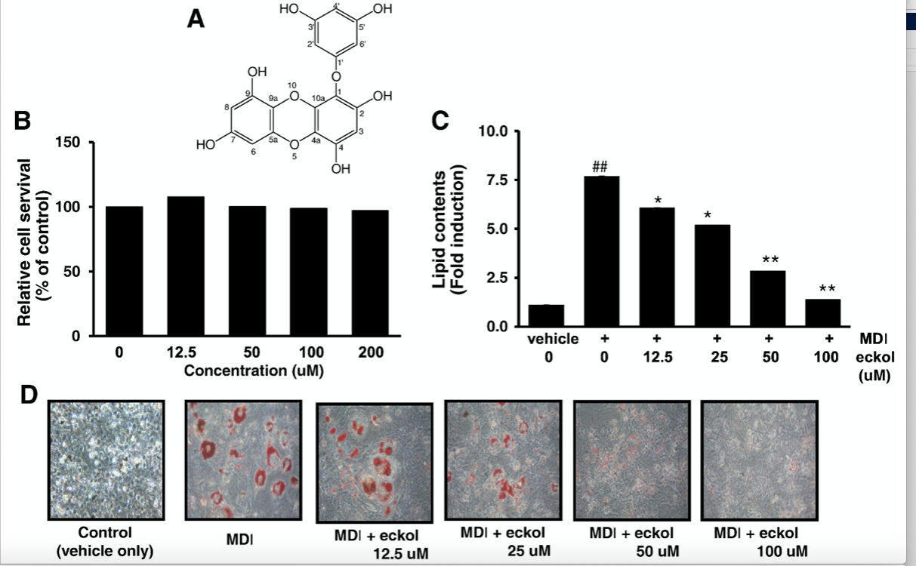
Effect of eckol on lipid accumulation in 3T3-L1 cells.
3T3-L1 cells have long served as a well-established in vitro assay system for assessing adipogenesis and adipocyte differentiation.
Triglyceride
Lipid droplets
https://doi.org/10.1016/j.fitote.2013.12.003

Slide 23
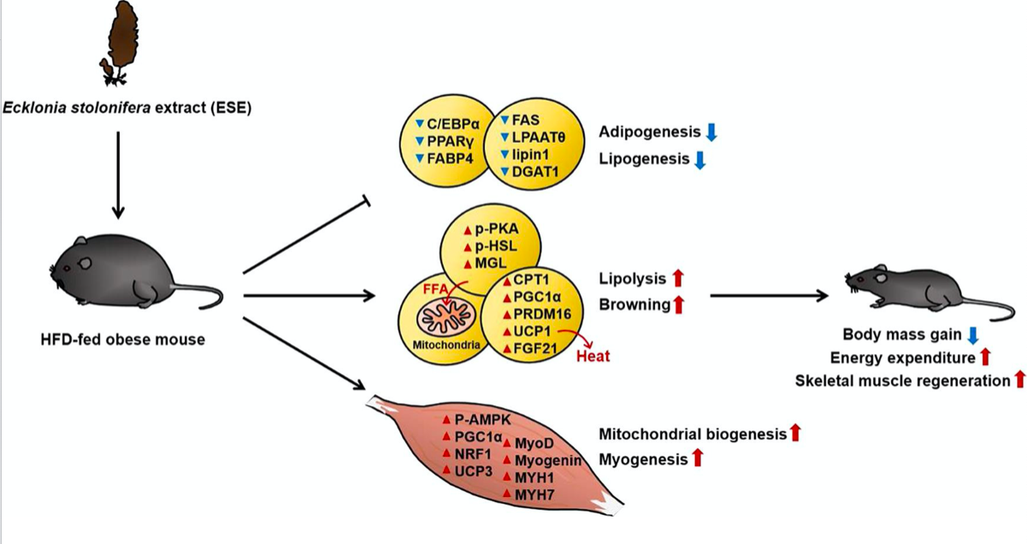
ESE reduces body mass gain in HFD-fed mice.
ESE inhibits lipid accumulation
ESE stimulates mitochondrial biogenesis and myogenesis in the skeletal muscle.
https://doi.org/10.1016/j.jff.2021.104511

