Slide 1
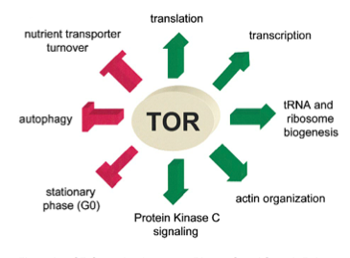
The TOR pathway
The Target Of Rapamycin (TOR), a highly conserved Ser/ Thr protein kinase, is the central component of a major regulatory signalling network that controls cell growth in diverse eukaryotic organisms, ranging from yeast to man.
The TOR proteins were first identified in yeast as the targets of the antifungal and immunosuppressive agent rapamycin, hence their name

Slide 2
The TOR pathway
TOR regulates:
growth (accumulation of mass)
proliferation (accumulation in cell number)
survival in response to nutritional changes by diverse mechanisms that include :
regulation of anabolic and catabolic metabolism
nutrient uptake
protein translation and turnover
gene transcription

Slide 3
The TOR pathway
The first TOR genes were isolated in the budding yeast Saccharomyces cerevisiae as point mutations that conferred resistance to the growth-inhibiting effect of rapamycin.
Rapamycin is a small hydrophobic molecule, a product of the soil bacterium Streptomyces hygroscopicus that was first isolated as an antifungal antibiotic but later proved to be a potent inhibitor of cellular growth in humans via inhibition of mammalian TOR (mTOR).
The antiproliferative effect of rapamycin has proved beneficial for several clinical applications, including immunosuppression for the prevention of allograft rejection, treatment of cancer, and elution of stents to prevent restenosis after angioplasty.

Slide 4
Rapamycin
Sirolimus, also known as rapamycin, is a macrolide (containing a macrolide ring) produced by the bacteria Streptomyces hygroscopicus
Sirolimus was discovered by Brazilian researchers in a soil sample from Easter Island, also known as Rapa Nui. It was approved by the US Food and Drug Administration in September 1999 and is marketed under the trade name Rapamune by Pfizer (EU 2000)
Sirolimus was originally developed as an antifungal agent. Now used as a potent immunosuppressive and antiproliferative drug

Slide 5
Rapamycin, an immunosuppressant drug
Rapamycin forms a complex with FKBP12, a peptidyl-prolyl isomerase that is known as FK506-binding protein of 12 kDa in mammals (FPR1 in yeast)
Rapamycin-FKBP12 binds and inhibits the target of rapamycin (TOR), which is a component of the T-cell interleukin-2 (IL-2) signalling pathway
Rapamycin, as an antifungal drug, forms a complex with FPR1 and this complex binds and inhibits TOR

Slide 6
The TOR pathway
Rapamycin induces cell growth arrest by mimicking a starvation-like response, which is characterized by the induction of autophagy.
Rapamycin and its derivatives, is useful for the treatment of neurodegenerative and metabolic diseases.
Rapamycin, similar to calorie restriction, reduces senescence in several model systems, including yeast, Caenorhabditis elegans, Drosophila melanogaster, and mice, making it the first drug with the potential to treat aging

Slide 7
Structural domain of TOR
TOR- which is found in yeast (TOR1 and TOR2 in S. cerevisiae and S. pombe, fungi (TOR1 in Cryptococcus neoformans), plants (AtTOR in Arabidopsis thaliana), worms (CeTOR), flies (dTOR) and mammals (mTOR, also known as FBKP12-rapamycin associated protein, FRAP)- is a member of the PHOSPHATIDYLINOSITOL KINASE-RELATED PROTEIN KINASE (PIKK) FAMILY
The carboxy-terminal region of TOR shows high homology to lipid kinases, but evidence supports a role for TOR as a serine/threonine protein kinase
TOR has several known or putative protein-protein interaction domains

Slide 8
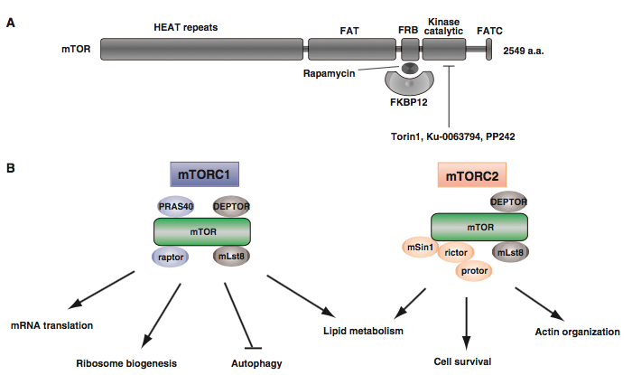
Schematic representation of the structure and complex formation of TOR
Terunao Takahara and Tatsuya Maeda. J. Biochem. 2013;154(1):1–10 doi:10.1093/jb/mvt047

Slide 9
HEAT repeats
A HEAT repeat is tandem repeat protein structural motif composed of two alpha helices linked by a short loop.
HEAT repeats can form alpha solenoids, a type of solenoid protein domain found in a number of cytoplasmic proteins.
The name "HEAT" is an acronym for four proteins in which this repeat structure is found: Huntingtin, elongation factor 3 (EF3), protein phosphatase 2A (PP2A), and the yeast kinase TOR1.
HEAT repeats form extended superhelical structures which are often involved in intracellular transport

Slide 10
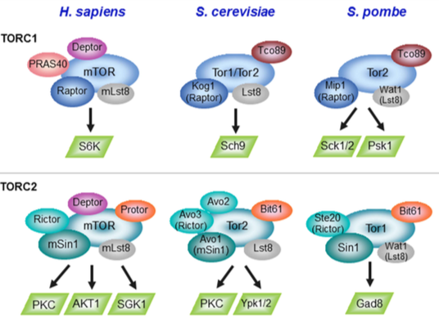
TORC1 and TORC2 complexes
Two distinct evolutionary conserved complexes:
TOR complex 1 (TORC1) and TOR complex 2 (TORC2)
Weisman R. 2016. Microbiol Spectrum 4(5): FUNK-0006-2016. doi:10.1128/microbiolspec.FUNK-0006-2016.

Slide 11
Tor 1 and Tor2 in S. cerevisiae
Yeast cells contains two functionally and structurally distinct TOR multiprotein complexes: TOR complex 1 (TORC1) and TOR complex 2 (TORC2)
Only TORC1 is specifically inhibited by rapamycin
The addition of rapamycin induces dramatic phenotypic changes such as cell cycle arrest and entry into G0, general downregulation of protein synthesis, accumulation of the reserve carbohydrate glycogen and the stress protectant trehalose, upregulation of stress response genes, autophagy and alterations in nitrogen and carbon metabolism
TORC1 signalling controls the temporal aspects of cell growth in response to the quality of the available nitrogen and carbon sources.
TORC2, is thought to regulate the spatial aspects of growth, such as the control of actin polarization

Slide 12
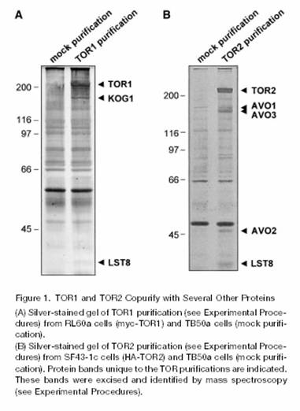
TOR complexes in S. cerevisiae

Slide 13
TOR complexes in yeast
TORC1 contains TOR1 or TOR2 and the evolutionarily conserved proteins kontroller of growth 1 (KOG1, the homolog of the mammalian TOR regulatory protein RAPTOR/mKOG1) and LST8:
1)KOG1 functions as scaffold protein to couple TOR to its targets
2)LST8 functions in regulation of the retrograde signalling pathway (cellular response to a loss of mitochondrial function)
TORC2 contains TOR2, AVO1, AVO2, AVO3 and LST8

Slide 14
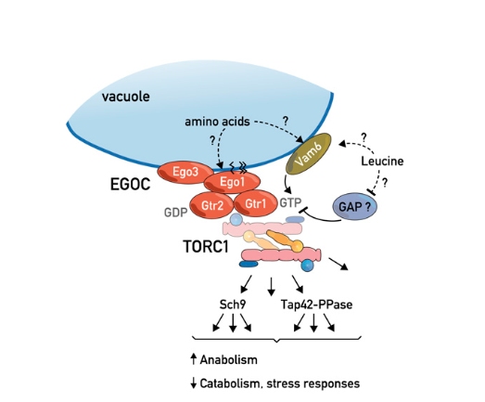
The EGO complex is a major regulator of TORC1
The EGO complex (EGOC) is composed of four proteins: the palmitoylated and myristolated protein Ego1, the transmembrane protein Ego3, and two Ras-family GTPases, Gtr1 and Gtr2.
Like TORC1, the EGO complex is localized to the vacuolar membrane where it sense/respond to intracellular leucine levels and potentially to intravacuolar amino acid levels. Vam6 has been identified as a guanine nucleotide exchange factor for Gtr1 but no other GEFs or GAPS for this GTPase system have been reported. In the Gtr1GTP and Gtr2GDP configuration, the EGO complex activates TORC1; the reverse conformation inactivates TORC1.
Loewith and Hall Genetics 2011, 189:1177-1201
Activated TORC1, via its two main effector branches, the AGC kinase Sch9 and the Tap42-PP2a and PP2a-like protein phosphatases, stimulates growth by favoring anabolic processes and by antagonizing catabolic processes and stress-response programs.

Slide 15
Downstream of TORC1
The best-characterized substrates of both yeast and metazoan TOR complexes are the AGC family kinases. This rather well-studied family of kinases is so named on the basis of its mammalian members PKA, PKG, and PKC.
Activation of AGC family kinases requires phosphorylation of two conserved regulatory motifs, the “activation,” loop located in the catalytic domain and the “hydrophobic” motif found toward the C terminus. Phosphorylation of these motifs helps stabilize the kinase domain in an active conformation.
Several AGC family kinases additionally contain a “turn” motif located between the kinase domain and the hydrophobic motif, phosphorylation of which is thought to promote protein stability.
While the “activation” loop is phosphorylated by PDK1 or its ortholog Pkh in mammalian or yeast cells, respectively, phosphorylation of the hydrophobic is often mediated by TORC1 or TORC2.
Analogous to S6K for mTORC1, the AGC kinase Sch9 is a direct substrate for yeast TORC1. TORC1-mediated phosphorylation is necessary for Sch9 activity.
S6K, ribosomal protein S6 kinase (p70S6K, p70-S6K). It is a serine/threonine kinase, its target substrate is the S6 ribosomal protein. Phosphorylation of S6 induces protein synthesis at the ribosome.

Slide 16
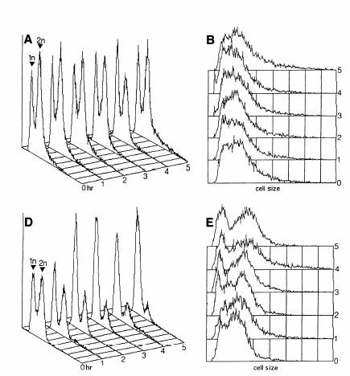
Inactivation of TOR in yeast
Wild-type without rapamycin
Wild-type with rapamycin
(0.2 μg/ml)
G1 arrest with 1C DNA content

Slide 17
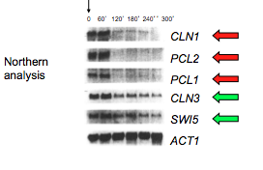
Down-regulation of G1 cyclins due to inactivation of TOR pathway
Rapamycin
Rapamycin treatment or inactivation of TOR results in a severe decrease in transcription of G1 cyclins
Growth-induced synthesis of cell cycle machinery components plays an important role in activating and allowing progression of the cell cycle

Slide 18
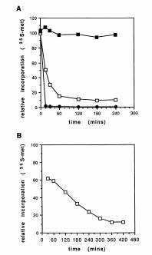
Inactivation of TOR in yeast
³⁵S-met
Wild-type with rapamycin
Yeast strain: tor^{ts}
(Restrictive temperature 37°C)

Slide 19
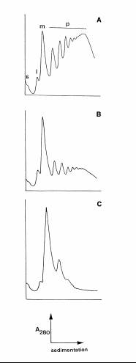
i= 60S
S=40S
M= 80S
p= polysomes
Inactivation of TOR in yeast
Wild-type without rapamycin
Wild-type with rapamycin (2 hr)
tor^{ts} after 5 hr at 37°C

Slide 20
Inactivation of TOR in yeast
Nutrients such as carbon and nitrogen stimulate cell growth
TOR signalling pathway respond to nutrients
Mutants that are defective in TOR function or cells that have been treated rapamycin
Cell Cycle arrest and entry into G0 (STARVATION)
Downregulation of protein synthesis;
Downregulation of ribosome biogenesis;
Upregulation of autophagy;
Upregulation of ubiquitin-dependent degradation;
Specific changes in transcription;
Increase in messenger RNA turnover
Accumulation of the reserve carbohydrate glycogen and the stress protectant trehalose
Upregulation of stress response genes
Alterations in nitrogen and carbon metabolism

Slide 21
TOR pathway and ribosome biogenesis
Several studies revealed that TORC1 complex plays prominent roles in the regulation of ribosome biogenesis, one of the most energetically demanding processes and thus a focal point for the coordination of growth with nutritional changes.
TORC1 complex regulates ribosome biogenesis at many levels, including transcriptional induction of rRNA, ribosomal proteins, and the ribosome biogenesis (Ribi regulon).
Several transcription factors were targets of TORC1 complex: 1) Maf1, the repressor of RNA pol III, Sfp1, which regulates the transcription of ribosomal protein and biogenesis genes, the forkhead transcription factor Fhl1, a regulator of ribosomal protein (RP) transcription.
TORC1 complex also directly binds 35S rDNA promoters to promote rRNA synthesis.

Slide 22
Nutritional control of ribosome biogenesis
The budding yeast ribosome is composed of 79 ribosomal proteins, encoded by 138 genes (the RP regulon), and 4 rRNAs (5S, 5.8S, 18S, and 25S) encoded by ∼150 rDNA repeats existing as a tandem array.
236 genes encoding non-ribosomal proteins are involved in various aspects of ribosome assembly and translational capacity (the Ribi regulon): RNA polymerases I and III, tRNA synthetases, rRNA processing and modifying enzymes, translation factors.
Synthesis of the translation machinery is very energetically expensive to the cell: in an exponentially growing cell, ribosome synthesis utilizes ∼90% of the total cellular energy

Slide 23
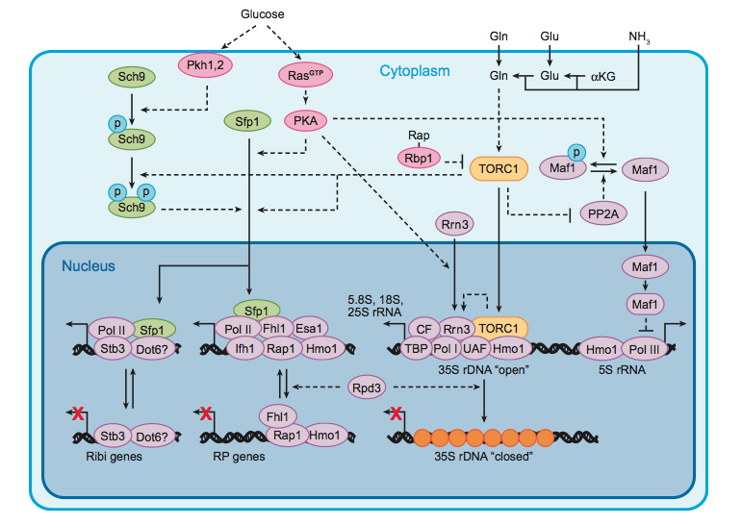
Control of rRNA synthesis
Maf1
Sch9
TORC1
nucleus
Maf1
RNA Pol III
5S RNA, along with tRNAs and a number of small nuclear RNAs are transcribed by RNA Pol III, whose activity is regulated in response to nutritional status by the highly conserved Maf1 repressor.
Maf1 function is regulated by nutrients through control of its subcellular localization. In particular, phosphorylated Maf1 is retained in the cytoplasm while dephosphorylated protein is imported into the nucleus where it inhibits RNA Pol III transcription.
TORC1 itself binds to the 35S and 5S rDNA chromatin under favourable nutrient conditions and this seems to be essential for the synthesis of 35S and 5S rRNA via, respectively, RNA polymerase I and III.
In addition, TORC1 stimulates the expression of tRNAs by RNA polymerase III.

Slide 24
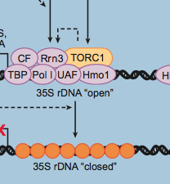
Control of rRNA synthesis
Yeast contain ca. 150 tandemly repeated rDNA copies encoding 35S precursor rRNA (RNA Pol I)
Carbon downshift, nitrogen starvartion, and rapamycin treatment determine a reduction in the initiation-competent form of RNA Pol I.
At least four general transcription factors promote initiation of RNA Pol I transcription at rDNA genes, among which the monomeric factor Rrn3, which forms a complex with RNA Pol I.
The formation and/or stability of the initiation-competent Rrn3-Pol I complex, is necessary for proper recruitment of the polymerase to the 35S rDNA promoter
Glucose addition increases synthesis of Rrn3 whereas TORC1-dependent signaling stabilizes the Rrn3-Pol I complex, providing at least two links between nutritional status and Pol I activity.
TORC1 directly binds to the 35S rDNA promoter in a nutrient- and rapamycin-sensitive manner and that this physical interaction is necessary for 35S rRNA synthesis.

Slide 25
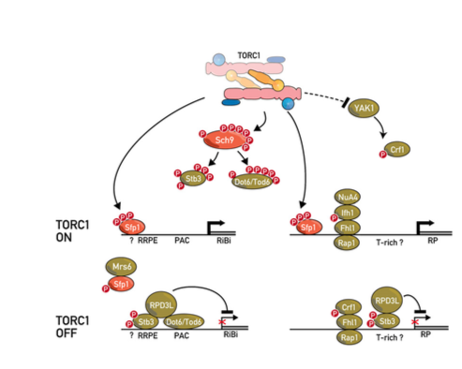
Control of RiBi and RP gene transcription by TORC1
Ribi regulon
RNA polymerases I and III
tRNA synthetases
rRNA processing modifying enzymes
translation factors
Loewith and Hall Genetics 2011, 189:1177-1201

Slide 26
RiBi factors are required for the proper expression, processing, assembly, export, and maturation of rRNA and RPs into ribosomes.
TORC1 regulates RiBi and RP gene transcription via multiple pathways:
TORC1 directly phosphorylates the Zn-finger transcription factor Sfp1, which presumably regulates its nuclear localization and/or binding to RP and possibly RiBi gene promoters to stimulate their expression.
Fhl1 and Rap1 bind constitutively to RP promoters. When TORC1 is active, phosphorylated Ifh1 binds to Fhl1 to stimulate transcription, possibly by recruiting the NuA4 histone acetyltransferase.
When TORC1 is inactive, Yak1 phosphorylates Crf1, which subsequently detaches Ifh1 for binding to Fhl1.
Sch9 phosphorylates and thus inhibits the transcription repressors Stb3 and Tod6. Inhibition of TORC1/Sch9 results in the dephosphorylation of these transcription repressors, which subsequently bind to RiBi promoters to repress transcription.

Slide 27
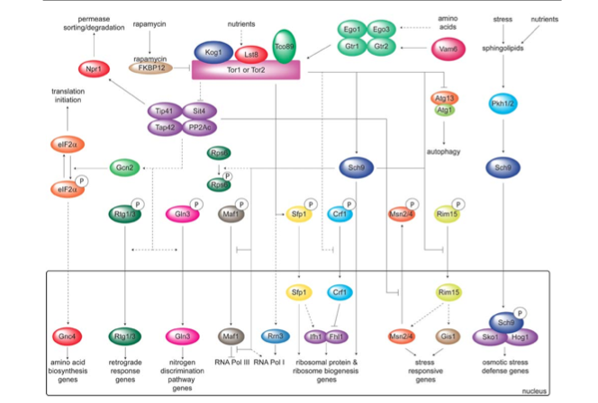
The TORC1 pathway in yeast

