Slide 3
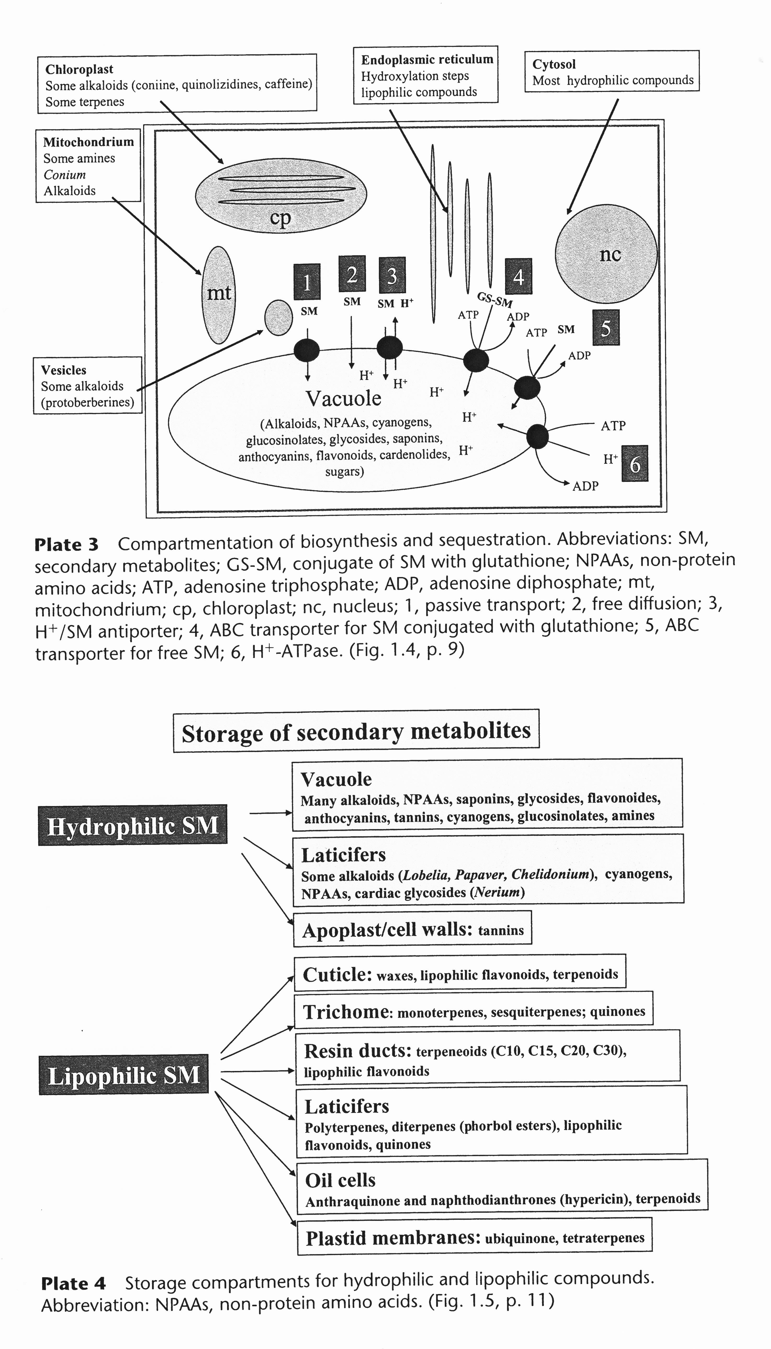

Slide 5
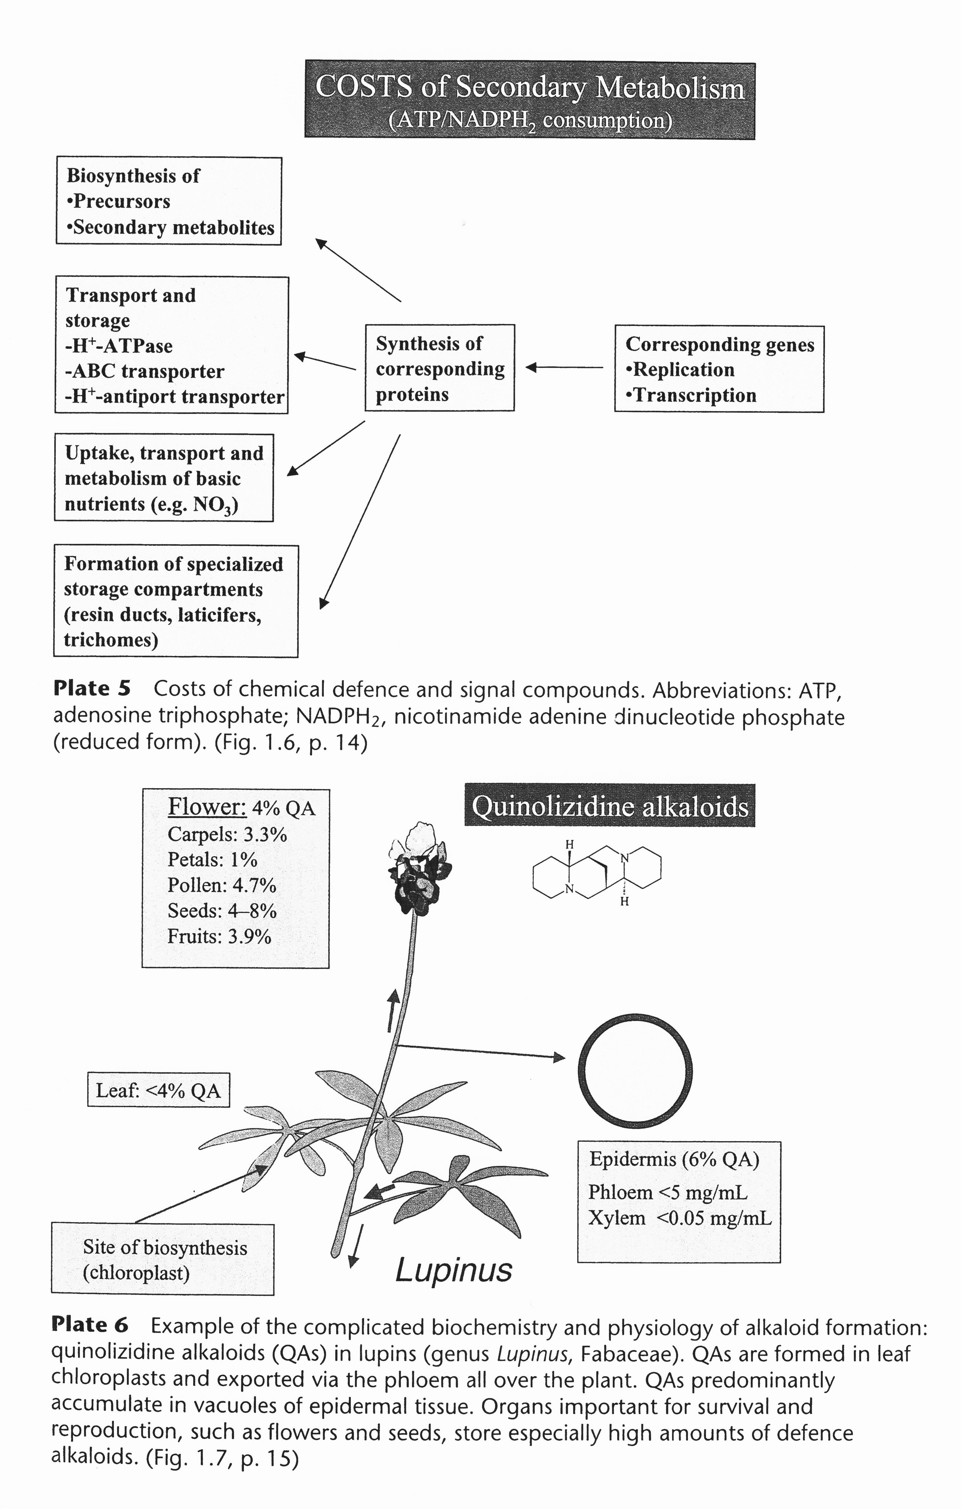

Slide 7
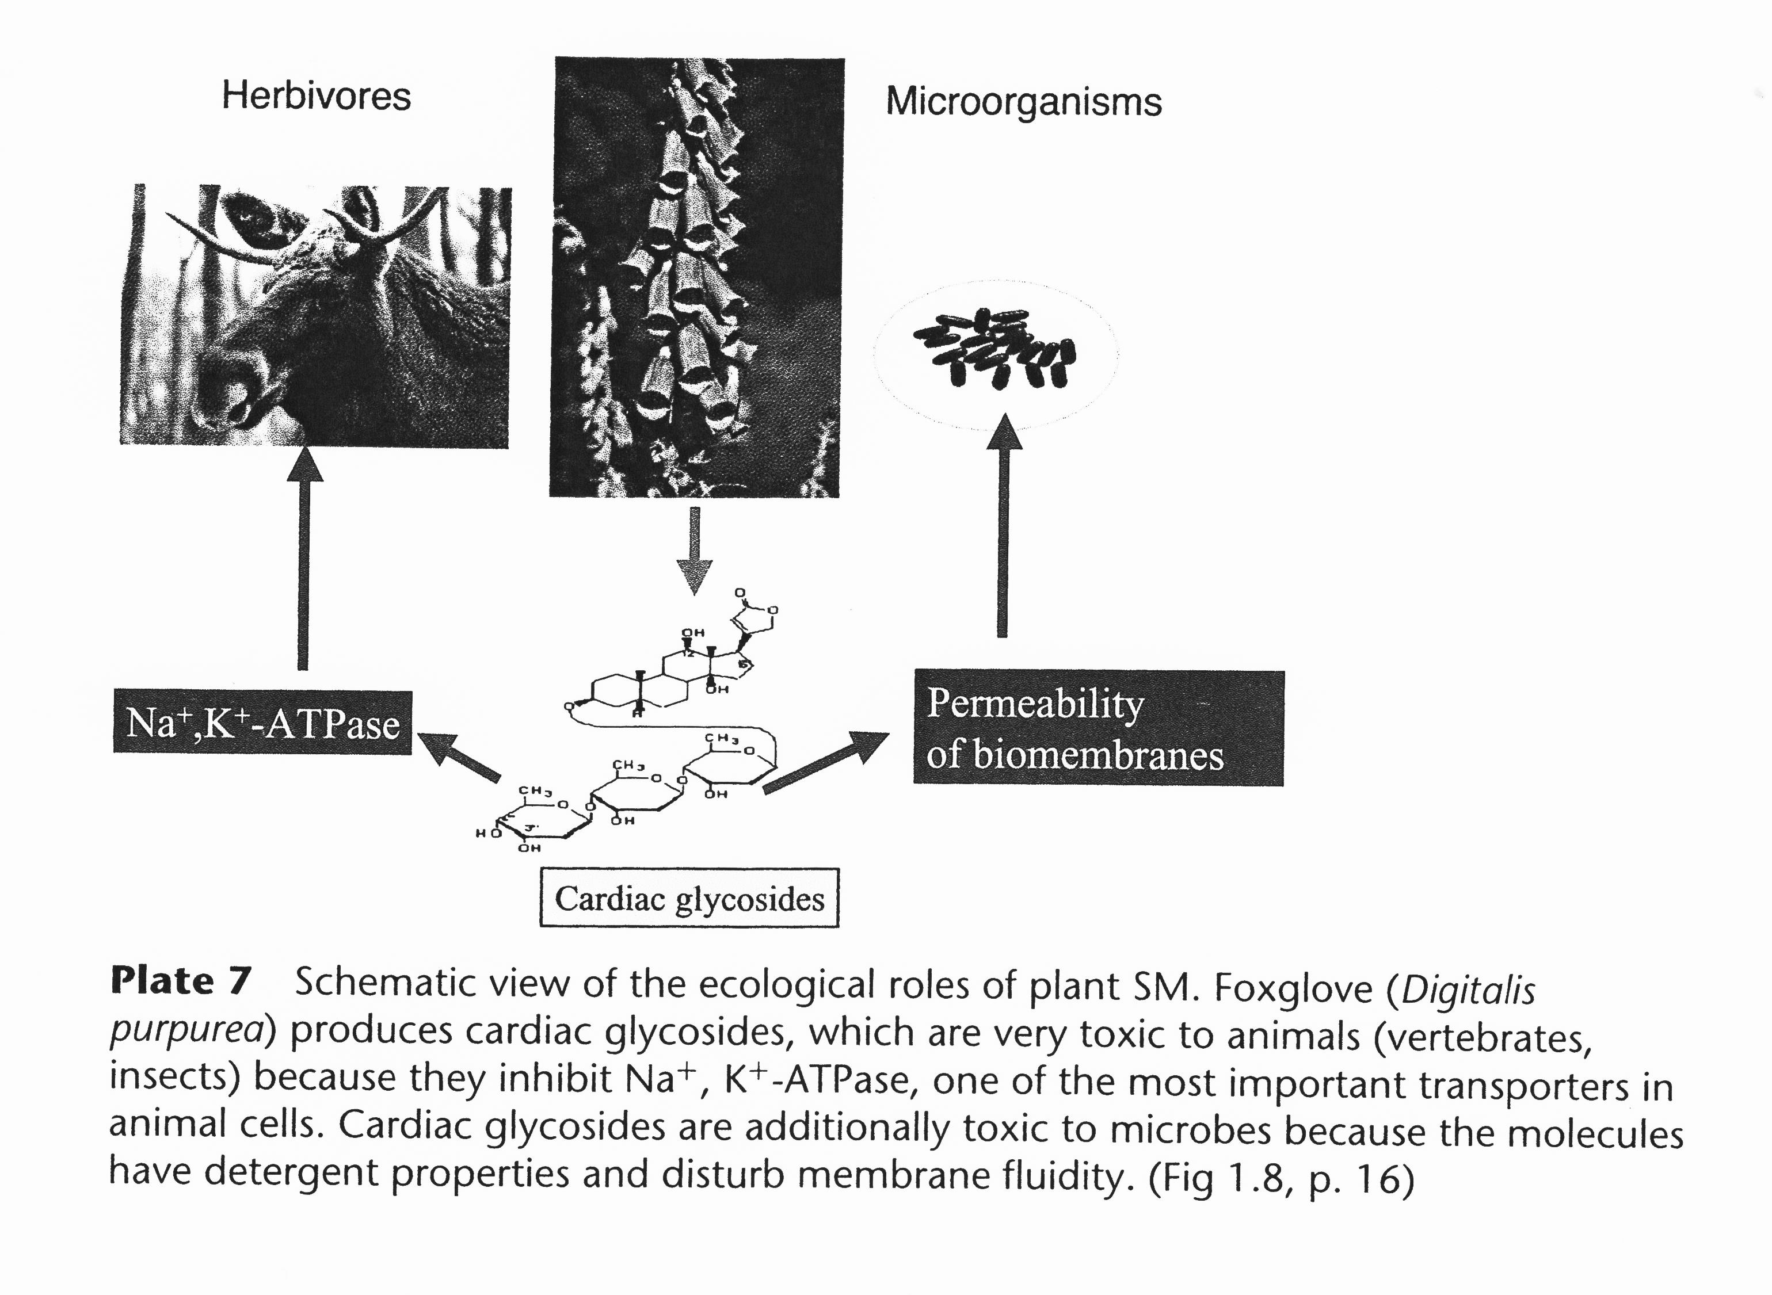

Slide 8
Natural products as drug candidates: a historical perspective
The first written records on medicinal applications of plants date back to 2600 BC and report the existence of a sophisticated medicinal system in Mesopotamia, comprising about 1000 plant-derived medicines.
Egyptian medicine dates back to about 2900 BC, but its most useful preserved record is the “Ebers Papyrus” from about 1550 BC, containing more than 700 drugs, mainly of plant origin.
Traditional Chinese medicine (TCM) has been extensively documented over thousands of years.
The knowledge on the medicinal application of plants in the Western world is mainly based on the Greek and Roman culture. Of particular importance are the compendia written by the Greek physician Dioscorides (1st century AD), and by the Romans Pliny the Elder (1st century AD) and Galen (2nd century AD).

Slide 9
Natural products as drug candidates: a historical perspective
The Arabs preserved a large amount of the Greco-Roman knowledge during the Dark and Middle ages (i.e., 5th to 12th centuries), and complemented it with their own medicinal expertise, and with herbs from Chinese and Indian traditional medicines.
15th and 16th century: several very influential herbal books were widely distributed in Europe, like The Mainz Herbal (Herbarius Moguntinus, 1484) and The German Herbal (1485), the Herbarium Vivae Eicones (Otto Brunfels; 1530), the Kreütter Buch by Hieronymus Bock (1546) that was written in German, and De Historia Stirpium by Leonhart Fuchs that was published in Latin in 1542 and also in German in the following year.
It was only in the 18th century that Anton von Störck, who investigated poisonous herbs such as aconite and colchicum, and others laid the basis for the rational clinical investigation of medicinal herbs (from an empirical basis to pharmacological investigations of active constituents).

Slide 10
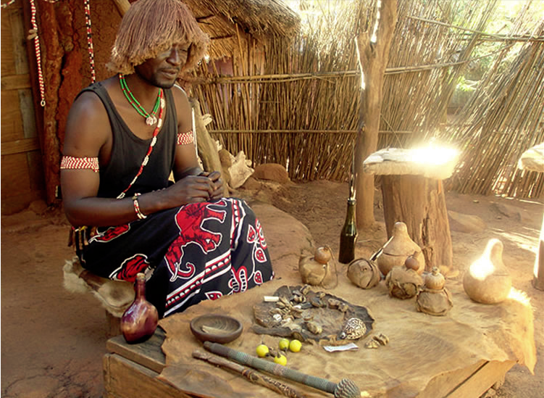
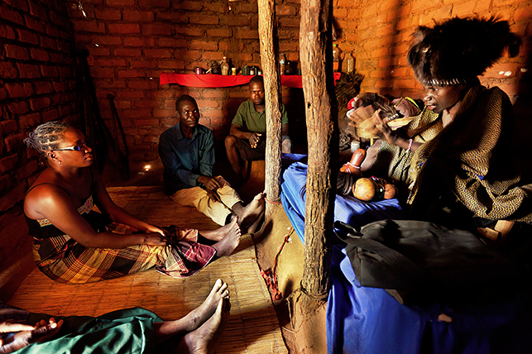
Traditional Medicine
For the WHO (World Health Organization) Traditional Medicine is the sum total of knowledge, skills and practices based on the theories, beliefs and experiences indigenous to different cultures, whether explicable or not, used in the maintenance of health as well as in the prevention, diagnosis, improvement or treatment of physical and mental illness.
Healers, especially in developing countries, hand down orally the recipes and treatments they use to their patients.
Writing prescriptions and therapies has the risk that they can be copied and for healers this can involve an economic risk as they earn from the exercise of that profession.
Over time, however, numerous collaborations have taken place between healers and university-trained researchers and this has produced numerous discoveries either regarding new molecules or for the treatment and administration of the preparations obtained according to the revealed recipes.

Slide 11
Rational drug discovery
Rational drug discovery from plants started at the beginning of the 19th century, when the German apothecary assistant Friedrich Sertürner succeeded in isolating the analgesic and sleep-inducing agent from opium which he named morphium (morphine) after the Greek god of dreams, Morpheus.
He published a comprehensive paper on its isolation, crystallization, crystal structure, and pharmacological properties, which he studied first in stray dogs and then in self-experiments (Sertürner, 1817).
This triggered the examination of other medicinal herbs, and during the following decades of the 19th century, many bioactive natural products, primarily alkaloids could be isolated from their natural sources:
quinine, caffeine, nicotine, codeine, atropine, colchicine, cocaine,
capsaicin.

Slide 12
Rational drug discovery
Apothecaries who specialized in the purification of these compounds were the progenitors of pharmaceutical companies.
The first one was H.E. Merck in Darmstadt (Germany) who started extracting not only morphine but also other alkaloids in 1826.
Subsequently, efforts were undertaken to produce natural products by chemical synthesis in order to facilitate production at higher quality and lower costs.
Salicylic acid was the first natural compound produced by chemical synthesis in 1853.

Slide 13
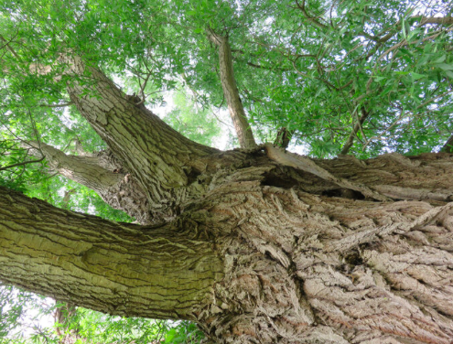
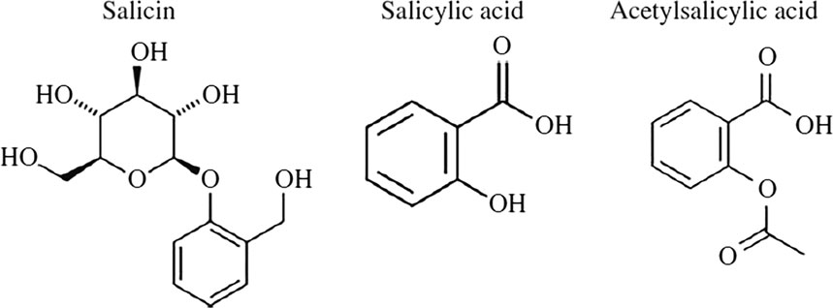
Willow bark has been used as a traditional medicine for more than 3500 years.
Unknown to the ancient Sumerians and Egyptians who made use of it, the active agent within willow bark was salicin, which would later form the basis of the discovery of aspirin.
Evidence for this early use of willow as an analgesic and antipyretic first surfaced in 1862.
Edwin Smith (1822–1906), an American trader living in Cairo purchased a pair of ancient documents, the provenance of which was unknown.
These scrolls dated back to around 1500 BC and are amongst the most important historical documents in medicine.
One of these is now known as the Edwin Smith Surgical Papyrus and details 48 surgical cases and their management. The other is now known as the Ebers Papyrus. This was an Egyptian record of around 160 herbal and vegetable remedies. One of these remedies is the first written record of the use of Salix (now known as willow) for treatment of non-specific pains.
The use of willow bark for pain relief continued through ancient Greece, where it was recommended by Hippocrates to relieve the pain of childbirth, through to Roman times, when its use was recorded by Pliny the Elder .
The Aspirin story
Salix alba

Slide 14
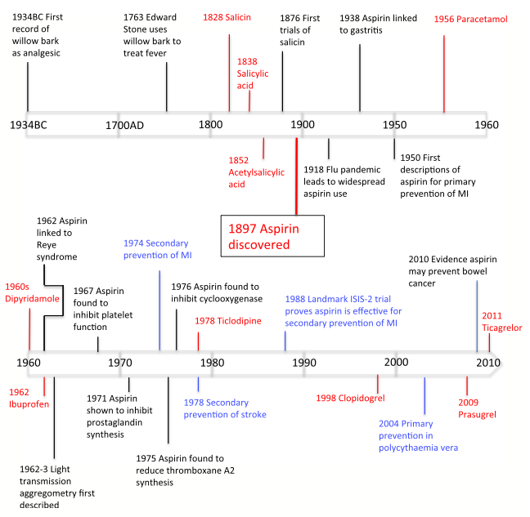
The active ingredient in willow bark was not discovered until 1828 when Johann Buchner first refined willow bark into yellow crystals and named it Salicin (after Salix, the genus of the willow tree).
In 1829, the process was further refined by Pierre-Joseph Leroux in France and taken a step further in 1838 when Raffaele Piria produced a stronger compound from the crystals isolated from willow bark, which he named salicylic acid (1838).
In 1852, the French chemist, Charles Gerhardt, was the first to modify salicylic acid with the introduction of an acetyl group in place of a hydroxyl group, but the compound was not stable.
Acetylation of salicylic acid later proved to be the key step in reducing its irritant properties.
In 1876, the first clinical trial of salicin was published by Thomas Maclagan, a Scottish physician at the Dundee Royal Infirmary, demonstrating its antipyretic and anti-inflammatory effects.
Despite the clear antipyretic benefits of salicin, it was not taken up more widely due to complications with gastritis.

Slide 15
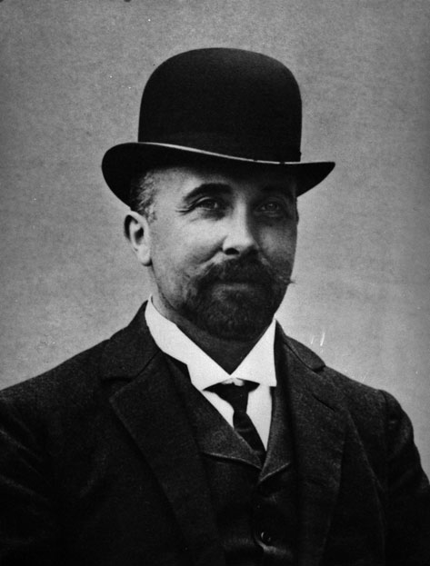
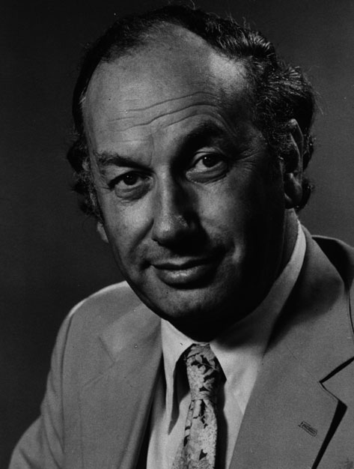
In 1897, Eichengrun (the head of Bayern factory) decided to develop a form of salicylate that did not cause gastric irritation.
He allocated this task to Felix Hoffmann (chemist). Hoffmann had studied as a pharmaceutical chemist at Munich University and in 1894. Hoffmann set to work trying to manipulate the salicylic acid that he extracted from dry meadowsweet leaves. He was able to acetylate a phenol group of salicylic acid, producing acetylsalicylic acid. His breakthrough was recorded in his laboratory book on 10 August 1897.
Although the uptake of aspirin in the medical community was initially slow, it soon took off and aspirin rapidly became known worldwide as one of the first analgesics. Aspirin went on to be considered by the public and the medical profession as an effective antipyretic and analgesic, with few side effects when taken at standard doses.
John Vane (1927–2004) is a key figure in the history of aspirin. He demonstrated that aspirin inhibited prostacyclin synthesis paved the way for the future development of nonsteroidal anti-inflammatory drugs (NSAIDs) and other cyclooxygenase (COX) inhibitors and earned John Vane the Nobel Prize for Physiology or Medicine in 1982.
Felix Hoffman (1868-1946)
John Vane (1927-2004)

Slide 16
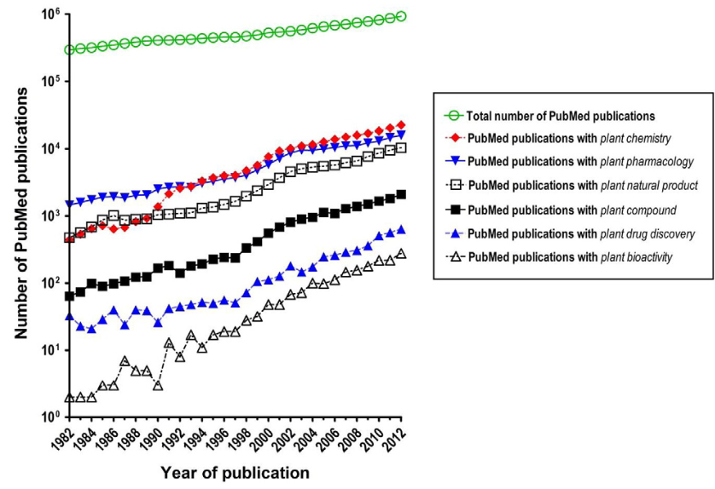
PubMed publication trend analysis, demonstrating increased scientific interest in plant-derived natural product pharmacology, chemistry and drug discovery

Slide 17
Of the 1073 new chemical entities belonging to the group of small molecules that had been approved between 1981 and 2010, only 36% were purely synthetic, while more than the half were derived or inspired from nature. A substantial number of these compounds have been discovered in higher plants.
Particularly prominent examples of plant-derived natural compounds that have become indispensable for modern pharmacotherapy can be found in the field of anti-cancer agents, e.g., paclitaxel and its derivatives from yew (Taxus) species, vincristine and vinblastine from Madagascar periwinkle (Catharanthus roseus (L.) G. Don), and camptothecin and its analogs initially discovered in the Chinese tree Camptotheca acuminata.
Further notable examples include the cholinesterase inhibitor galanthamine that has been approved for the treatment of Alzheimer's disease and was initially discovered in Galanthus nivalis L., and the important antimalarial and potential anti-cancer agent artemisinin originally derived from the traditional Chinese herb Artemisia annua L.

Slide 18
Particularly in the context of drug discovery from medicinal plants, a big advantage is that sometimes well documented ethnopharmacological information about the traditional use is available, which can provide hints for compounds therapeutically effective in humans.
In line with this notion, analysis of 122 plant-derived compounds identified to be globally used as drugs revealed that 80% of them originate from plants that have ethnomedical use.
Furthermore, it was even demonstrated that natural products used for the development of medicines are highly likely to be used traditionally, even if this was not known at the stage of drug development (e.g., the discovery of the anti-cancer agent taxol from T. brevifolia was done with a random screening approach, but later on it came to light that the plant has been used by western Indian cultures as a medicine).

Slide 19
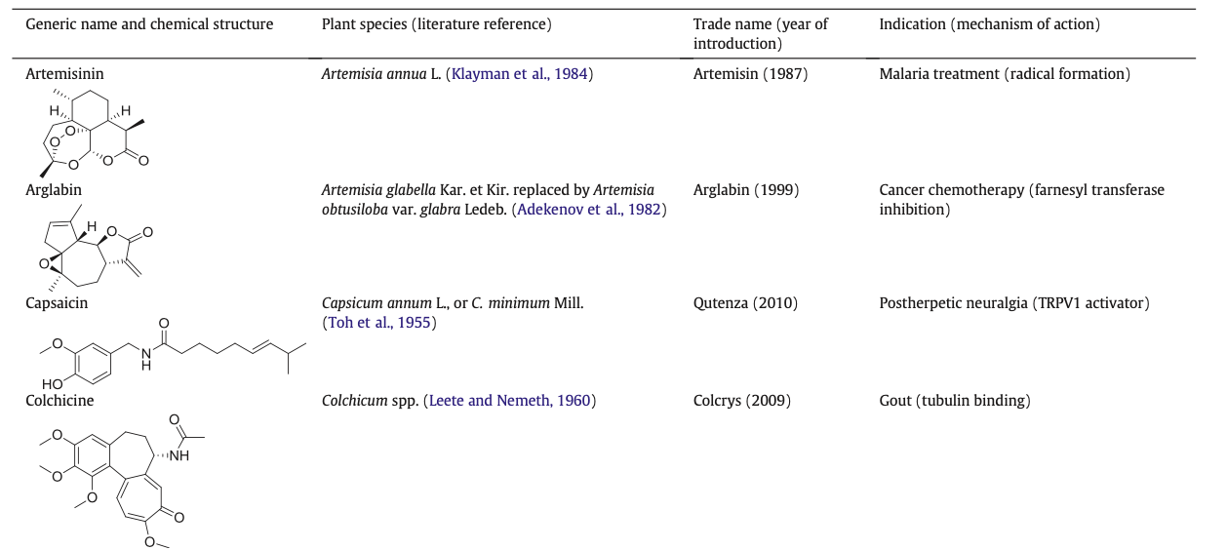
Plant-derived natural products approved for therapeutic use in the last thirty years (1984–2014)

Slide 20
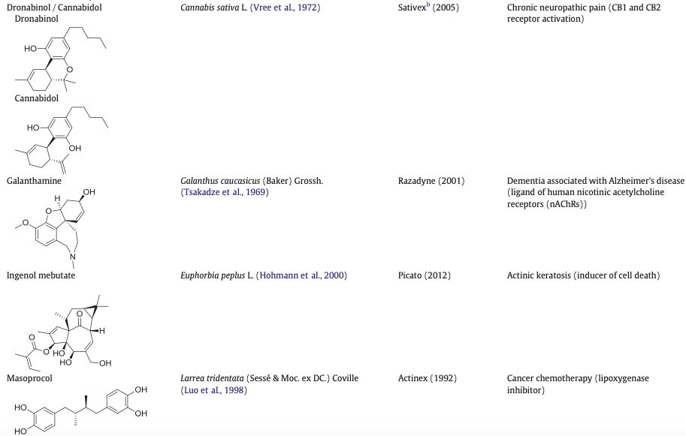

Slide 21
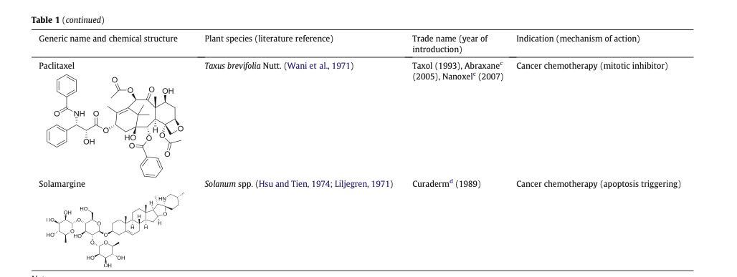

Slide 22
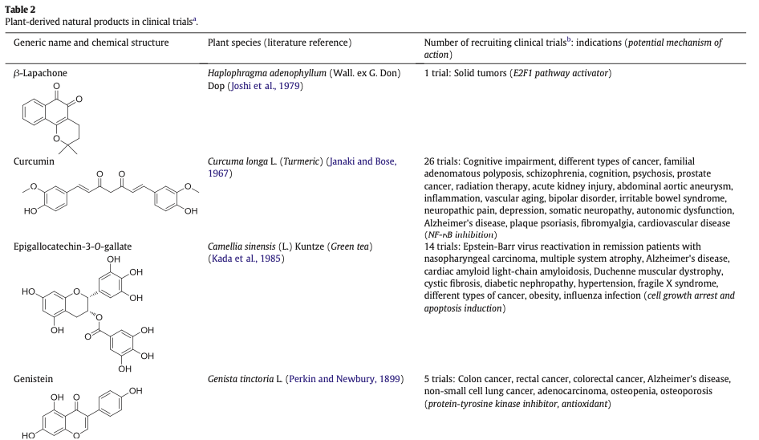

Slide 23
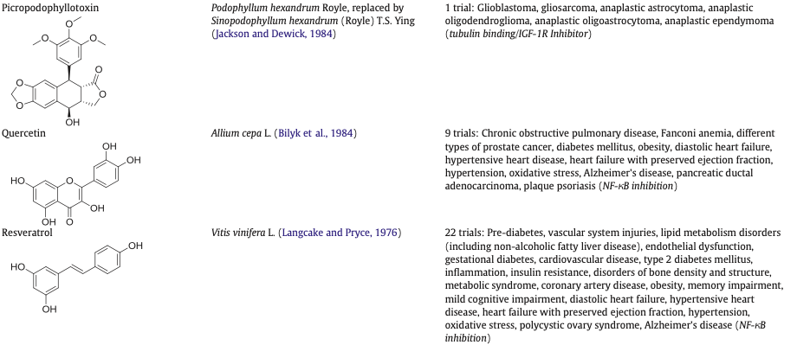

Slide 24
Approaches for resupply of pharmacologically active plant compounds
Many potent plant-derived natural products such as paclitaxel, podophyllotoxin, or vinblastine share severe difficulties to meet the market demands, as their natural sources are often slow-growing or even endangered species that tend to accumulate these compounds at very low quantities over long growth periods.
Plant cell cultures (dedifferentiated cells suspended in liquid nutrient medium) have been aptly denominated as chemical factories of secondary metabolite.
Despite of many decades of research in the field, at present only fourteen substances or products are produced commercially from plant cell cultures, with the most prominent being paclitaxel from Taxus spp. This is due to several limitations of plant cell cultures in comparison to microbial production sources, including slow growth rates and low and variable yields of metabolites — in fact, many metabolites do not accumulate in plant cell cultures because of lacking differentiation and compartmentalization.

Slide 25
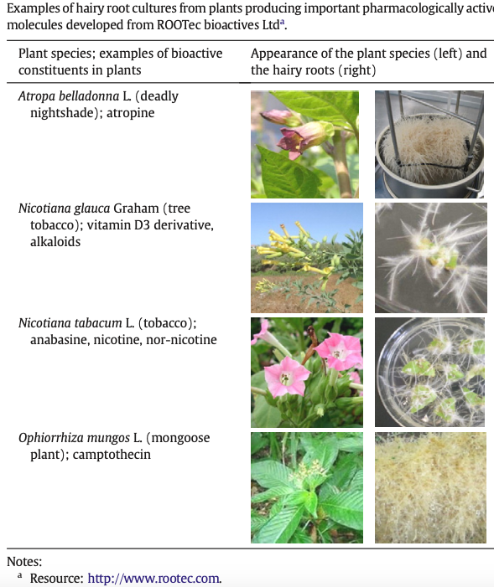
Recent research on the production through hairy roots of lignans, steroids, anthraquinones, or alkaloids clearly indicates that optimized hairy root culture systems can be used for the sustainable biotechnological production of biologically active compounds.
Regarding the commercial application, the Swiss company ROOTec Bioactives AG(https://www.crunchbase.com/organization/rootec-bioactives) has developed an optimized bioreactor system for large-scale cultivation of hairy roots with potential to produce a number of pharmacologically active compounds.

Slide 26
The heterologous biosynthesis of plant-derived natural compounds, i.e. the reconstitution of the target compound's biosynthetic pathway in a foreign host in order to increase product yield, is another alternative to the traditional production routes.
This approach has originally been developed in order to transfer the biosynthesis of valuable microbial secondary metabolites from their original producers that are often poorly characterized and difficult to cultivate into microbial hosts that are more amenable to fermentation processes.
The choice of the appropriate host system is crucial for success of heterologous production.
Concerning microbial hosts, Escherichia coli and Saccharomyces cerevisiae have been most widely applied.

Slide 27
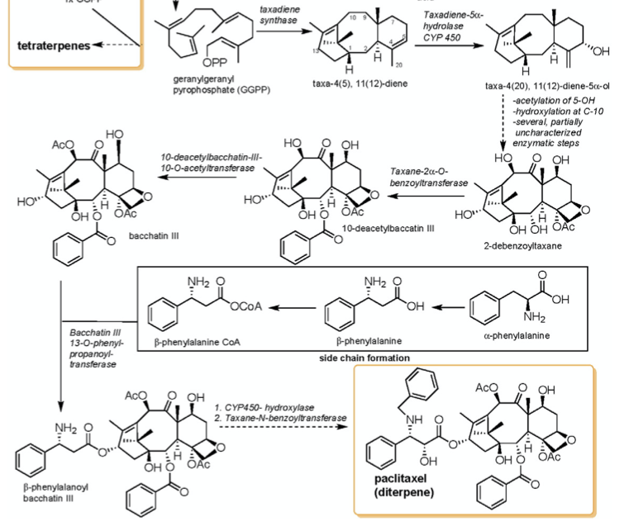
The synthesis of paclitaxel
Paclitaxel, a complex natural product with a diterpenoid core, was isolated and structurally elucidated for the first time in the late 1960s from the stem bark of western yew (T. brevifolia).
In the late 1970, it was discovered as the first antimitotic agent that acted by promoting the irreversible assembly of tubulin into microtubules.
Currently, paclitaxel is approved for the treatment of different kinds of cancers, and its fields of application are expected to expand as the compound is currently also studied for the treatment of other, non-cancer related diseases.
Its market price is very high at $ 600,000 per kg.

Slide 28
As extraction from natural sources and total synthesis have proven infeasible to meet the market demands, the compound is currently produced by two different approaches:
1) paclitaxel and analogs thereof are produced by semi-synthesis using taxanes that occur more abundantly than paclitaxel in various yew species such as bacchatin III or 10-deacetylbacchatin III as starting materials;
2) Taxus plant cell cultures are used for paclitaxel production.
Also heterologous paclitaxel production has been intensively investigated. Indeed, the early-stage paclitaxel intermediate taxadiene could be produced in several microbial and plant heterologous hosts.
While production in Arabidopsis thaliana only reached levels of 600 ng per gram dry weight, transgenic tomato plants overexpressing taxadiene synthetase and lacking the ability to utilize geranylgeranyl diphosphate (GGPP) for carotenoid biosynthesis accumulated up to 160 μg paclitaxel/g freeze dried tomatoes, which is close to the quantities reported in western yew bark.

Slide 29
Concerning microbial heterologous hosts, taxadiene levels of 8.7 mg/l could be reached in S. cerevisiae.
High-level production of up to 1 g taxadiene/l could be achieved in engineered E. coli strains. Taxadiene is only a very early-stage intermediate of the paclitaxel biosynthetic pathway. It would be necessary engineer six more hydroxylation reactions and other steps in order to achieve baccatin III, a feasible precursor for paclitaxel semi-synthesis. However, already the introduction of the genes encoding the enzymes to produce taxa-4 (20),11(12)-diene-5α-ol, the intermediate following taxadiene in the paclitaxel pathway, led to a significant reduction of productivity.
In addition, several steps in the overall pathway have not been conclusively identified or confirmed. Therefore, the total heterologous production of paclitaxel has not been still reached.

Slide 30
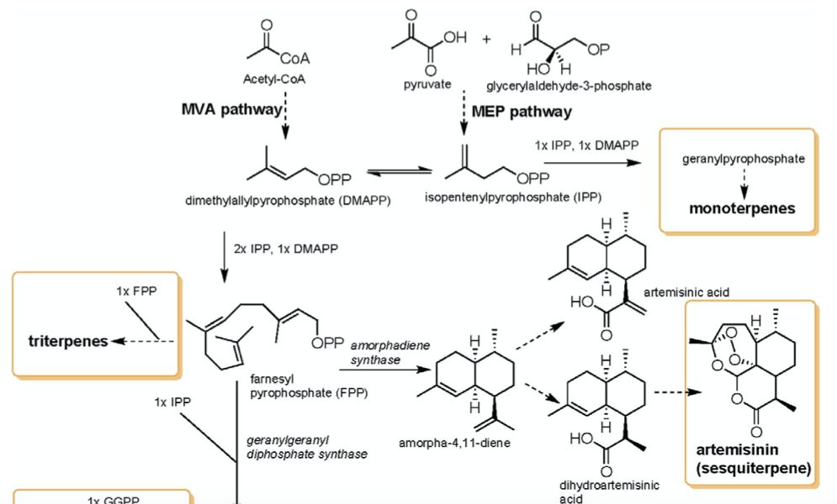
The production of artemisin
Availability of artemisin is limited due to its low abundance in the natural source and due to the low yield of chemical total synthesis, thus resulting in a high price that is unaffordable for people in developing countries where malaria frequently occurs.
Therefore, there has been an intensive exploration of alternative strategies for artemisinin production in order to enhance supply and to reduce costs, among them the development of a heterologous production process.
The goal of the strategy was the heterologous production of artemisinin precursors such as amorpha-4,11-diene, artemisinic acid or dihydroartemisinic acid, followed by their semi-synthetic derivatization to artemisinin.

Slide 31
These efforts have led to the development of an economically feasible production process consisting of heterologous production of artemisinin from inexpensive carbon sources (glucose, ethanol) in a S. cerevisiae strain engineered for high yield artemisinic acid production (production titres: up to 25 g/l), and subsequent semi-synthetic conversion of artemisinic acid to artemisinin by a simple and inexpensive chemical conversion procedure.
Process development from laboratory research to industrial scale has been funded by a five year grant from the Bill & Melinda Gates Foundation, and involved the University of California, Berkeley, USA, the synthetic biology inventor Amyris Inc., and the non-profit pharmaceutical company One World Health (now PATH's Drug Development Program).
Sanofi is now using this technology for large-scale production of artemisinin. The company is committed to apply a no profit, no loss production model in order to maintain a low price for developing countries. (http://en.sanofi.com/Images/32474_ 20130411_ARTEMISININE_en.pdf).

Slide 32
Alternatively to this very successful development, efforts have been made to directly produce artemisinin in heterologous plant hosts, since microbial hosts only allowed the heterologous production of artemisinin precursors, while the heterologous production of artemisinin itself could only be realized in plants so far.
Indeed, the artemisinin biosynthetic pathway was transfered into tobacco plants, using a mega vector construct that consisted of five plant- and yeast-derived genes involved in the mevalonate and artemisinin biosynthetic pathway, all of them regulated by distinct constitutive promoters. The gene products were targeted to diverse cellular compartments to increase precursor availability.
With this approach, the accumulation levels that ranged around 7 μg/g biomass dry weight are currently too low to compete with other production alternatives.

Slide 33
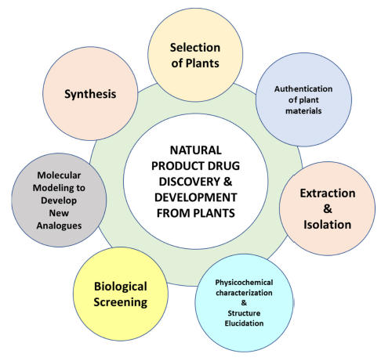
Molecules , 2022,27,349
Modern Approaches in the Discovery and Development of
Plant-Based Natural Products and Their Analogues as Potential
Therapeutic Agents
Asim Najmi 1, Sadique A. Javed 1,* , Mohammed Al Bratty 1 and Hassan A. Alhazmi 1,2
The major processes involved in the discovery and development of natural products from botanical sources

Slide 34
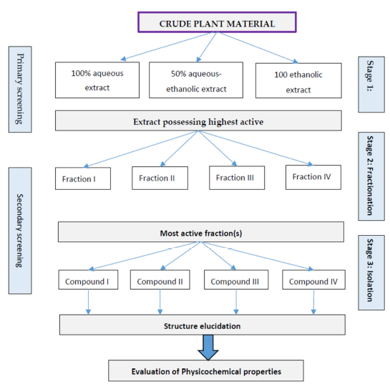
An outline of parallel approach for biological activity guided fractionation of plant extracts

Slide 35
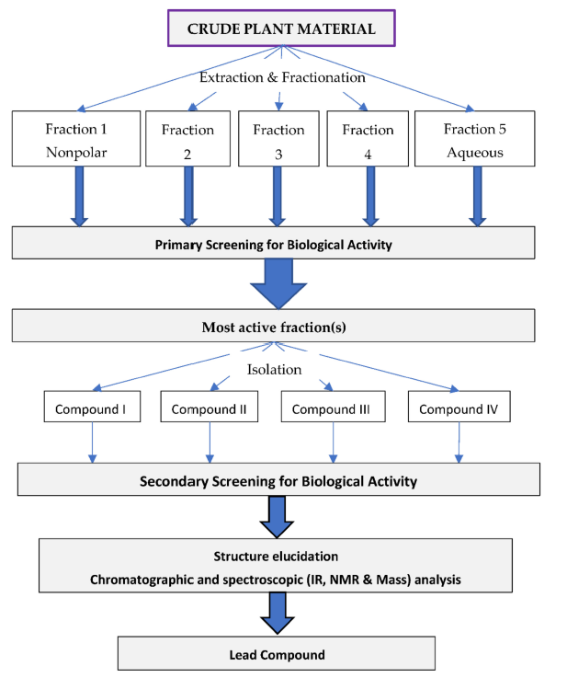
An outline of sequential approach for biological activity guided fractionation of plant extract.

Slide 36
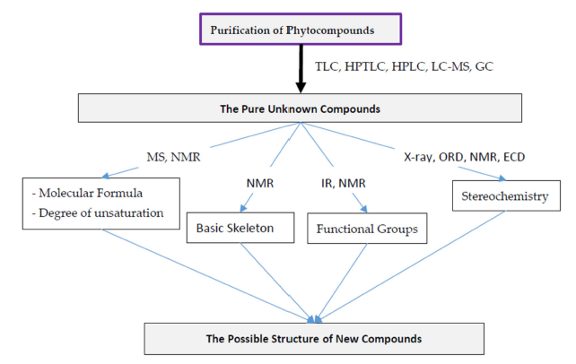
An outline for structural elucidation of new phytochemicals.

Slide 37
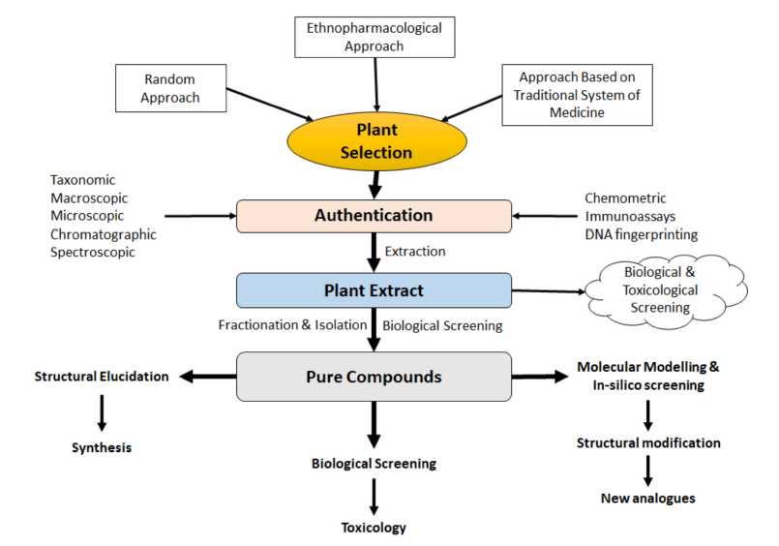
The overall approaches in modern drug discovery and development process from botanical sources

Slide 38
