Slide 1
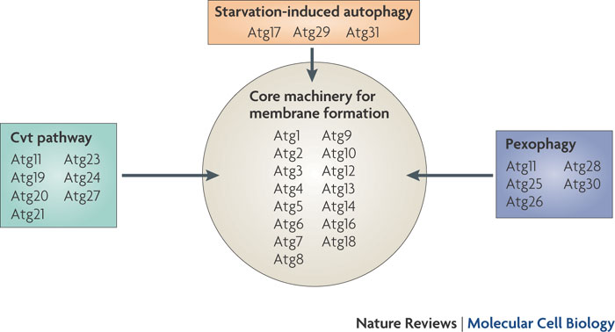
Classification of Atg proteins
ATG (autophagy-related)
Hitoshi Nakatogawa, Kuninori Suzuki, Yoshiaki Kamada and Yoshinori Ohsumi doi:10.1038/nrm2708, 2009

Slide 2
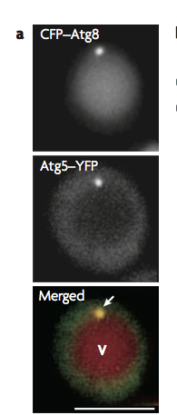
The PAS as the assemly of Atg proteins
Fluorescence microscopy showed that one dot of fluorescently tagged Atg8 is usually observed in close proximity to the vacuole
Autophagosomes are generated at or around this dot, and most Atg proteins are at least partly colocalized here.
The dot represents the assembly of the Atg proteins responsible for autophagosome formation, and thus the assembly was termed the PAS.
Atg proteins organize the PAS according to hierarchical relationships among the subgroups

Slide 3
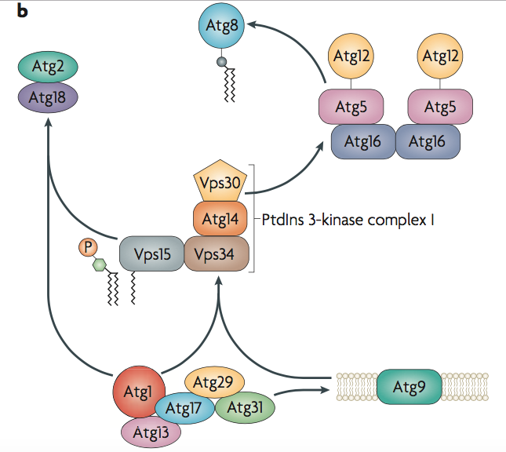

Slide 4
Atg1 kinase and its regulators

Slide 5
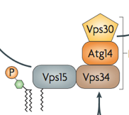
PtdIns 3-kinase complex

Slide 6
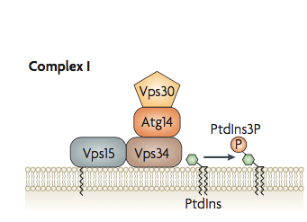
Class III PtdIns 3-kinase complex and nucleation
In autophagy, nucleation refers to the process of mobilizing proteins to the PAS
Nucleation as an amplification event to recruit proteins needed for phagophore expansion
The activity of the class III PtdIns 3-kinase complex I is essential for autophagy
The lipid kinase Vps34 forms two distinct complexes, I and II
Complex I is composed by Vps34, the regulatory kinase Vps15, Vps30/Atg6, Atg14 and localizes to the pre-autophagosomal structure (PAS)
PtdIns 3K is responsible for the production of phosphatidylinositol-3-phosphate (PtdIns3P) which is important for the correct localization of Atg18 and Atg2
Atg18 and Atg2 enable the recruitment of Atg8, Atg9 and Atg12 to the PAS

Slide 8
Atg2-Atg18 complex and Atg9

Slide 9
Atg2–Atg18 complex and Atg9 trafficking
PtdIns3P that is produced by complex I is thought to recruit effector proteins required for autophagosome formation to the PAS: Atg18 and Atg2
Of the core Atg proteins, Atg9 is the sole integral membrane protein
Atg9 is probably the membrane transporter for the growing phagophore
In addition to its localization to the PAS, Atg9–GFP is also observed as small dots that move in the cytoplasm
Atg9 shuttles between the PAS and the cytoplasmic pool during autophagosome formation
The machinery that is involved in Atg9 includes Atg11, Atg23 and Atg27

Slide 11
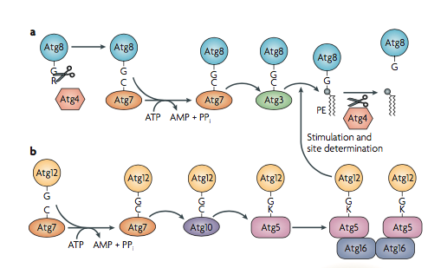
Phagophore expansion:
Two ubiquitin-like conjugation systems
There are two ubiquitin-like (Ubl) conjugation systems required for phagophore expansion: the Ubl proteins Atg8 and Atg12 and three enzymes (Atg7: the common E1 enzyme; Atg3, the specific E2 enzyme for Atg8-PE formation; Atg10, the specific E2 enzyme for Atg12-Atg5) that are required for their conjugation reactions
Atg12 is conjugated to Atg5 (via the action of the E1 Atg7 and E2 Atg10)
The complex Atg5-Atg12 binds Atg16 to form the dimeric Atg12-Atg5-Atg16 complex
Atg8 is conjugated to phosphatidylethanolamine (PE), a major component of various biological membranes
Atg8-PE involves the protease Atg4, Atg7(E1), Atg3(E2) and the Atg12-Atg5-Atg16 complex which acts as an E3 enzyme

Slide 12
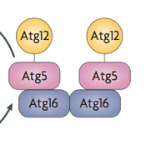
Atg12 conjugation system

Slide 13
Atg8 conjugation system
Atg8 serves as a marker for membrane dynamics during autophagy

Slide 15
Conjugation of Atg8
Atg8 is synthesized as a precursor with an additional sequence in its carboxyl terminus (a single Arg residue in S. cerevisiae Atg8)
This is immediately cleaved by the protease Atg4 to expose the Gly residue that is essential for subsequent reactions
Formation of the Atg8–PE conjugate is mediated by Atg7 and Atg3, which are the E1 and E2 enzymes in the ubiquitylation reaction, respectively
Atg8, in this lipidated form, localizes to the isolation membrane and the autophagosome.
Atg4 is also a deconjugation enzyme that cleaves Atg8–PE to liberate the protein from membrane

Slide 16
Conjugation of Atg12
Similar to the Atg8–PE, the conjugation reaction of Atg12 is catalysed by the common E1 enzyme Atg7 and the specific E2 enzyme Atg10
The C-terminal Gly residue of Atg12 forms an isopeptide bond with the specific lys residue of Atg5
The Atg12–Atg5 conjugate further interacts with Atg16 and forms a complex
Immunoelectron microscopic analyses of mammalian cells showed that LC3 (a mammalian Atg8 homologue) is present on both surfaces of the isolation membrane
The ATG12–ATG5–ATG16L (a mammalian Atg16 homologue) complex predominantly localizes on the outer surface of the membrane

Slide 17
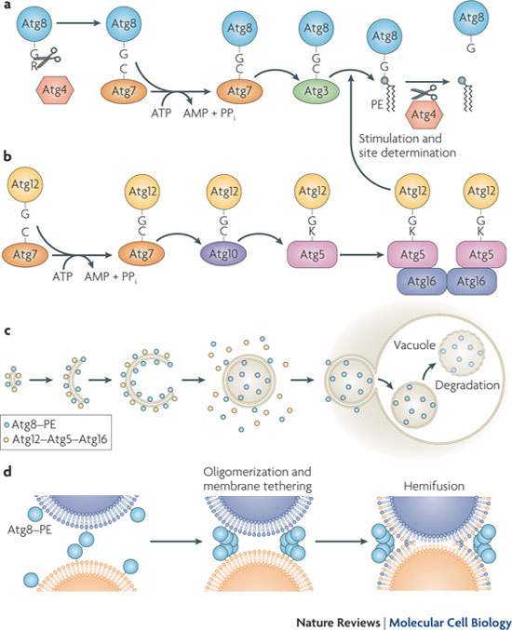
Autophagosome targeting, docking and fusion
The mechanism is not completely known at present
Atg8-PE deconjugation is necessary for the autophagosme to initiate its fusion with the vacuole
The autophagy body membrane is degraded by the lipase Atg15

Slide 18
GFP-Atg8 processing assay
The appearence of free GFP represents lysis of the membrane of the autophagy body
Atg8 is rapidly degraded
GFP is stable and accumulates in the lumen
YPD -N
GFP-Atg8
Atg8 exists in two pools: a non-lipidated form (diffuse cytosolic localization) and the PE- conjugated species.
Atg8-PE appears following autophagy induction
Atg8-PE form is membrane associated and appears primarily as a punctum at the PAS
GFP
Usha Nair et al., 2012
Bernales S et al., 2006

Slide 19
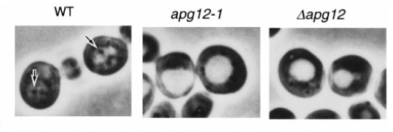
Atg12 Conjugation-system
Noboru Mizushima et al., 1998

