Slide 1
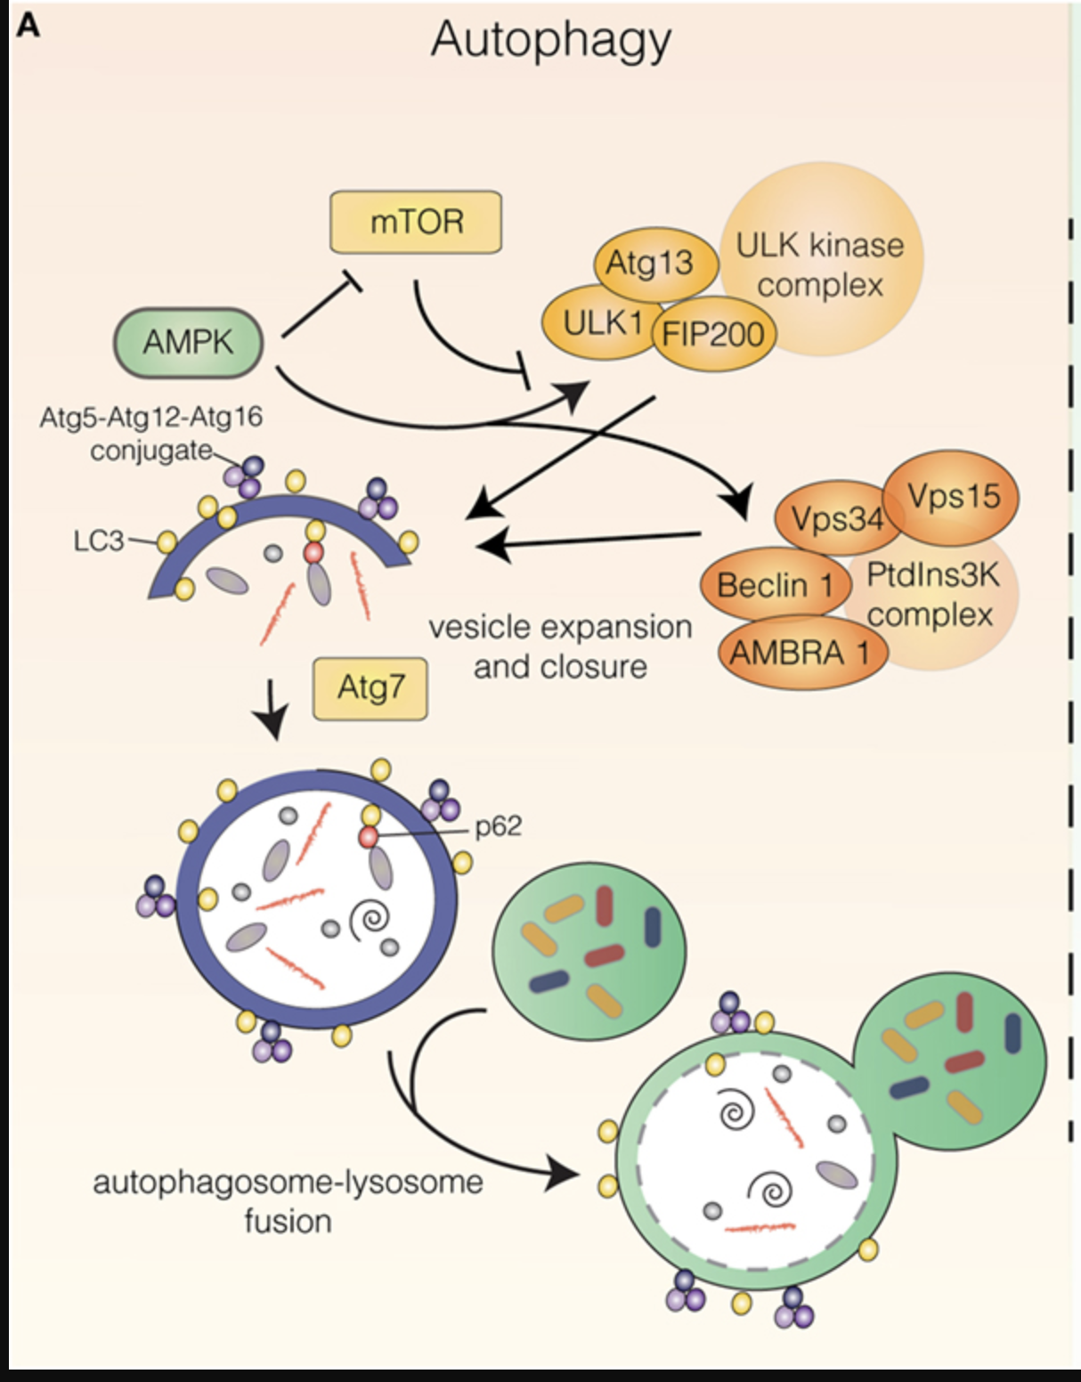
Autophagy in mammalian systems
mTORC1 is the main autophagy suppressor in mammalian cells
mTORC1 is normally active in situations of high energy levels, high amino acid cellular content, or growth factors stimulation, all of which have a negative impact in autophagic degradation
On the contrary, AMPK activation positively regulates autophagic activity, due to its pro-catabolic functions
AMPK negatively regulates mTORC1 activity, which blocks its inhibitory effect on ULK1 (ATG1) by two complementary actions:
AMPK activates TSC2 (Tuberous sclerosis complex 2) by phosphorylating Thr1227 and Ser1345 residues, thus favoring the assembly of TSC1/TSC2 heterodimer, which negatively impacts mTORC1 activity
AMPK can inhibit mTORC1 by direct phosphorylation of RAPTOR (regulatory-associated protein of mTOR) Ser722 and Ser792 residues

Slide 2
Autophagy in mammalian systems
The initiation phase of autophagy is governed by two main complexes:
the unc-51-like autophagy-activating kinase (ULK1) complex
ULK1-FIP200-ATG13
the phosphatdylinositol 3-kinase (PtdIns3K) complex
Vps34-Vps15-Beclin1-AMBRA1
Amino acid starvation leads to inactivation of mTORC1 and lower levels of phosphorylation on ULK1
mTORC1-mediated phosphorylation of ULK1 produces inhibition, in part by inducing conformational changes that prevent ULK1–AMPK interactions
AMPK increases ULK1 activity which increases the recruitment of ATG proteins to the membrane domains in which autophagosome formation takes place

Slide 3
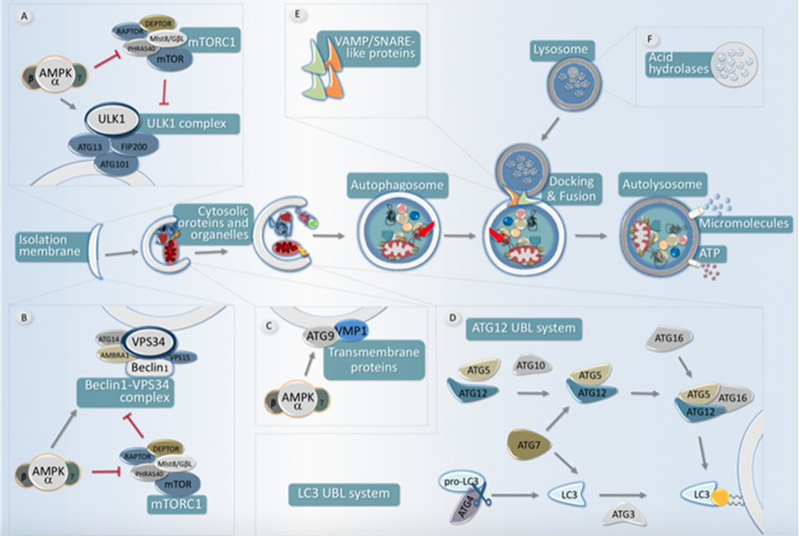
The main steps for autophagy
The ULK1-FIP200-ATG13 complex is responsible for initiating the autophagic process
The activity of this protein complex is antagonistically regulated by mTORC1 (inhibitory phosphorylation) and by AMPK, which both activates the ULK1 complex as well as inhibits the activity of the mTORC1 complex
mTORC1 phosphorylates ULK1 at S758 and ATG13 at S259 to repress autophagy
S758 (ULK1) is rapidly dephosphorylated upon amino acid starvation or mTOR inhibition
mTOR inhibits initial autophagosome synthesis via phosphorylation of ATG13 and ULK1 and inhibits the maturation stage of autophagosome synthesis via phosphorylation of ATG14 (PI3K complex ).

Slide 4
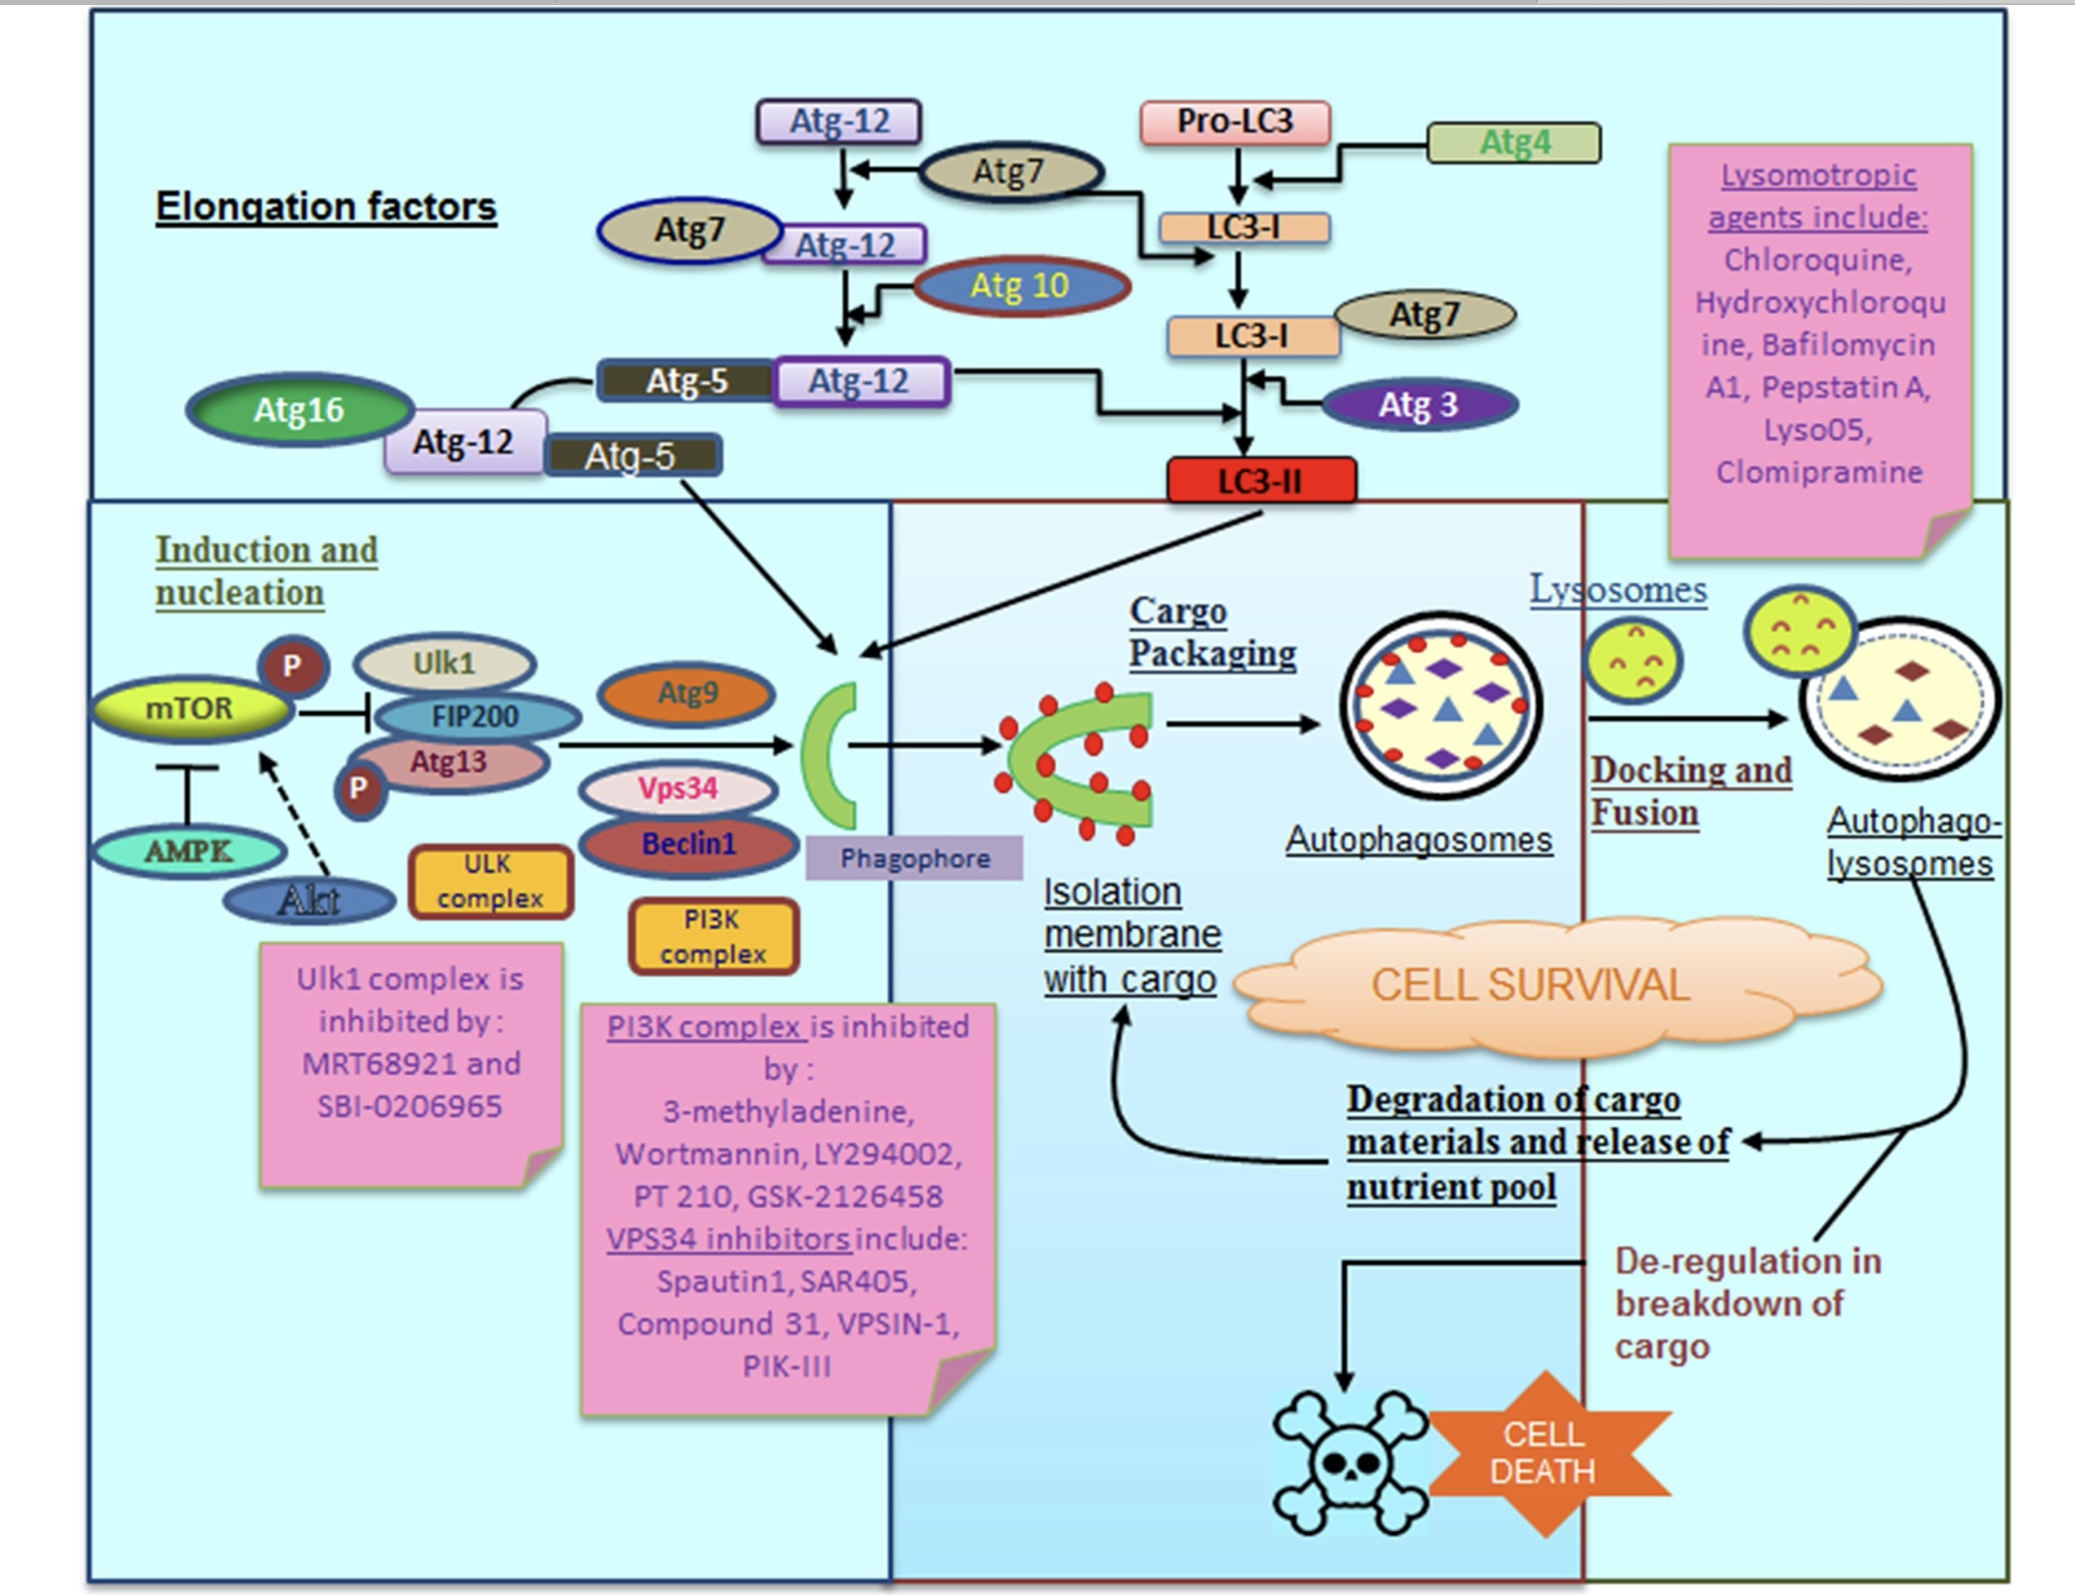

Slide 5
The main steps for autophagy
The PI3K complex formed by the lipid kinase VPS34, Beclin1, ATG14, AMBRA1, and other subunits creates a membrane domain enriched in PtsIns3P, which drives the nucleation of ATG (AuTophaGy-related) proteins in the phagophore.
The development and maturation of the autophagosome is controlled by the PI3K complex.
ULK1 phosphorylates Beclin1, increasing lipid kinase activity of ATG14-containing VPS34 complexes and directing the VPS34 complex to the developing autophagosome.
In addition, ULK1 phosphorylates ATG14 at S29 to stimulate VPS34 activity.
Opposing this, the direct phosphorylation of ATG14 by mTOR at multiple sites decreases VPS34 activity.

Slide 6
The main steps for autophagy
Two different transmembrane proteins, the vacuole membrane protein 1 (VMP1) and ATG9 participate in the recruitment of membranes to the phagophore.
AMPK is able to phosphorylate ATG9, which increases its recruitment towards autophagosome formation sites.
There are two ubiquitin-like conjugation systems that mediate vesicle expansion [the autophagy-related gene 8 (Atg8) and autophagy-related gene 12 (Atg12) systems].
Both systems require the E1-like protein autophagy-related gene 7 (Atg7) for activation of the ubiquitin-like proteins Atg8 [light chain 3 (LC3) in mammals] and Atg12.
Atg8/LC3 undergoes proteolytic processing and covalent attachment to the lipid phosphatidylethanolamine (the precursor form is termed LC3-I and the lipidated form LC3-II), by which it becomes associated with the phagophore membrane at the nascent autophagosoma.
C
ATG7: the E1-like enzyme (common to both conjugation systems)
ATG10 (ATG12 system), and ATG3 (LC3 system): the E2-like enzymes
ATG4: the cysteine proteinases (which activate LC3 by cleaving its carboxyl terminus)

Slide 7
The main steps for autophagy
Upon completion, fully-formed autophagosomes move along the microtubule network, eventually fusing with a lysosome, thus acquiring hydrolytic activity, and thus becoming autolysosomes
Once content and inner membrane are degraded by acidic hydrolases, the resultant molecules (amino acids, nucleotides, lipids, etc.) are recycled back to the cytoplasm by membrane permeases

Slide 8
AMPK Regulates Class III PI3K Complex Activity
Apart from its role in regulating ULK1 activity, AMPK is also involved in the regulation of PI3K complex, including VPS34 itself, which modifies their affinity for other components of the complex.
AMPK phosphorylation of Beclin1 increases Beclin1 binding to VPS34 and ATG14, which promotes higher autophagy activity upon glucose withdrawal.
ULK1 itself exerts its pro-autophagic activity by phosphorylating several components of this complex, including Beclin1, AMBRA1, or the catalytic subunit VPS34.
AMPK can also influence autophagic activity by specific phosphorylation of ATG9, the transmembrane protein involved in autophagosome biogenesis by supplying vesicles which contribute to autophagosome elongation. In fact, AMPK-mediated phosphorylation in Ser761 of ATG9 increases recruitment of ATG9A (and ATG9-containing vesicles) to LC3-positive autophagosomes, thus enhancing autophagosome biogenesis.

Slide 9
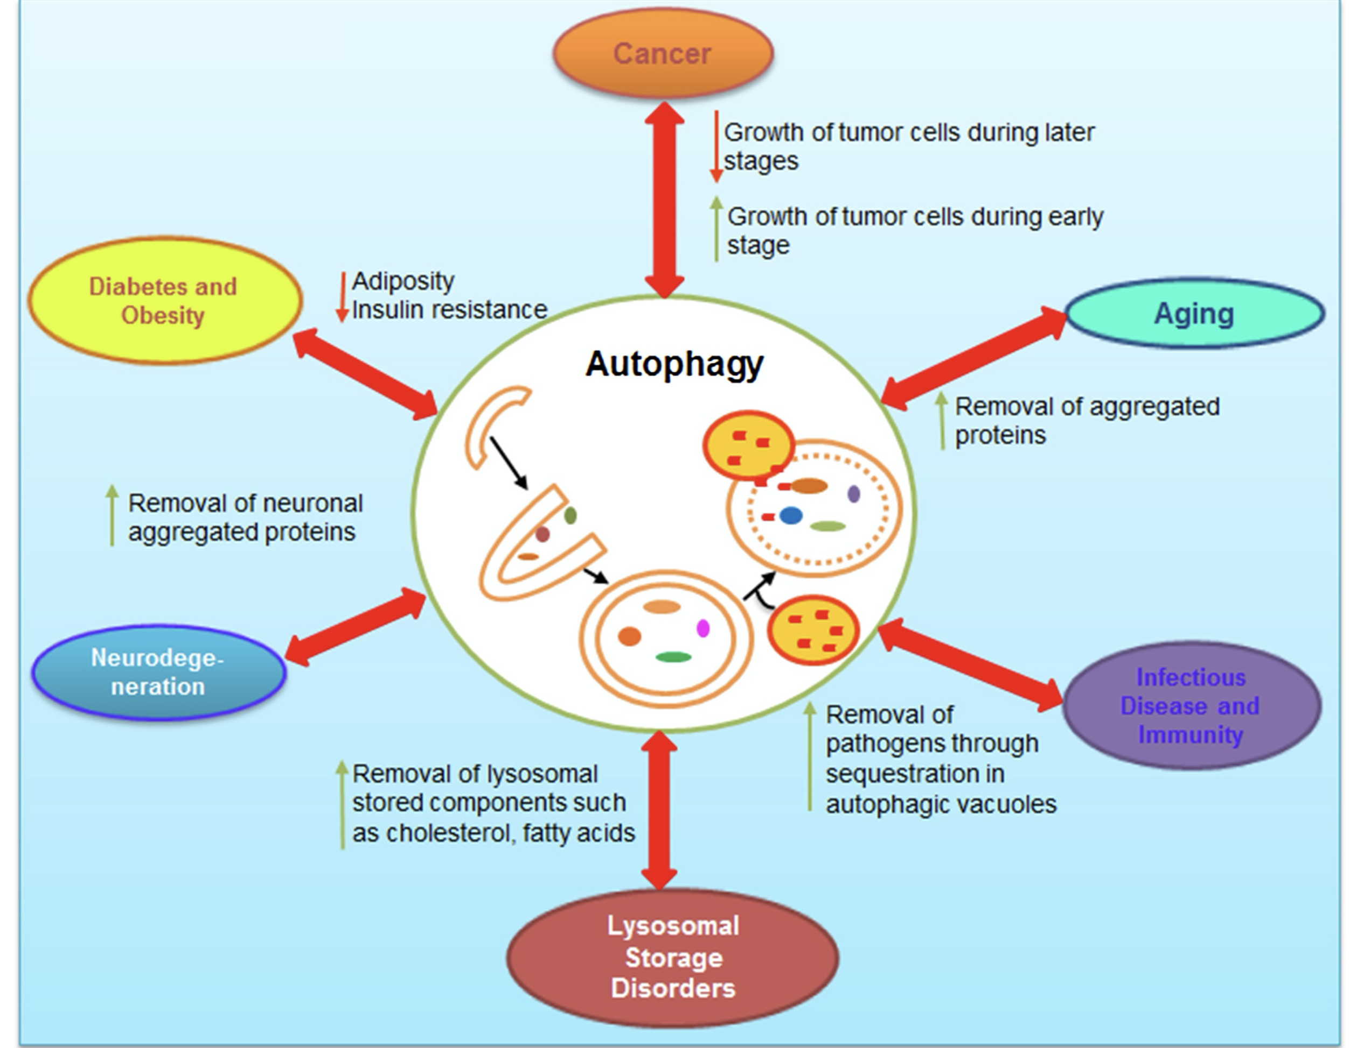
Role of autophagy in various diseases

Slide 10
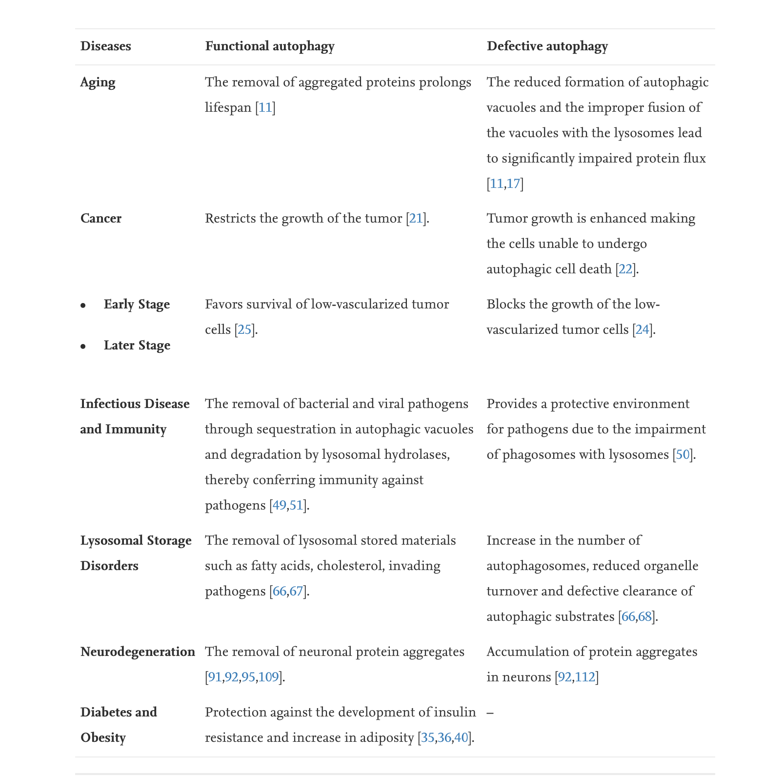
Role of autophagy in various diseases
The role of autophagy in aging is manisfested by the removal of aggregated proteins
Similarly, in neurodegenerative disorders, accumulation of neuronal proteins has been attributed to be removed by autophagy.
Equivalently, autophagy show a protective role in the removal of lysosomal stored components in lysosomal storage disorders
On the other hand, autophagy has also proved beneficial in evading various foreign pathogens, thereby contributing to the innate immunity
The role of autophagy in diabetes and obesity has been shown to decrease adiposity and insulin resistance
In the context of cancer, autophagy has shown to play a dual role where it serves as a tumor suppressor during initial stages but protects the tumor cells during the later stages

Slide 11
Complex roles of autophagy in cancer development and progression
Autophagy is an important process during cancer progression, but the exact roles of autophagy in cancer cells are strongly context-dependent.
Its cytoprotective function is believed to have tumour-suppressive potential before the onset of tumorigenesis, and loss of autophagy has been associated with increased risk of cancer
Autophagy has also been shown to allow premalignant cells to escape genotoxic stress and inflammation that promote tumorigenesis
There is good evidence, moreover, that autophagy provides cancer cells with metabolic plasticity, allowing them to thrive in suboptimal environments and to exploit the prosurvival activity of autophagy to cope with therapy-induced stresses
Many types of advanced cancers exhibit high autophagic activity, and it was proposed that certain tumours, such as pancreatic cancer is highly dependent on autophagy
In general, autophagy seems to be a double-edged sword in the context of cancer therapies, and it remains to be established whether it can be successfully targeted — inhibited or induced — for therapeutic benefit

Slide 12
Autophagy in malignant transformation and tumor progression
Healthy cells appear to be protected from malignant transformation by proficient autophagic responses. Conversely, autophagy promotes tumor progression and therapy resistance in a variety of models. Thus, the transition of a healthy cell toward a metastatic and therapy-insensitive neoplasm may involve a temporary (but not a stable) loss in autophagy competence. The mechanisms underlying the restoration of proficient autophagic responses after malignant transformation remain to be elucidated.
Galluzzi L. et al., 2015

Slide 13
Autophagy in neurodegenerative diseases
Autophagic dysfunction has been associated with a large number of neurodegenerative diseases. One of the hallmarks of many neurodegenerative diseases is the accumulation of aggregated proteins that escape the degradative process resulting in neuronal cell death
One of the basic concepts is that fully differentiated nondividing cells rely extensively on autophagy to remove waste products that accumulate over time
Neurons are particularly dependent on autophagic degradation
Alzheimer disease is one example of neurodegeneration associated with autophagy. Amyloid plaques composed of amyloid-β peptides and hyperphosphorylated MAPT/tau proteins are the most commonly known marker of the disease
A general model is that defects in autophagy, which generally declines with age, may lead to an increase in these neuropeptides, ultimately resulting in neuronal cell death
Autophagosomes have been seen to accumulate in samples from patients with Alzheimer disease, which suggests a block in the degradative system
Conversely, it has been proposed that in diseased cells the mammalian autophagosome may actually contribute to the generation of disease-causing peptides, implicating autophagy as playing a more active role in disease onset

