Slide 1
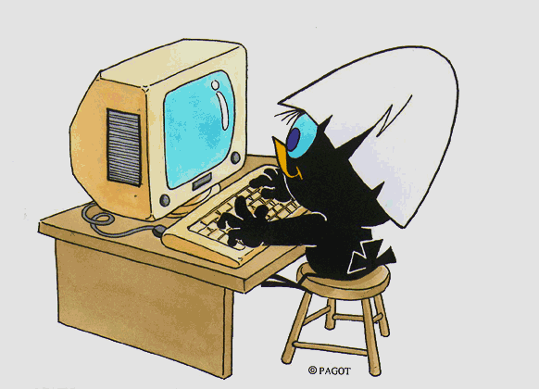
THE STUDY PLAN
MASTER'S DEGREE PROGRAM IN
MATERIALS SCIENCE AND NANOTECHNOLOGY
Writing Guide

Slide 2
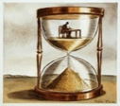
What is a study plan?
A study plan is a set of compulsory educational activities, activities provided as optional and free-choice activities chosen independently by the student in accordance with the Teaching Regulations of the Program.
When is it compiled?
When enrolling, you are automatically assigned a study plan called statutory plan, which includes all compulsory educational activities. Subsequently, during the periods established by the University, usually November and March, you will be required to submit a study plan indicating your optional and free-choice activities in line with the number of credits to be acquired as well as any constraints and prerequisites set out by the Teaching Regulations of your Program. A detailed and annually updated calendar is available online at https://www.unimib.it/servizi/segreterie-studenti/piani-degli-studi/area-scienze in the "AVVISO PRESENTAZIONE PIANI DI STUDIO" document (STUDY PLAN SUBMISSION NOTICE).

Slide 3
How is it submitted?
The plan must be submitted electronically through the Online Student Registry at https://s3w.si.unimib.it/Home.do After submission, you must confirm the plan by clicking on the CONFERMA button. Plans left in draft form (bozza) are not reviewed. You may complete it online as long as you are currently enrolled.
Students not currently enrolled must submit a paper form to the Careers Office, at the following address:
segr.studenti.scienze@unimib.it.

Slide 4
Can I change my chosen plan?
You may change the plan, but only during set periods, usually in November and March.
Until the new study plan is implemented, you are obliged to follow the previous plan and cannot register for exams in classes you have requested to join.
You can take exam assessments for an educational activity only if it is in your most recent approved study plan. Passed examinations cannot be removed from the plan.
Sitting exams (Art.26 of the Student Regulations)
Students may register for exams, for activities included in their approved plan which refer to the year following the year of enrolment, only if the classes have commenced and if they have acquired at least 75% of the credits of the year of enrolment, complying with any prerequisites.
Free-choice examinations may be held in advance, regardless of the number of credits acquired (see slide n. 21).

Slide 5
Approval of the study plan
The study plan yet to be approved (da approvare), laid down for your Program, allows to select free-choice educational activities from the teaching offer provided by your Program of study and other Programs of the University.
Once confirmed, the study plan is considered as «proposed» and it must be approved by the Program’s Didactic Coordination Committee. The approval process will take place after the expiration of the submission deadline, then your academic career will be updated according to the approved study plan.
It is possible to change the study plan once completed (Click “Undo Study plan”). By returning on the main page it is possible to submit a new study plan within the time allowed.

Slide 6
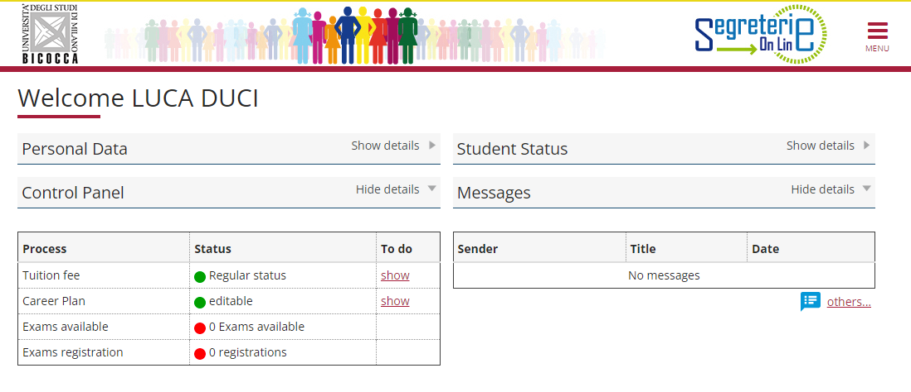
How do you fill it out?
To access it, log in at https://s3w.si.unimib.it/Home.do
This page shows the career(s) associated with your name. Select the active one to start.
The study plan can be modified until the deadline expires: click on «SHOW» (fig.1).
Fig. 1

Slide 7
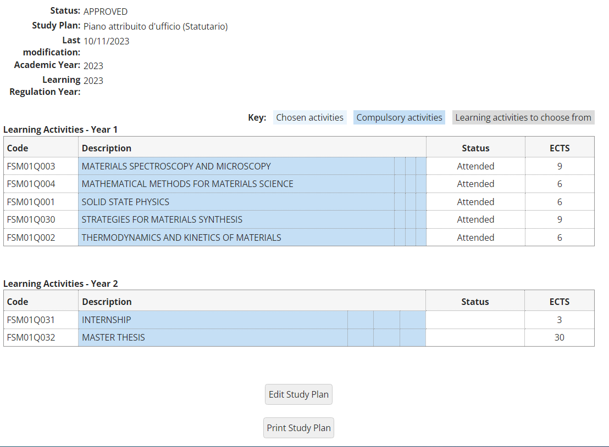
This screen shows the so-called statutory study plan (fig. 2) which includes compulsory activities and classes under the Teaching Regulations of the Program. Click «Edit Study Plan" to continue.
Fig.2
Fig. 2

Slide 8
Click «Continue with your Stady Plan" to proceed (fig. 3).
Fig. 3

Slide 9
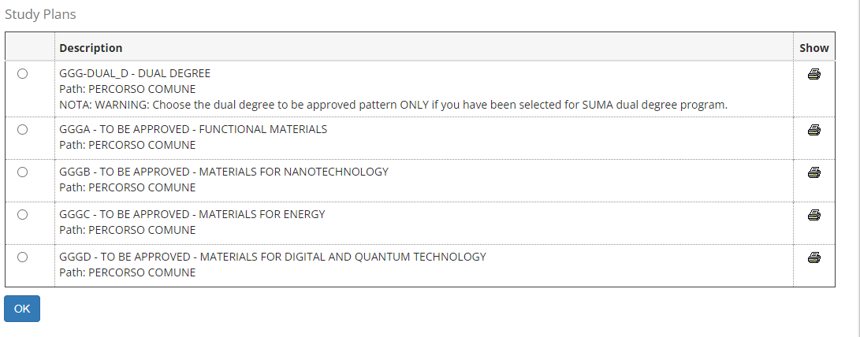
You need to choose one of the four major track (FUNCTIONAL MATERIALS - MATERIALS FOR NANOTECHNOLOGY - MATERIALS FOR ENERGY - MATERIALS FOR DIGITAL & QUANTUM TECHNOLOGY) or the DUAL DEGREE pattern (Fig 4). You are allowed to choose the dual degree to be approved pattern ONLY if you have been selected for SUMA dual degree program. We will consider, in this guide, only the FUNCTIONAL MATERIALS track and the DUAL DEGREE pattern to illustrate the compilation of the study plan.
Fig.4

Slide 10
MSc COURSE IN MATERIALS SCIENCE & NANOTECHNOLOGY 2023-2024
TRACK B
MATERIALS FOR NANOTECHNOLOGY
TRACK A
FUNCTIONAL MATERIALS
2 Elective compulsory courses (12 CFU)
MATERIALS area
COMMON FUNDAMENTAL COURSES
2 Elective compulsory courses (12 CFU)
MATERIALS area
1 Elective compulsory course (6 CFU)
NANOSYSTEMS area
1 Elective compulsory course (6 CFU)
APPLICATIONS area
1 Elective compulsory course (6 CFU)
APPLICATIONS area
Semester I
Semester II
1 Elective compulsory course (6 CFU)
MATERIALS ENGINEERING area
3 Free Elective courses (18 CFU)
SOLID STATE
PHYSICS
ALL COURSES, ANY AREAS
1 Conditional Elective Course (6 CFU) Physics & Chemistry of Matter
MATERIALS SPECTROSCOPY AND MICROSCOPY
3 Free Elective courses (18 CFU)
ALL COURSES, ANY AREAS
TRACK D
MATERIALS FOR DIGITAL & QUANTUM TECH.
THERMODYNAMICS AND KINETICS OF MATERIALS
TRACK C
MATERIALS FOR ENERGY
2 Elective compulsory courses (12 CFU)
MATERIALS area
STRATEGIES FOR MATERIALS SYNTHESIS
1 Elective compulsory courses (6 CFU)
1 Elective compulsory course (6 CFU)
THEORY & MODELS area
MATERIALS area
MATH. METHODS FOR MATER. SCIENCE
4 Compulsory course (24 CFU)
ENERGY area
1 Elective compulsory course (6 CFU)
QUANTUM SYSTEMS area
3 Free Elective courses (18 CFU)
1 Elective compulsory course (6 CFU)
MATERIALS ENGINEERING area
ALL COURSES, ANY AREAS
3 Free Elective courses (18 CFU)
ALL COURSES, ANY AREAS
Communication skills (3 CFU) + Internship (3 CFU) + MSc THESIS (30 CFU)
FINAL DEFENSE

Slide 11
TRACK A
ELECTIVE COURSES
MATERIALS area
TRACK B
ELECTIVE COURSES
MATERIALS area
TRACK C
ELECTIVE COURSES
MATERIALS area
TRACK D
ELECTIVE COURSES
.
MATERIALS area
CHEMISTRY OF INORGANIC MATERIALS
CHEMISTRY OF MOLECULAR MATERIALS
PHYSICAL CHEMISTRY OF SOLIDS
PHYSICS OF SEMICONDUCTORS
METALS SCIENCE AND SUSTAINABILITY
CHEMISTRY OF INORGANIC MATERIALS
CHEMISTRY OF MOLECULAR MATERIALS
PHYSICAL CHEMISTRY OF SOLIDS
PHYSICS OF SEMICONDUCTORS
METALS SCIENCE AND SUSTAINABILITY
CHEMISTRY OF INORGANIC MATERIALS
CHEMISTRY OF MOLECULAR MATERIALS
PHYSICAL CHEMISTRY OF SOLIDS
PHYSICS OF SEMICONDUCTORS
METALS SCIENCE AND SUSTAINABILITY
PHYSICAL CHEMISTRY OF SOLIDS
PHYSICS OF SEMICONDUCTORS
MATERIALS ENGINEERING area
APPLICATIONS area
APPLICATIONS area
ENERGY area
PHYSICS AND TECHNOLOGY OF ELECTRONIC DEVICES
QUANTUM ELECTRONICS
CHEMISTRY & TECHNOLOGY OF POLYMERS & INDUSTRIAL APPLICATIONS
APPLICATIONS OF MATERIALS FOR IONIZING RADIATION DETECTION
LOW ENVIRONMENTAL IMPACT MATERIALS AND PROCESSES
MOLECULAR ELECTRONICS AND PHOTONICS
CHEMISTRY & TECHNOLOGY OF POLYMERS & INDUSTRIAL APPLICATIONS
APPLICATIONS OF MATERIALS FOR IONIZING RADIATION DETECTION
LOW ENVIRONMENTAL IMPACT MATERIALS AND PROCESSES
MOLECULAR ELECTRONICS AND PHOTONICS
FUNDAMENTALS OF ELECTROCHEMISTRY FOR ENERGY STORAGE
CATALYSIS FOR ENERGY AND THE ENVIRONMENT
MODELS AND MATERIALS FOR ELECTROCHEMICAL ENERGY GENERATION AND CONVERSION
ENERGETICS
PHOTOVOLTAICS & OTHER RENEWABLE ENERGY TECHNOLOGIES
THEORY & MODELS area
ADVANCED SOLID STATE PHYSICS
COMPUTATIONAL MATERIALS SCIENCE
QUANTUM SYSTEMS area
MATERIALS ENGINEERING area
NANOSYSTEMS area
QUANTUM MATERIALS SYNTHESIS
QUANTUM PHOTONICS
ADVANCED FUNCTIONAL POLYMERS
ENGINEERED NANOMATERIALS
NANOTECHNOLOGY & INNOVATION
NANOCHEMISTRY AND NANOPOROUS MATERIALS
PHYSICS OF SOFT MATTER NANOSTRUCTURES
ENGINEERED NANOMATERIALS

Slide 12
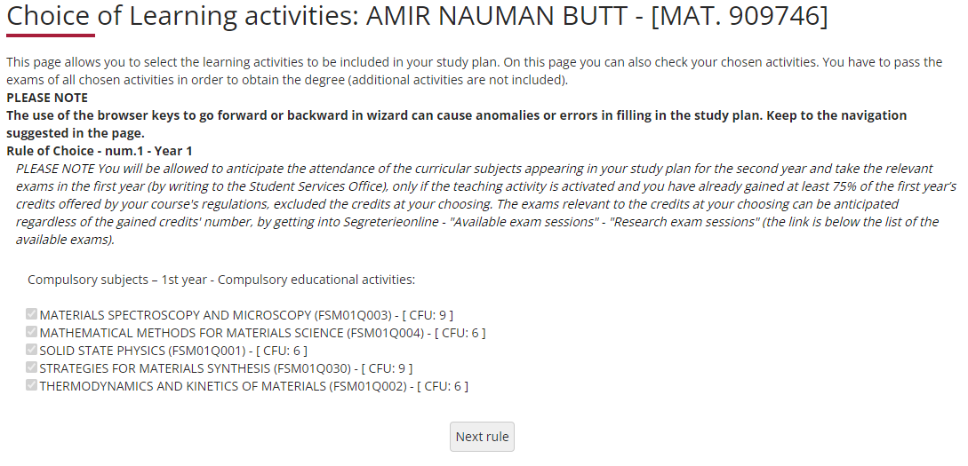
FUNCTIONAL MATERIALS TRACK The following rule lists and ticks compulsory first-year classes and their credits (fig. 5). Click «Next rule» to continue submitting the plan.
Fig. 5

Slide 13
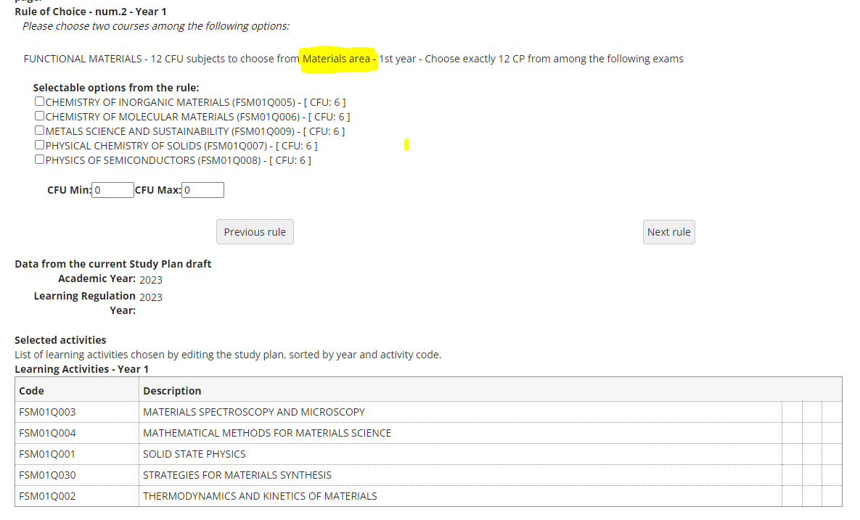
FUNCTIONAL MATERIALS TRACK In this section, you must select two 6-credit first-year subject from Materials area (fig. 6). After choosing, click "Next rule" to continue. PLEASE NOTE: you can view, in addition to the compulsory teaching activities, all the teachings selected so far at the bottom of the webpage. (fig.6)
Fig. 6

Slide 14
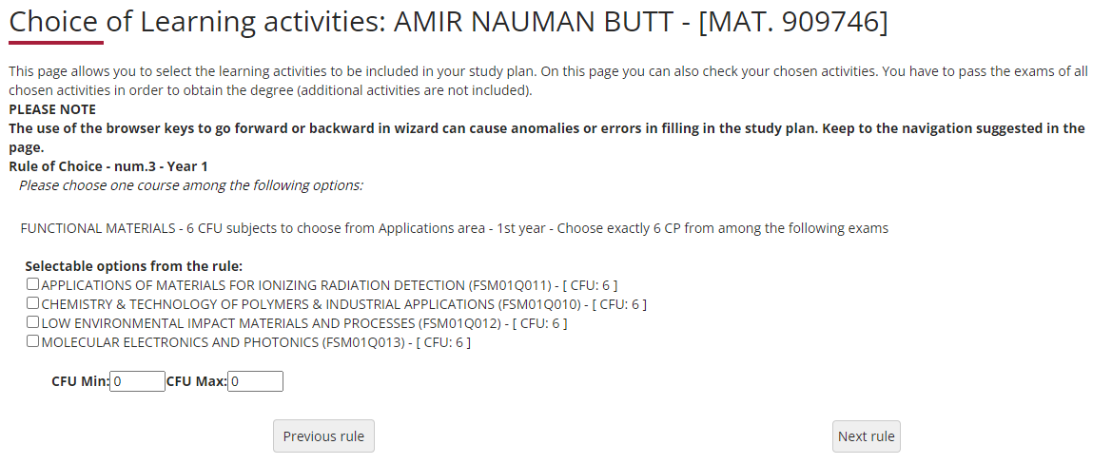
FUNCTIONAL MATERIALS TRACK Select one 6-credit first-year subject from Applications area (fig. 7) in this rule. After choosing, click "Next rule" to continue.
Fig. 7

Slide 15
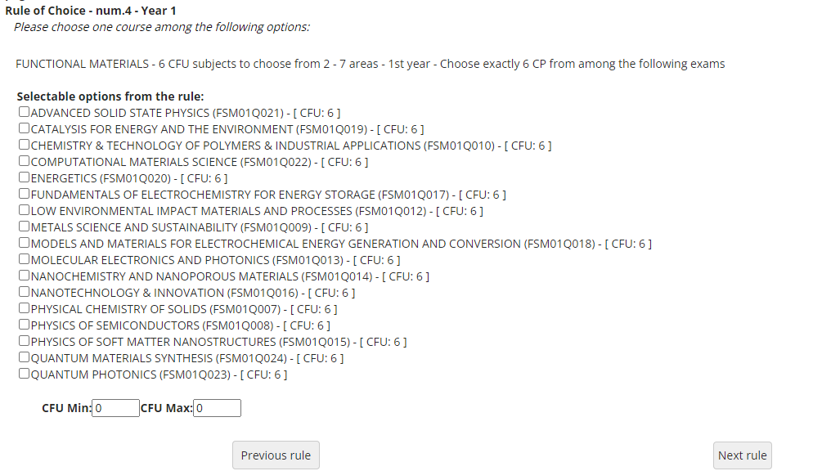
FUNCTIONAL MATERIALS TRACK Select one 6-credit first-year subject from 2-7 areas (fig. 8) in this rule. After choosing, click "Next rule" to continue.
Fig. 8

Slide 16
In the following Rule the compulsory second-year teachings are listed (fig. 9). Click on “Next rule” to continue.
Fig. 9

Slide 17
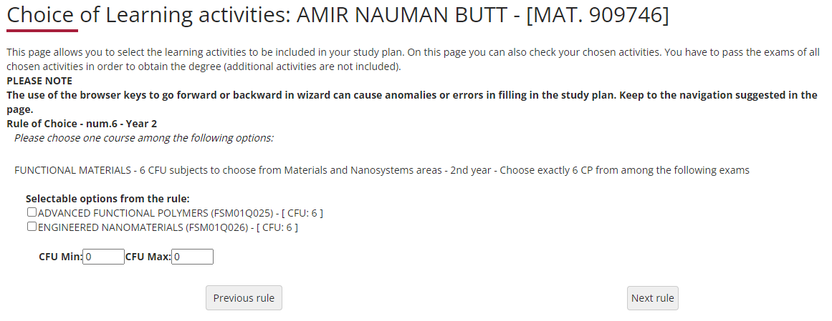
FUNCTIONAL MATERIALS TRACK Select one 6-credit second-year subject from Materials and Nanosystems areas (fig. 10) in this rule. After choosing, click "Next rule" to continue.
Fig. 10

Slide 18
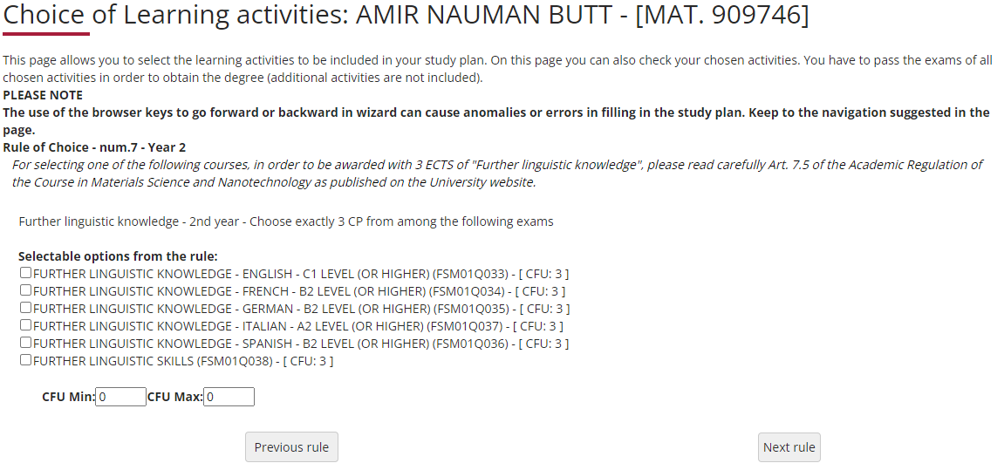
In the following Rule (fig. 11) select an educational activity (3 CFUs) related to «Further Linguistic Knowledge», according to the Teaching Regulations of the Program (see the next slide). Click on “Next rule.” to continue.
Fig. 11

Slide 19
Further Linguistic Knowledge
Further Linguistic knowledge (3 CFUs) is acquired according to the procedures set out below:
Italian Students:
passing a B2 level University foreign language assessment, either in FRENCH, SPANISH or GERMAN;
alternatively, passing a C1 level University language assessment in ENGLISH.
In both cases students who already hold certificates issued by Bodies accredited by the University (attesting language skills at a level equal to or higher than B2 for French, Spanish or German, or equal to or higher than C1 for English) will be exempt from the assessment and awarded the required credits.
attending one or more of the University's cross-discipline activities recognised by the CCD for a total of at least 3 credits, aiming to acquire additional skills (Writing of scientific papers, Communicating research in the era of social media, Basic principles of public relations and media relations for academics, Public speaking and effective communication)
Foreign Students:
- passing a A2 level University language assessment in ITALIAN.
Students who already hold a certificate issued by a Body accredited by the University attesting their language skills, with a level equal to or higher than A2, will be exempt from the test and awarded the required credits.
Information on how to take these tests is set by the University and available on the University's website at: https://www.unimib.it/didattica/opportunita/lingue-unimib

Slide 20
FREE-CHOICE TEACHING ACTIVITIES
You may achieve the free-choice credits (18 CFUs) by choosing from the following options:
teaching activities of the Program offered in your Track and other Tracks (those NOT previously selected in the curricular rules);
Teaching activities of other Master's degree programs at our University.
exams passed during the ERASMUS program*.
PLEASE NOTE: if you select free-choice courses with a sum of 18 credits, you cannot gain further credits. However, if you select exams with credits exceeding 18, for instance two 6-credit exams and an 8-credit one, you may "exceed" the 18-credit limit, up to a maximum of 22 credits.
* For detailed information on the ERASMUS program, participation conditions and deadlines, please visit the following UNIMIB page: https://www.unimib.it/internazionalizzazione/erasmus-studio

Slide 21
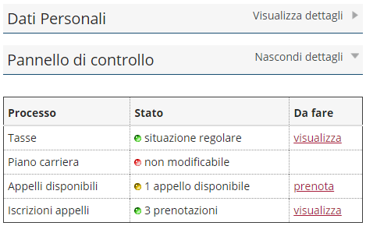
These images illustrate the procedure for booking exams for free-choice activities to be held in advance, regardless of the number of credits acquired .
To begin registering for the exam:
Click on the Prenota (Book) option in the Appelli Disponibili (Exams Available) section shown on your Online Student Registry homepage.
On the next screen listing available exams, select ricerca appelli (search for exams).
Select a free-choice activity
Proceed to registering for the exam.

Slide 22
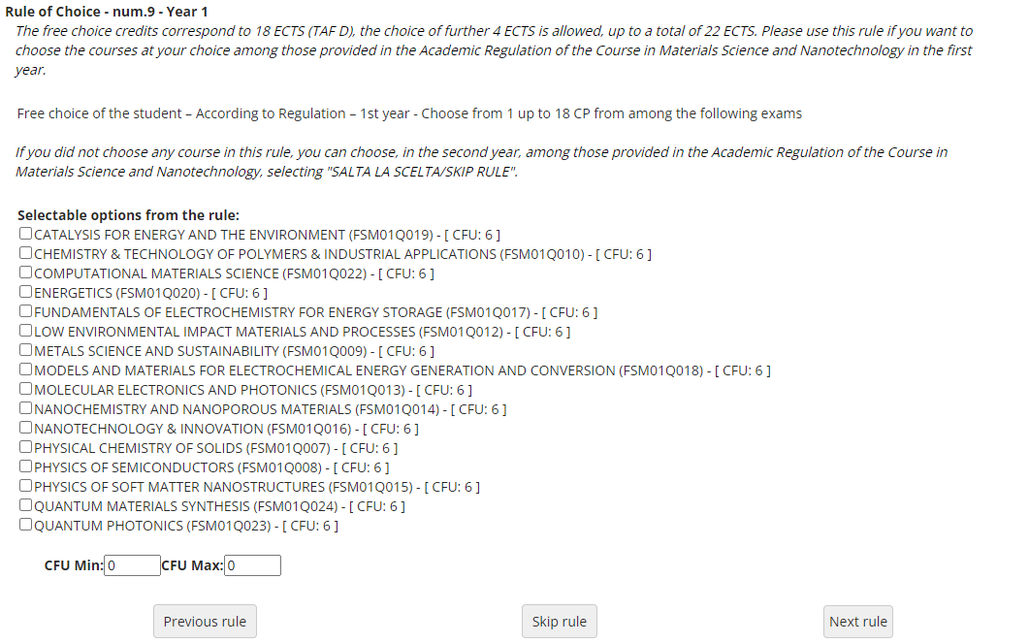
In this section (fig. 12), the optional classes offered by your Course Regulations in the first year which were not previously selected are listed and offered again as free-choice credits. You can find here courses of your trakc and other trakcs. If you are using this section, click «Next rule» to continue. If you do not wish to select any activities, click «Skip rule» to continue.
Fig.12

Slide 23
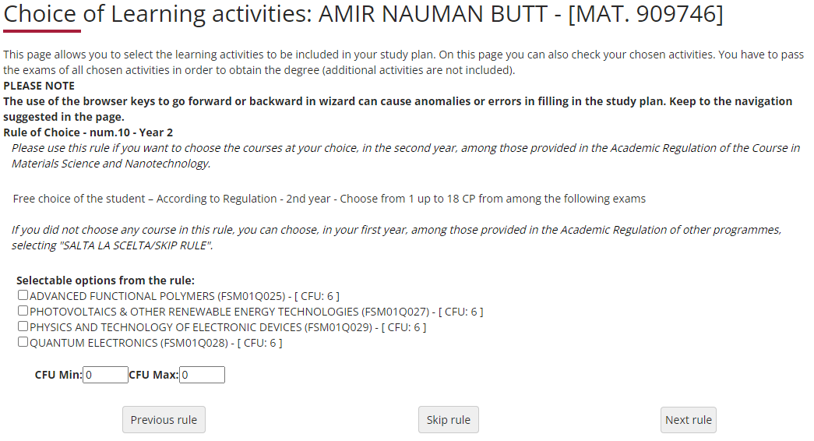
In following rule (fig. 13), the optional courses offered in the second year which were not previously selected are listed and offered again as free-choice credits. You can find here courses of your trakc and other trakcs. If you are using this section, click «Next rule» to continue. If you do not wish to select any activities, click «Skip rule» to continue.
Fig.13

Slide 24
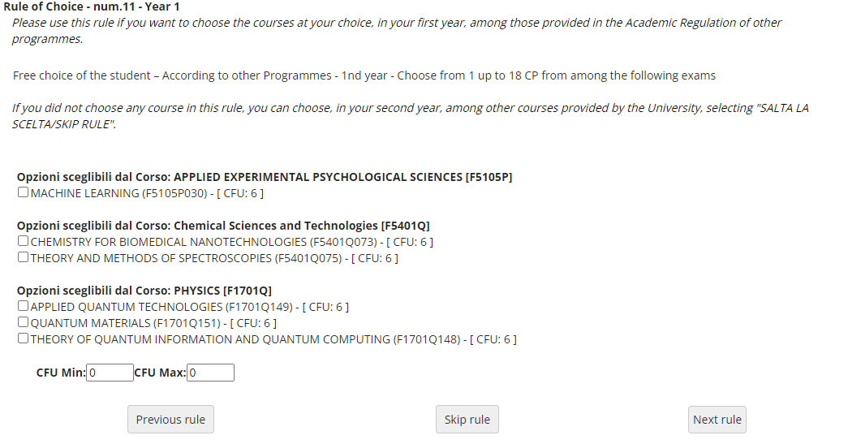
In following rule (fig. 14), the ) you may add, in the first year, free-choice courses selected among the three University Programs listed below. f you are using this section, click «Next rule» to continue. If you do not wish to select any activities, click «Skip rule» to continue.
Fig.14

Slide 25
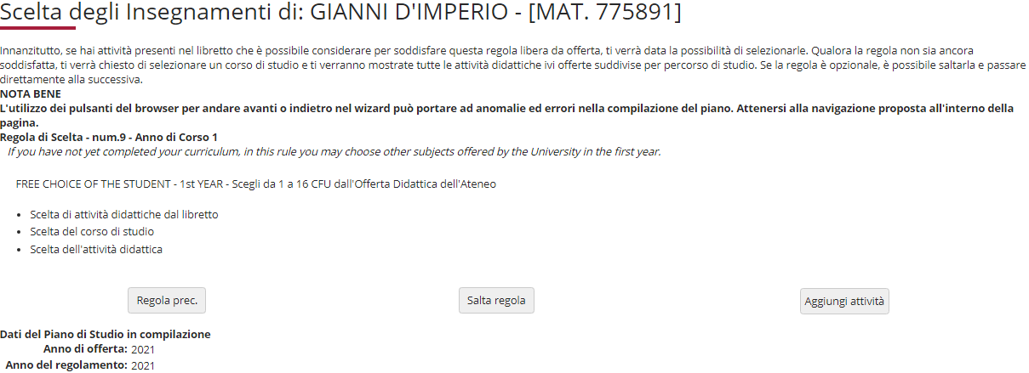
Using this section and the next one you can select free-choice credits by choosing from classes offered by other Programs at our University, in the first and/or second year. Click "Aggiungi attività" (Add activity - fig. 15) to access the list of University's Master’s degree classes (fig. 16) and the classes available in your first year (fig. 17). Click "Salta regola" if you prefer to choose from the classes offered in your second year.
Fig. 15

Slide 26
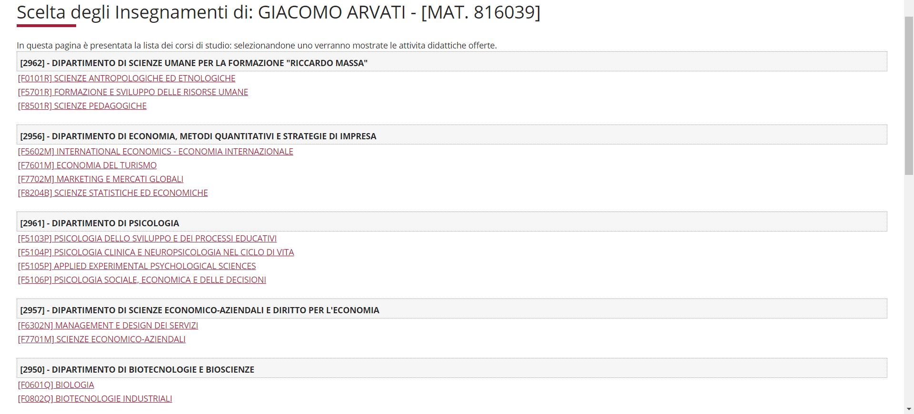
In the following webpage select the Program you are interested in.
MARIO ROSSI
Fig. 16

Slide 27
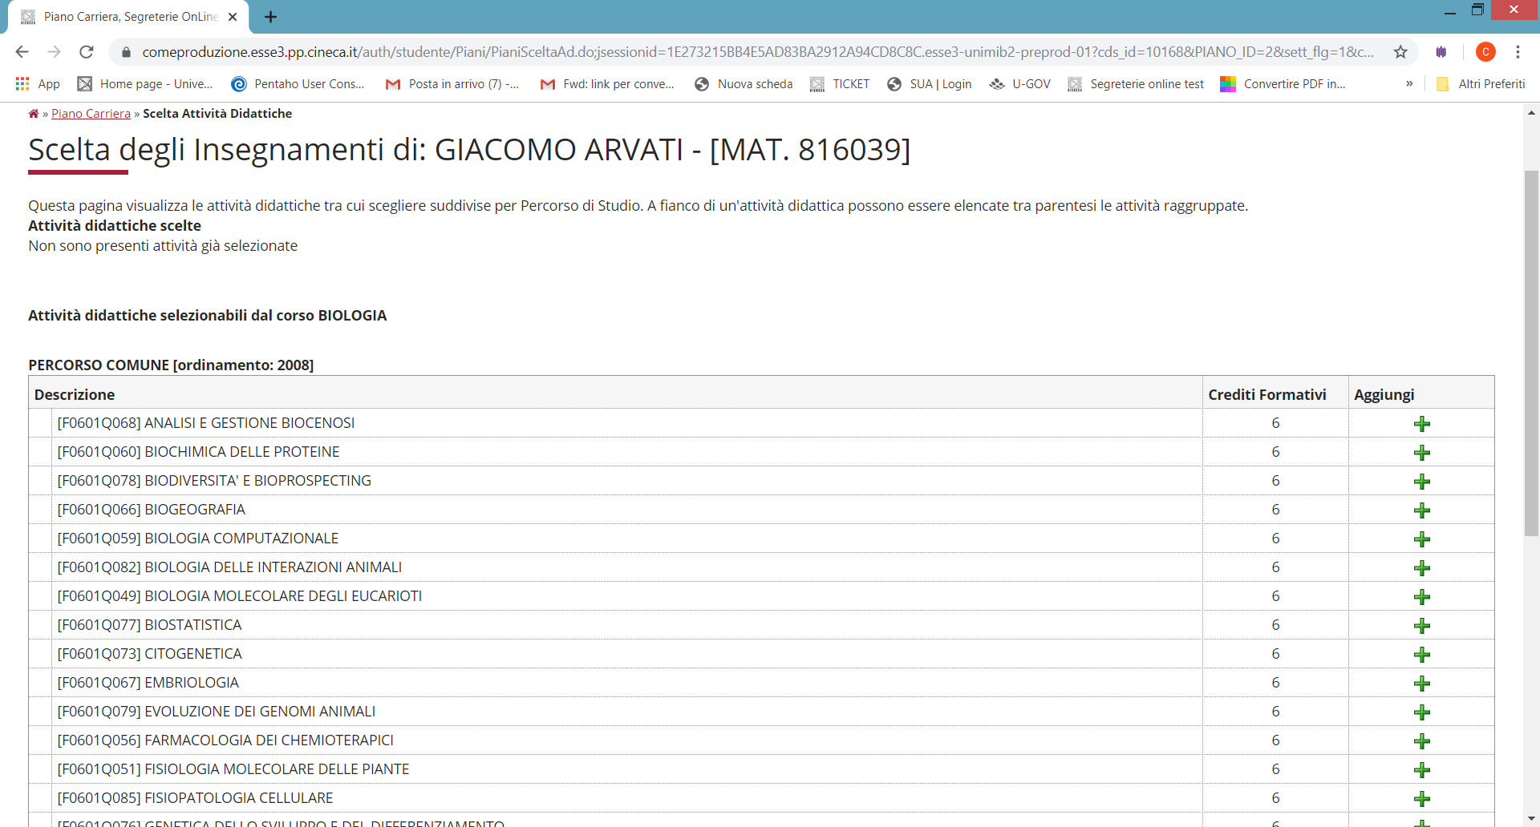
After selecting the Class you are interested in, click on the + (Aggiungi) symbol to add the activity (fig. 17) to your first year. .
MARIO ROSSI
MARIO ROSSI
Fig. 17

Slide 28
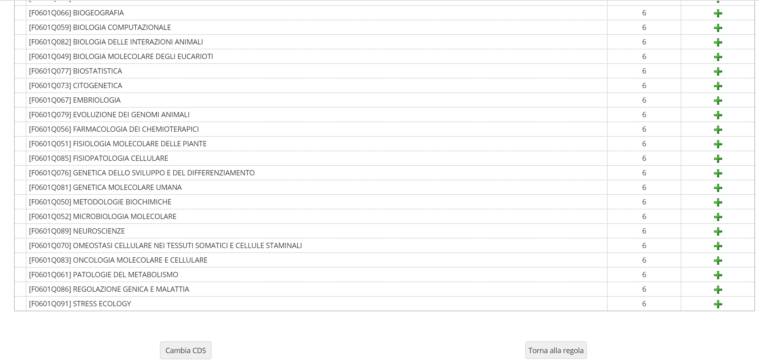
If you do not wish to add any activities, click "Torna alla regola" to return to the previous page. If you would like to review the list of Master's degree classes to choose from (fig. 18), click "Cambia CDS".
Fig. 18

Slide 29
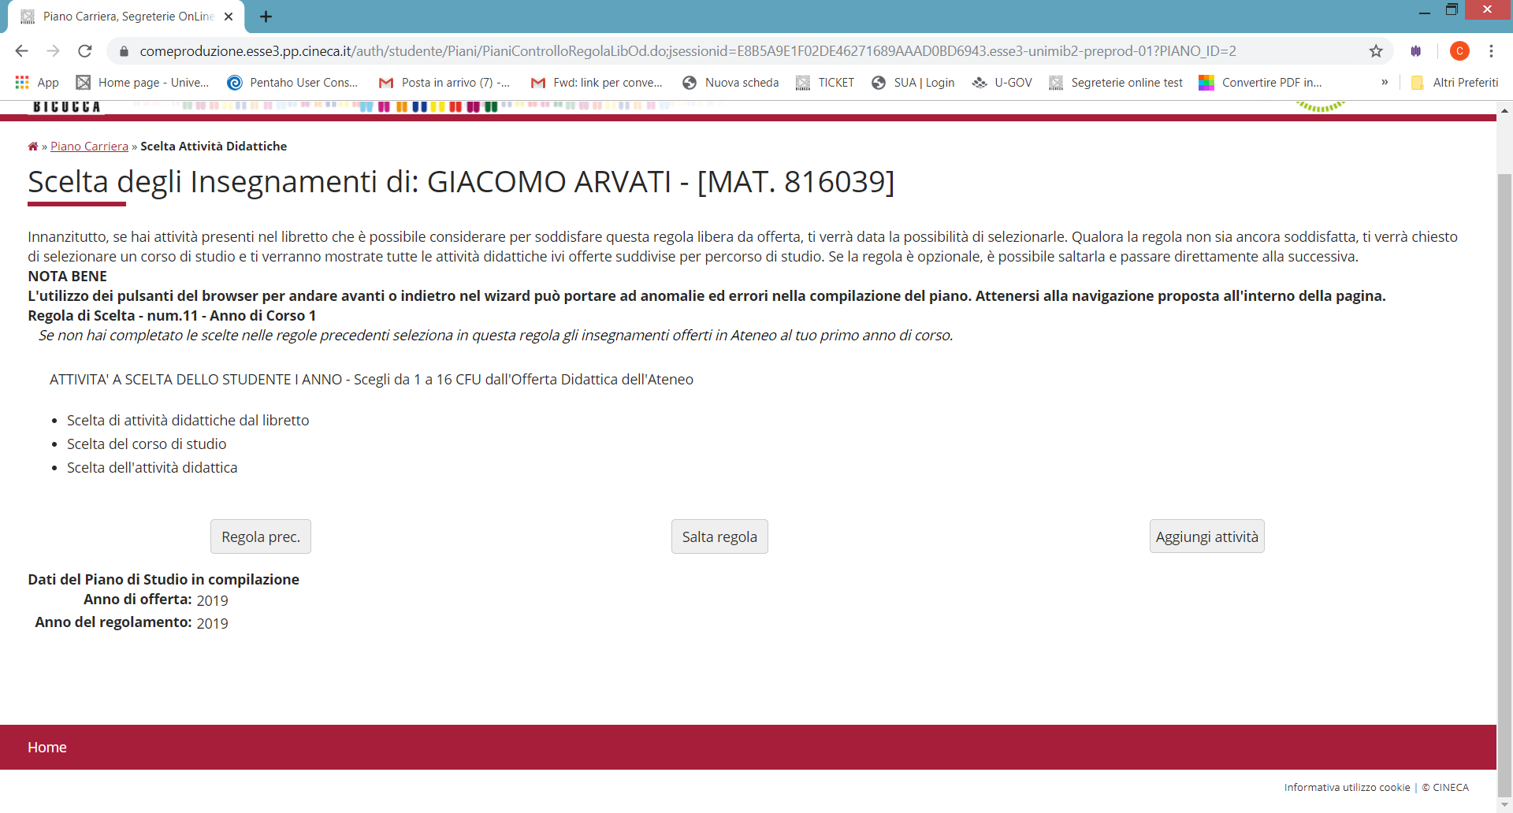
If you do not wish to choose first-year classes and would like to see the classes offered by other Programs at our University in your second year, click "Salta regola" (fig. 19).
MARIO ROSSI
Fig. 19

Slide 30
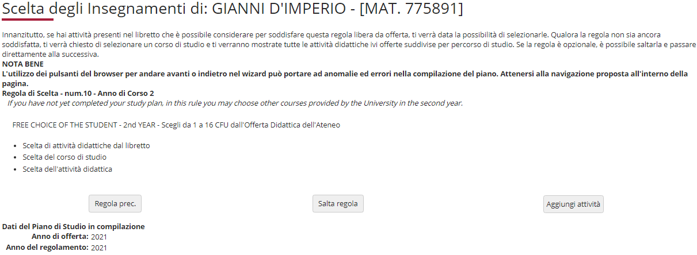
In this section (fig. 20), if you click on "Aggiungi attività", you will see a list of Master’s degree classes; once you have selected a Class, by clicking on + Aggiungi, you may add a free-choice class to your second year. If you have completed all your choices using the previous sections, click "Salta regola" to continue.
MARIO ROSSI
Fig. 20

Slide 31
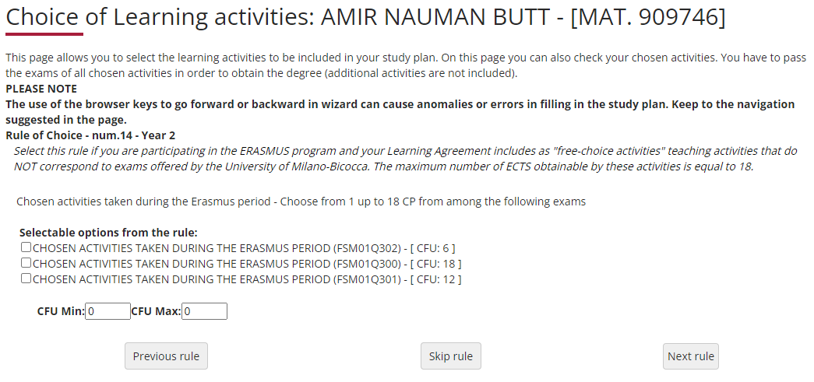
Use this section (fig. 21) if you are participating in the ERASMUS program and if your Learning Agreement includes free-choice activities that do NOT correspond to exams offered by our University. You may choose up to 18 CFUs. If you are using this section, click «Next rule" to continue. If you do not wish to select any activities, click «Skip rule" to continue.
Fig. 21

Slide 32
Extra Credits
Master's degree students may include extra activities in their study plan for up to a maximum of 16 CFUs.
It is possible to select extra activities choosing either courses from your own degree programme or courses offered by other programmes at our University.
Credits and marks obtained through extra activities are not counted in your exam grade point average, but they are recorded in your career.
PLEASE NOTE: You can not include extra courses in the dual degree pattern

Slide 33
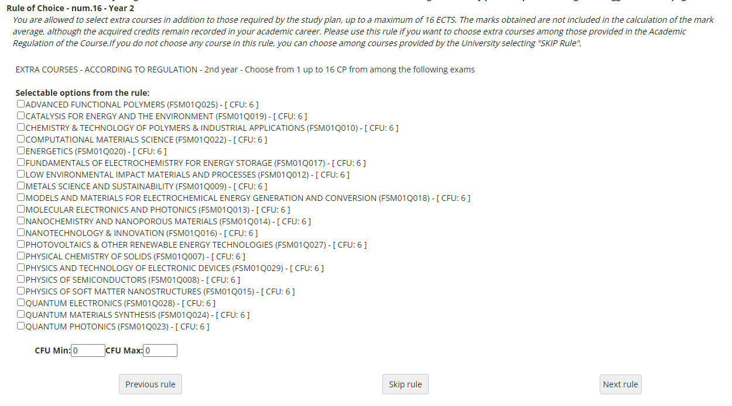
Find in this section all the subjects of your Master degree programme you may add to your study plan as extra credits (fig. 22). You may choose up to 16 CFUs. If you are using this section, click «Next rule» to continue. If you do not wish to select any activities, click «Skip rule" to continue.
Fig. 22

Slide 34
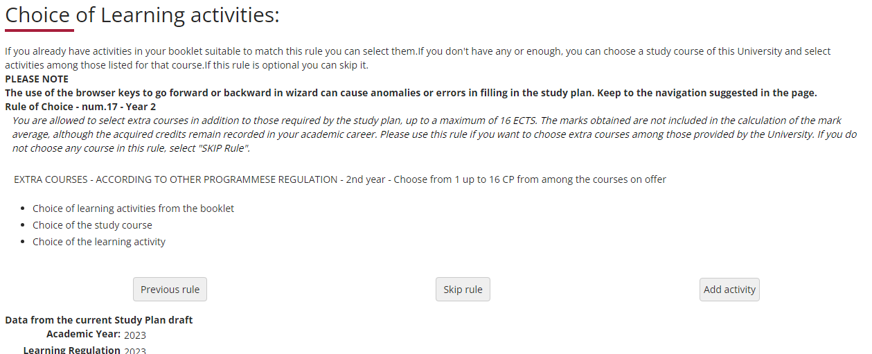
In this last section (Fig. 23) you may add to your study plan extra courses offered by other Master degree programmes of our University.
You may choose up to 16 CFUs. See slides n. 25-28 to proceed.
If you do not wish to select any activities, click “Skip rule” to confirm your plan
Fig. 23

Slide 35
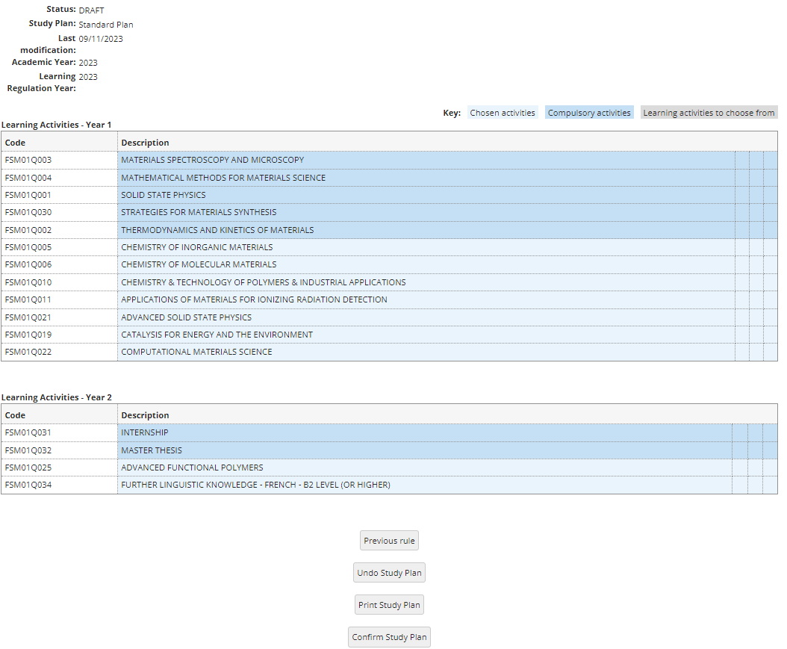
Once you have finished making your choices, click «Confirm Study Plan" (fig. 24) to confirm and register your plan. PLEASE NOTE: Plans left in draft form are not considered.
Fig. 24

Slide 36
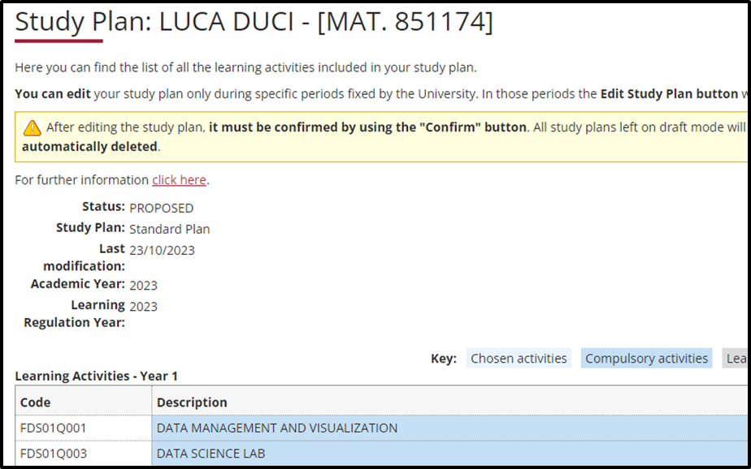
Your plan will be registered in the system and will appear as PROPOSED (fig. 25). You may still modify your selected classes throughout the entire plan submission period..
Fig. 25

Slide 37
Double Degrees and Study Plans
The Master's Degree course in Materials Science is part of a European Union network project of double master's degrees called "SUMA - Master Programmes on sustainable materials", which aims to train a generation with an advanced scientific background and awareness on sustainable technological development. There are 7 partners participating in this graduate training network:
- University of Milano-Bicocca (Italy)
- KU Leuven (Belgium)
- Montanuniversität Leoben (Austria)
- University of Trento (Italy)
- Grenoble INP (France)
- AGH University of Science and Technology (Poland)
- Universidad Politecnica de Madrid, UPM (Spain)
These universities offer different double degree pathways, 2 of which involve the Master's Degree Course in Materials Science at the University of Milano-Bicocca. These two pathways are:
• UNIMIB – KU Leuven
• KU Leuven – UNIMIB
By studying for a full year in one of the partner Countries and doing the second year and thesis in a different country, students may obtain a double degree.
Students participating in one of these pathways must choose a DUAL DEGREE pattern study plan.

Slide 38
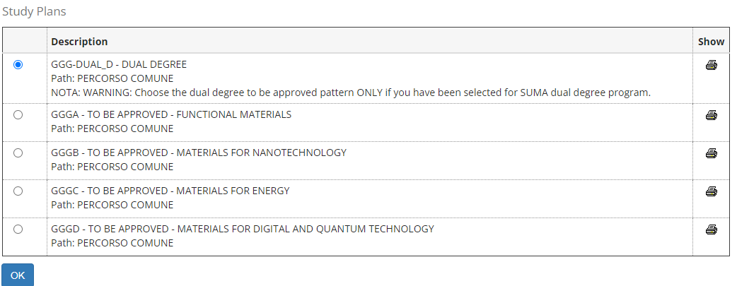
If you have been selected for SUMA dual degree program choose the dual degree to be approved pattern (Fig.26)
Fig.26

Slide 39
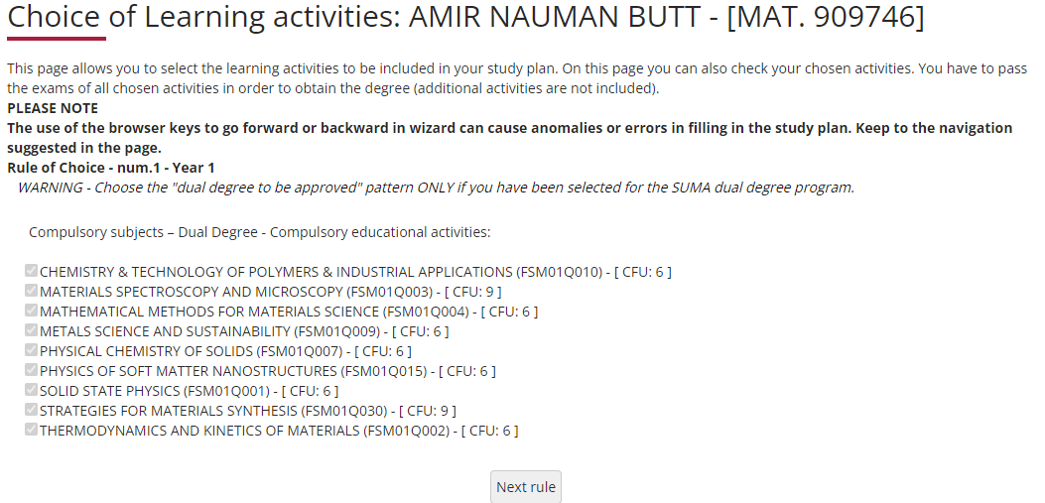
DUAL DEGREE The following rule lists and ticks compulsory first-year classes and their credits (fig. 27). Click «Next rule» to continue submitting the plan.
Fig. 27

Slide 40
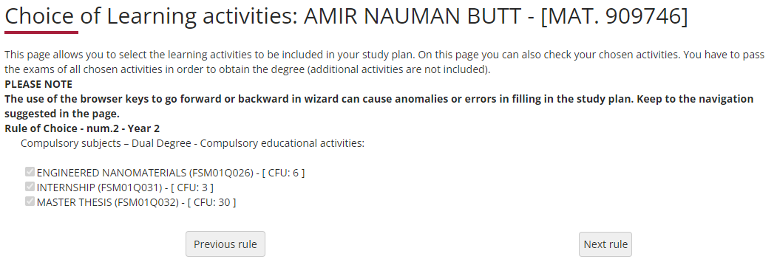
DUAL DEGREE The following rule lists and ticks compulsory second-year classes and their credits (fig. 28). Click «Next rule» to continue submitting the plan.
Fig. 28

Slide 41
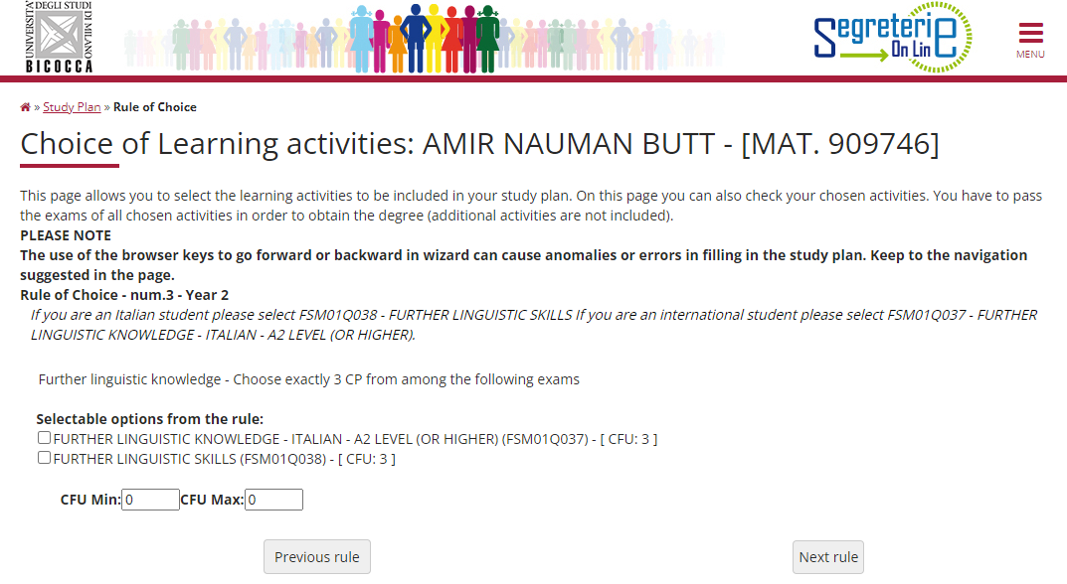
DUAL DEGREE Select FSM01Q038 - FURTHER LINGUISTIC SKILLS if you are italian (Fig. 29). Select FSM01Q037 - FURTHER LINGUISTIC KNOWLEDGE - ITALIAN - A2 LEVEL (OR HIGHER) if you are an international student. Click on “Next rule.” to continue.
Fig. 29

Slide 42
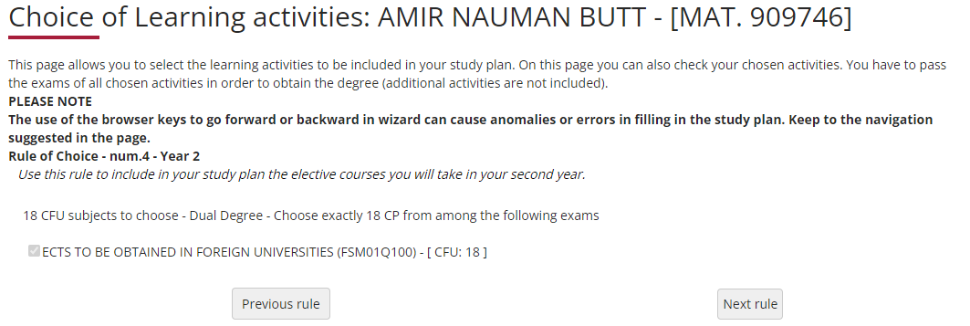
DUAL DEGREE Use this rule ( Fig 30) to include in your study plan the elective courses you will take in your second year. Click on “Next rule.” to complete the process and confirm your study plan.
Fig. 30

Slide 43
PLEASE NOTE: Once you have finished submitting your plan, you may still make changes.
Click on "Undo Study Plan", then "Edit Study Plan" on the next page to return to the initial screen.
For further information or issues with the online procedure, contact the Science Department Careers Office at segr.studenti.scienze@unimib.it
Please refer to:
the Program Teaching Regulations at https://elearning.unimib.it/mod/folder/view.php?id=1048774
the University of Milano - Bicocca Student Regulations (specifically art. 26 - Study Plan), at https://www.unimib.it/sites/default/files/2023-10/reg-stud_Versione%20sito.pdf
Happy studying!

Slide 44
Who to contact for what
Teaching Office
The Teaching Office provide didactic support and information for students (class schedules, lecturer office hours, exam schedules, study plans, workshops).
Face-to-face appointments
On Mondays, from 9 -12 hours at U5 Building, 1° floor, room 1007, by appointment via e-mail didattica.materiali@unimib.it.
Remote appointments (via Meet/Webex)
On Thursdays, from 9-12 hours, by appointment via e-mail: didattica.materiali@unimib.it.
Telephone Help Desk
on Tuesdays and Fridays, from 14-15:30 hours
U5 Building, 1° floor, room 1007
e-mail: didattica.materiali@unimib.it
Phone: 02/64485102
All information on teaching activities is available at : https://elearning.unimib.it/course/index.php?categoryid=9489

Slide 45
Who to contact for what
Ufficio segreteria studenti – Scienze
L’Ufficio segreteria studenti manages the administrative aspects of the whole student career, from admission to registration renewal and to getting your degree. It also deals with issuing certificates and receiving qualifications and exams from other universities, including recognised foreign ones.
Regarding the study plan, the Careers Office is the one responsible for supporting students with the technical aspects of the plan submission system via the Online Student Registry.
For administrative information, visit https://www.unimib.it/servizi/studenti-e-laureati/segreterie
For more detailed information on study plans and submission deadlines for the academic year, please visit : https://www.unimib.it/servizi/studenti-e-laureati/segreterie-studenti/piani-degli-studi/area-scienze
Online Help Desk
Lo sportello telematico (videoconferenza) è previsto il venerdì, dalle 9:30 alle 12:30, previo appuntamento tramite mail a: segr.studenti.scienze@unimib.it.
On-site Reception
On Wednesdays from 09:30 to 12:30 - desk 4, U17 building (Ipazia),
It is mandatory to book your appointment, click here and select "Scienze MM.FF.NN. (Gestione Carriere)".
Telephone Help Desk
0039 0264484499
On Tuesdays and Thursdays from 10:00 to 11:30. The service is only available on the days and times previously indicated..

