Slide 1
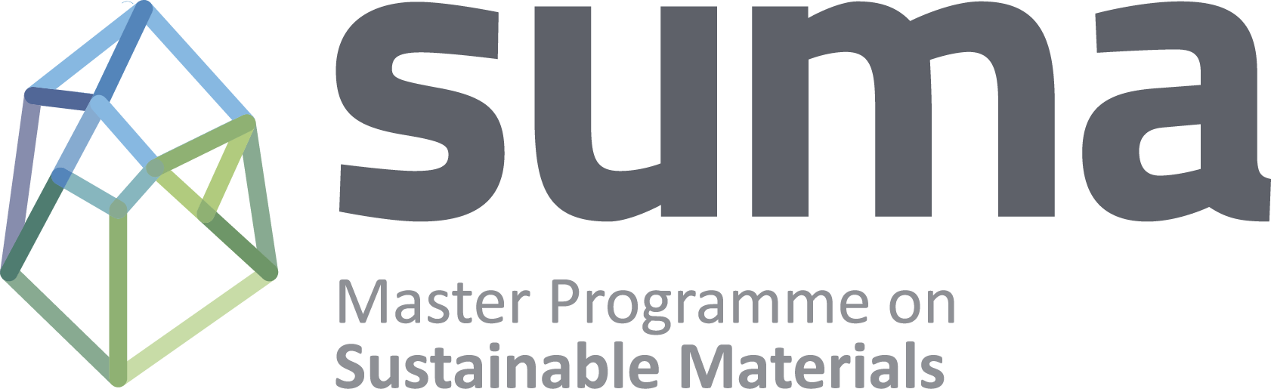

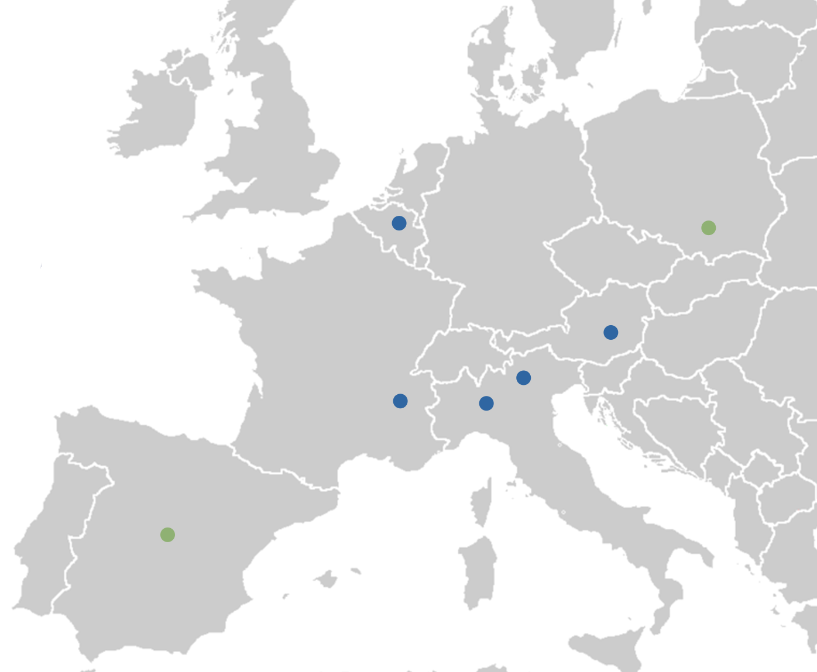




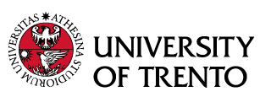
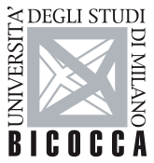
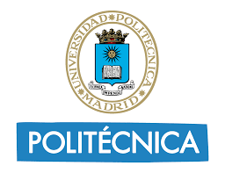


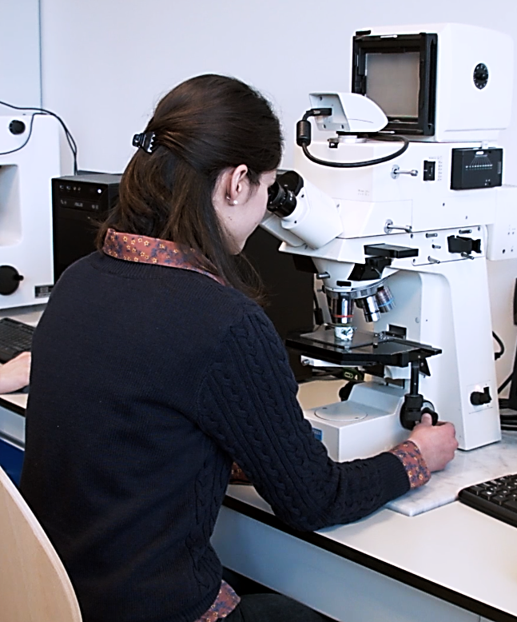
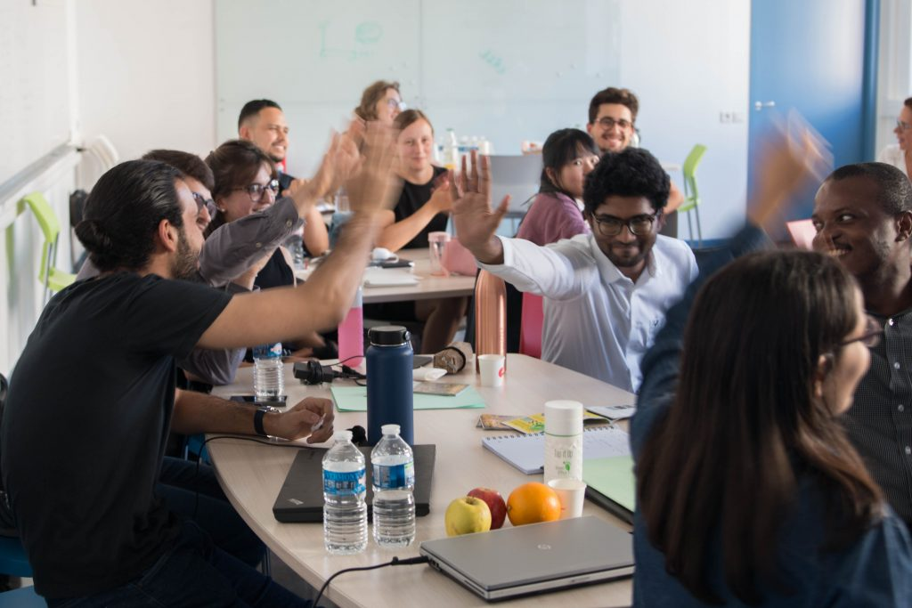
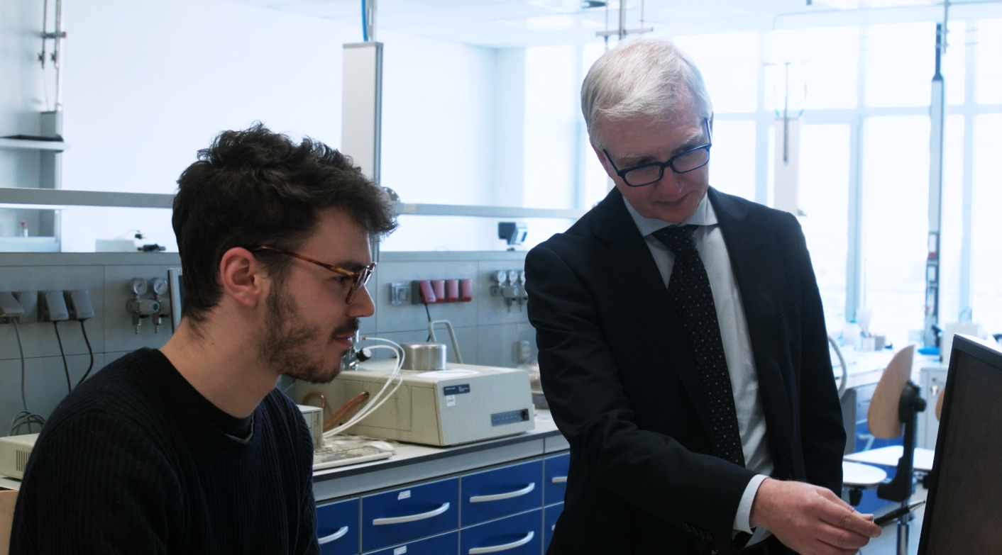
Master Programme on Sustainable Materials (SUMA)
The EIT-labelled SUMA programme educates high-level students in the field of materials science and engineering. It contributes to a solid EIT RawMaterials educational backbone by forming innovators and entrepreneurs for the materials industry with deep expertise in sustainable materials and processes.
7 partner universities
2 industrial partners
9 study tracks
Building the circular economy of tomorrow
We form professionals to contribute to a sustainable, net carbon-zero society with respect to materials and material production, processing, and recycling technologies.
Fostering innovation and entrepreneurship
Together with a solid technical background, our students are equipped with I&E knowledge and skills to tackle the sector’s challenges with an entrepreneurial mindset.
Creating bridges with industry
SUMA is advised by an industrial advisory board (IAB) to align the programme with the needs of the industry. The IAB also offers internships and master thesis projects.
EIT-Labelled Master Programme
SUMA has been awarded an EIT Label – a quality seal given to excellent educational programmes which successfully combine technical education and skills in innovation and entrepreneurship with direct involvement with industry.
https://master-suma.eu/
Contact: Mónica Guasca
monica.guasca@kuleuven.be

