Slide 1
Statistical Methods
for the territorial and social environment
IBM SPSS Statistics
09/03/2023

Slide 2
TODAY
BOXPLOT
COMPARING MEANS
ASSOCIATION
LIKERT SCALE
SEMANTIC DIFFERENTIAL SCALE

Slide 3
Boxplot

Slide 4
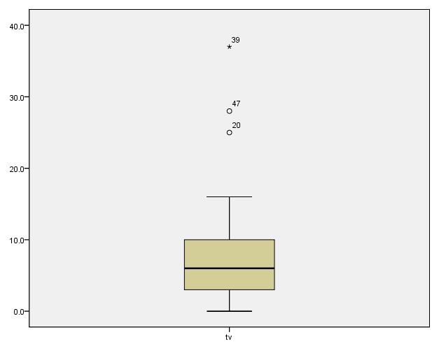
BOXPLOT
Box plots have box from LQ to UQ, with median marked. They portray a five-number summary of the data:
Minimum,
LQ,
Median,
UQ,
Maximum
except for outliers identified separately
Outlier = observation falling
below LQ – 1.5(IQR)
or above UQ + 1.5(IQR)
Outliers
SPSS-Lecture 1
4
Notes:
03/03/2014
4

Slide 5
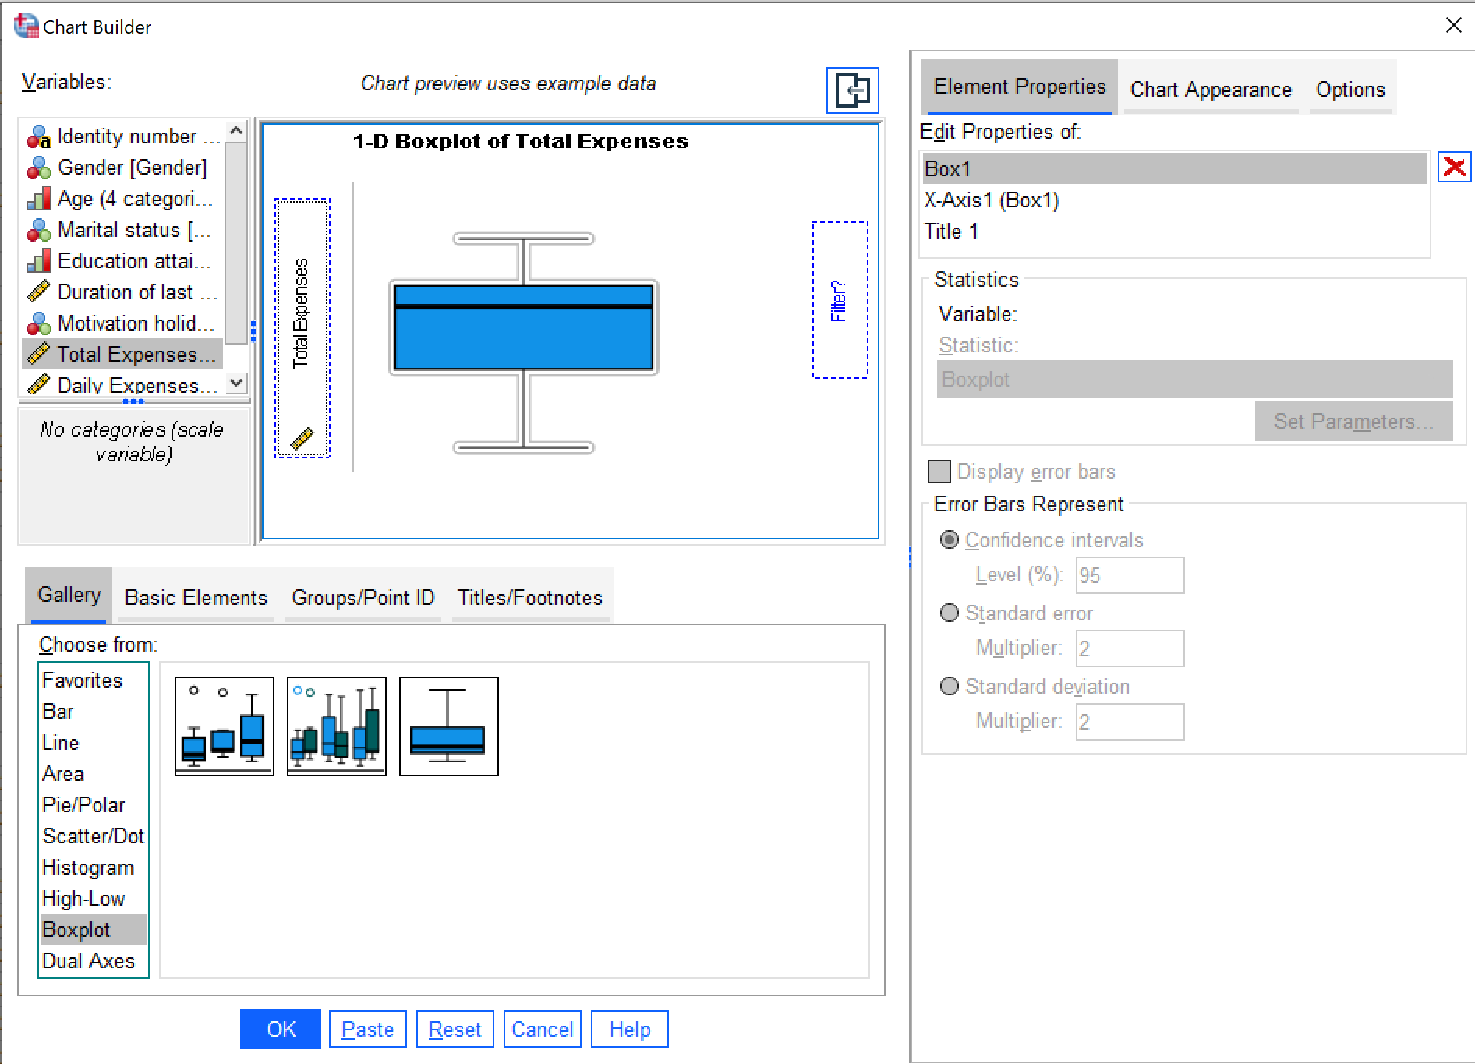
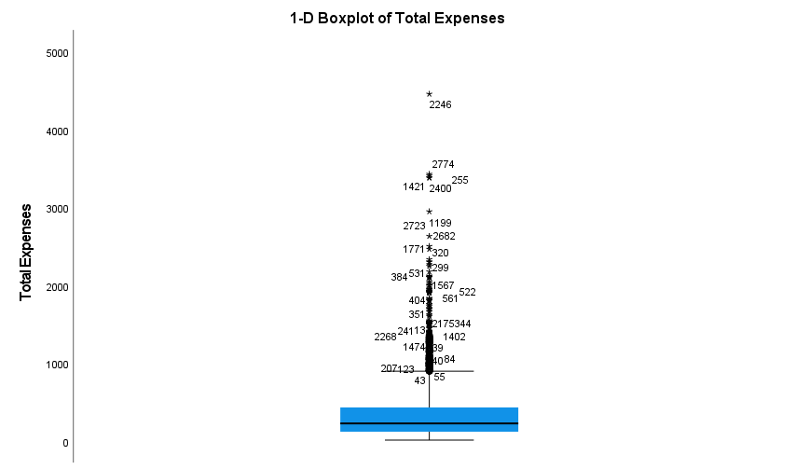
BOXPLOT
SPSS-Lecture 1
5
Notes:
03/03/2014
5

Slide 6
Comparing means Association

Slide 7
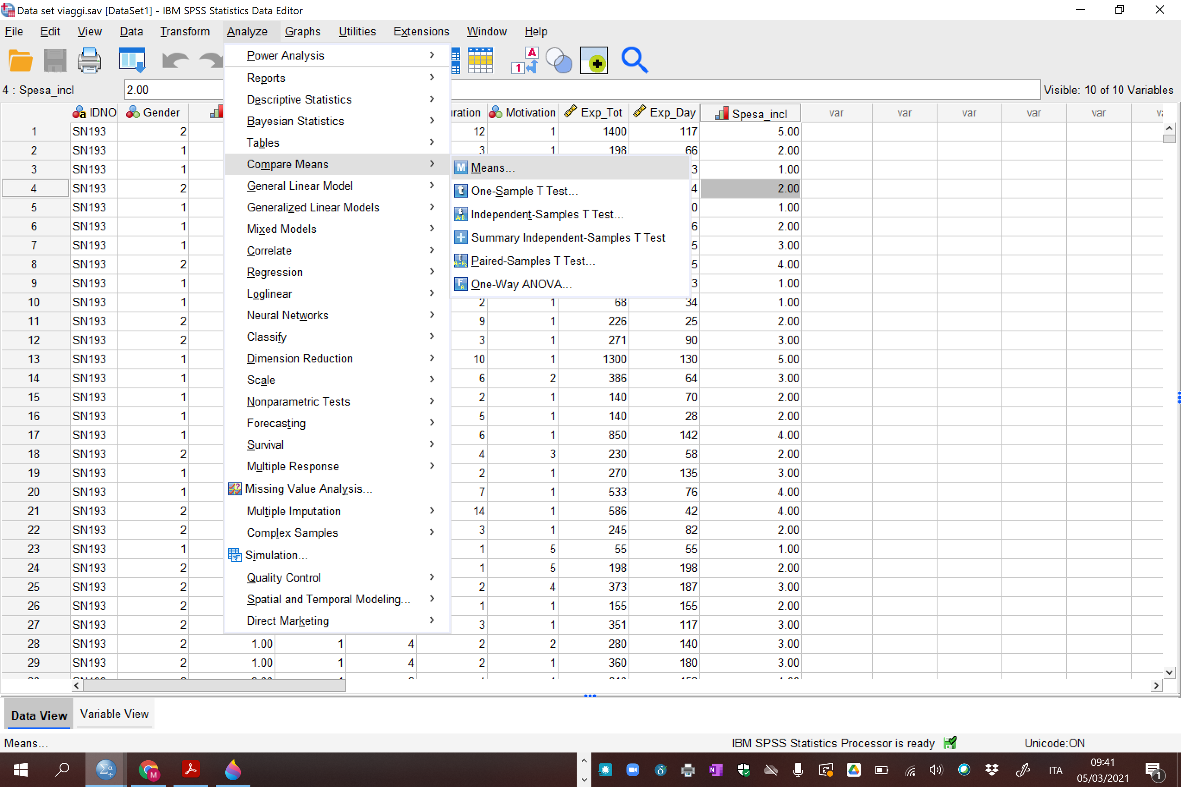
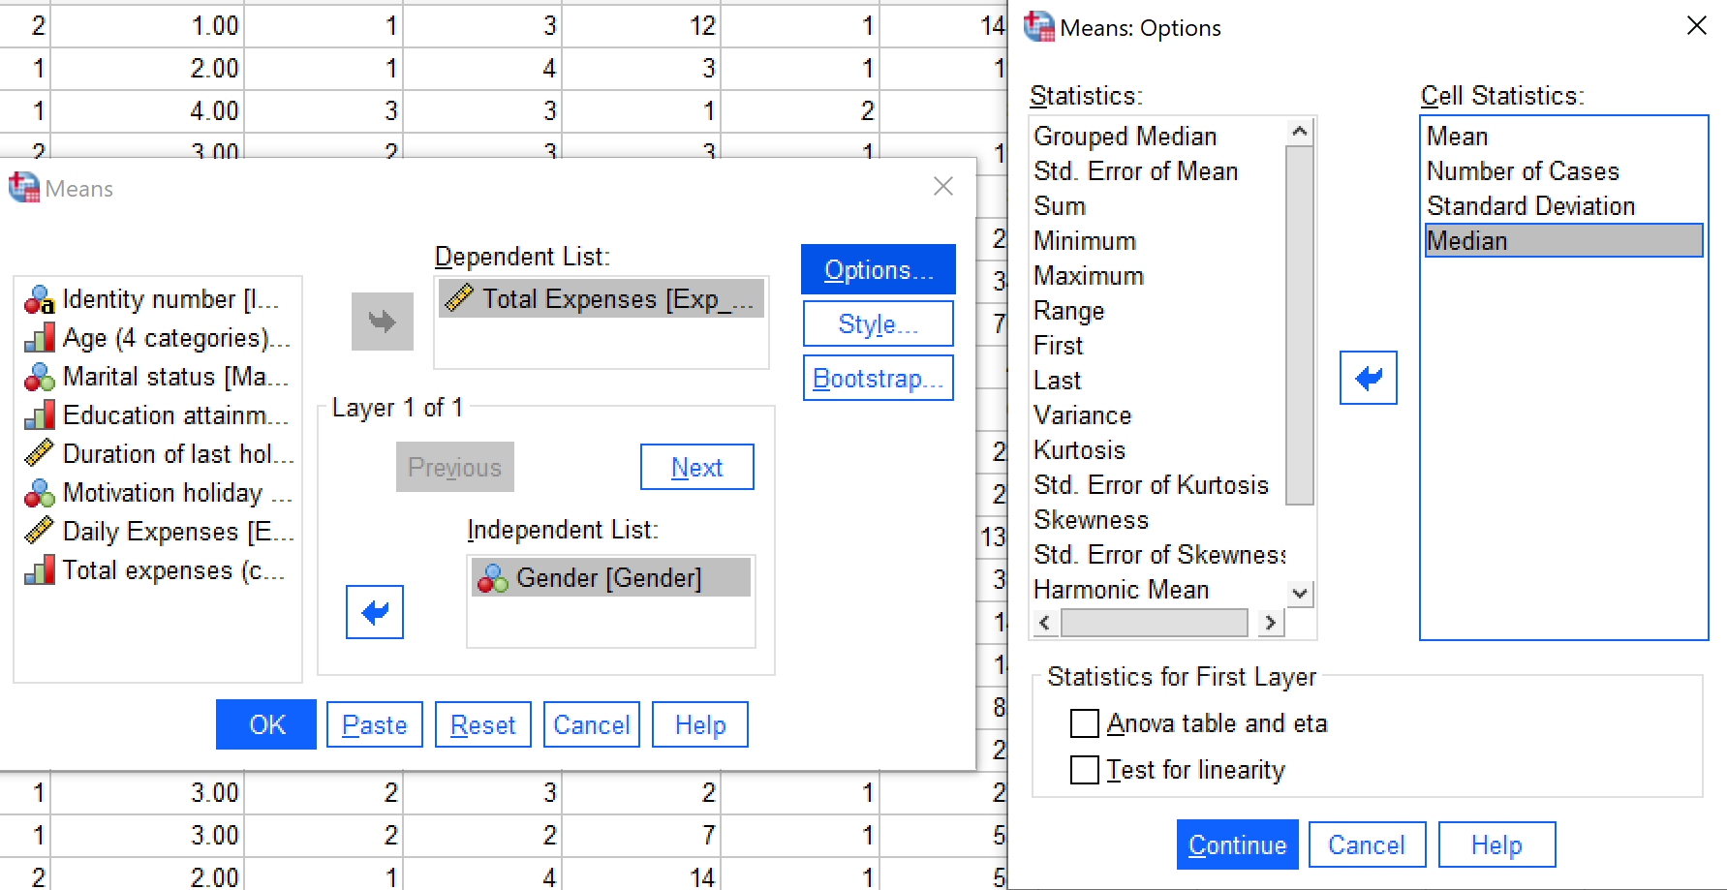
COMPARING MEANS

Slide 8
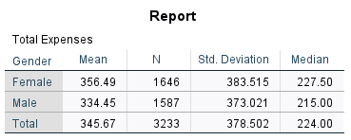
COMPARING MEANS

Slide 9
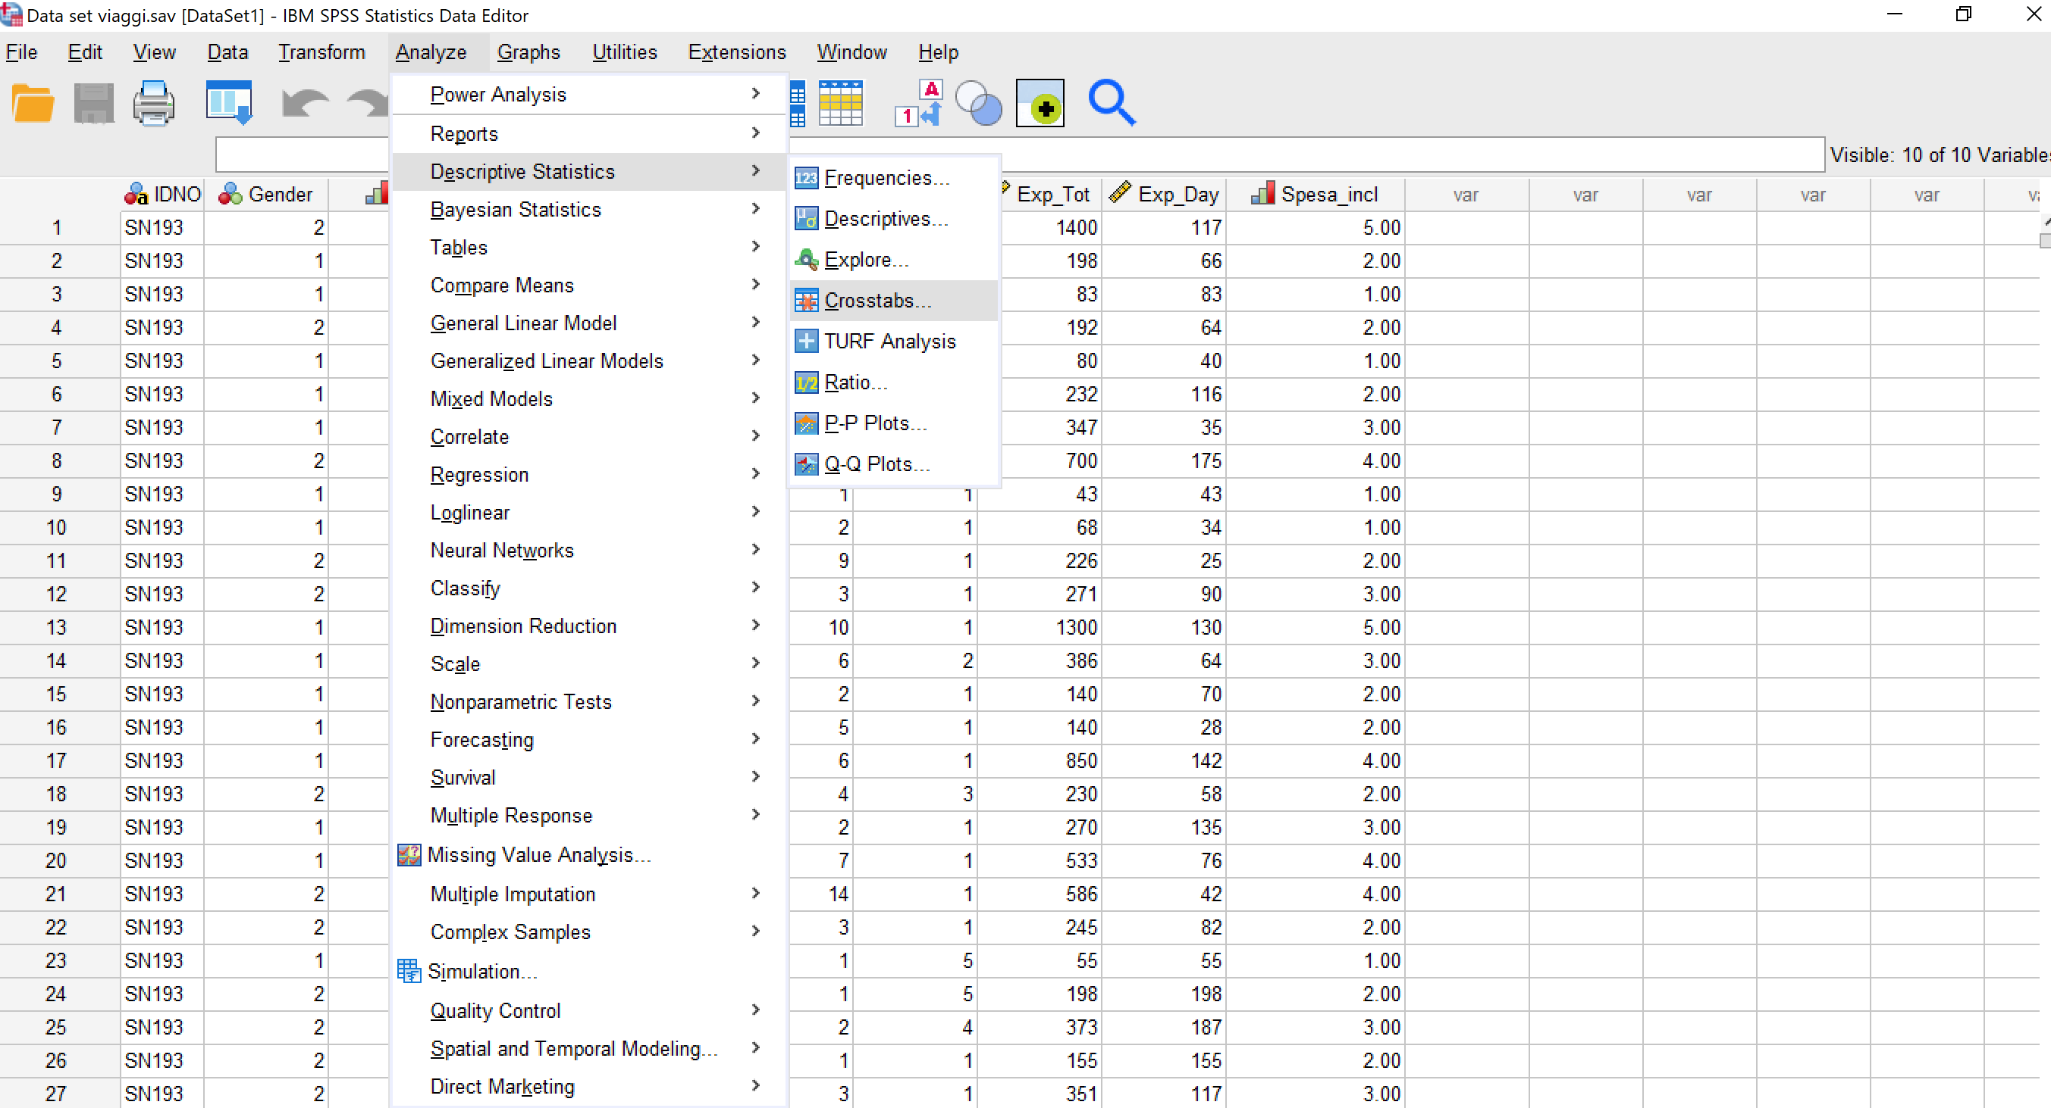
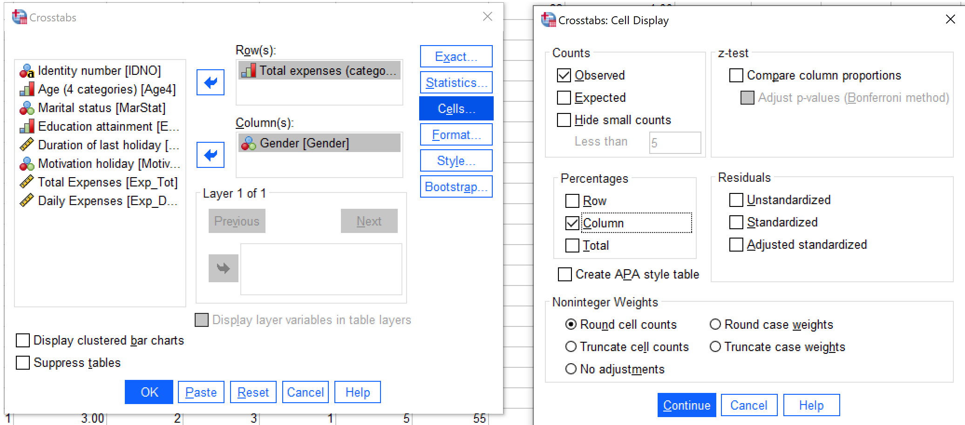
ASSOCIATION

Slide 10
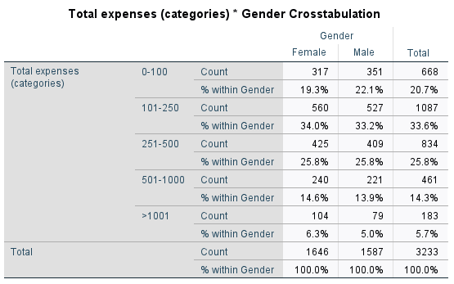
ASSOCIATION

Slide 11
Likert scale

Slide 12
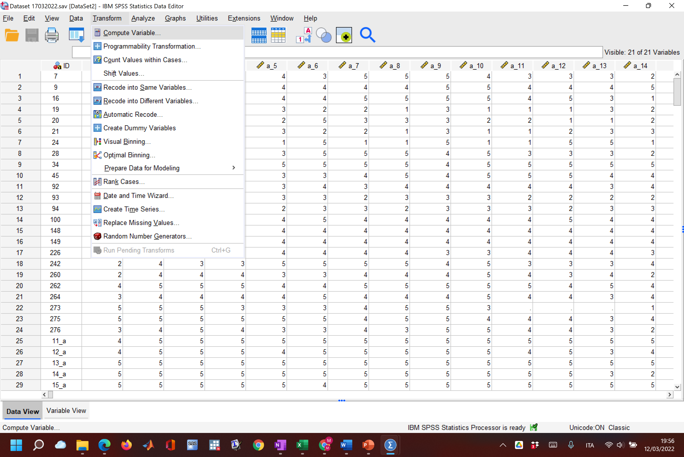
CREATE A LIKERT SCALE
CREATE A LIKERT SCALE
Dataset 09032023

Slide 13
