Slide 1
Research Methods for Leisure and Tourism
5th edition
Chapter 17
Statistical analysis

Slide 2
2. The statistics approach
Probabilistic statements
The normal distribution
Probabilistic statement formats
Significance
The null hypothesis
Dependent and independent variables

Slide 3
Probabilistic statements
descriptive: e.g. : 10% of adults play tennis
comparative: e.g. : 10% play tennis, but 12% play golf
relational: e.g. 15% of people with high incomes play tennis but only 7% of people with low incomes do so: there is a positive relationship between tennis-playing and income
However, when based on a samples, the above must be made using a probabilistic format

Slide 4
Probabilistic statements (contd.)
We can be 95% confident that the proportion of adults that plays tennis is between 9% and 11%
The proportion of golf players is significantly higher than the proportion of tennis players (at the 95% level of probability)
There is a positive relationship between level of income and level of tennis playing (at the 95% level)

Slide 5
Probabilistic statement formats
95% probability
sometimes expressed as 5%
sometimes as 0.05
99% probability is also used
also expressed 1% or 0.01

Slide 6
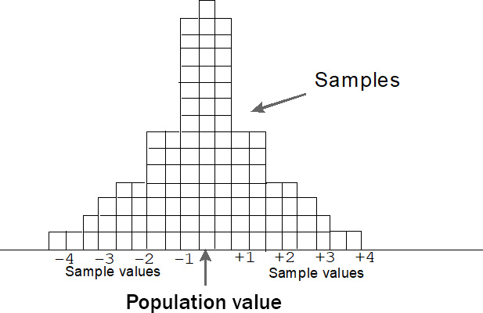
Normal distribution (Figure 17.1):
a. Drawing repeated samples (theory)

Slide 7
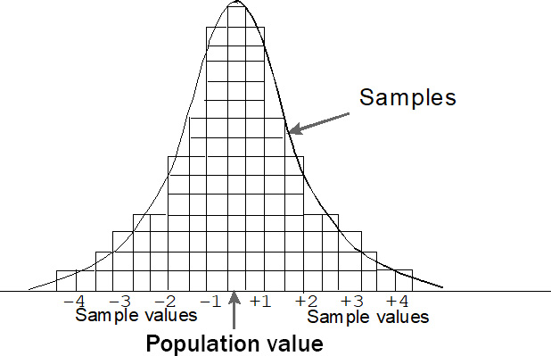
Normal distribution (contd.)
b. Normal distribution/curve

Slide 8
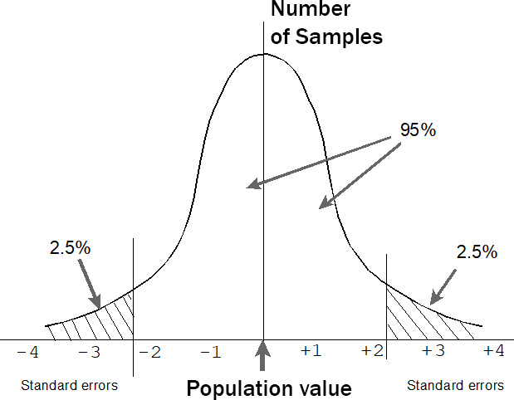
Normal curve (Figure 13.1)

Slide 9
Significance
Statistically significant: unlikely to have happened by chance (highly probable)
Level of significance is affected by sample size (not by population size)
Probability of finding happening by chance related to normal curve and similar theoretical distributions
But NB: small differences or weak relationships may not be socially or managerially significant – even when they are statistically significant

Slide 10
Null hypothesis
H₀ – Null hypothesis: there is no significant difference or relationship
H₁ – Alternative hypothesis: there is a significant difference or relationship
e.g.
H₀ tennis and golf participation levels are the same
H₁ tennis and golf participation levels are significantly different

Slide 11
Dependent and independent variables (Figure 17.2)
Independent variable 1
Independent variable 2
Dependent variable
Independent variable 3

Slide 12
Statistical tests
Task | Format of data | No. of variables | Types of variable | Test
Relationship between 2 variables | Crosstabulation of frequencies | 2 | Nominal | Chi-square
Difference between 2 means - paired | Means: for a whole sample | 2 | Two scale/ordinal | t-test - paired
Difference between 2 means – indep-endent samples | Means: for 2 sub-groups | 2 | 1. scale/ordinal (means) 2. nominal (2 groups only) | t-test – independent samples

Slide 13
Statistical tests (contd.)
Task | Format of data | No. of variables | Types of variable | Test
Relationship between 2 variables | Means - for 3+sub-groups | 2 | 1. scale/ ordinal (means) 2. nominal (3+ groups) | One-way analysis of variance
Relationship between 3 or more variables | Means: crosstabulated | 3+ | 1. scale/ordinal (means) 2. Two or more nominal | Factorial analysis of variance

Slide 14
Statistical tests (contd.)
Task | Format of data | No. of variables | Types of variable | Test
Relationship between 2 variables | Individual measures | 2 | Two scale/ ordinal | Correlation
Linear relationship between 2 variables | Individual measures | 2 | Two scale/ ordinal | Linear regression
Linear relationship between 3+ variables | Individual measures | 3+ | Three or more scale/ ordinal | Multiple regression
Relationships between large nos of variables | Individual measures | Many | Large numbers of scale/ ordinal | Factor analysis Cluster analysis

Slide 15
Comparing two means: t-test
Paired samples: whole sample: comparing means for 2 variables
Independent samples: sample divided into two groups (e.g. males and females) and comparing means for 1 variable

Slide 16
Comparing 2 means: t-test: Paired samples
Example 1: Compare average times played sport in last 3 months (12.2) with average times visited national parks (9.8)
Difference is 2.4
value of t is 1.245
Significance is 0.219, which is larger than 0.05
Null hypothesis is accepted: difference is not significant

Slide 17
Comparing 2 means: t-test : Paired samples
Compare course costs for males ($110.00 pa) and females ($136.60)
Difference is $28.60
value of t is −1.245
significance is 0.219
Null hypothesis is accepted: difference is not significant

Slide 18
6. One-way analysis of variance (ANOVA)
Means of one variable for groups defined by another variable

Slide 19
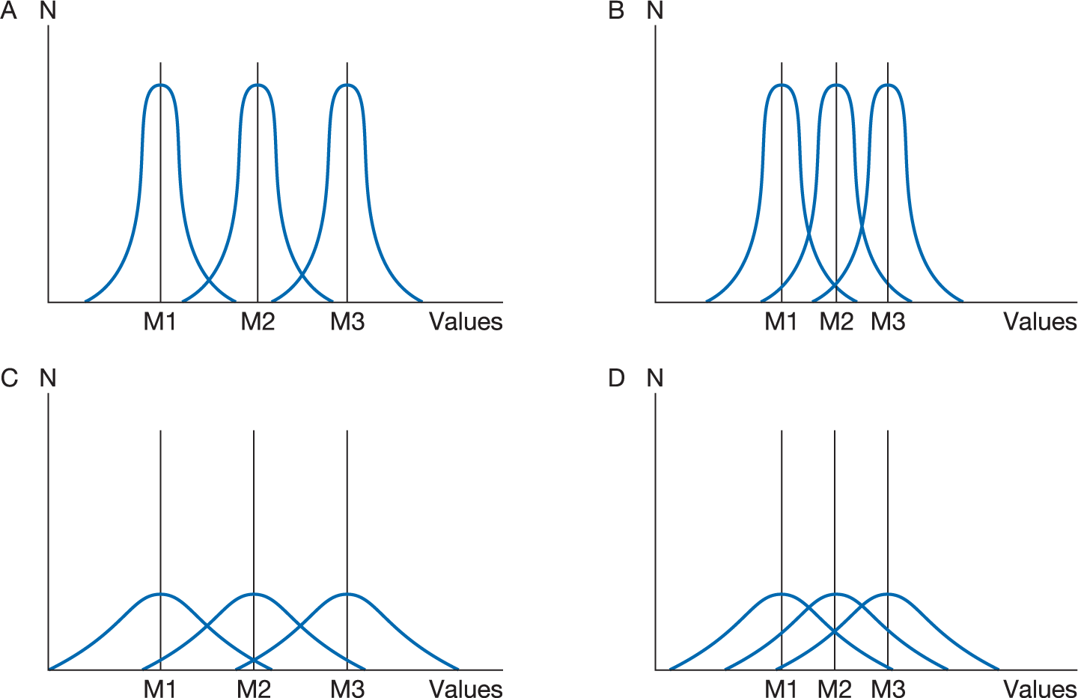
One-way analysis of variance (ANOVA) (contd.)
Comparing means and variances

Slide 20
One-way analysis of variance (ANOVA)
F-test rather than r-test
E.g. Means of times played sport by student status:
F/T student/no paid work: mean = 9.7 times in 3 months
F/T student/paid work: 9.6 times
P/T student – F/T job: 19.1 times
P/T student – Other: 12.2 times
Value of F: 2.485, Significance 0.072, which is greater than 0.05
Null hypothesis accepted: no relationship between status and sport
But for ‘going out for a meal’: F = 6.64 and Sig. = 0.001, which is less than 0.05, so null hypothesis rejected: there is a significant relationship

