Slide 1
Statistical Methods
for the territorial and social environment
IBM SPSS Statistics
21/03/2024

Slide 2
TODAY
LIKERT SCALE
SEMANTIC DIFFERENTIAL SCALE

Slide 3
Likert scale
Dataset 09032023.sav

Slide 4
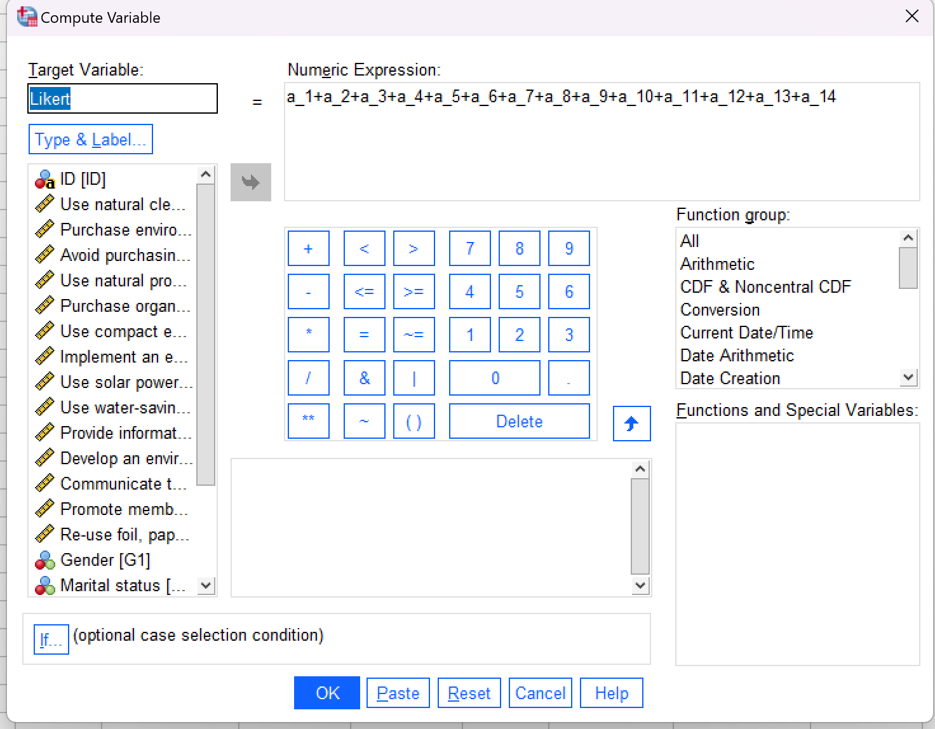
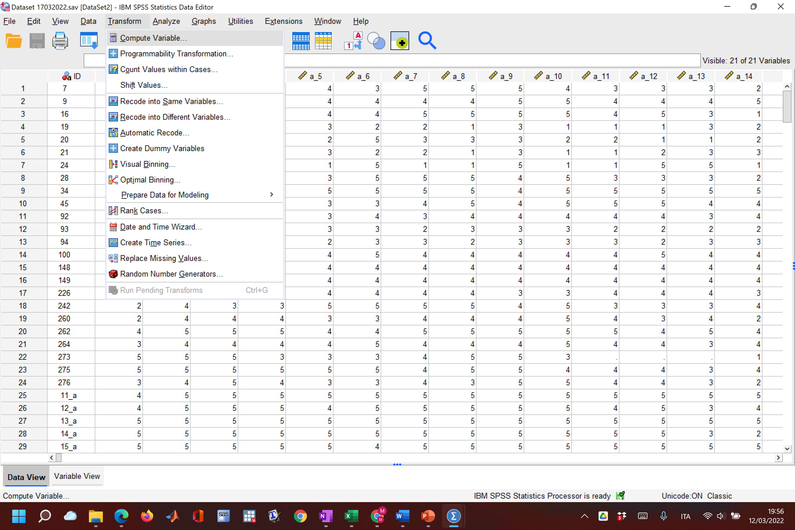
CREATE A LIKERT SCALE
CREATE A LIKERT SCALE
Dataset 09032023

Slide 5
Describe Likert_1
Frequency table (low informative)
Histogram (box-plot)
Mean, std
Produce «compare means» respect to the sociodemographic variables
Hp1: Gender L1(Female)=L1(Male) Not reject (for alpha=0.05)
Hp2: Age L1(older)=L1(Younger) Not reject (for alpha=0.05)
Hp3: Marital status L1==each category Not reject (for alpha=0.05)
Hp4: Ed. L1(higher ed)=L1(lower ed) Not reject (for alpha=0.05)
Hp5: Income L1==each category Not reject (for alpha=0.05)
Hp6: L1(greater env level)==L1(lower env level) Reject (for alpha=0.05): when the env. level increases, the Likert mean
increases too.

Slide 6
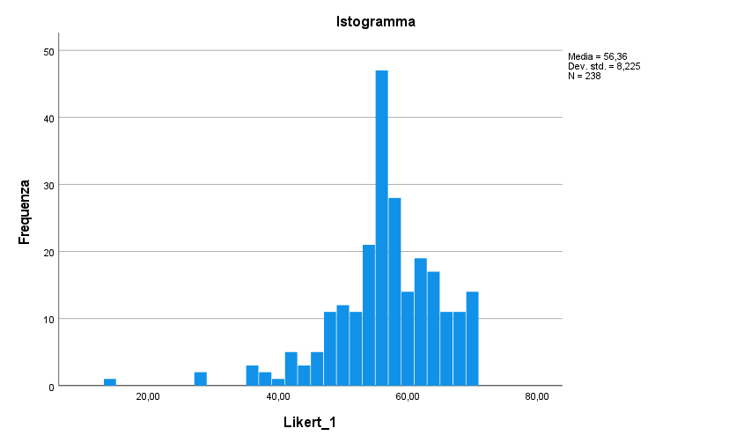
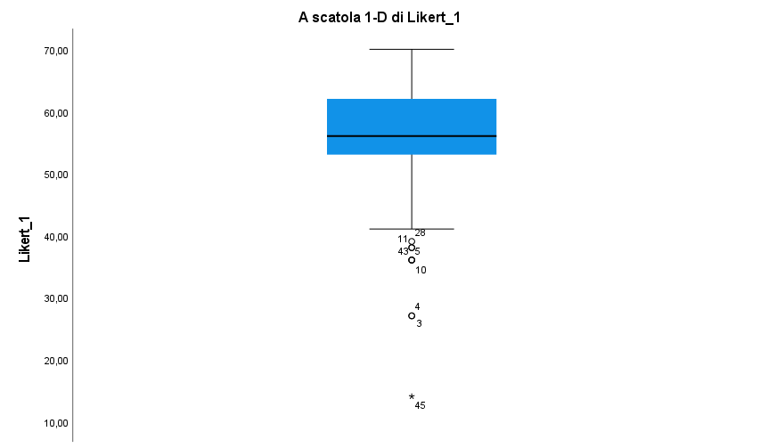

Slide 7
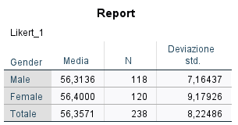
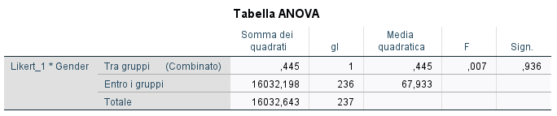
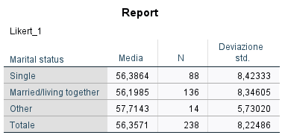
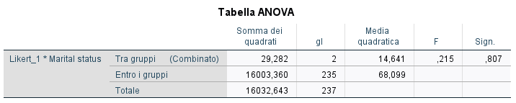
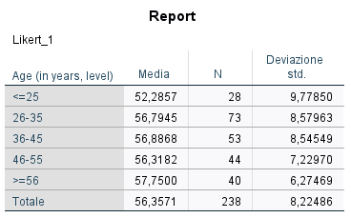
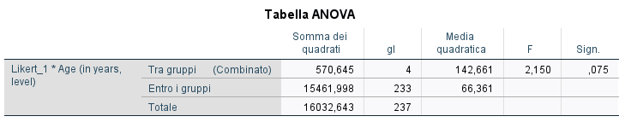

Slide 8
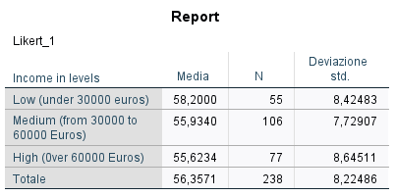
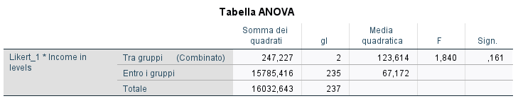
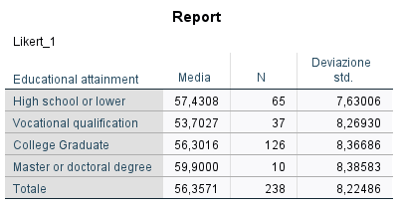
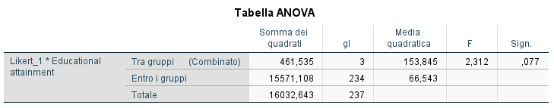

Slide 9
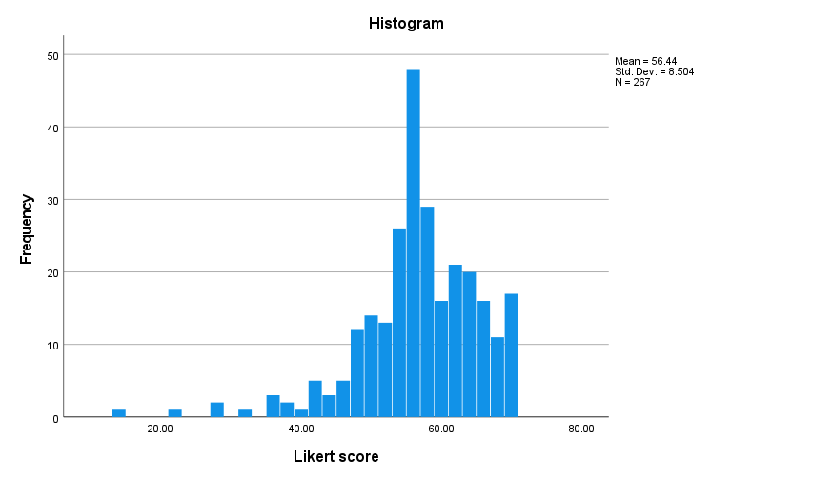

Slide 10
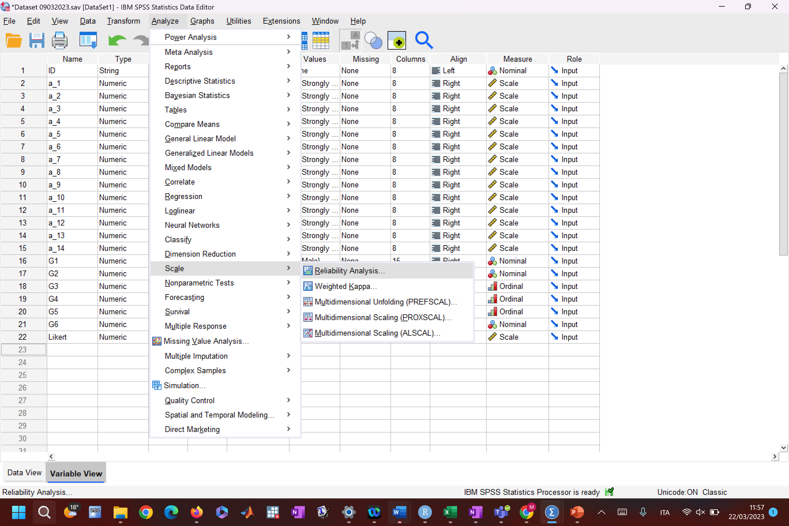
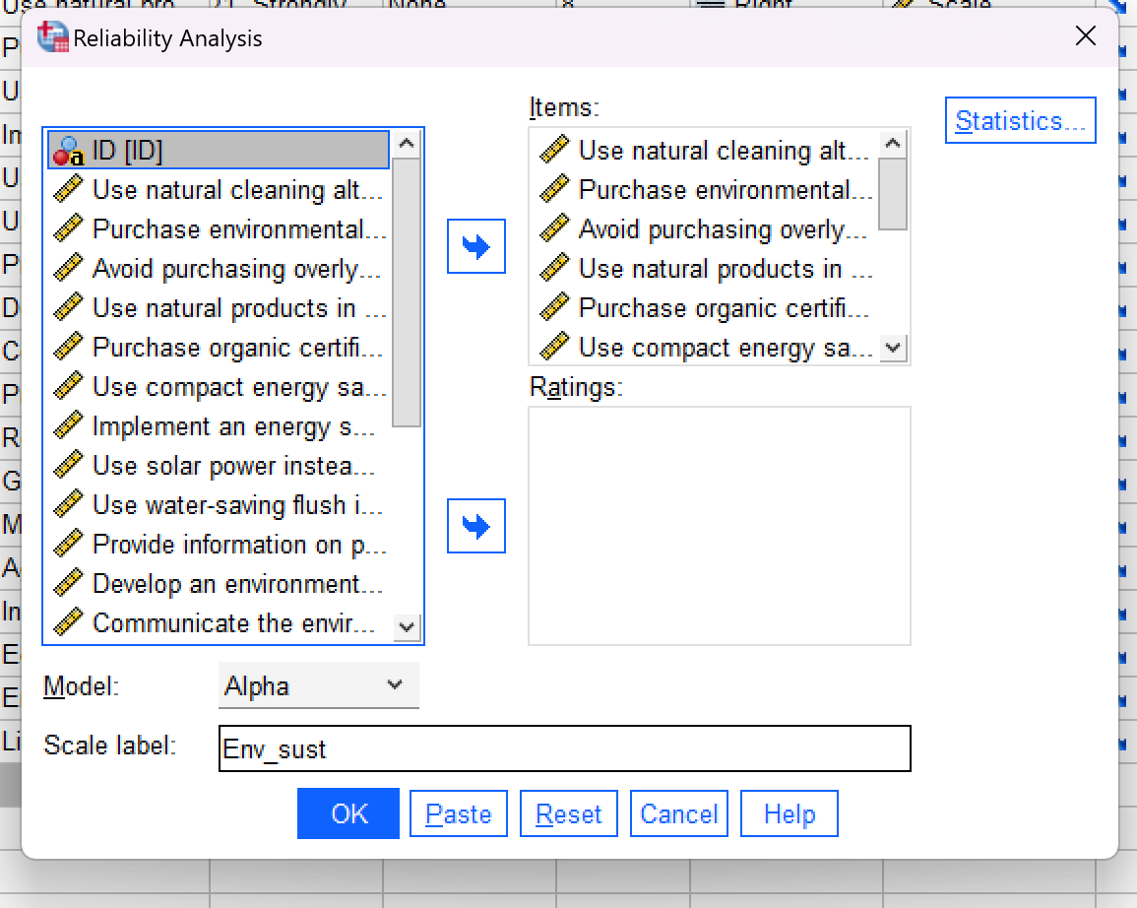
Reliability

Slide 11
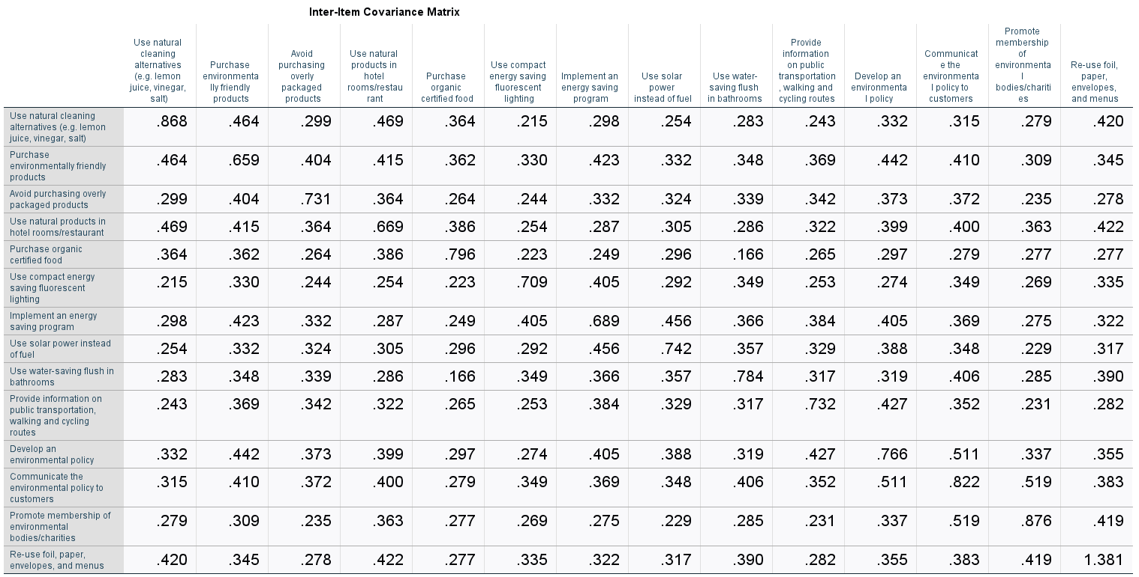
Variance-covariance matrix

Slide 12
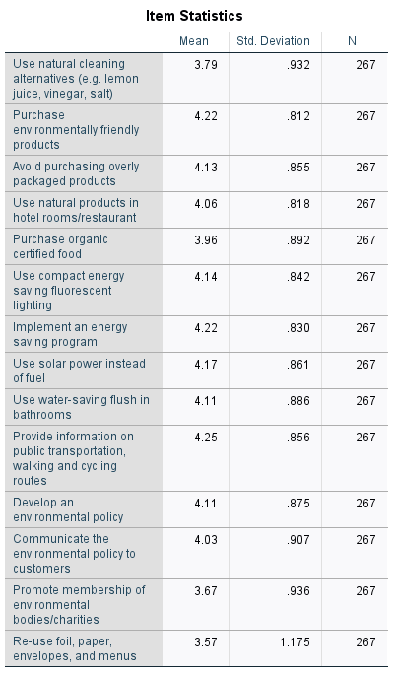
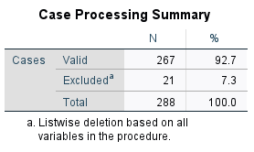
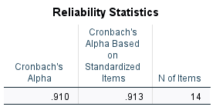

Output α-Cronbach

Slide 13
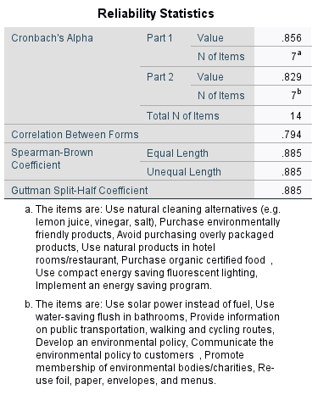
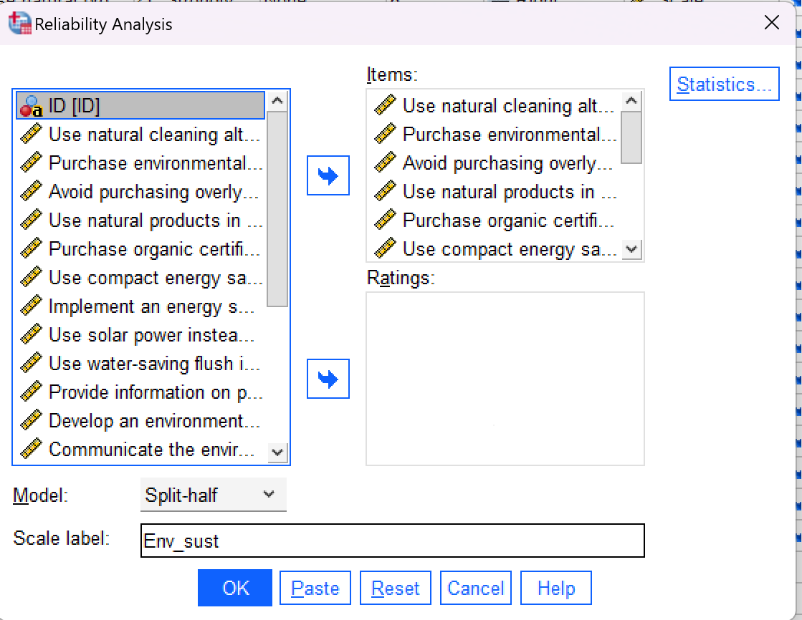
Output half-split coefficient

Slide 14
Semantic differential scale
Dataset osgood.sav

Slide 15
 | Male | Female | Total | F | Sig.
Old-Modern | 4.89 | 4.30 | 4.48 | 1.289 | 0.266
Expensive-Cheap | 4.44 | 5.30 | 5.03 | 3.193 | 0.085
Unpleasant-Pleasant | 4.44 | 4.50 | 4.48 | 0.011 | 0.917
Dirty-Clean | 4.00 | 4.80 | 4.55 | 3.673 | 0.066
Disreputable-Reputable | 4.89 | 5.15 | 5.07 | 0.276 | 0.604
Unsuccessful-Successful | 5.44 | 5.35 | 5.38 | 0.037 | 0.850
Worthless-Valuable | 4.44 | 4.90 | 4.76 | 0.965 | 0.335

