Slide 1
Statistical Methods for Tourism II
IBM SPSS Statistics
29/02/2024
29/02/2024
SPSS-Lecture 1
1
Notes:
1
03/03/2014

Slide 2
Download SPSS (vs.29) on your computer/laptop, use the university license
License: ee101730993a20e687f6
Download web
Windows [https://www.statisticsfordataanalysis.com/download-v-29-win ]
Mac and Linux [https://www.statisticsfordataanalysis.com/download-v-29-mac]
SPSS-Lecture 1
2
Notes:
2
03/03/2014

Slide 3
Virtual Lab
If you can’t install SPSS on your laptop/computer, you can use the virtual LAB of the course “Statistical methods for tourism II”.
First of all, you need to enrol to the virtual LAB. Here you can find the link to enrol to the virtual LAB
https://libaas.unimib.it/PubLab/register/1ae8da25acd9d20d3549
Here, you can find a guide to start to use the virtual LAB of the course. Unfortunately, it is in Italian language! If you need assistance, please contact me by email!

Slide 4
SPSS stands for Statistical Package for the Social Sciences
SPSS was made to be easier to use then other statistical software like S-Plus, R, or SAS.
SPSS-Lecture 1
4
Notes:
4
03/03/2014

Slide 5
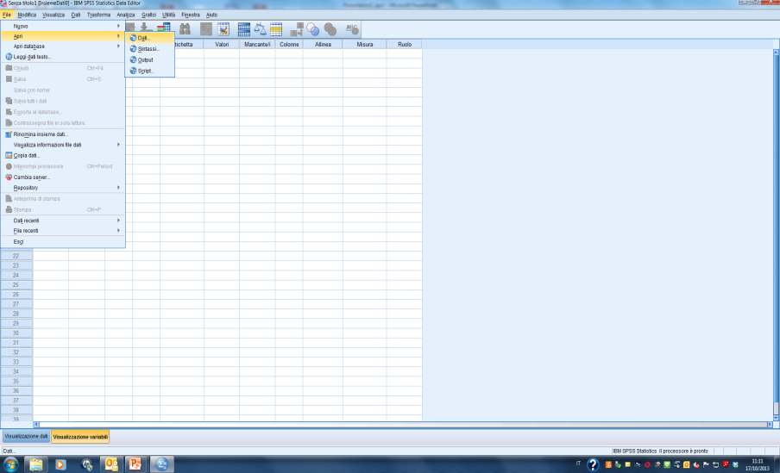
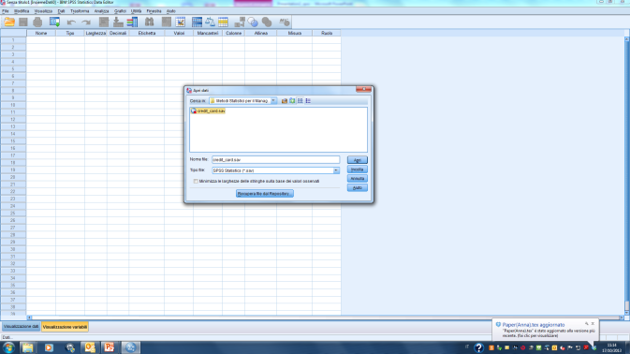
SPSS-Lecture 1
5
Notes:
5
03/03/2014

Slide 6
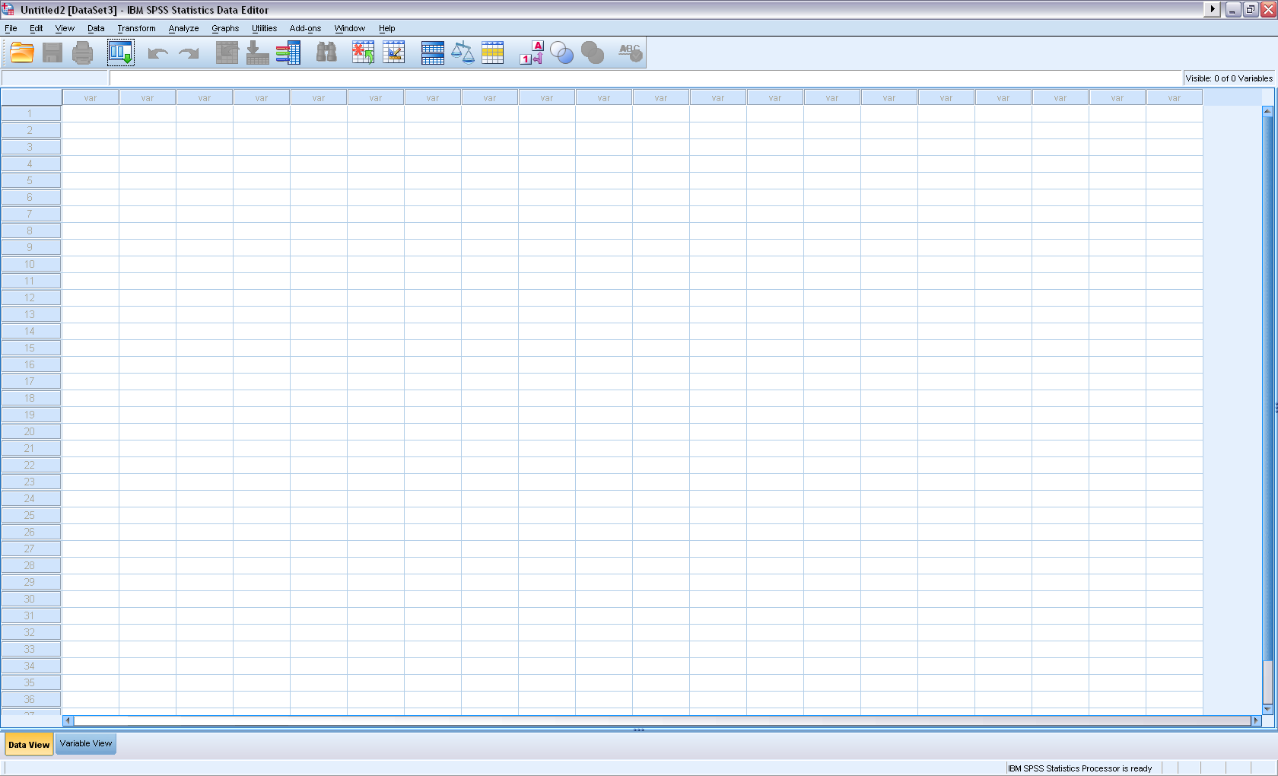
Columns: variables
Rows: cases
Under Data View
SPSS-Lecture 1
6
Notes:
6
03/03/2014

Slide 7
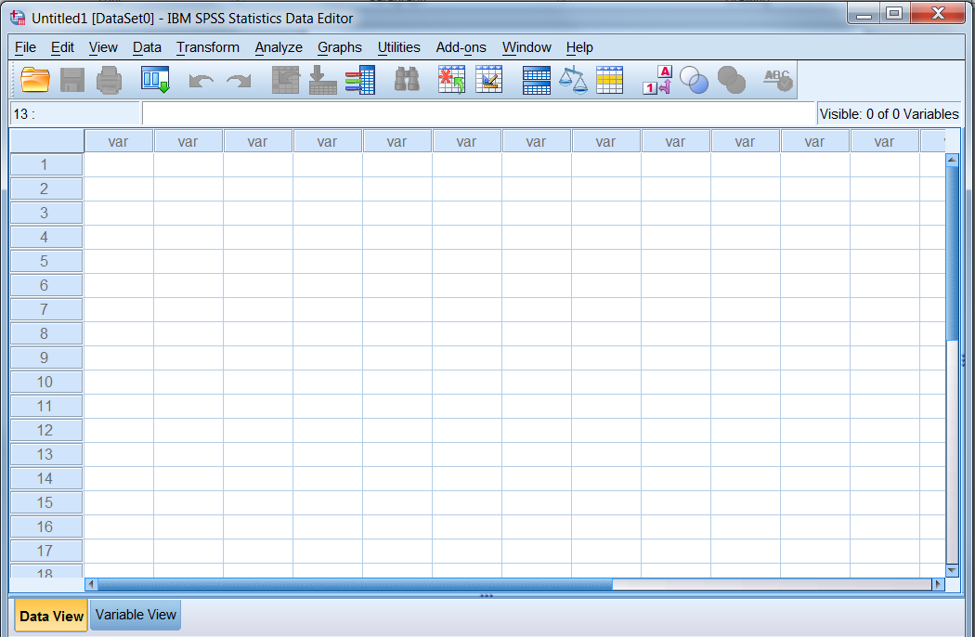
Basic Information
Above the data cells, you will find the toolbar (1) and the menu bar (2). Each provides the functions you will need to open/save data, perform transformations, and conduct your statistical operations.
Toolbar:
The toolbar contains icons to facilitate easy point and click operations. Because these can be customized, they may vary slightly between systems. Below is a description of the main icons:
Open files Undo last operation
Save data Redo last operation
Print file Insert case
Find data Insert variable
(1)
(2)
SPSS-Lecture 1
7

Slide 8
Basic Information
Menu Bar:
The menu bar provides a series of “drop down” commands to perform most essential SPSS functions. By clicking on a menu command, a further series of menu options will appear. Many of these submenu commands will be discussed in further detail in this manual.
File: These are the basic file management operations.
e.g. opening, saving, and printing files
Edit: This allows you to perform editing functions on the current data set.
e.g. cut, copy, clear, undo changes and redo changes
View: Allows you to change the current view of data, as well as toolbar options.
e.g. grid lines, value labels
Data: These functions deal with the configuration, defining, and management of data.
e.g. insert variables/cases, sort data, merge files
Transform: This allows you to transform the data set you’ve entered.
e.g. calculating new variables, recoding, missing values
Analyze: Includes the main data analysis functions.
e.g. descriptive statistics, t-Tests, ANOVA, correlation, data reduction
Windows: Allows you to alter the appearance, format, position of the SPSS windows.
SPSS-Lecture 1
8

Slide 9
Data set viaggi.sav
This data file consists of 3233 respondents of the survey “Viaggi e vacanze “ ISTAT 2016.
The headings at the top of this file refer to the variables
IDNO= Identity number
Gender = Gender of respondent
Age4= Age (4 categories)
MarStat= Marital status
Educ4= Education attainment (4 categories)
Duration= Duration of last holiday
Motivation=Motivation of the holiday
Exp_Tot=Total Expenses of the last holiday
Exp_Day=Mean of the Daily Expenses
Spesa_incl=Total expenses (categories)
SPSS-Lecture 1
9

Slide 10
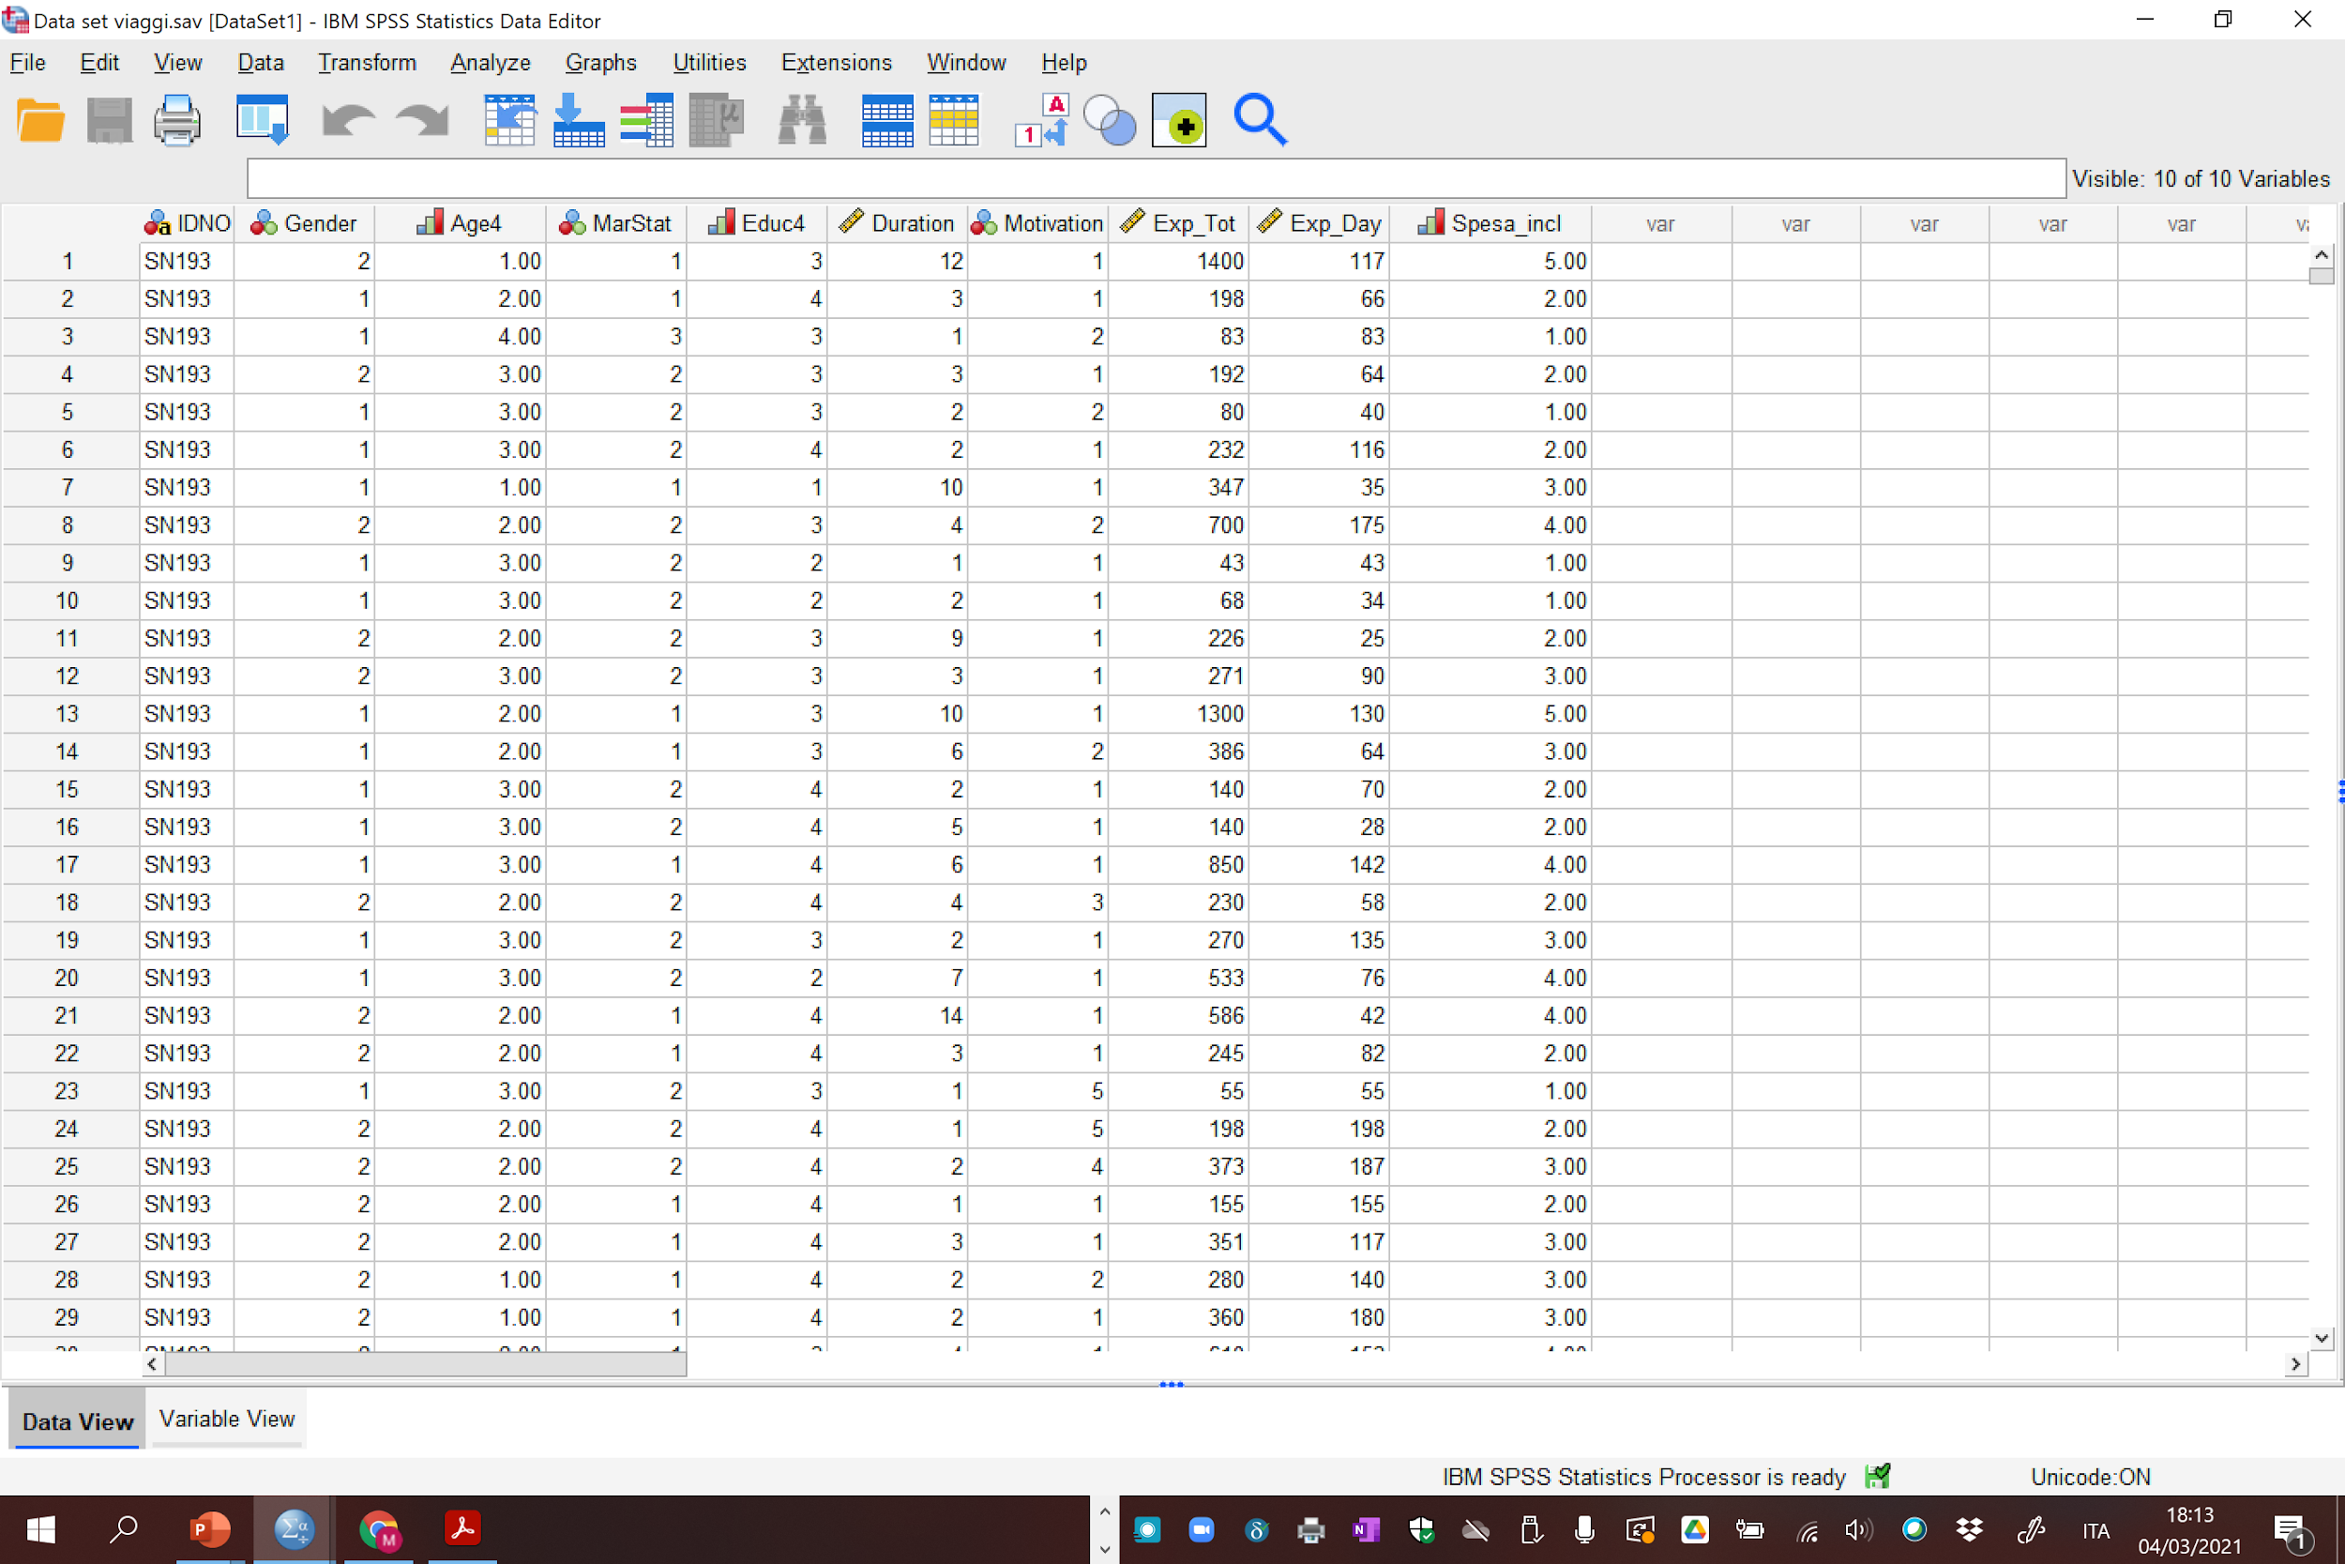
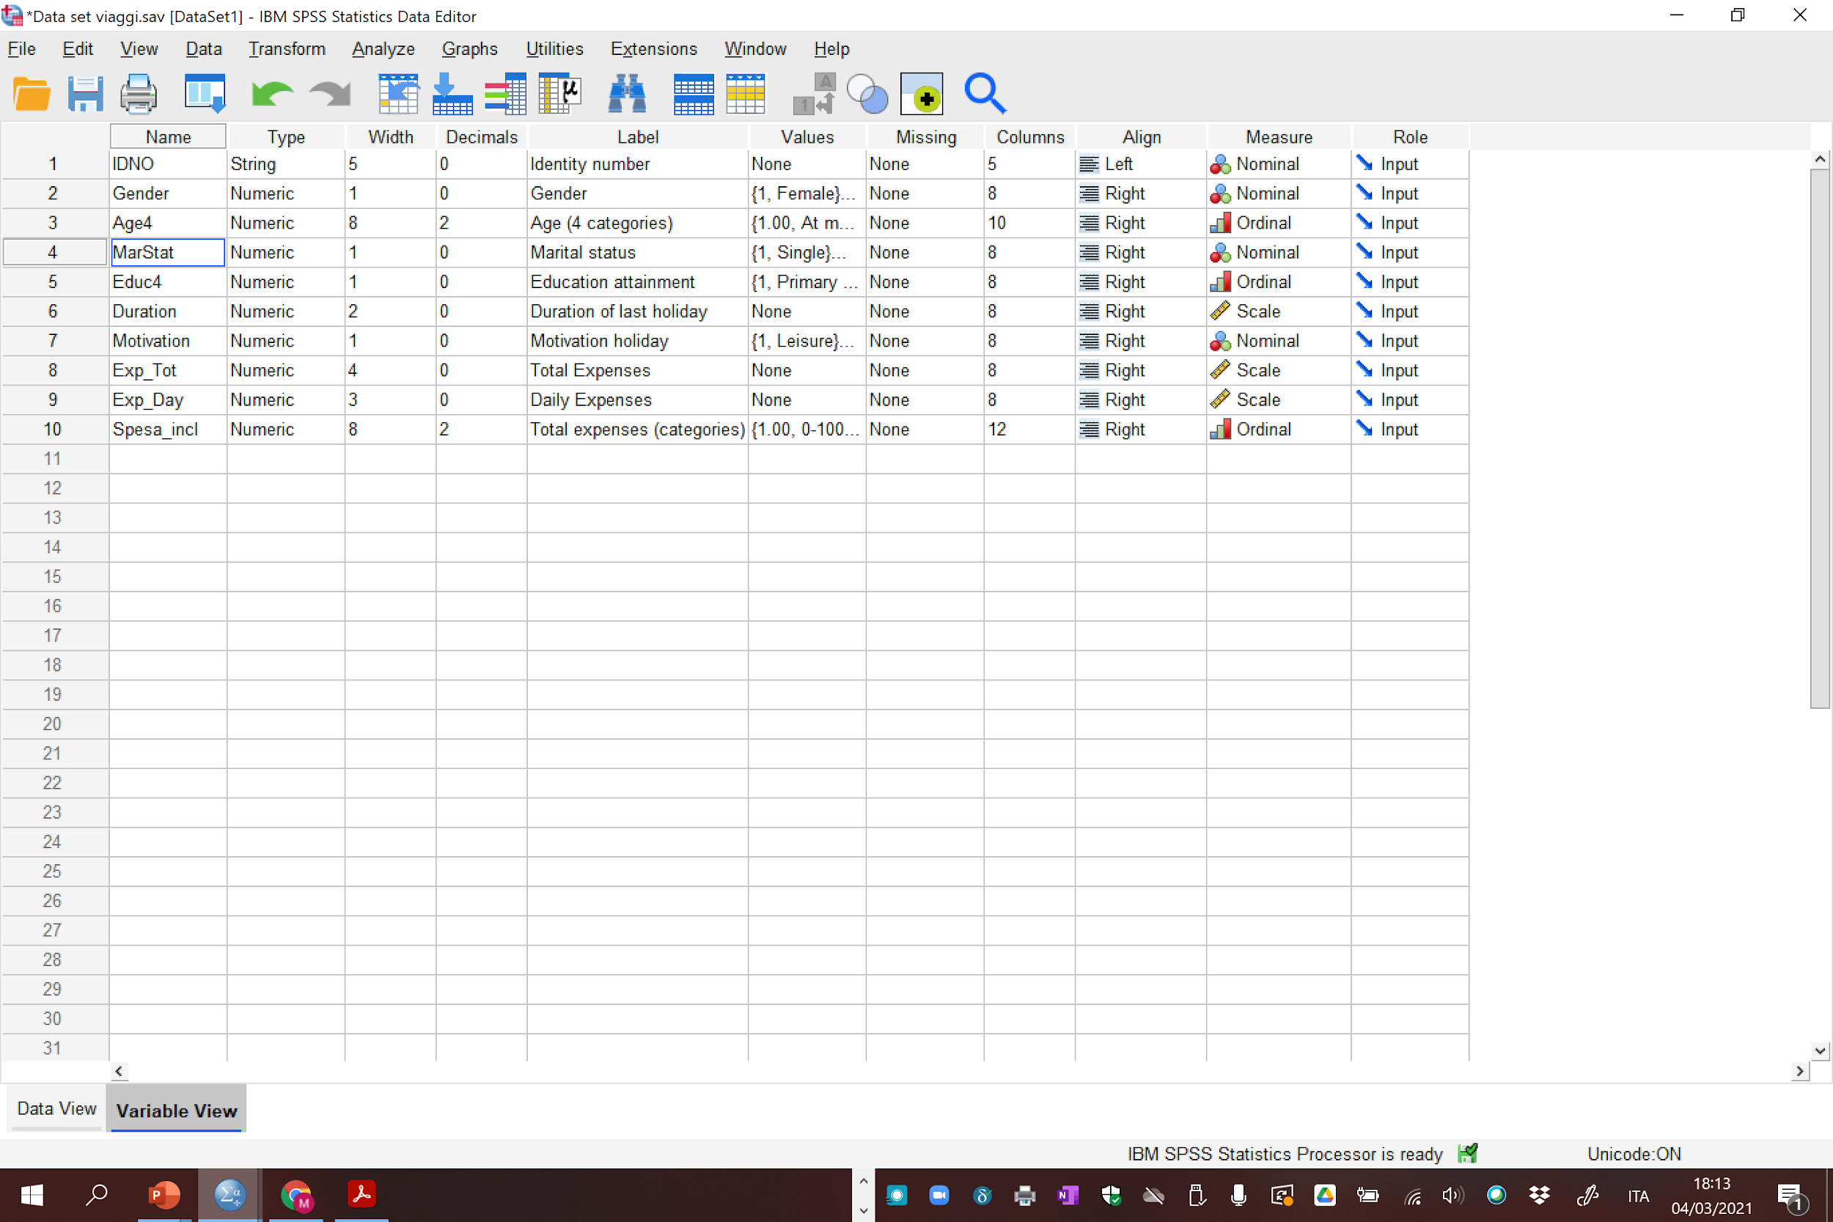
Data
Variables
SPSS-Lecture 1
10

Slide 11
Descriptive Statistics
Describing data with tables and graphs
(quantitative or categorical variables)
Numerical descriptions of center, variability, position (quantitative variables)
SPSS-Lecture 1
11

Slide 12
Tables and Graphs
Frequency distribution: Lists possible values of variable and number of times each occurs
SPSS-Lecture 1
12

Slide 13
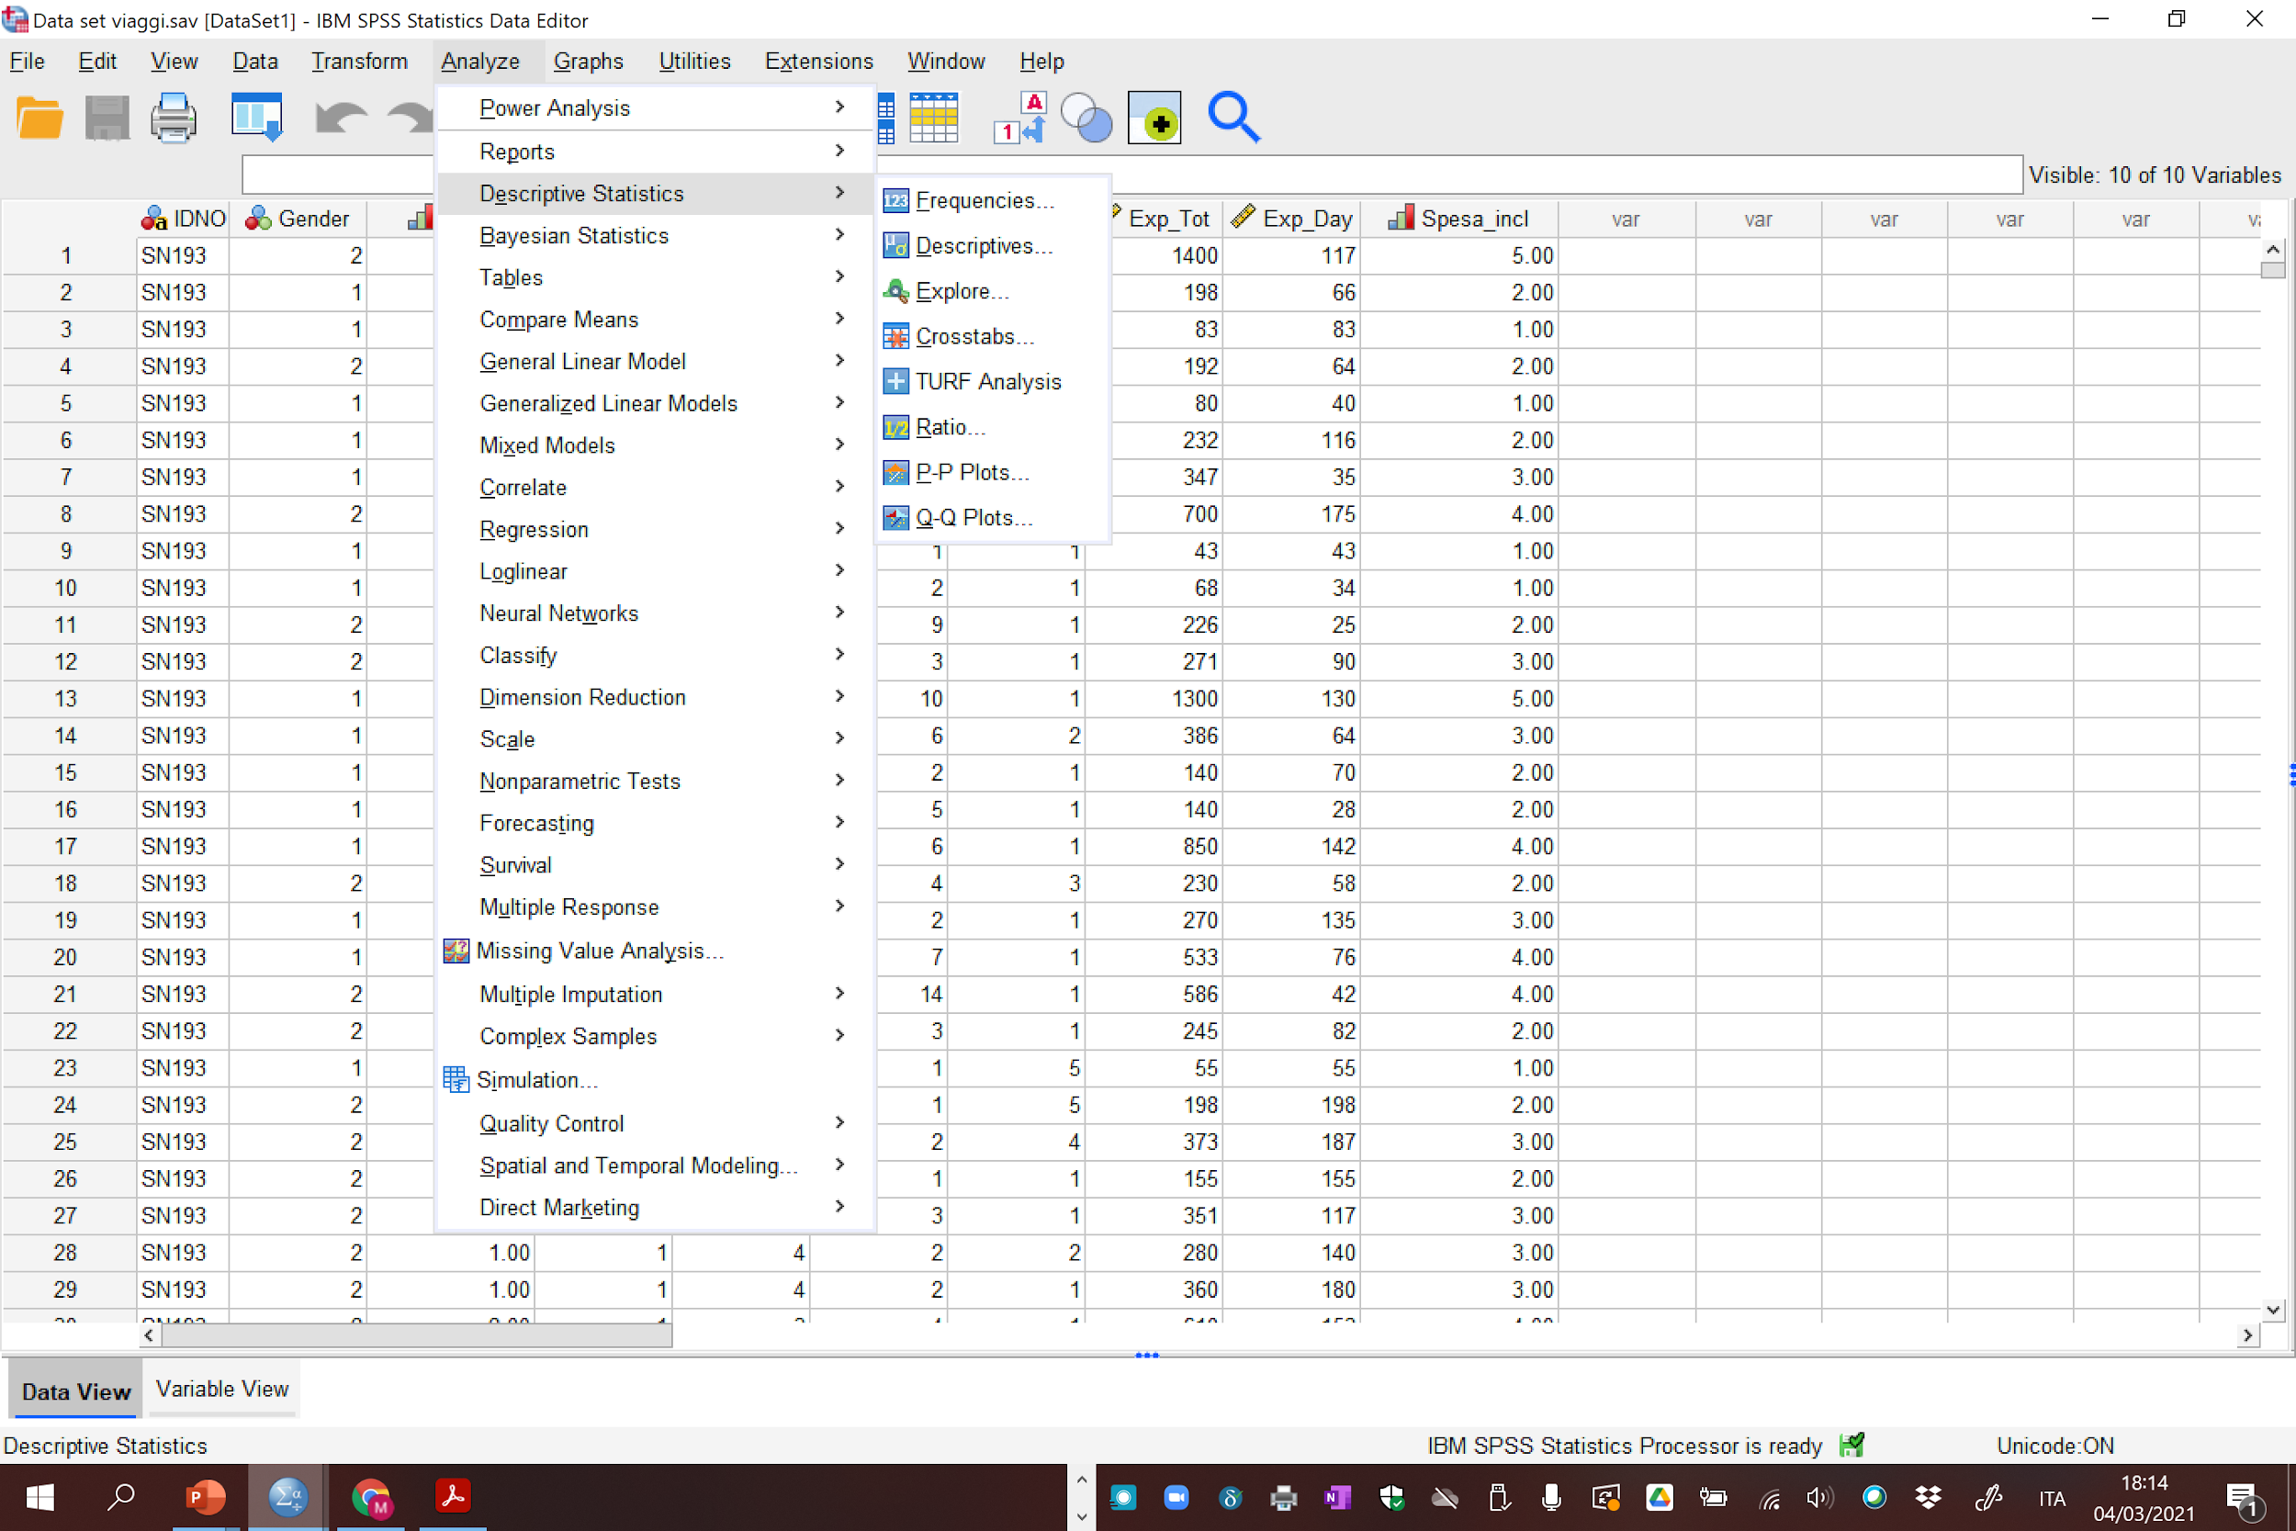
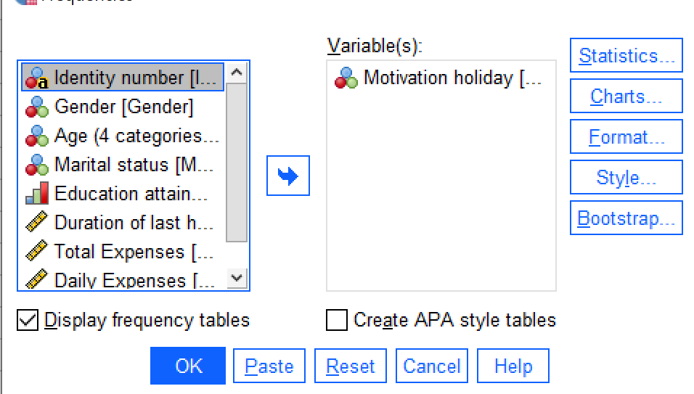
SPSS-Lecture 1
13

Slide 14
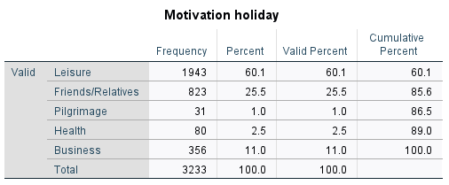
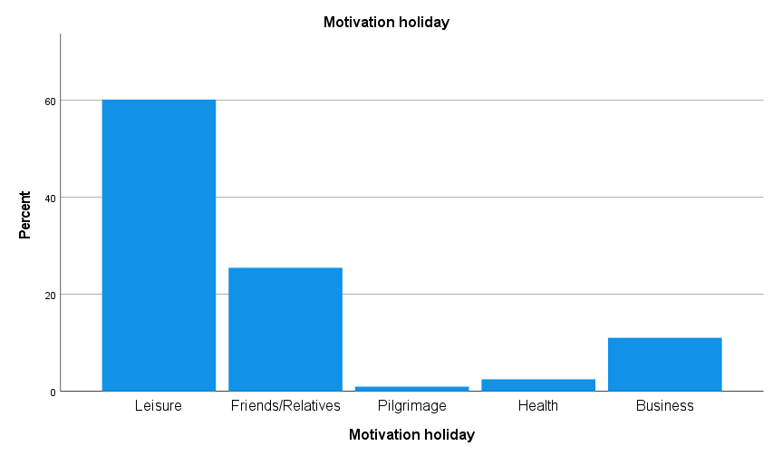

Slide 15
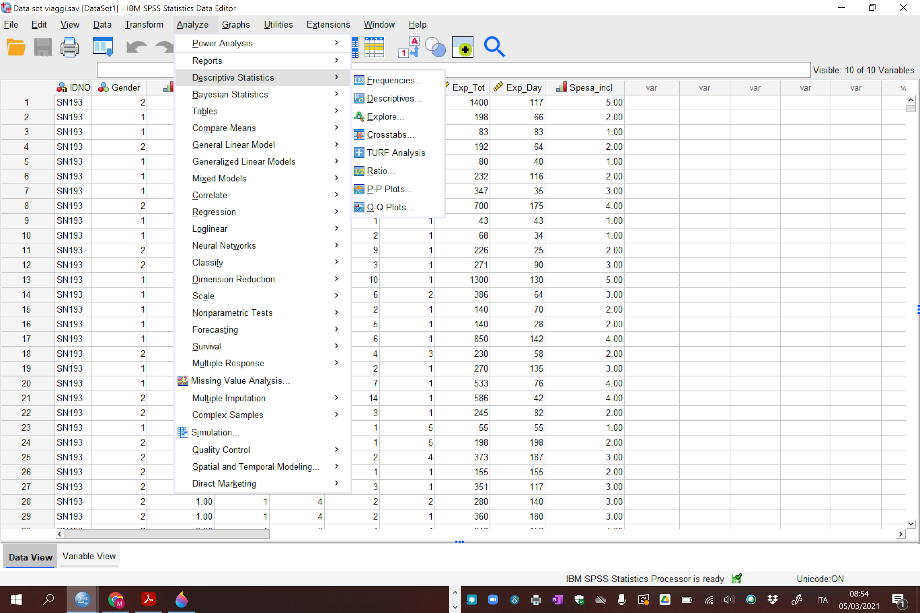
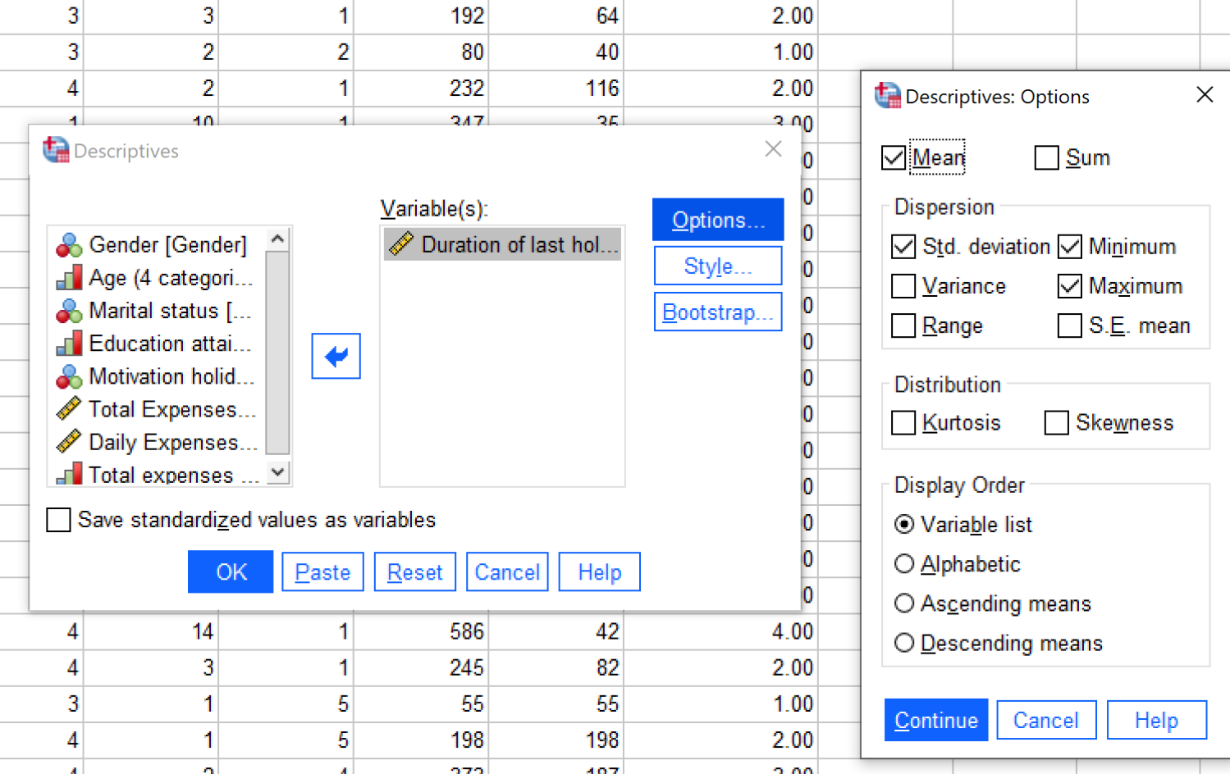
Descriptive statistics
SPSS-Lecture 1
15
Notes:
15
Due to John Tukey, EDA, 1977

Slide 16
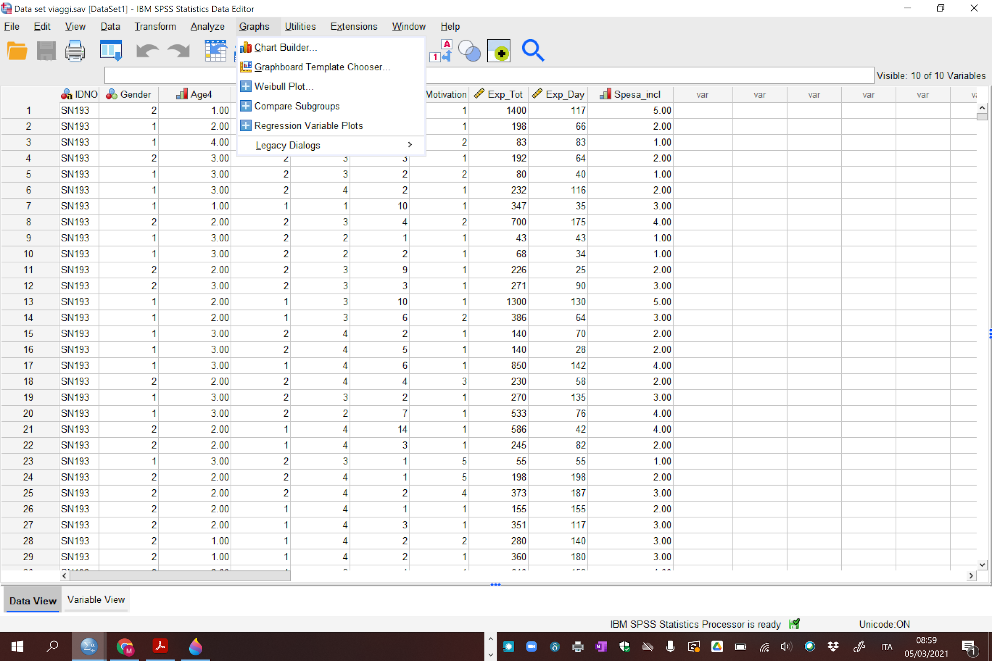
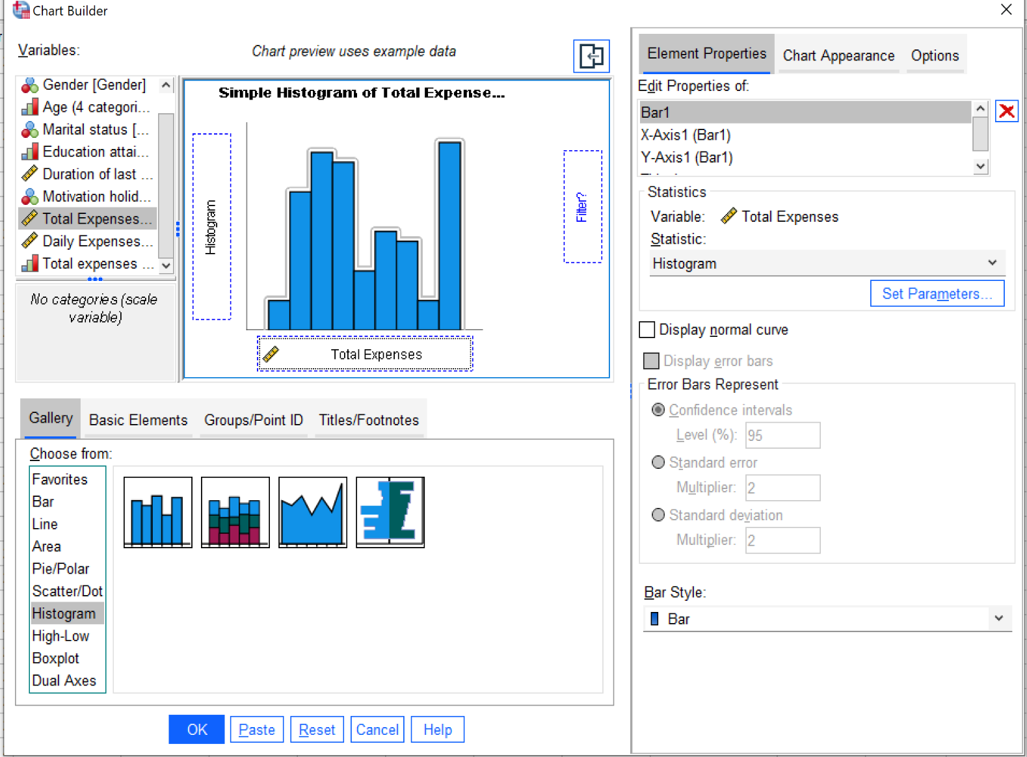
Histogram (for quantitative variables)
SPSS-Lecture 1
16
Notes:
16
Draw on board, perhaps add U-shaped

Slide 17
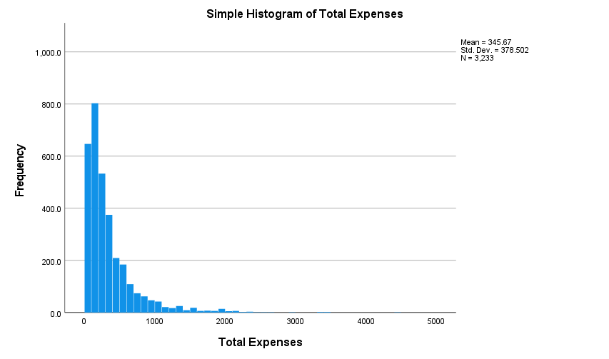
Histogram Total Expenses
SPSS-Lecture 1
17

Slide 18
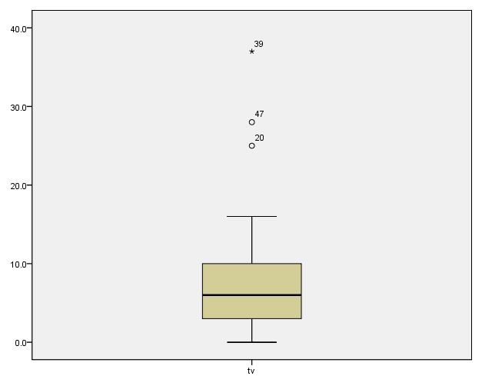
BOXPLOT
Box plots have box from LQ to UQ, with median marked. They portray a five-number summary of the data:
Minimum,
LQ,
Median,
UQ,
Maximum
except for outliers identified separately
Outlier = observation falling
below LQ – 1.5(IQR)
or above UQ + 1.5(IQR)
Outliers
SPSS-Lecture 1
18
Notes:
03/03/2014
18

Slide 19
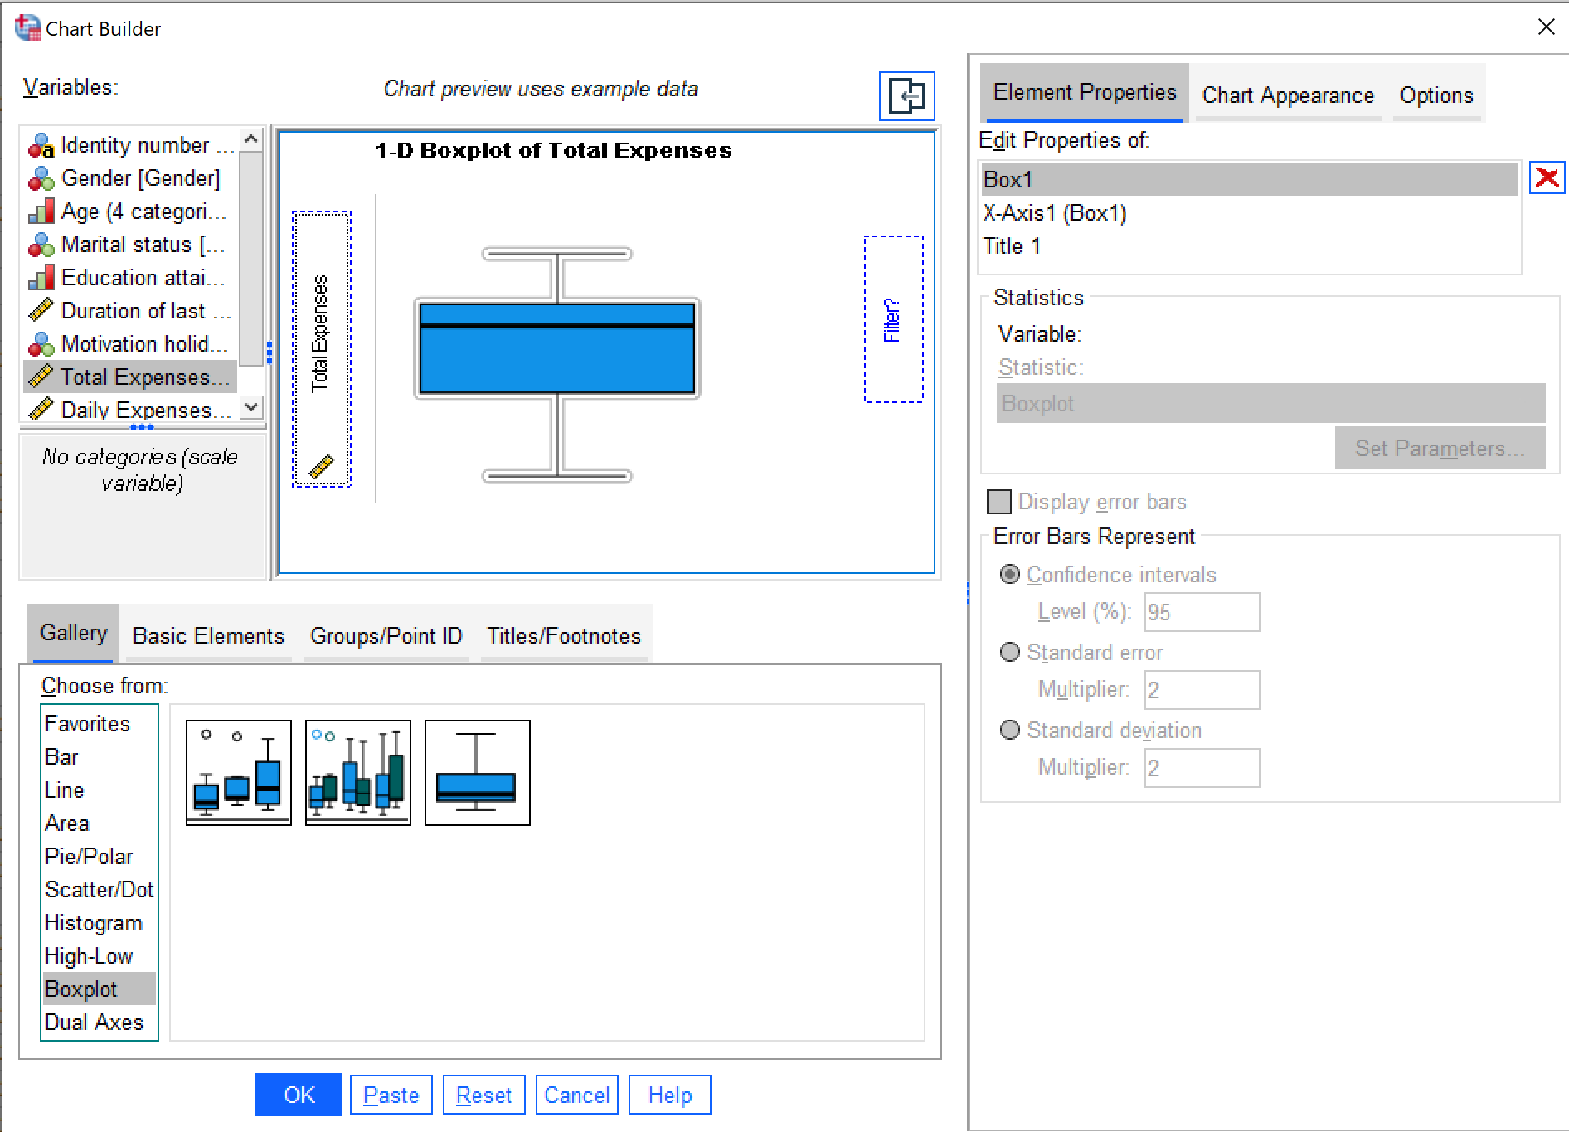
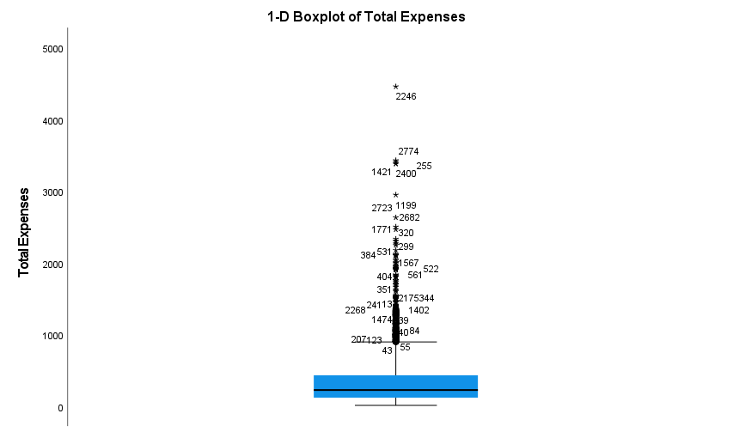
BOXPLOT
SPSS-Lecture 1
19
Notes:
03/03/2014
19

