Slide 1
Statistical methods for tourism II
IBM SPSS Statistics
30/03/2023

Slide 2
TODAY
MULTIPLE LINEAR REGRESSION
SERVQUAL
PCA

Slide 3
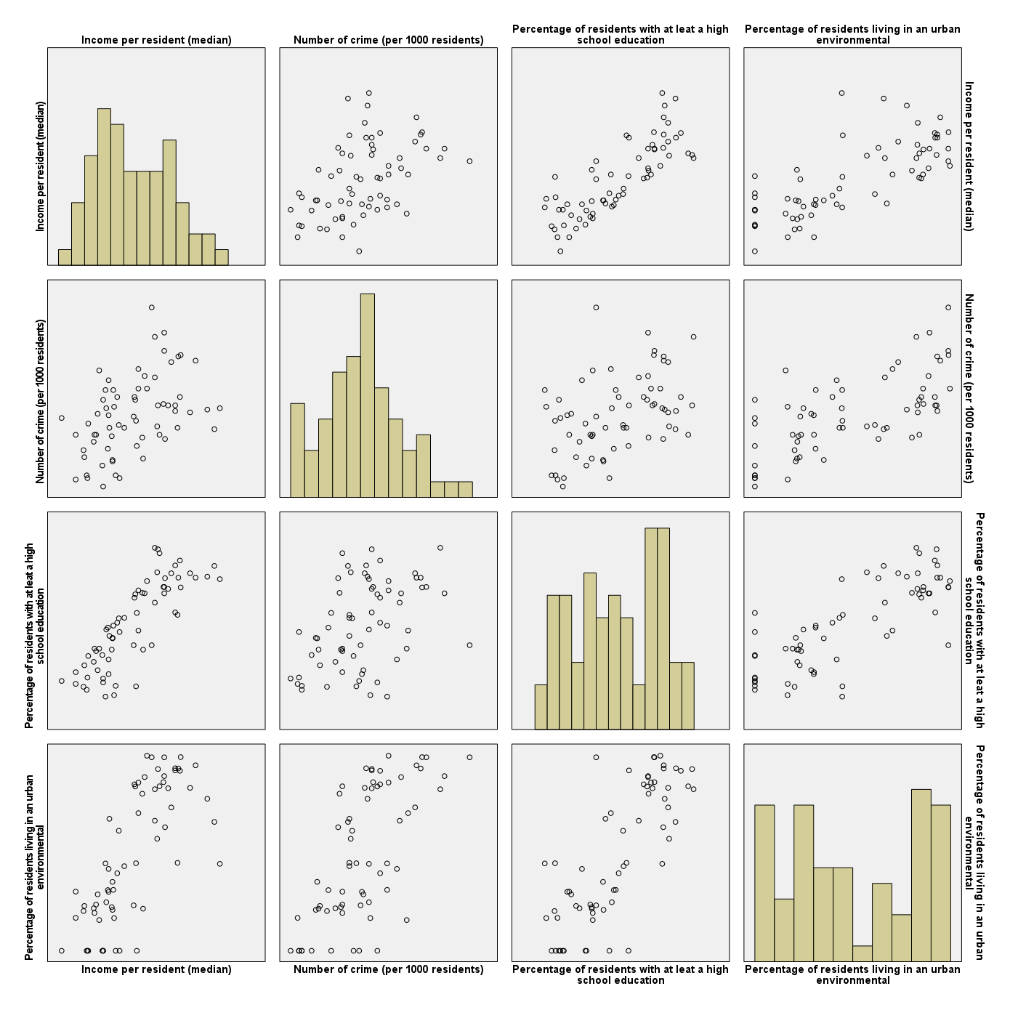
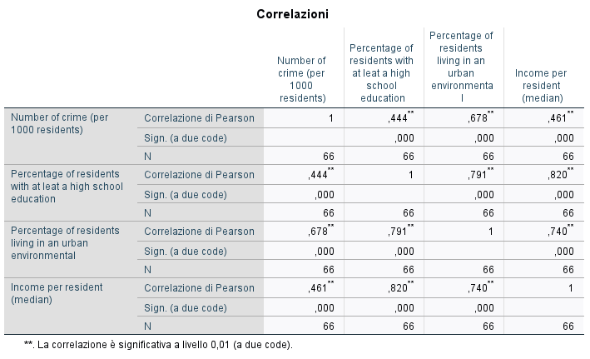
CORRELATION
DATA SET COUNTY.SAV
CORRELATION
MATRIX OF SCATTERPLOT

Slide 4
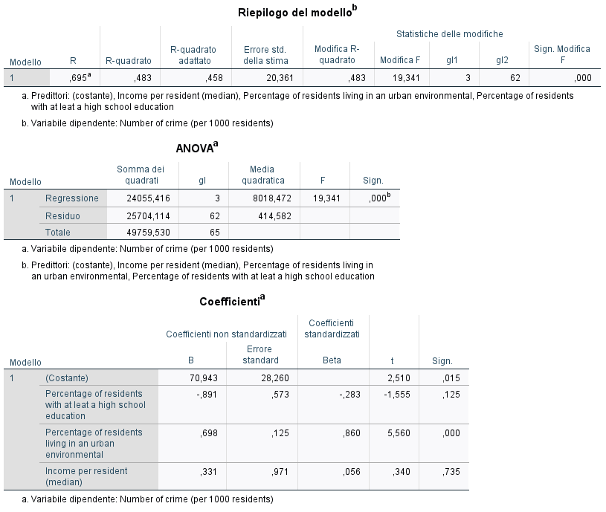
MULTIPLE LINEAR REGRESSION

Slide 5
SERVQUAL
DATA SET SERVQUAL.SAV

Slide 6
PCA and RELIABILITY
Variable | Description
id | ID questionnaire
Autunno | I am satisfied with tourism in my municipality in Autumn (1=Completely in disagree,…,5=Completely agree)
Inverno | I am satisfied with tourism in my municipality in Winter (1=Completely in disagree,…,5=Completely agree)
Primavera | I am satisfied with tourism in my municipality in Spring (1=Completely in disagree,…,5=Completely agree)
Estate | I am satisfied with tourism in my municipality in Summer (1=Completely in disagree,…,5=Completely agree)
Benefici_comunità | Tourism and tourists visiting my municipality give benefits to the community (1=Completely in disagree,…,5=Completely agree)
Benefici_pers | I have benefits from tourism and tourists visiting my municipality (1=Completely in disagree,…,5=Completely agree)
Coinvolgimento | Overall, I am satisfied with the involvement in planning and development of tourism.
Cultura | How does tourism influence the identity, culture and heritage on your municipality? (1=it damages, 2=it helps to preserve, 3= it helps to improve, 4= no effects, 5= don’t know)
QOL | How does tourism influence on the quality of life of your municipality? (1=it damages, 2=it helps to preserve, 3= it helps to improve, 4= no effects, 5= don’t know)
Genere | Gender (1=male, 2=female)
Eta | Age (1=young, 2=adult, 3=elderly)
Education | Level of education (1=at most middle school, 2=high school, 3 =at least undergraduate degree)
Residenza | Municipality
Forza_lavoro | Workforce
VSS_students.sav

Slide 7
The Global Satisfaction Index
I1 | Satisfaction in Autumn. | Overall, I am very satisfied with tourism in my destination in Autumn. | 1=Strongly disagree; 2=Disagree; 3=Neutral; 4=Agree; 5=Strongly agree. | Ind1 Percentage of residents who are satisfied (Agree+ Strongly Agree) with tourism in the destination in Autumn. ETIS INDICATOR
I2 | Satisfaction in Winter. | Overall, I am very satisfied with tourism in my destination in Winter. | 1=Strongly disagree; 2=Disagree; 3=Neutral; 4=Agree; 5=Strongly agree. | Ind2 Percentage of residents who are satisfied (Agree+ Strongly Agree) with tourism in the destination in Winter. ETIS INDICATOR
I3 | Satisfaction in Spring. | Overall, I am very satisfied with tourism in my destination in Spring. | 1=Strongly Disagree; 2=Disagree; 3=Neutral; 4=Agree; 5=Strongly Agree. | Ind3 Percentage of residents who are satisfied (Agree+ Strongly Agree) with tourism in the destination in Spring. ETIS INDICATOR
I4 | Satisfaction in Summer. | Overall, I am very satisfied with tourism in my destination in Summer. | 1=Strongly disagree; 2=Disagree; 3=Neutral; 4=Agree; 5=Strongly agree. | Ind4 Percentage of residents who are satisfied (Agree+ Strongly Agree) with tourism in the destination in Summer. ETIS INDICATOR

Slide 8
Frequency distribution of the 4 items.
 | N | Strongly Disagree (%) | Disagree (%) | Neutral (%) | Agree (%) | Strongly Agree (%) | Indicator
Overall, I am very satisfied with tourism in my destination in Autumn. | 584 | 10.0 | 39.8 | 19.4 | 22.4 | 8.3 | 30.7
Overall, I am very satisfied with tourism in my destination in Winter. | 584 | 14.5 | 41.5 | 18.2 | 18.4 | 7.5 | 25.9
Overall, I am very satisfied with tourism in my destination in Spring. | 584 | 6.5 | 16.8 | 15.8 | 41.7 | 19.2 | 60.9
Overall, I am very satisfied with tourism in my destination in Summer. | 584 | 4.9 | 11.7 | 7.8 | 41.7 | 33.8 | 75.5

Slide 9
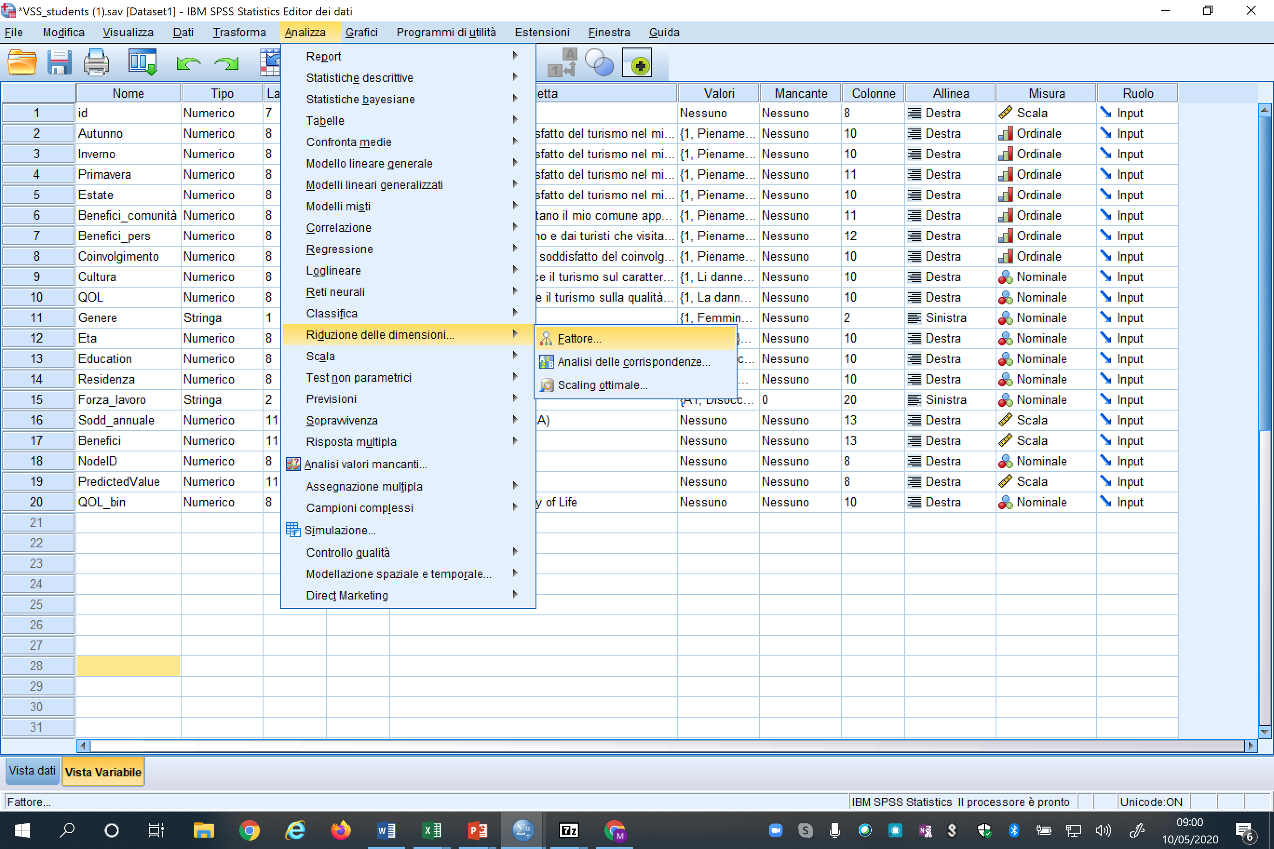
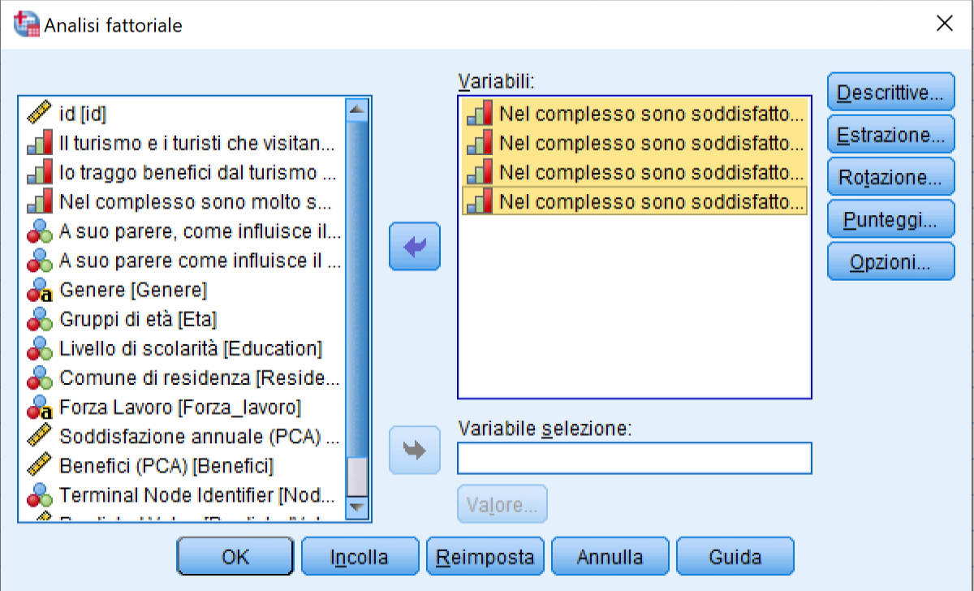

Slide 10
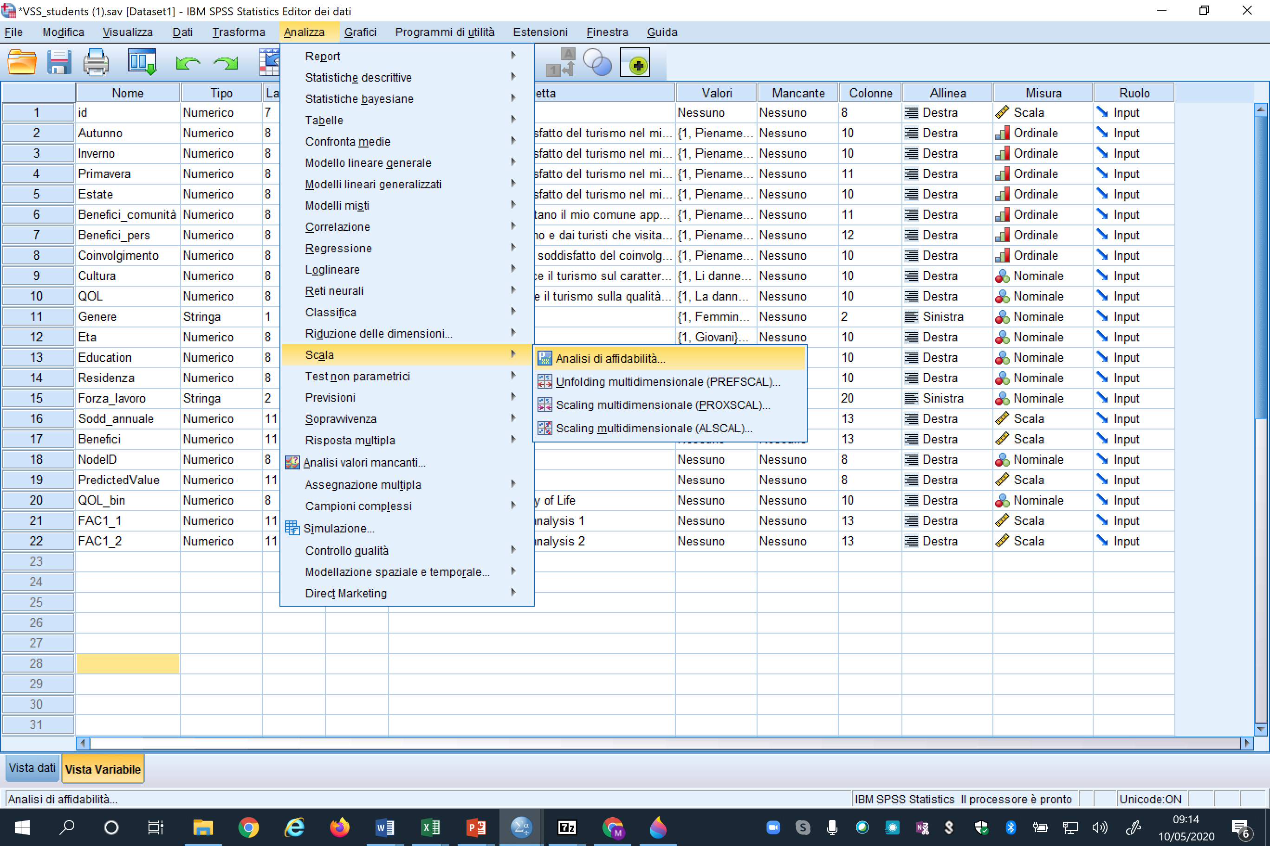

Slide 11
Results of the Factor analysis method using the Maximum Likelihood Estimation on the 4 items
 | SD % | D % | Ne % | A % | SA % | Mean | STD | Factor Loading | Eigenvalue | % Variance | Cronbach’s alpha
Global satisfaction |  |  |  |  |  |  |  |  | 2.816 | 70.405 | 0.858
I1 | 10.0 | 39.8 | 19.4 | 22.4 | 8.2 | 2.79 | 1.147 | 0.964
I2 | 14.5 | 41.5 | 18.2 | 18.4 | 7.5 | 2.63 | 1.158 | 0.921
I3 | 6.5 | 16.8 | 15.8 | 41.7 | 19.2 | 3.50 | 1.167 | 0.654
I4 | 4.9 | 11.7 | 7.8 | 41.7 | 33.8 | 3.88 | 1.148 | 0.547

