Slide 1
One Health Laboratory: From Environment To Health
Prof.ssa Paola Coccetti
Dott.ssa Farida Tripodi
Lab 1027-1026
https://elearning.unimib.it/course/view.php?id=45967

Slide 2
Biological complexity
Natural Bioactive compounds
Bioactivity in biological models

Slide 3
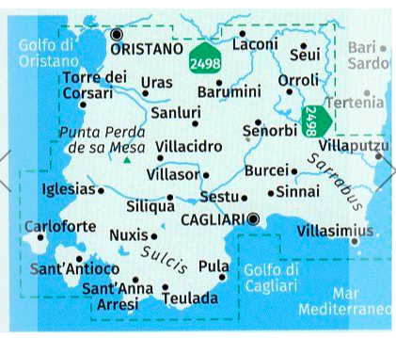
Biological complexity
Parco Naturale Regionale Molentargius-Saline
Foresta Demaniale di Marganai
Riserva Monte Arcosu
Dune di Chia
Onop
Onopordum illyricum
Cynara cardunculus
Myrtus communis

Slide 4
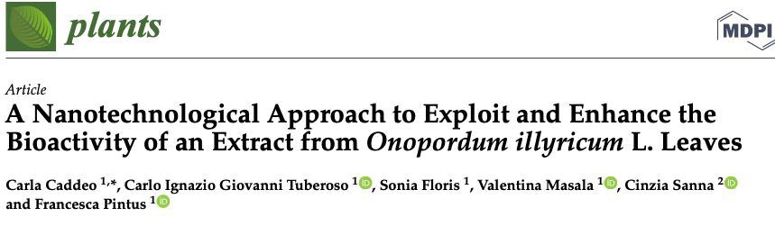
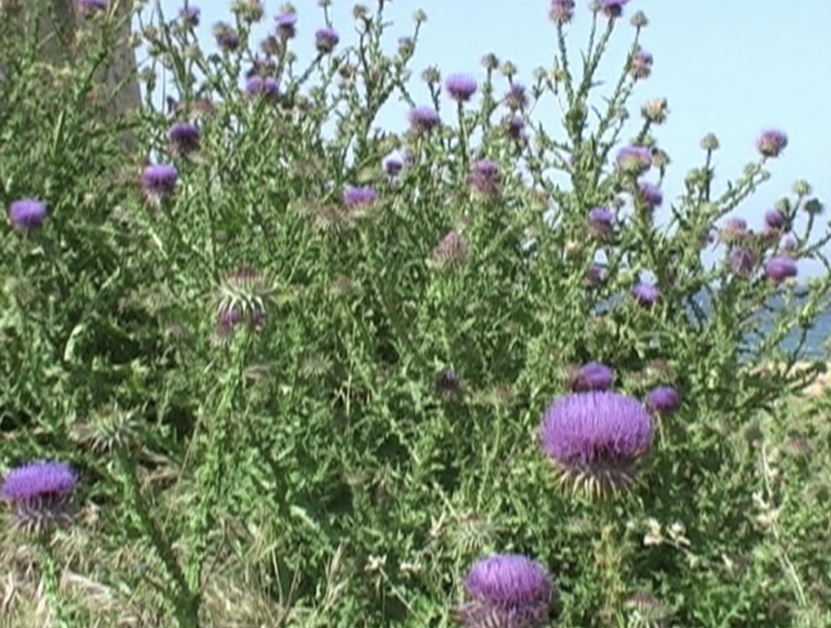
https://doi.org/10.3390/plants12071453
It is traditionally used for food and therapeutic purposes.
In Sardinia, its young scapes and capitula are eaten raw in salad.

Slide 5
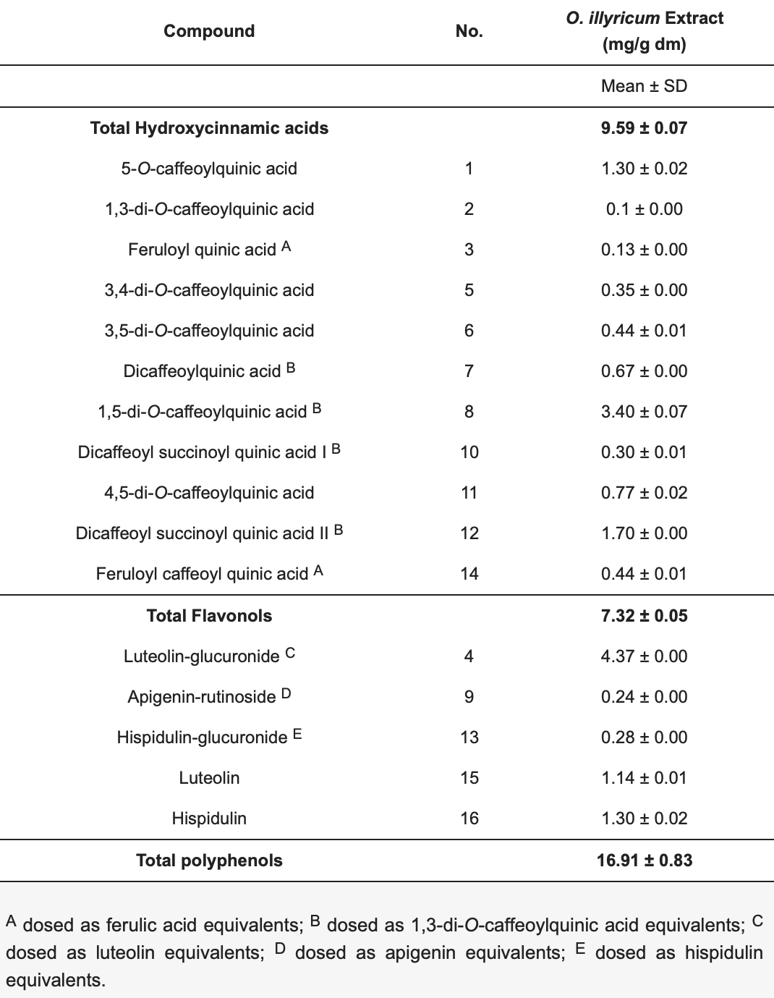
An extract from Onopordum illyricum leaves was produced by maceration in 80% ethanol, characterized by liquid chromatography coupled to mass spectrometry.
Phenolic compounds were abundantly present in the extract, especially hydroxycinnamic acid and flavonol derivatives.
Cultured skin cells treated exposed to oxidative stress show enhanced reduction of intracellular reactive oxygen species (ROS) levels in the presence of O. illyricum extract.

Slide 6
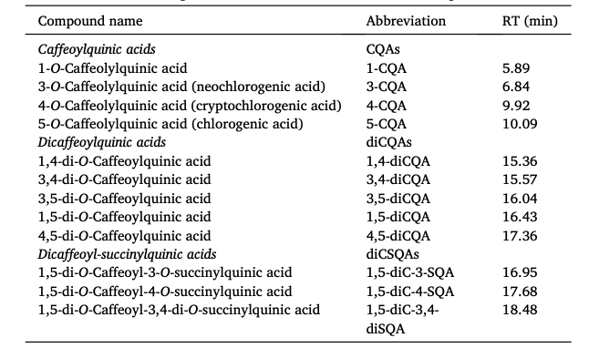
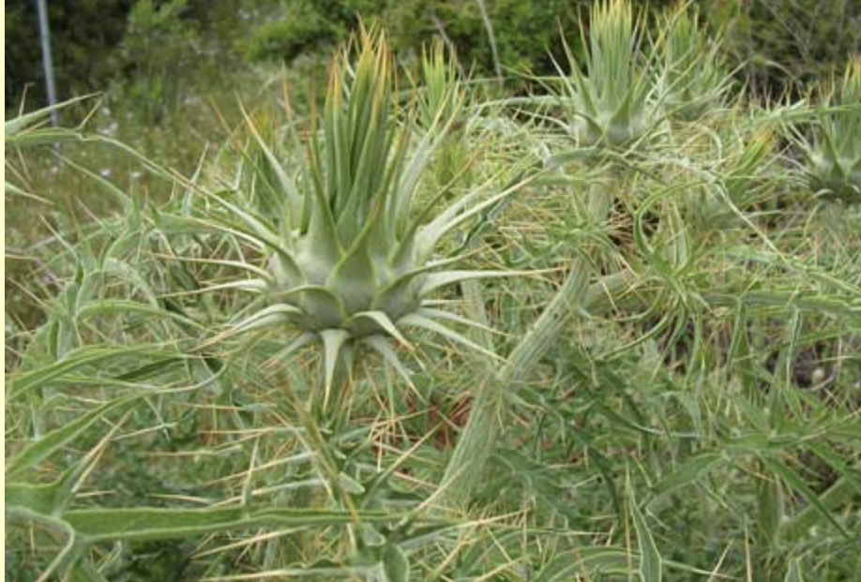
Cynara cardunculus
Twelve phenolic compounds, belonging to the chemical class of hydroxycinnamic acids
https://doi.org/10.1016/j.jfca.2021.104342

Slide 7
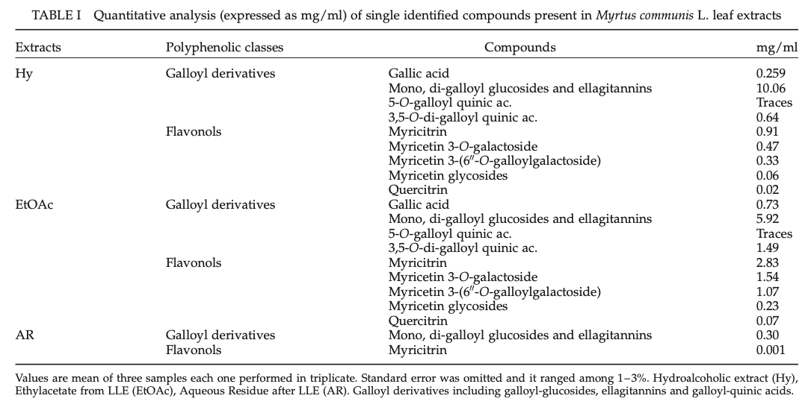
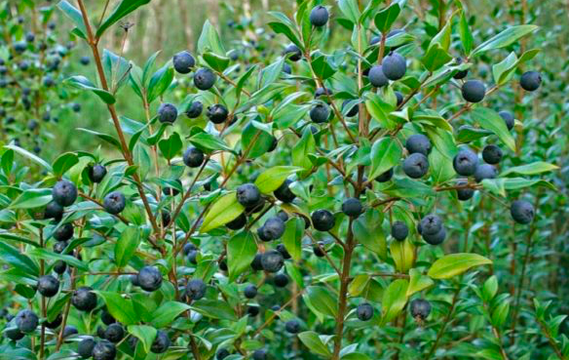
Myrtus communis
DOI: 10.1080/10715760310001625609

Slide 8
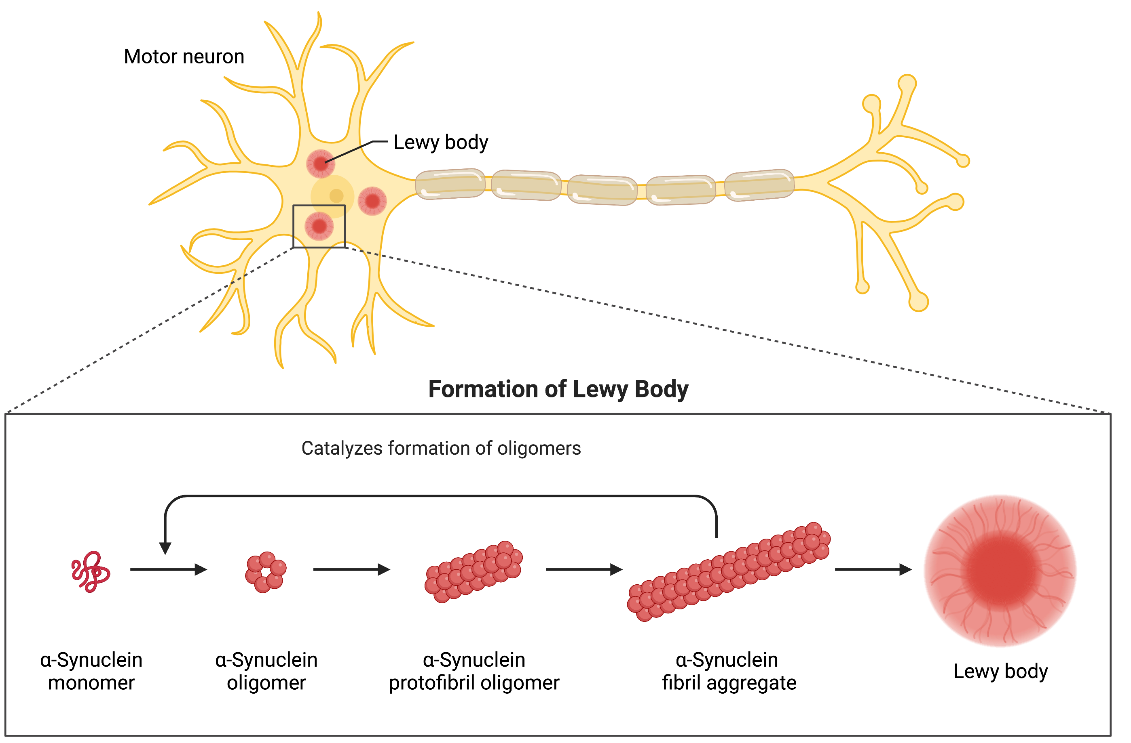
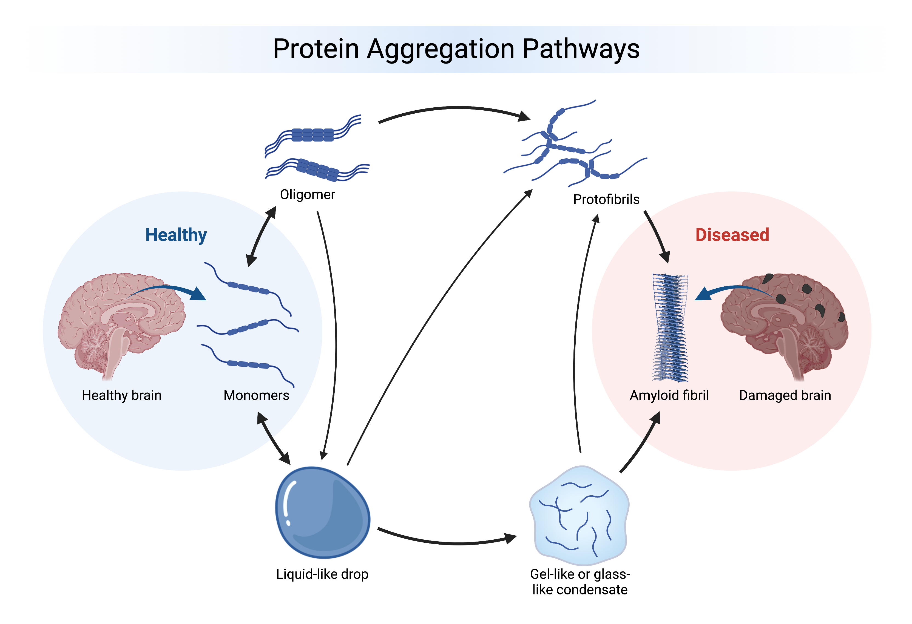
The model:
cell cultures of neuroblastoma cells overexpressing α-synuclein (SHSY)
α-Synuclein is a neuron-specific protein that contributes to the pathology of Parkinson’s disease via mitochondria-related mechanisms.
Interaction of α-synuclein with mitochondria causes release of cytochrome c, increase of mitochondrial calcium and nitric oxide, and oxidative modification of mitochondrial components.
These findings suggest a pivotal role for mitochondria in oxidative stress and apoptosis induced by α-synuclein.
DOI 10.1007/s00018-008-7589-1

Slide 9
Evaluation of the effects of the extracts on:
oxidative stress induced by H2O2 (cell viability and enzymatic assays)
activation of apoptosis (cleaveage of PARP)
intracellular α-synuclein level
2 extraction procedures : H₂O and EtOH/H₂O (50:50, v/v)

Slide 10
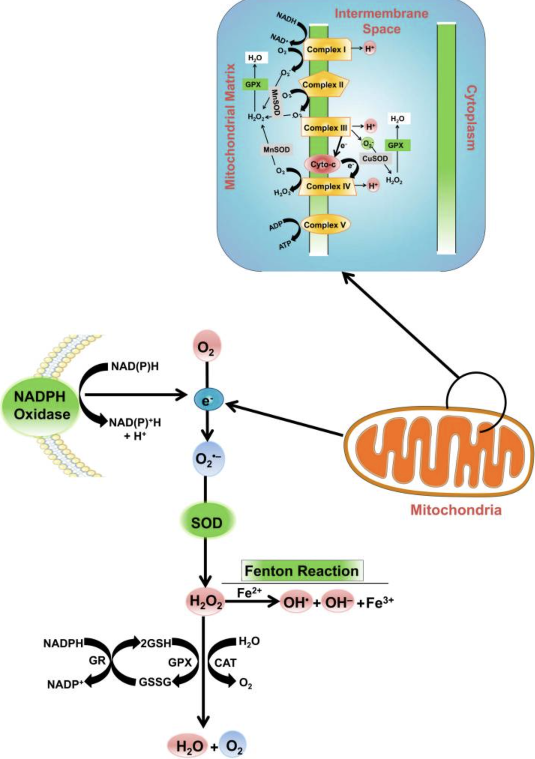
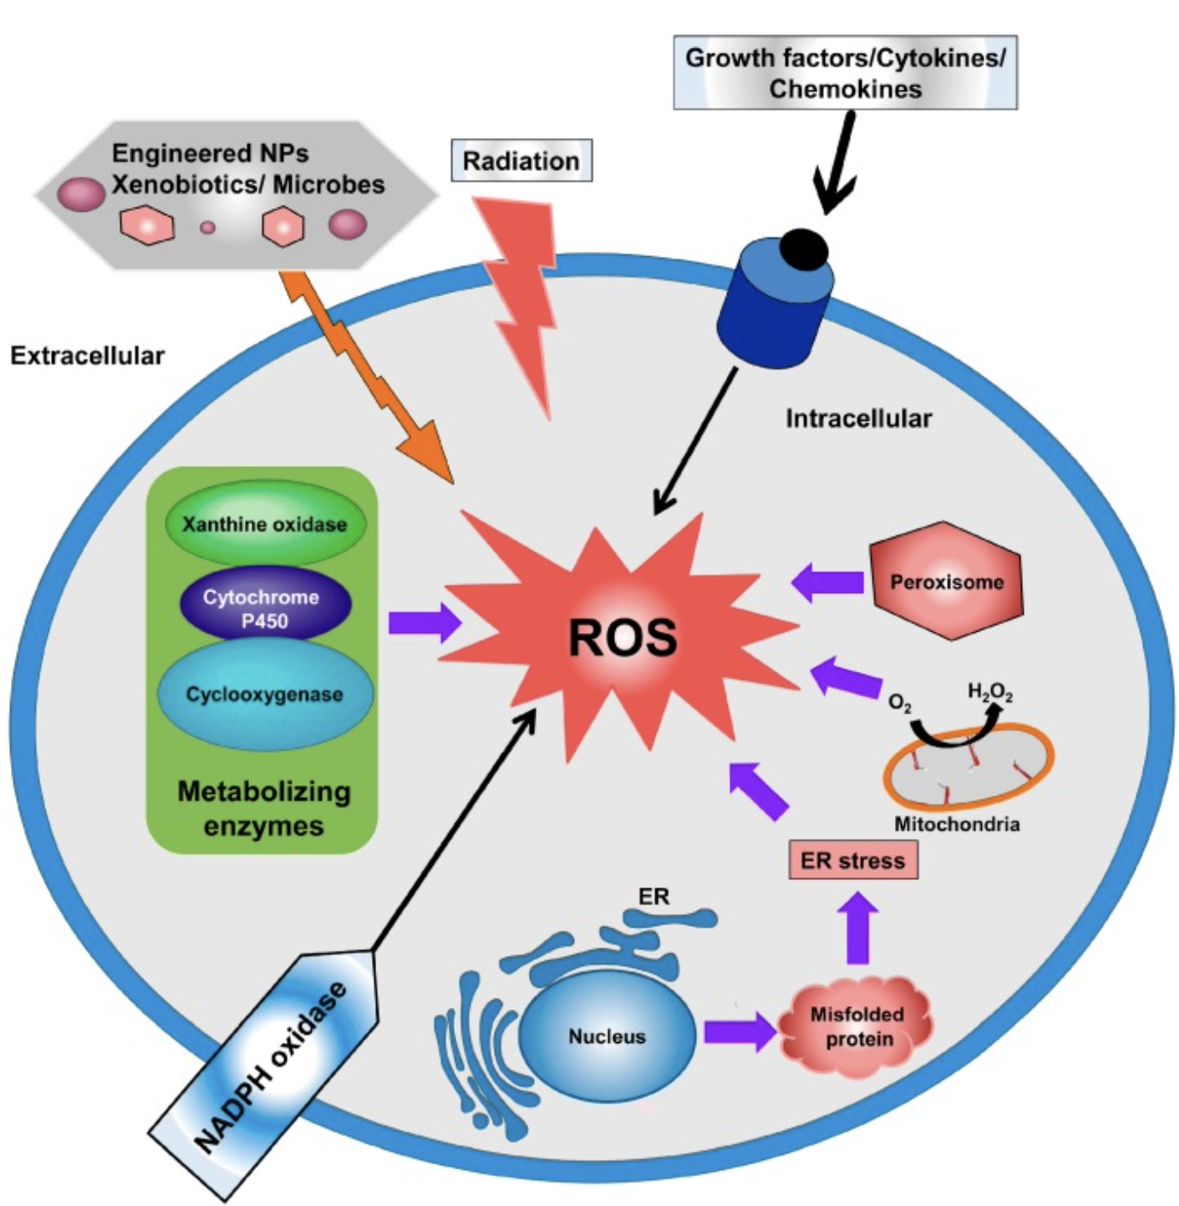
Exposure to hydrogen peroxide (H₂O₂) is a widely used procedure to cause oxidative damage/stress in cellular models.
The Fenton’s reaction between H₂O₂ and Fe²⁺ ions generates the highly reactive OH radical and is thought to be the main mechanism for oxidative damage.
doi: 10.3390/ijms18010120

Slide 11
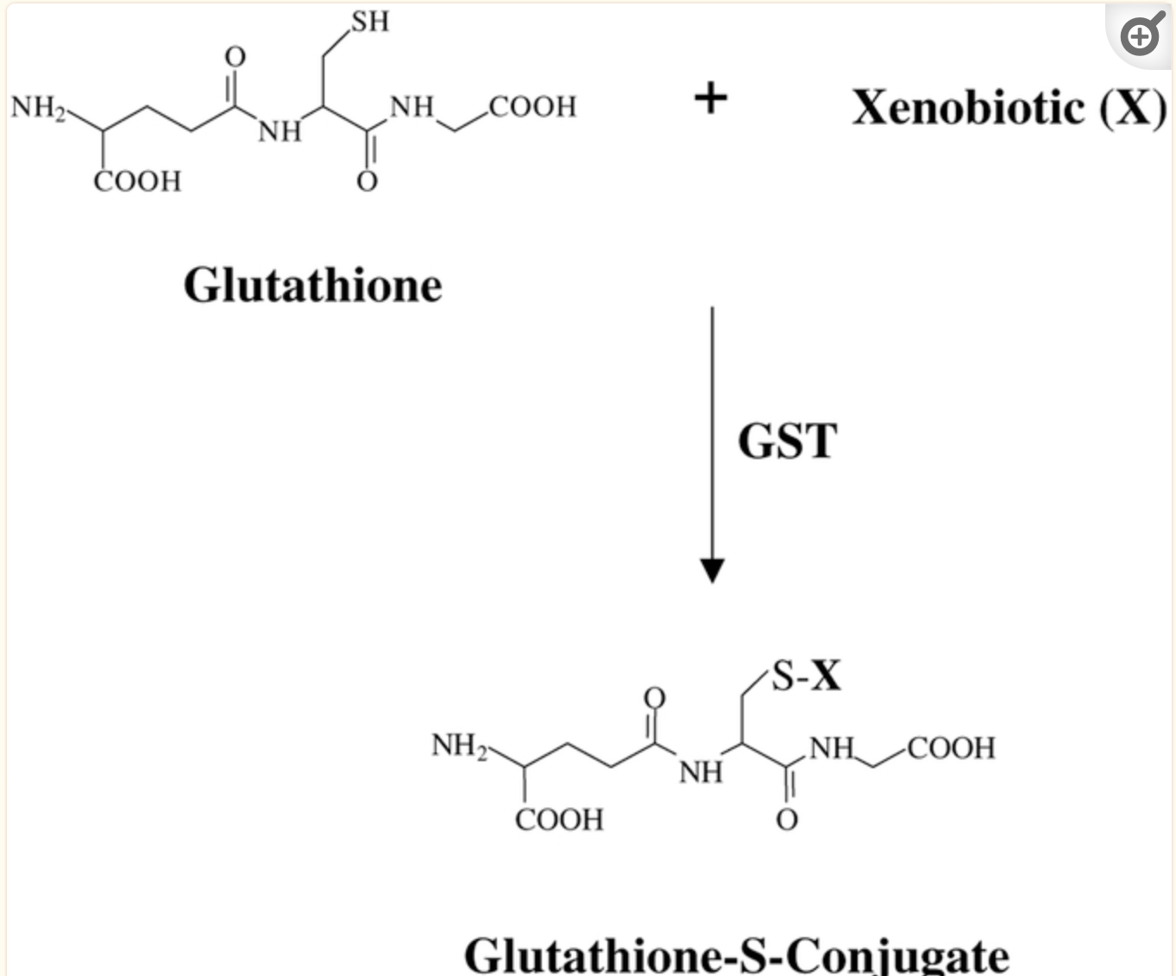
Glutathione S-transferases (GSTs)
Glutathione S-transferases (GSTs) are a family of Phase II detoxification enzymes that function to protect cellular macromolecules from attack by reactive electrophiles.
Specifically, GSTs catalyse the conjugation of glutathione (GSH) to a wide variety of endogenous and exogenous electrophilic compounds.
Glutathione conjugation is the first step in the pathways that lead to the elimination of toxic compounds.
GSTs have evolved with GSH, and are abundant throughout most life forms.
doi: 10.1038/sj.onc.1206940

Slide 12
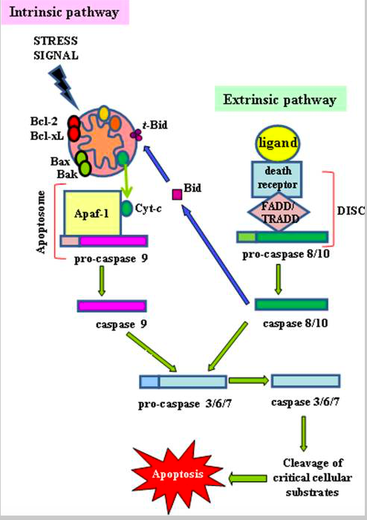
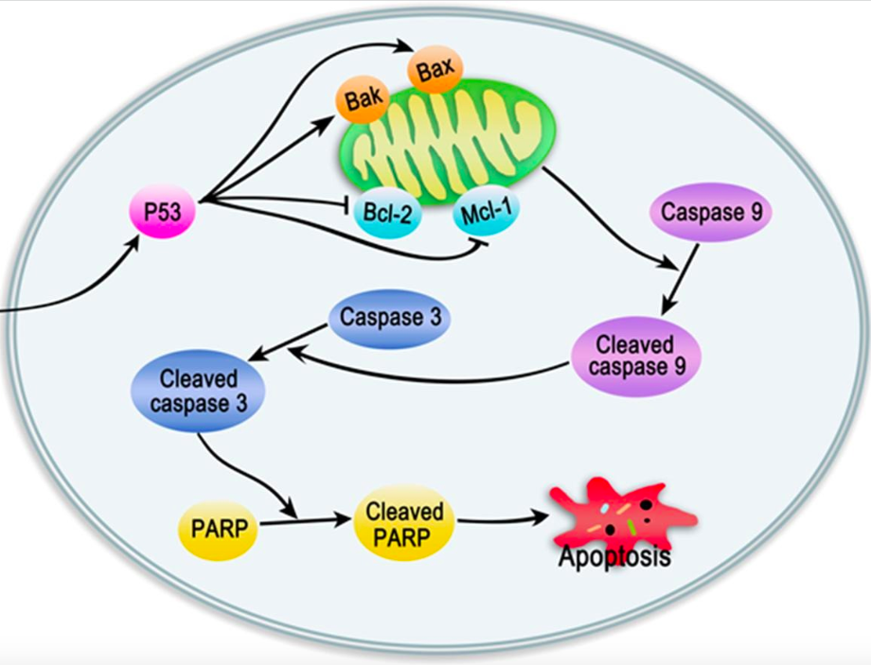
Apoptosis
Stress
signal
Cleavage of PARP-1 by caspases
is considered a hallmark of apoptosis
DOI: 10.18632/aging.100934.

Slide 13
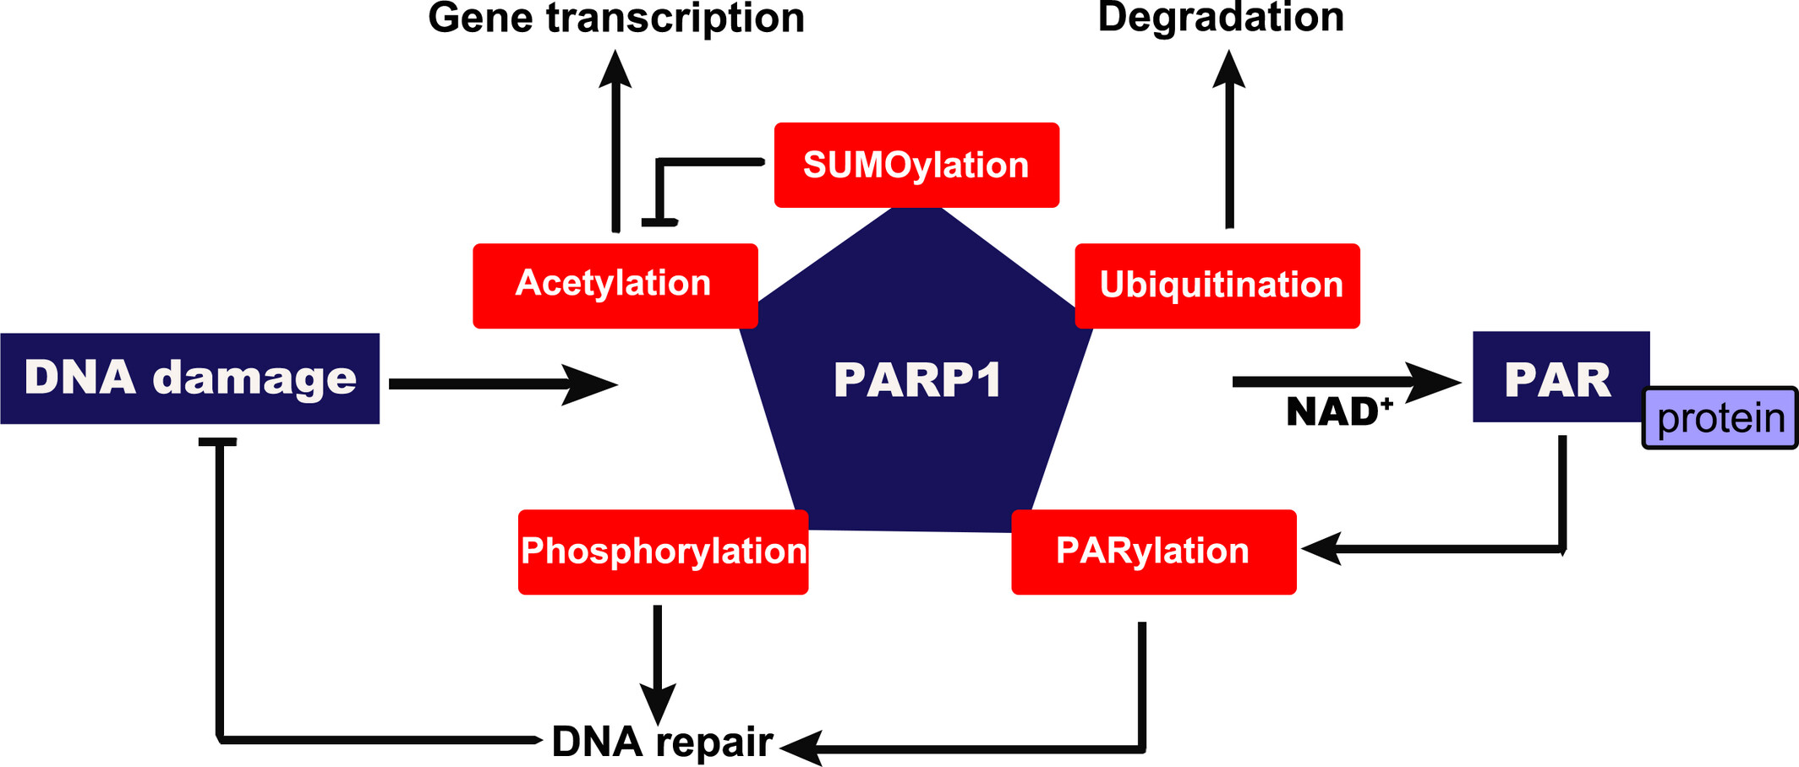
PARP1 responds to and is critically involved in DNA damage repair.
PARP1 catalyzes the covalent attachment of poly (ADP-ribose) (PAR) on itself as well as its substrates in an NAD⁺-dependent manner.
Phosphorylation of PARP1 shows increased activity after DNA damage in regulating cellular signaling pathways.
PARylation of PARP1 is crucial in DNA damage repair.
The FEBS Journal, Volume: 289, Issue: 8, Pages: 2013-2024, First published: 18 January 2021, DOI: (10.1111/febs.15716)

Slide 14
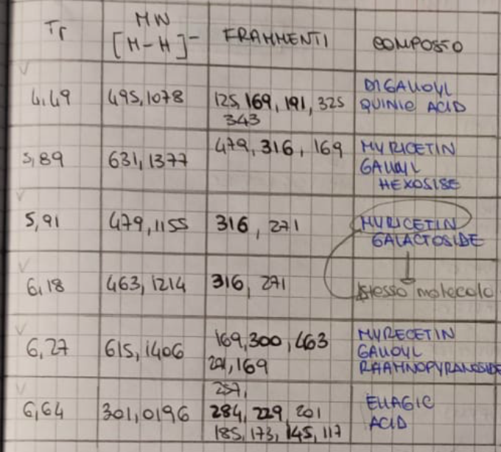
Myrtus communis
EtOH/H₂O (50:50, v/v)

Slide 15
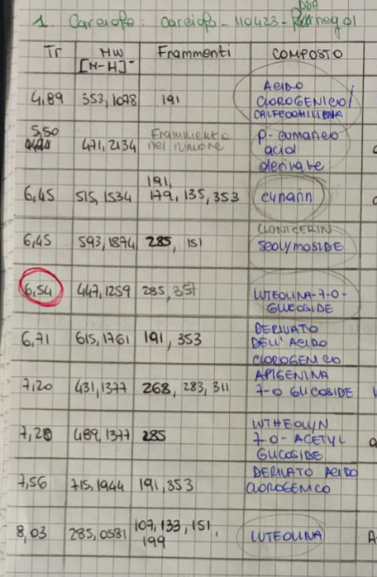
Cynara cardunculus
EtOH/H₂O (50:50, v/v)

