Slide 1
Shikimic acid : Aromatic AA and Phenylpropanoids

Slide 2
Solar energy
CO₂
CELLULOSE
C3-C4 photosynthesis with Calvin Cycle
SUGARS
GLUCOSINOLATES
Carbohydrates
GLYCOLYSIS
MALONYL-CoA
LIPIDS, PHOSPHOLIPIDS, FATS, WAXES
PENTOSE PHOSPHATE P.
ERYTROSE 4-PHOSPHATE
PHOSPHOENOLPYRUVATE
ACETYL-CoA
MEVALONIC ACID P.
SHIKIMIC ACID P.
DOXP/MEP
PATHWAY
TCA
TERPENOID
PATHWAY
IPP
AROMTIC AA
ALIPHATIC AA
MO-SESQUI-DI-TRI-TETRA-POLY
TERPENES
NITROGEN-CONTAINING SECONDARY PRODUCTS (e.g. ALKALOIDS)
ANTHOCYANINS
FLAVONOIDS
LIGNIN
TANNINS
QUINONES
PHENYLPROPANOID P.
PHENOLIC COMPOUNDS

Slide 3
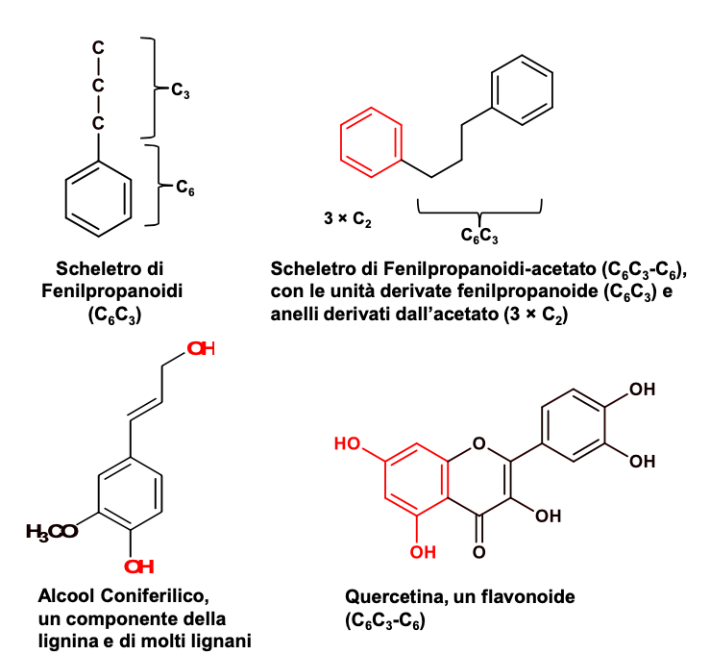
Phenylpropanoids and derivatives are compounds containing a C₆C₃ -moiety derived from the amino acid
L-phenilalanine
Structure of
phenylpropanoids
(C₆C₃)
Phenylpropanoid containing an aromatic ring (C₆)
(C₆C₃-C₆)
Quercetin,
a flavonoid
C₆C₃-C₆
Coniferyl alcohol forms lignin and lignans

Slide 4
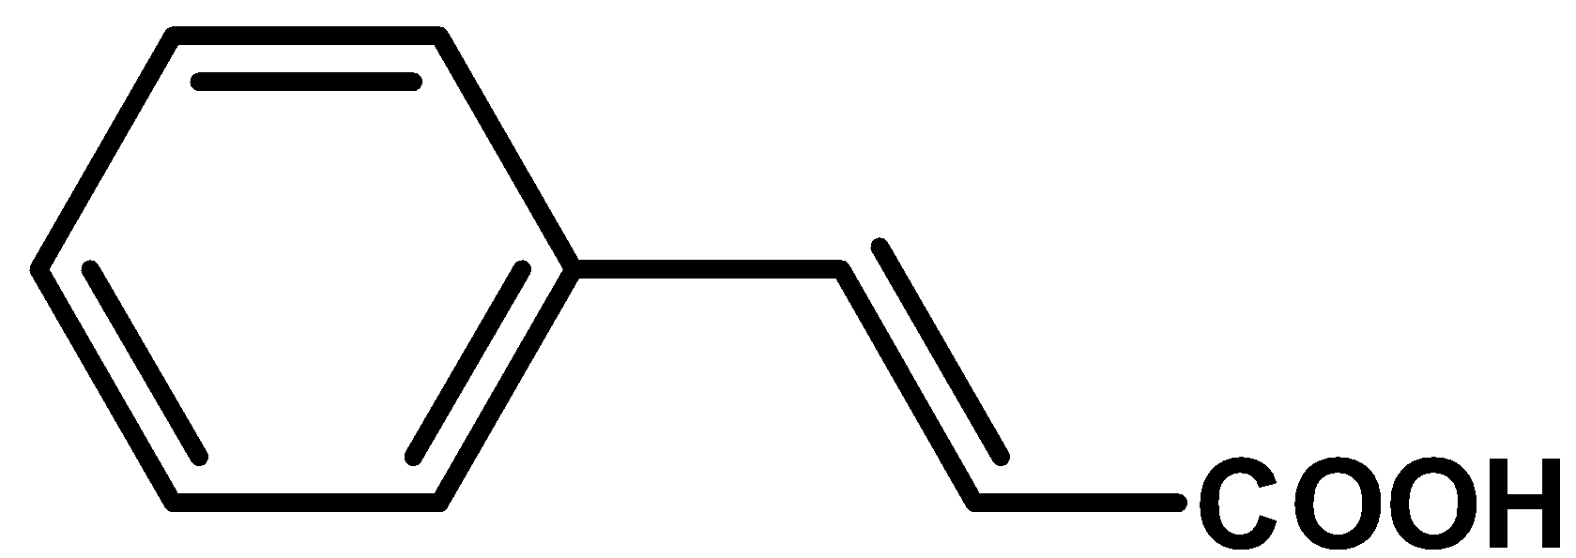
Gallotannins
Shikimic acid
PHENYLPROPANOIDS
Quinones
Phosphoenolpyruvate
+
Erytrose 4-phosphate
Corismic acid
L-Tyrosine
trans-Cinnamic acid
L-Phenylalanine
Phenylpropenols
Coumarin
Lignans
Lignins
Benzoic acids
4-Cumaric acid
(4-Hydroxy-cinnamic acid)
Aromatic polyketides
Flavonoids (Anthocyanins,
Catechins, Tannins)
Stilbens
Chalcons
Flavonolignans
Isoflavonoids
Coumarins
Phenylpropens

Slide 5
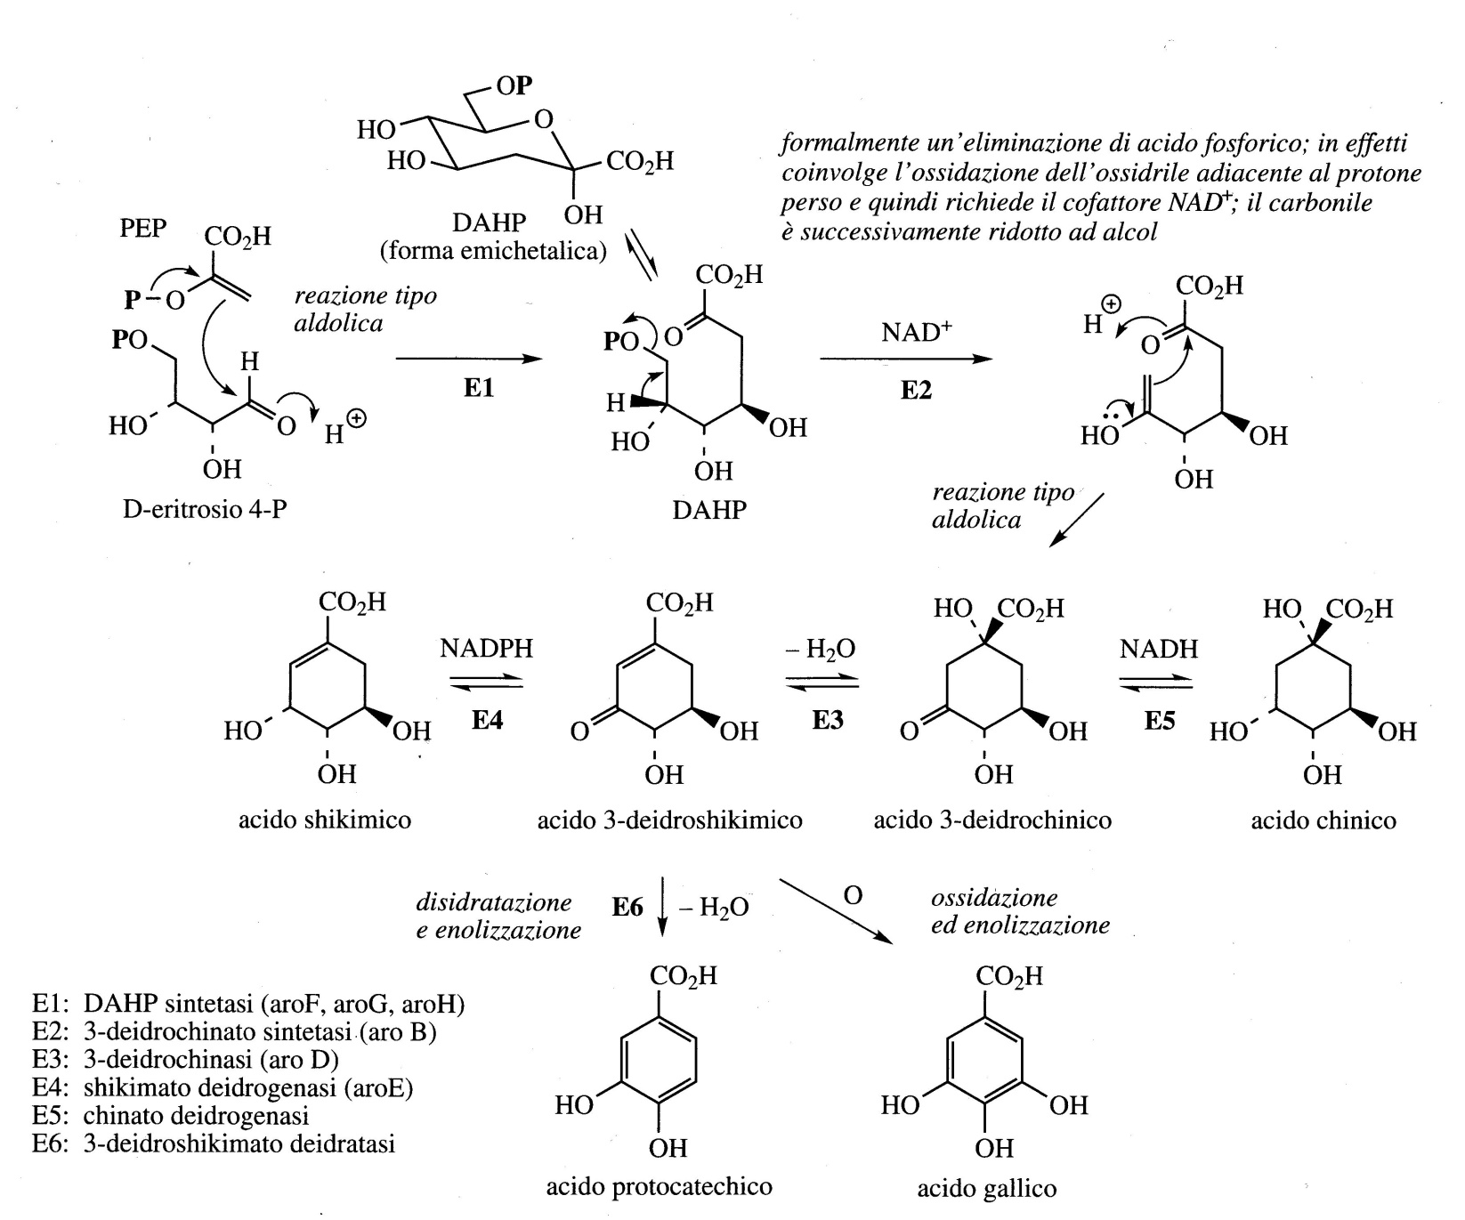
Biosynthesis of Shikimic acid : Aromatic AA and Phenylpropanoids
DAHP Acido 3-deossi-D-arabino-eptulosonico-7-fosfato

Slide 6
Gallotannins
Shikimic acid
PHENYLPROPANOIDS
Quinones
Phosphoenolpyruvate
+
Erytrose 4-phosphate
Corismic acid
L-Tyrosine
trans-Cinnamic acid
L-Phenylalanine
Phenylpropenols
Coumarin
Lignans
Lignins
Benzoic acids
4-Cumaric acid
(4-Hydroxy-cinnamic acid)
Aromatic polyketides
Flavonoids (Anthocyanins,
Catechins, Tannins)
Stilbens
Chalcons
Flavonolignans
Isoflavonoids
Coumarins
Phenylpropens

Slide 7
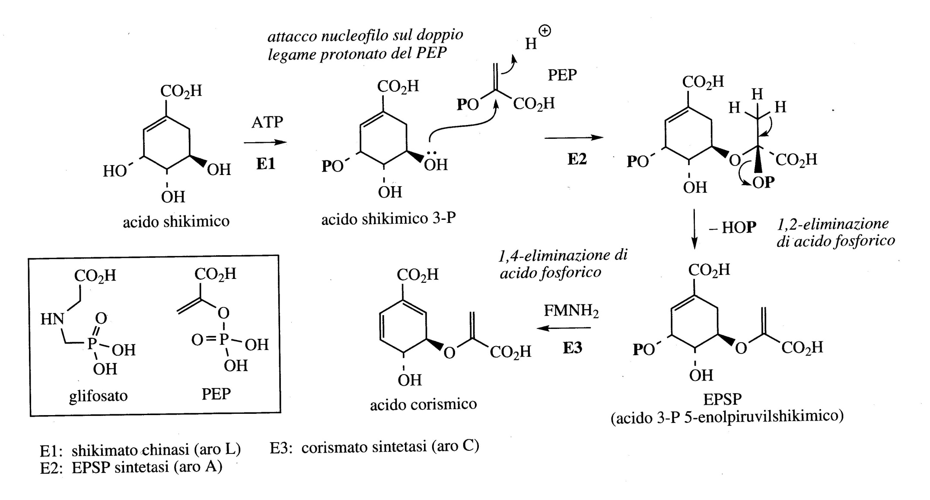
Synthesis of Corismic acid

Slide 8
Gallotannins
Shikimic acid
PHENYLPROPANOIDS
Quinones
Phosphoenolpyruvate
+
Erytrose 4-phosphate
Corismic acid
L-Tyrosine
trans-Cinnamic acid
L-Phenylalanine
Phenylpropenols
Coumarin
Lignans
Lignins
Benzoic acids
4-Cumaric acid
(4-Hydroxy-cinnamic acid)
Aromatic polyketides
Flavonoids (Anthocyanins,
Catechins, Tannins)
Stilbens
Chalcons
Flavonolignans
Isoflavonoids
Coumarins
Phenylpropens

Slide 9
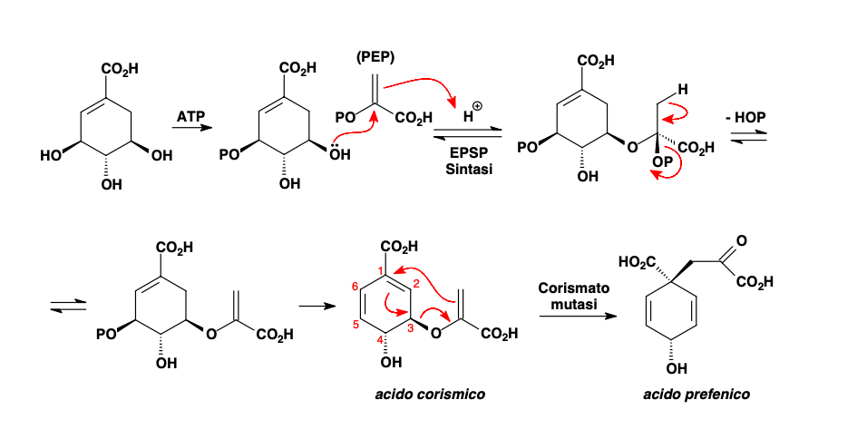
Synthesis of prefenic acid from shikimic acid

Slide 10
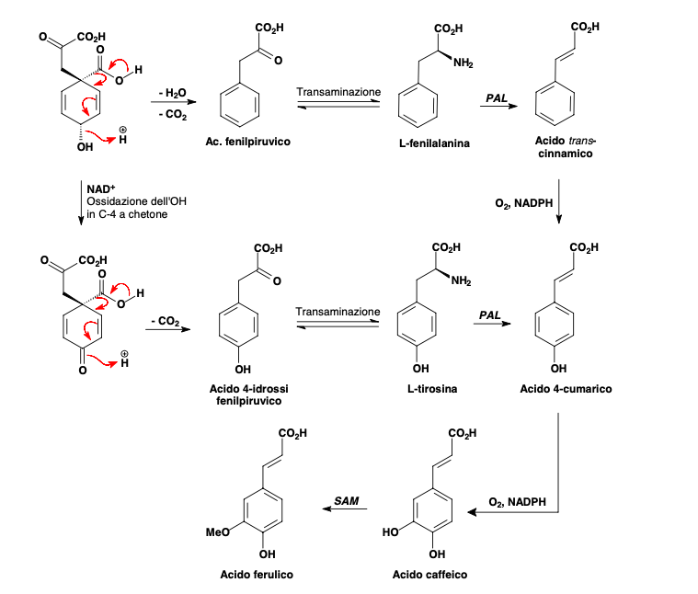
Synthesis of 4-Cumaric acid
and derivatives from prefenic acid
4-coumaric acid (4-Hydroxy-cinnamic acid) (and derivatives among which ferulic acid and caffeic acid) is esterified with CoA and is the starter unit in the synthesis of polychetides.
PAL: phenylalanine/tyrosine ammonia lyases (PAL, TAL)

Slide 11
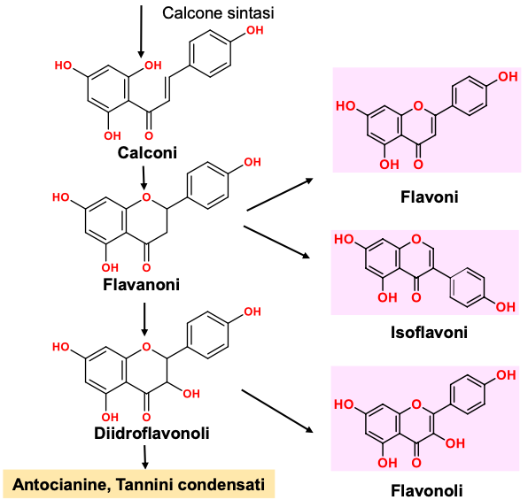
1
2
PAL

Slide 12
Synthesis of 4-Cumaric acid
from prefenic acid
4-coumaric acid (4-Hydroxy-cinnamic acid) is esterified with CoA and is the starter unit in the synthesis of aromatic polyketides.
PAL: phenylalanine/tyrosine ammonia lyases (PAL, TAL)

Slide 13
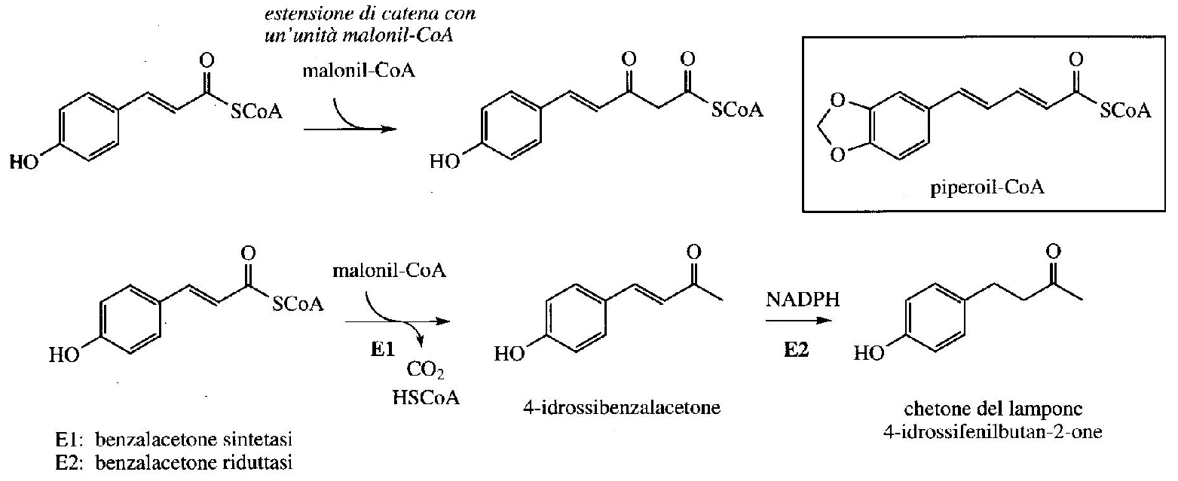
Aromatic polyketides
In the synthesis of aromatic polyketides, both shikimic acid and acetate pathways are involved
Coumaroil-CoA
Piperonyl is involved in the biosynthesis of alkaloid piperine.
Piperonyl-CoA
Coumaroil-CoA
Flvavouring of raspberry

Slide 14
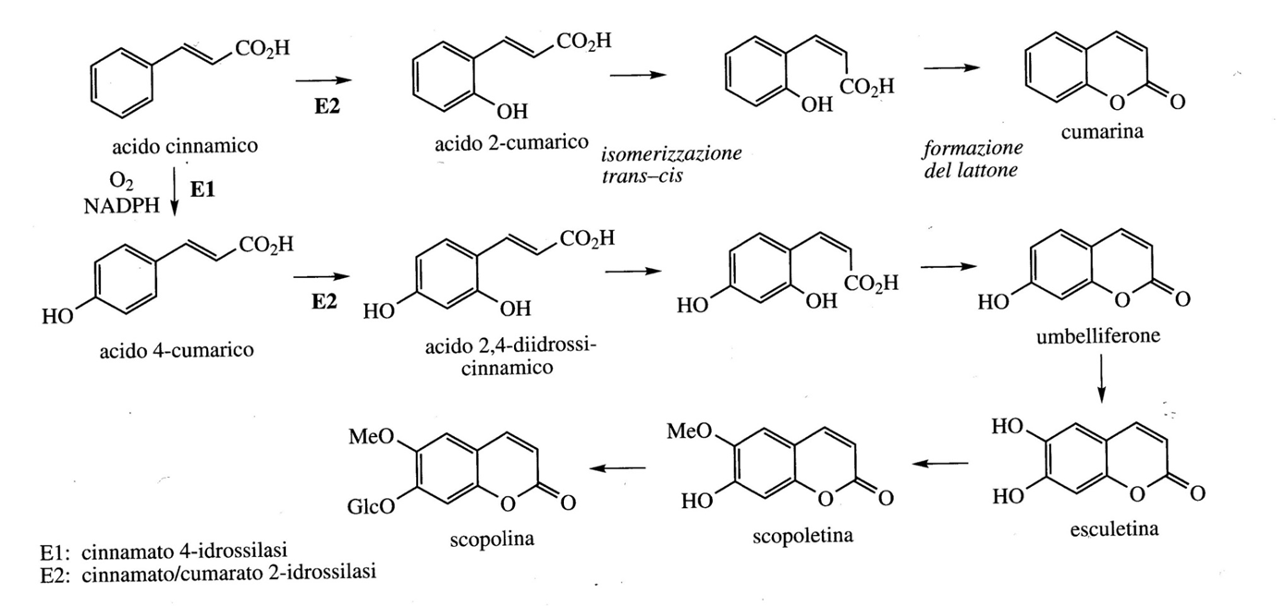
Coumarins
Coumarins are lactone (cyclic ester) derivatives of cinnamic acid. For coumarins, unlike most of the hydroxylations that occur in position 4 with respect to the side chain of cinnamic acids, it occurs in position 2 (ortho). Cinnamic acids then undergo trans / cis isomerization of the double bond
Cinnamic acid and 4-Coumaric acid give rise to coumarins Coumarin and Umbelliferone, respectively. From this derive Esculetina and Scopoletina. Coumarins are usually found in Umbelliferae and Rutaceae both in free form and as glycosides.

Slide 15
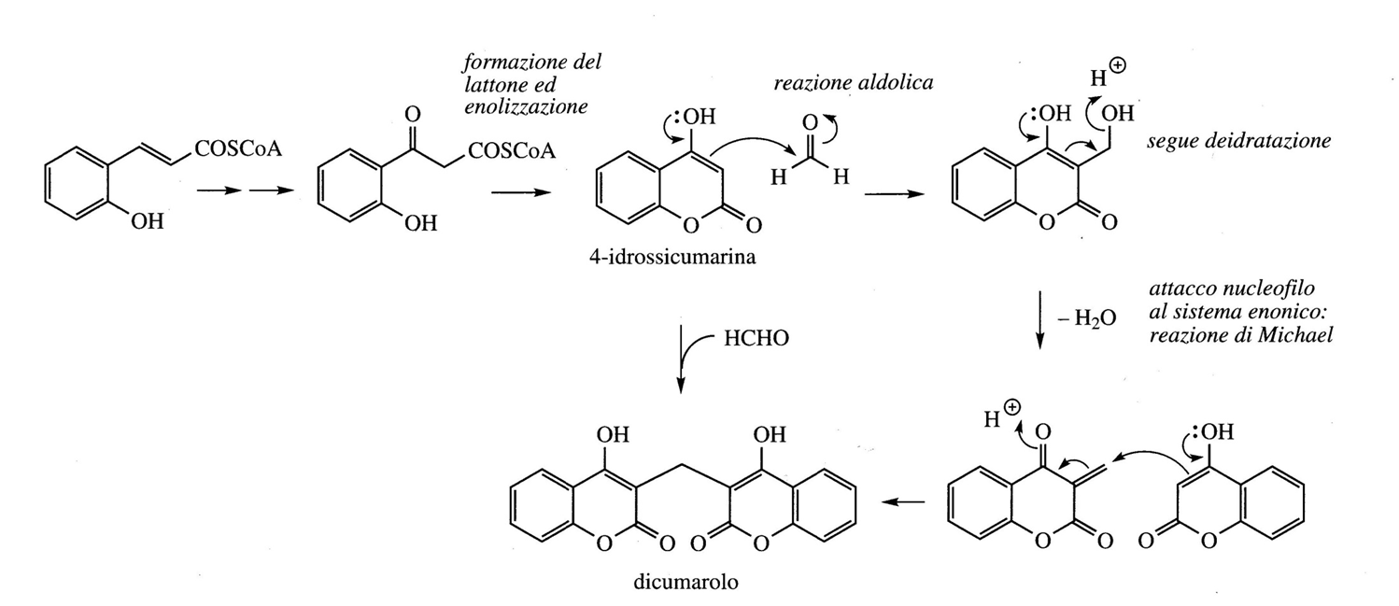
Coumarin is found in Meliloto (Leguminosae / Fabaceae) which, if fermented, in the presence of formaldehyde, derived from bacterial fermentation, produces Dicumarol which has anticoagulant properties and is a rodenticide
2-hydroxy-cinnamic acid-CoA

Slide 16
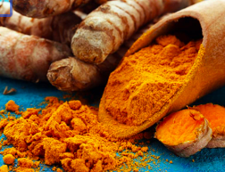
Turmeric
Turmeric, also known as Indian saffron, is a perennial herb. It belongs to the Zingiberaceae family
The most widespread turmeric is curcuma longa.
The main component of turmeric is Curcumin (anti-inflammatory, anti-oxidant, anti-ulcer and anti-tumor properties).

Slide 17
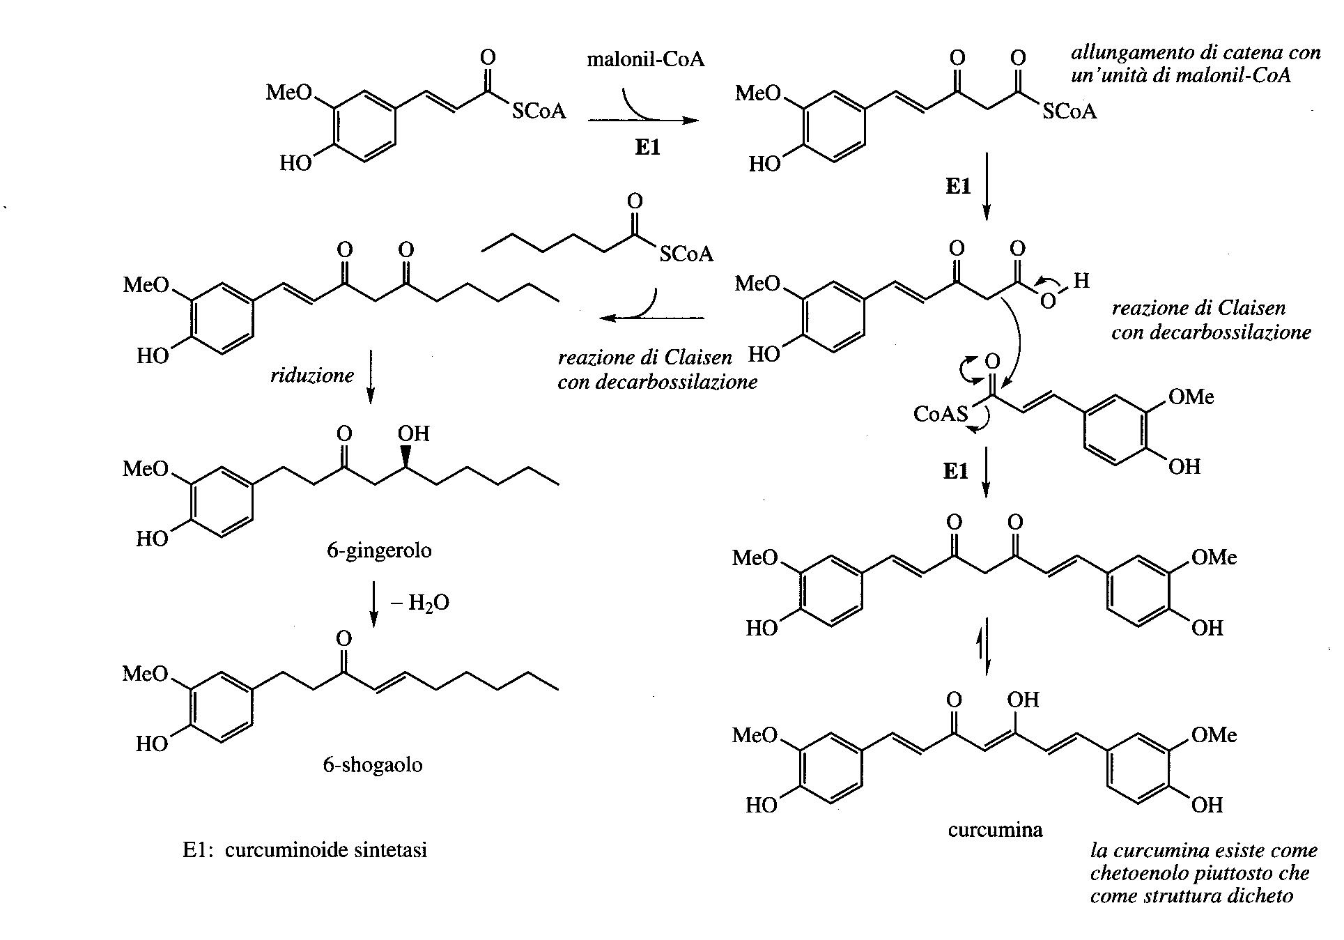

Slide 18
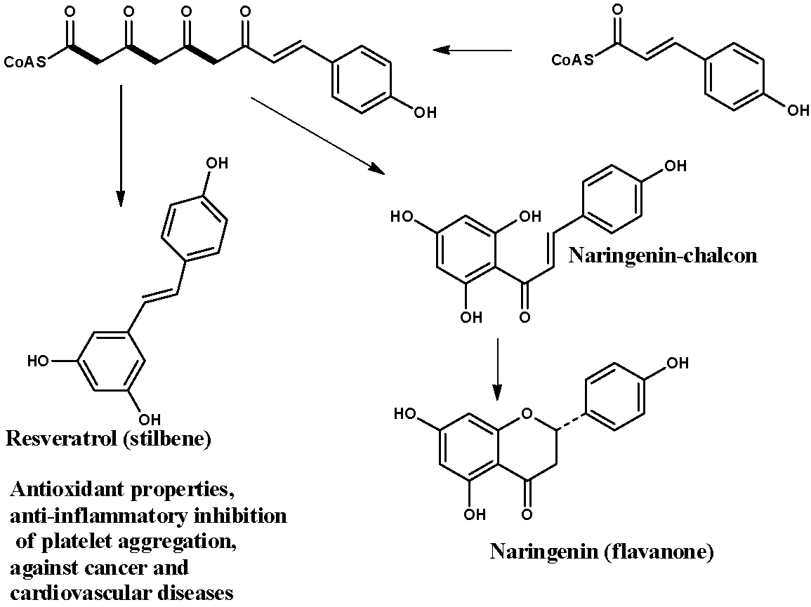
Flavonoids and Stilbenes
Flavonoids and Stilbenes are produced by a Coumaroil-CoA starter unit elongated with three chains of Malonil-CoA

Slide 19
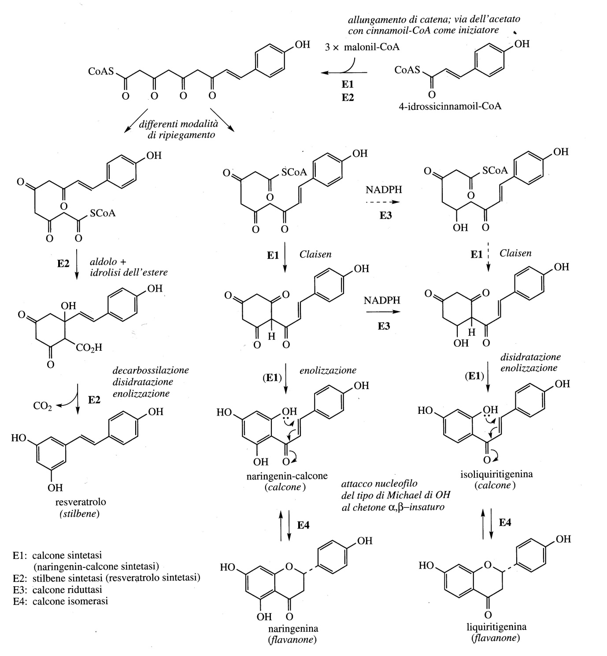
Flavonoids and Stilbenes
Flavonoids and Stilbenes are produced by a 4-hydroxy-Cinnamoyl-CoA starter unit with three chain extensions of Malonyl-CoA

Slide 20
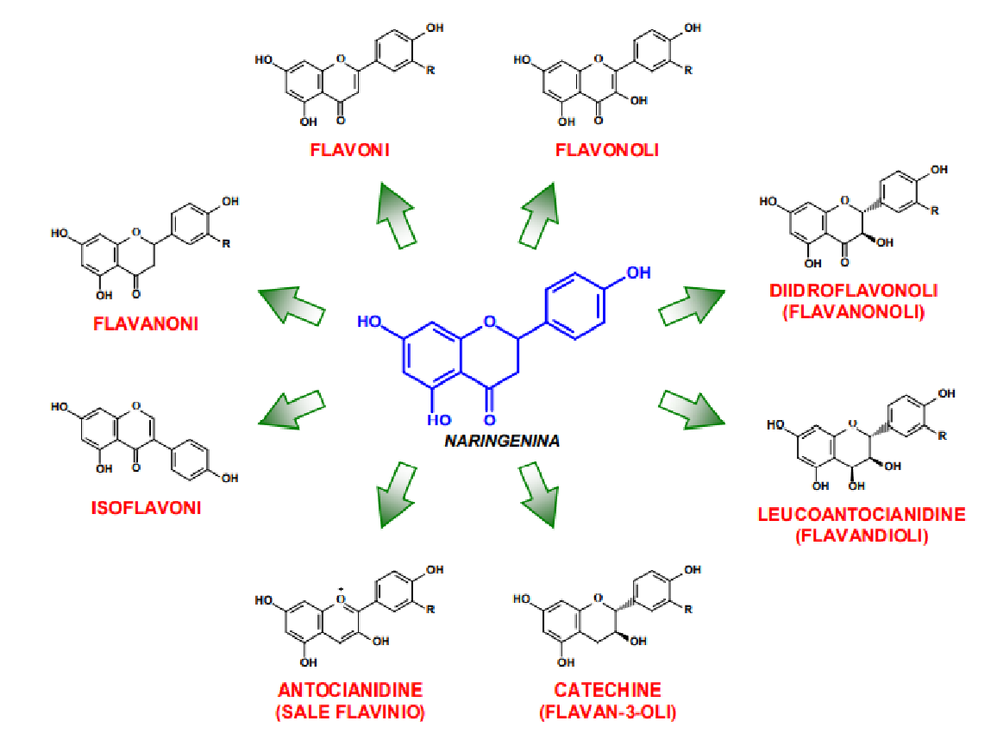
Naringenin is the first flavonoid that is formed and which, in turn, is an intermediate starting point for the biosynthesis of many other flavonoids

Slide 21
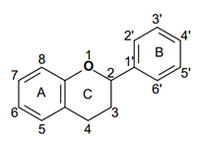
Flavonoids
Flavonoids are a group of pigments contained in plants with a broad spectrum of biological activities.
The basic phenolic-type structure is a a flavanic nucleus containing 15 carbon atoms (C6-C3-C6) arranged in 3 rings, indicated by the letters A, C and C where the bridge with 3 carbon atoms it is commonly cyclized with oxygen.
Glucose is the most common sugar residue (also galactose, rhamnose and xylose).
Among the different classes of flavonoids, those of greatest interest are flavones, flavanones, flavonols, flavanonols, flavan-3-olis, anthocyanidins and isoflavones.
These compounds are largely responsible for the colors of plants, flowers and fruits, in particular the bright shades of blue, scarlet and orange.
In addition to the various types of vegetables and fruits (in particular in citrus fruits, apples and grapes), flavonoid they are also found in seeds, nuts, cereals, spices, herbs (rosemary, thyme and parsley), in legumes, onions and various medicinal plants; plus several drinks like wine (especially red wine), black and green tea, contain appreciable quantities of flavonoids.

Slide 22
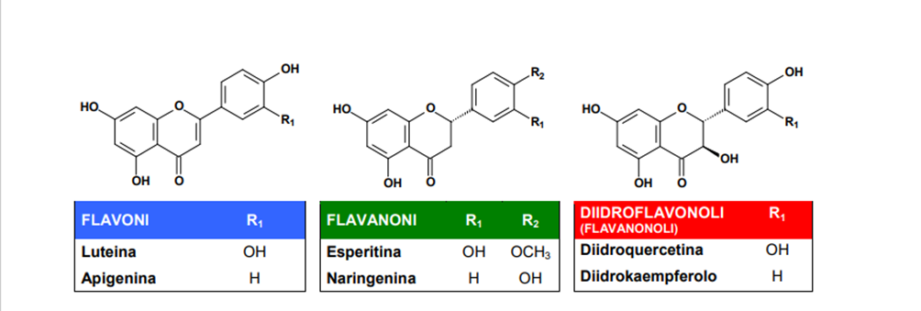
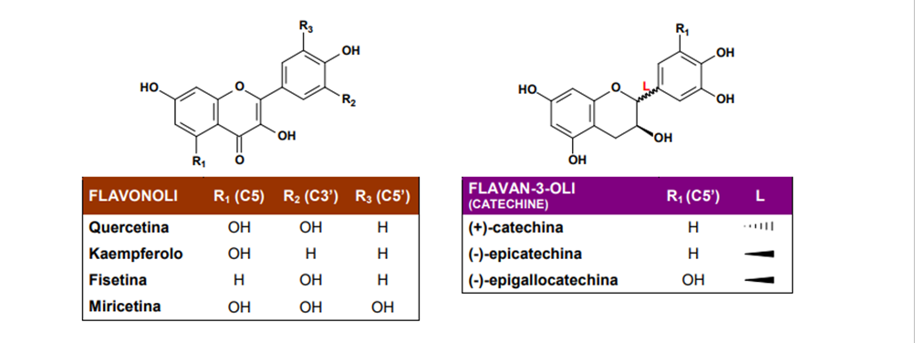

Slide 23
Biological activities of Flavonoids
Flavonoids are important components in the human diet as well, although they are considered gods non-nutrient, the daily amount taken is quite high (50-800 mg) and depends on the consumption of vegetables and fruit and specific beverages such as wine, tea and beer. For this reason, recently, rutin (quercetin + rutinose) obtained from buckwheat and from rue, and hesperidin (hesperetin + rutinose), obtained from citrus peel, were included in dietary adjuvants such as vitamin P, and indicated for the treatment of capillary fragility.
Some important properties of flavonoids:
Ability to impart colors: flavonols and chalcones give yellow, the anthocyanidins give red, blue and violet colors. Even colorless substances such as flavones, by strongly absorbing UV light, are perceptible to insects and can act like visual cues for pollinating insects;
Astringent property: the catechins form oligomers (small polymers) called tannins condensates that contribute to the astringent taste of some foods and drinks (these substances they also have commercial importance in the tanning of hides), also together with others flavonoids represent a defensive system against harmful insects;
Function of catalysts in photosynthesis and / or as regulators of iron channels through the protein phosphorylation;
Antioxidant actions in plant cells through electron transport systems. Was proved that the flavonoids of red wine (quercetin, kaempferol and anthocinidins) and tea (catechins and its esters with gallic acid) have proven effective antioxidants against free radicals.

Slide 24
Examples of free radicals are reactive oxygen species such as superoxide anion (O2·), peroxide (ROO·), alkoxide (RO·) and hydroxyl (HO·) radicals, and nitric oxide (NO) .
Reactive oxygen species can cause considerable damage by attacking cell membrane lipids, tissue proteins and enzymes, carbohydrates and DNA inducing oxidative processes which cause damage to biological membranes, modifications in enzymatic activity and even more damage serious to DNA.
Antioxidant activity of flavonoids
The mechanisms underlying the antioxidant activity include:
Suppression of the reactive oxygen species formed, through the inhibition of enzymes or the chelation of elements involved in the production of free radicals; in particular, inhibition of the enzymes responsible for the production of superoxide anion, such as xanthine oxidase and influence on the activity of numerous enzymes involved in the generation of reactive oxygen species such as cyclooxygenase, lipoxygenase, microsomal monooxygenase , glutathione S-tranferase, NADH oxidase.
Elimination of reactive oxygen species
"Up-regulation" or protection of the antioxidant defenses of the human body.

Slide 25
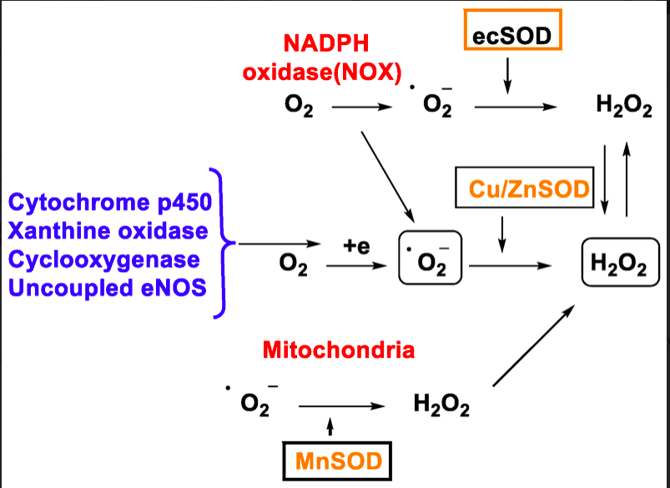
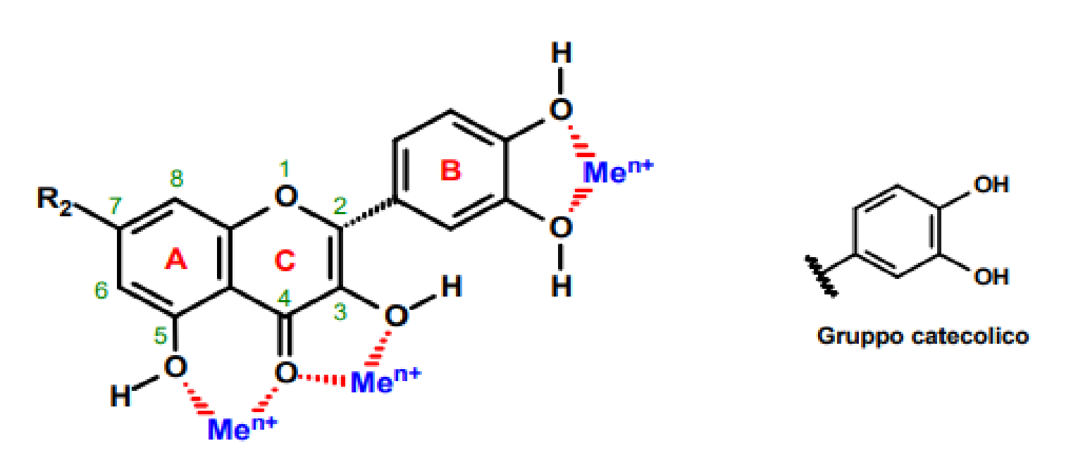
Some flavonoids are able to effectively chelate the metals involved in metabolism of oxygen, such as iron and copper, which reduce hydrogen peroxide by generating the hydroxyl radical (HO·) (1) and oxidize LDL (low density lipoprotein) (2)

Slide 27
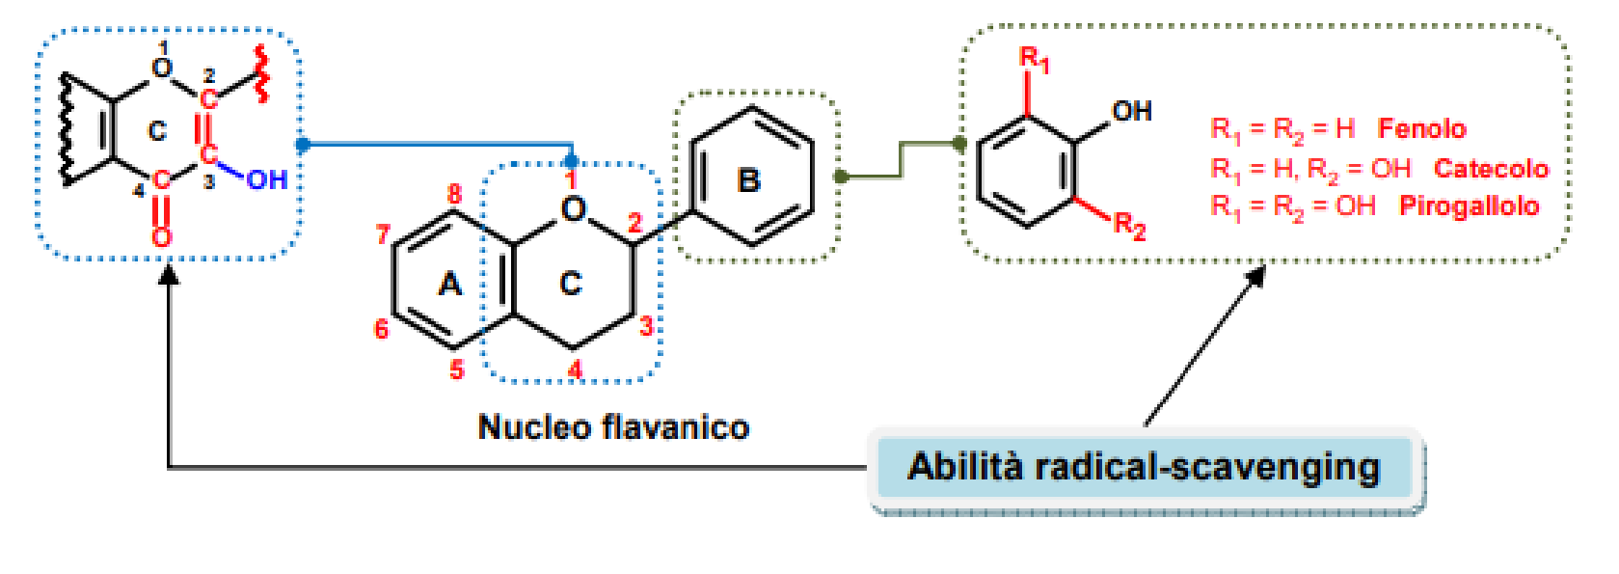
The antioxidant activity depends on the functional groups and is greater when the B ring consists of a catechol, as it is a better electron-donor group than a simple phenol.
Furthermore, a double bond in position ∆ 2,3 conjugated with an “oxo” group in C-4 is necessary, which is responsible for the delocalization of the electrons.
The presence of an OH group on C-3 in the heterocyclic ring increases the radical-scavenging activity.
The radical-scavenging activity does not increase with an additional OH and / or Methoxy group in position 5 and 7.

Slide 28
To establish the relationship between antioxidant activity (radical-scavenging) and the structure of the different flavonoids, a procedure was developed that allowed the construction of a radical-scavenging skill scale of flavonoids and related phenolic acids.
The assay is based on the ability of an antioxidant to eliminate at pH 7.4 a radical cation preformed by the 2,2'-azinobis- (3-ethylbenzothiazolin-6-sulfonic) acid (ABTS).
This ability is compared with the 6-hydroxy-2,5,7,8-tetramethylcroman-2-carboxylic acid known by the term TROLOX, a water-soluble vitamin E analogue.
The TEAC, or the “TROLOX equivalent antioxidant capacity” is defined as the concentration of TROLOX having the same radical-scavenging capacity as an antioxidant under study in a concentration of 1mM. The data obtained clearly prove that the radical-scavenging ability depends on the structure of flavonoids.

Slide 29
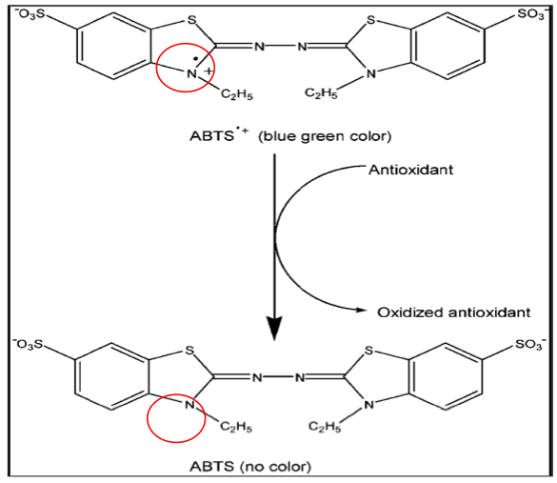
TEAC : TROLOX EQUIVALENT ANTIOXIDANT CAPACITY
THE REDUCING ACTIVITY OF ANTIOXIDANTS IS DETERMINED ON THE BASIS OF THEIR ABILITY TO REDUCE THE COLORED RADICAL CATION ABTS^{•+} WITH CONSEQUENT LOSS OF COLOR.
THE ANTIOXIDANT ACTIVITY IS DETERMINED BY MEASURING THE DECREASE ABSORBANCE (OD 734 nm) AFTER A FIXED TIME OF INCUBATION OF THE RADICAL CATION SOLUTION WITH THE SAMPLE TO BE TESTED.
Doi:
dx.doi.org/10.17504/protocols.io.42xgyfn

Slide 30
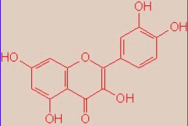
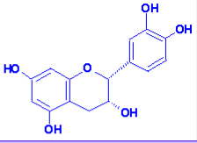
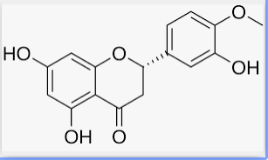
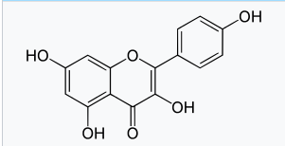
QUERCETIN (flavonol)
Trolox equivalent antioxidant capacity : 4.7
EPICATECHIN (flavan-3-ol, catechin)
Trolox equivalent antioxidant capacity : 2.4
HESPERETIN (flavanon)
Trolox equivalent antioxidant capacity : 0.9
KAEMPFEROL (flavonol)
Trolox equivalent antioxidant capacity : 1.3

Slide 31
Chalcones are precursors of a large class of flavonoids

Slide 32
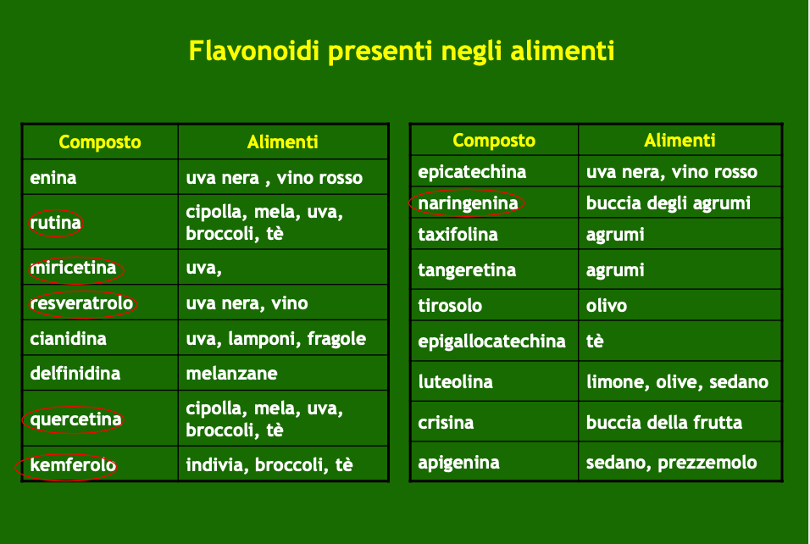
Flavonoids are anti-oxidants and protect against cardiovascular and neurodegenerative diseases.
The flavonoids of red wine (quercetin, kaempferol and antocyanidins) and green tea (catechins and catechin esters with gallic acid) are effective oxidants

Slide 33
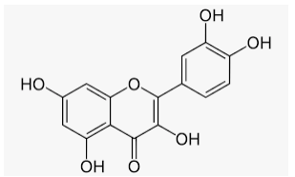
QUERCETIN (flavonol)
PROPERTIES: antioxidant, anti-inflammatory, antiviral, immunomodulatory, anticancer and gastroprotective. It can have antiallergic activity and in the prevention of secondary complications of diabetes.

Slide 34
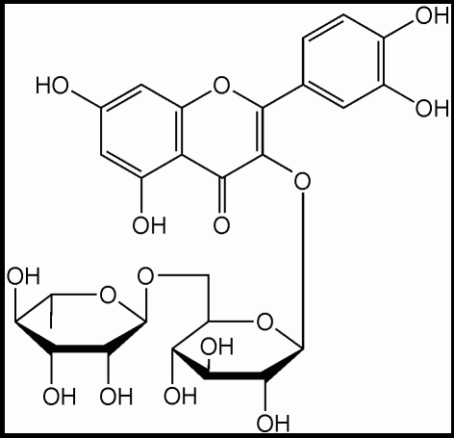
RUTIN
It is a glycosidic flavonoid of the FLAVONOL class composed of quercetin and the disaccharide rutinose. It is found in various plants such as BUCKWHEAT (Fagopyrum esculentum), whose flour is used for various purposes, in BLACK TEA and APPLES (peel). It is the flavonoid most represented in tomatoes.
PROPERTIES
anti-inflammatory, antioxidant, anticarcinogenic, antithrombotic and vasoprotective.
Absorption appears to occur mainly in the colon without the glucoside half detached by the enzymes of the intestinal bacterial flora to form quercetin which is transported to the liver via portal circulation

Slide 35
Flavonoids and Stilbenes
Flavonoids and Stilbenes are produced by a Coumaroil-CoA starter unit elongated with three chains of Malonil-CoA

Slide 36
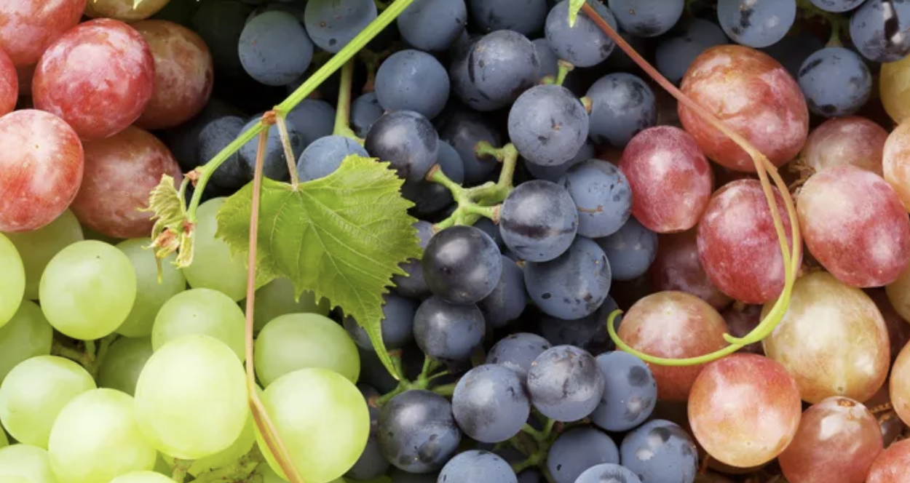
Vitis vinifera
RESVERATROL: 8.5 μg/g

Slide 37
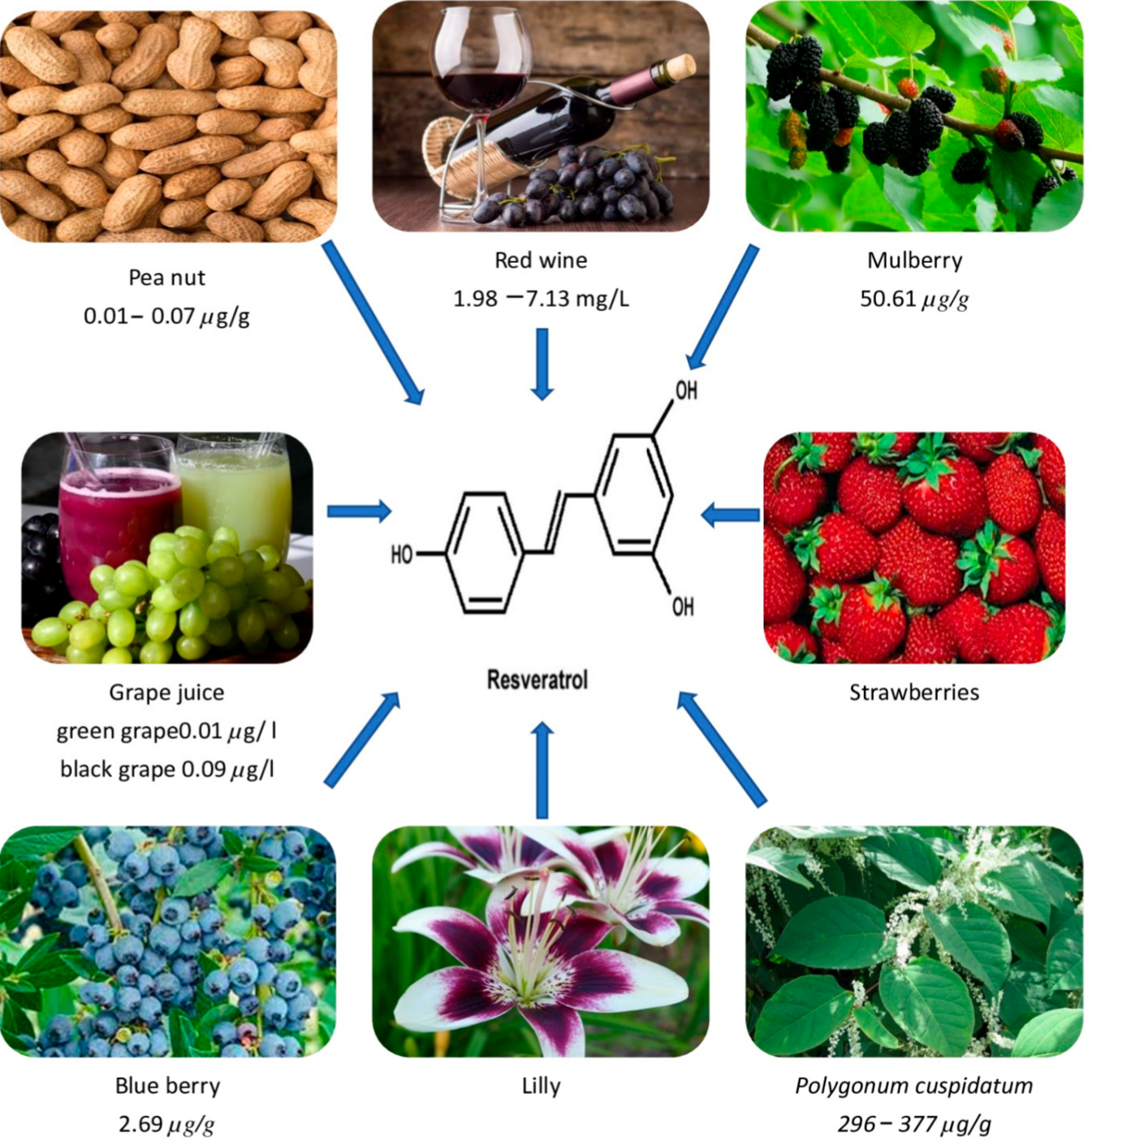
Resveratrol
Resveratrol is a natural phenolic compound (stilbene) and has been found in many foods, such as grapes, peanuts, blueberries, and red wine.
Resveratrol has shown many bioactivities, such as antioxidant, anti-inflammatory, immunomodulatory, hypotensive, and hypolipidemic actions, as well as activities in the prevention of cardiovascular and neurodegenerative diseases, and obesity.
Many studies highlighted its importance in aging treatment through suppressing oxidative stress, inhibiting inflammatory response, improving mitochondrial function and autophagy.
Pharmaceuticals 2022, 15, 957. https://doi.org/10.3390/ph15080957

Slide 38
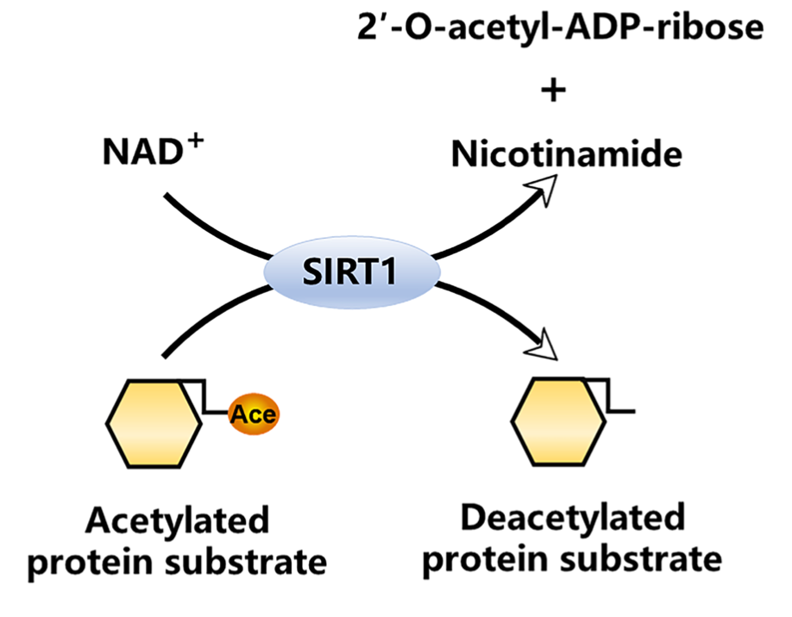
The silent information regulator sirtuin 1 (SIRT1) and resveratrol
Sirtuin-1 (Sirt-1) is a NAD⁺ -dependent deacetylase
SIRT1 was the first SIRT to be discovered in mammals (Sir2 in yeast)
SIRT1 can be activated by caloric restriction and resveratrol (also by depletion of its negative regulators (among which nicotinamide)
SIRT1-mediated deacetylation profoundly impacts multiple biological processes, including cellular senescence, apoptosis, sugar and lipid metabolism, oxidative stress, and inflammation. Thus, even minor changes in SIRT1 expression and function can significantly impact cellular responses.
SIRT1 is well known for its antioxidant and anti- inflammatory properties
SIRT1 plays a role in promoting longevity. As such, SIRT1-targeted anti- inflammatory therapies are attracting increasing attention for their clinical applications in treating inflammatory diseases.
Several signaling pathways provoked by immune cell activation are tightly associated with SIRT1 function.
Front. Immunol. 13:831168. doi: 10.3389/fimmu.2022.831168

Slide 39
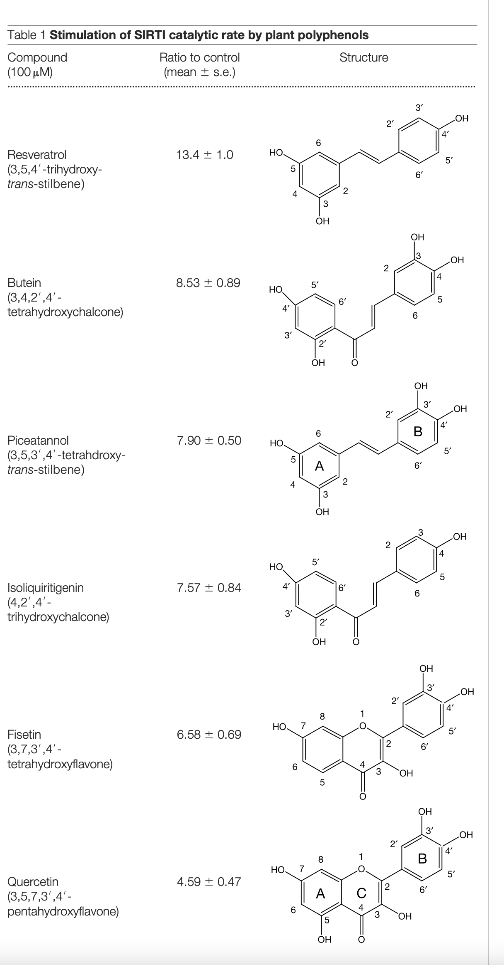
Resveratrol increses lifespan and stimulates SIRT1 catalytic activity
Assay:
Purified recombinant SIRT1 Sir2 proteins: 1.0 mg of SIRT1 and 1.5 mg of Sir2 were used per deacetylation assay
25 mM p53-382 acetylated peptide substrate and 25 mM NAD⁺
Resveratrol increases average lifespan by 70% and also maximum lifespan (yeast cells)
Konrad T. Howitz et al 2003

Slide 40
Effect of resveratrol on life extension
https://doi.org/10.1155/2021/9932218

Slide 41
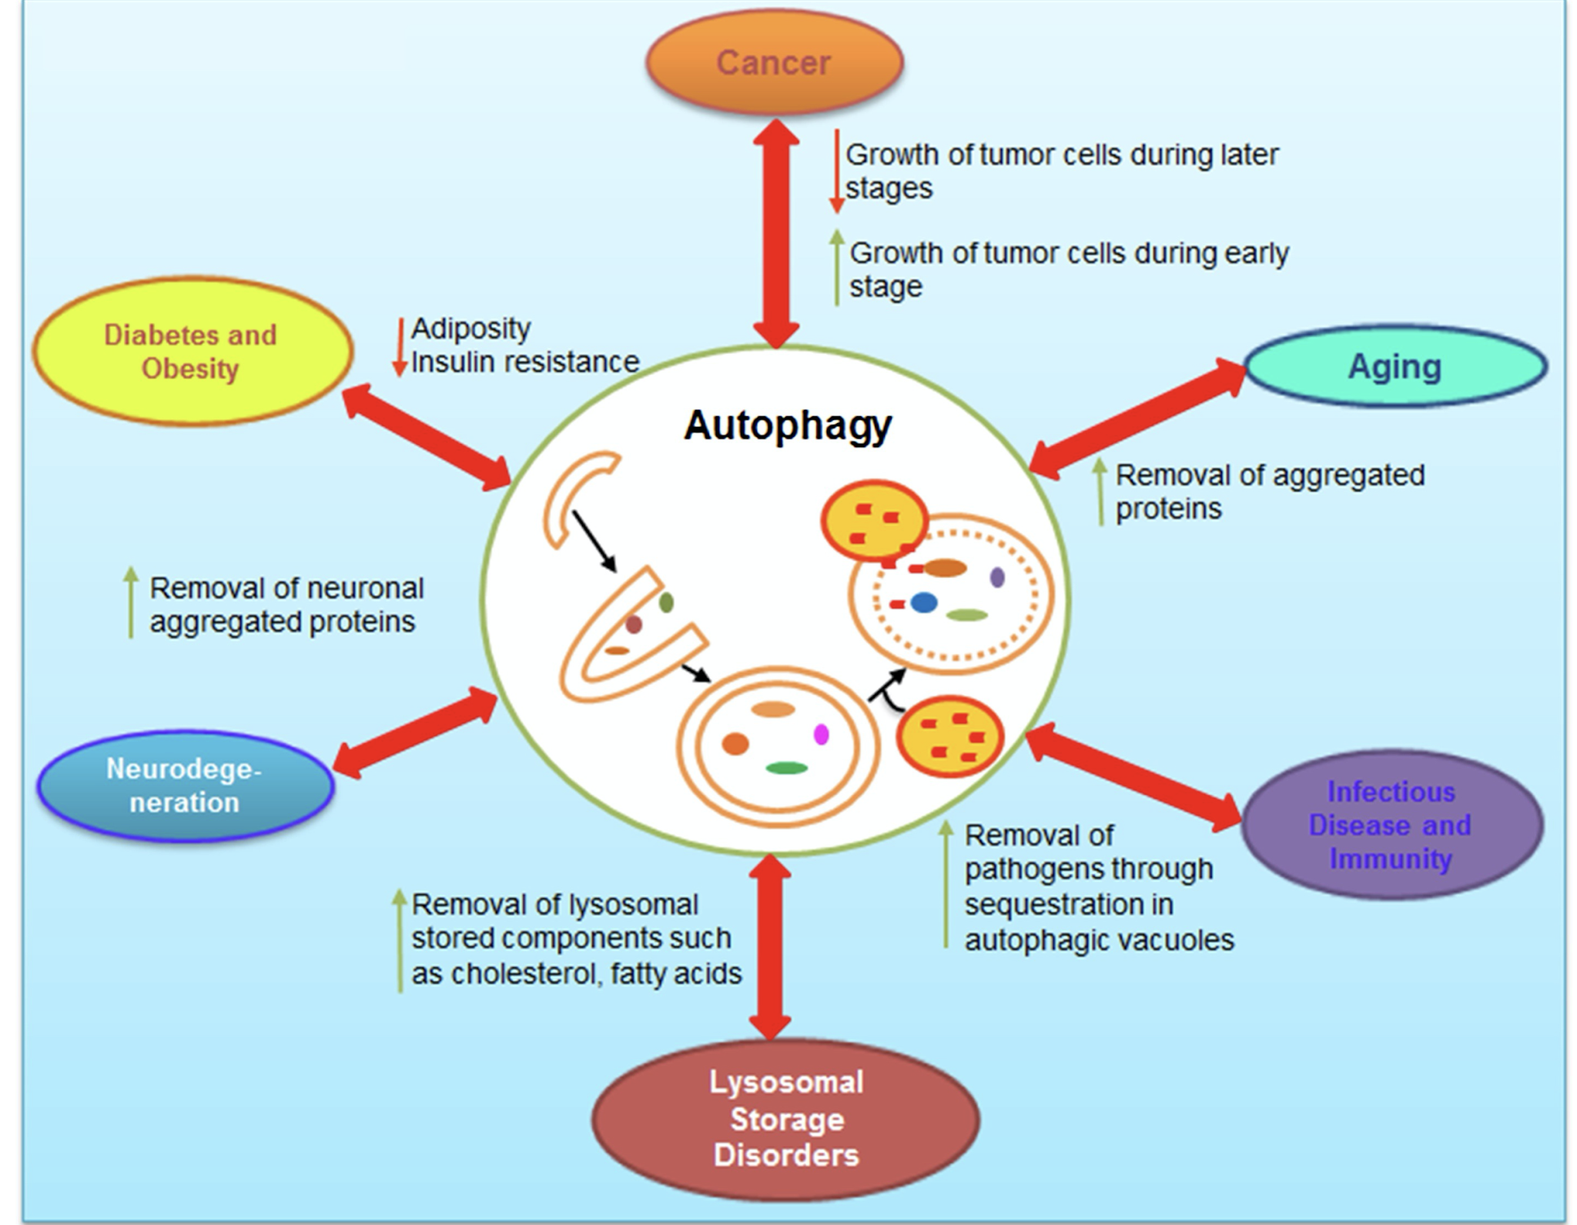
Autophagy is a conserved catabolic pathway that delivers cytoplasmic components, such as damaged organelles or long-lived proteins, to lysosomes for bulk degradation.
Autophagy involves the formation of an isolation membrane (phagophore) that progressively enwraps portions of the cytoplasm until a double-membraned vesicle (autophago- some) is formed.
Autophagosomes mature fuse with lysosomes (generating autophagolysosomes) and their luminal content are degraded by lysosomal hydrolases and generated substrates are exported into the cytosol for metabolic recycling.
Autophagy is mostly a cytoprotective mechanism that allow cells to mobilize their energy reserves and to recycle damaged organelles in conditions of lacking nutrients.
Autophagic dysfunction has been associated with a large number of neurodegenerative diseases. One of the hallmarks of many neurodegenerative diseases is the accumulation of aggregated proteins that escape the degradative process resulting in neuronal cell death

