Slide 1
Male, 78 years
Past medical history:
- At 59 years diagnosed with type II diabetes mellitus, on metformin therapy
- At 60 years of age first finding of arterial hypertension. Since then treated with ACE inhibitor and calcium channel blocker
- At 68 years of age apical acute myocardial infarction with residual small area of hypokinesia
Recent medical history :
For abdominal discomfort the patient performs, on the advice of the doctor, an upper abdomen ultrasound with evidence of a hypoechoic lesion of about 5 cm localized to the VI segment of the liver. The lesion appears partially exophytic.
WHAT DO YOU DO?

Slide 2
Scenario 1
At the visit, the abdomen appears globose for fat, treatable and slightly painful on palpation in the epigastrium. The liver appears difficult to palpable at about 1 cm from the costal arch, poorly assessable in the margins and consistency. Not palpable spleen.
Not abdominal masses.
No signs of advanced liver disease.
Hb (MCV) | 15.7 g/dL (92 fL)
PLT | 186.000/mcl
AST/ALT | 38/45 U/L
Gamma GT | 124 U/L
Total Bilirubin | 0,8 mg/dL
PT-INR | 0,8
Albumin | 4,8 g/dL
Alfa-fetoprotein | 10 ng/mL
Serology for HCV, HBV | neg
Ferritin | 436 mcg/dL

Slide 3
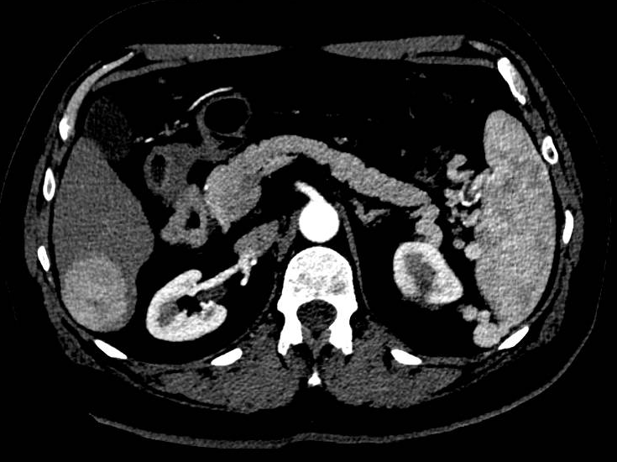
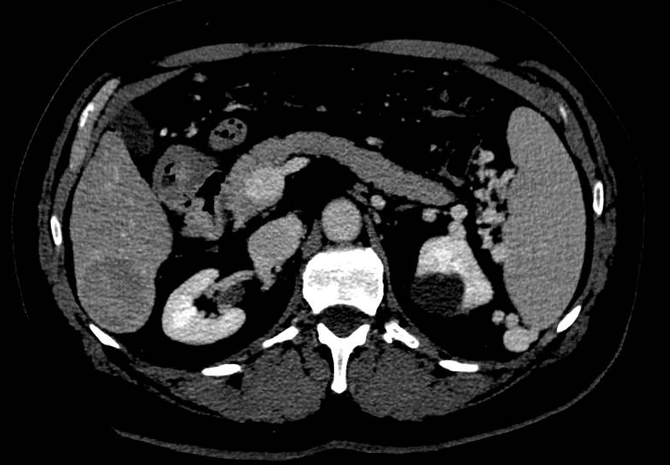
Contrast CT scan of the upper abdomen
CAN I DIAGNOSE HEPATOCARCINOMA?
YES
NO
HOW DO YOU PROCEED?
Biopsy the lesion
Biopsy lesion and extralesional parenchyma
Request another second level imaging (MR)
Perform a FibroScan
Notes:
3

Slide 4
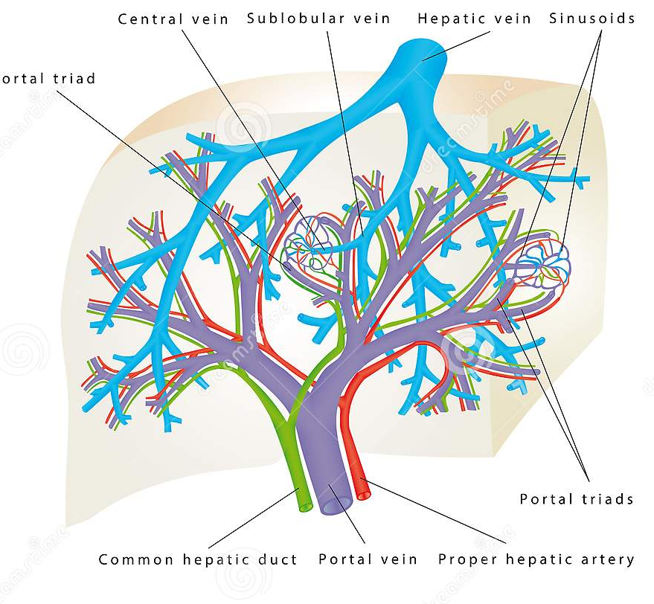
THE PREREQUISITES FOR RADIOLOGICAL DIAGNOSIS
80% of venous flow
20% of arterious flow
Notes:
The liver has dual blood supply from the portal vein and the hepatic artery.

Slide 5
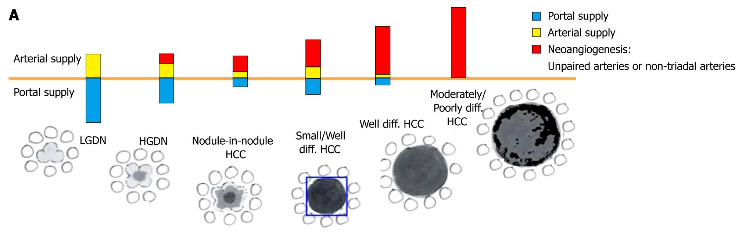
VASCULAR CHANGES ASSOCIATED WITH DEVELOPMENT OF HCC
Notes:
5

Slide 6
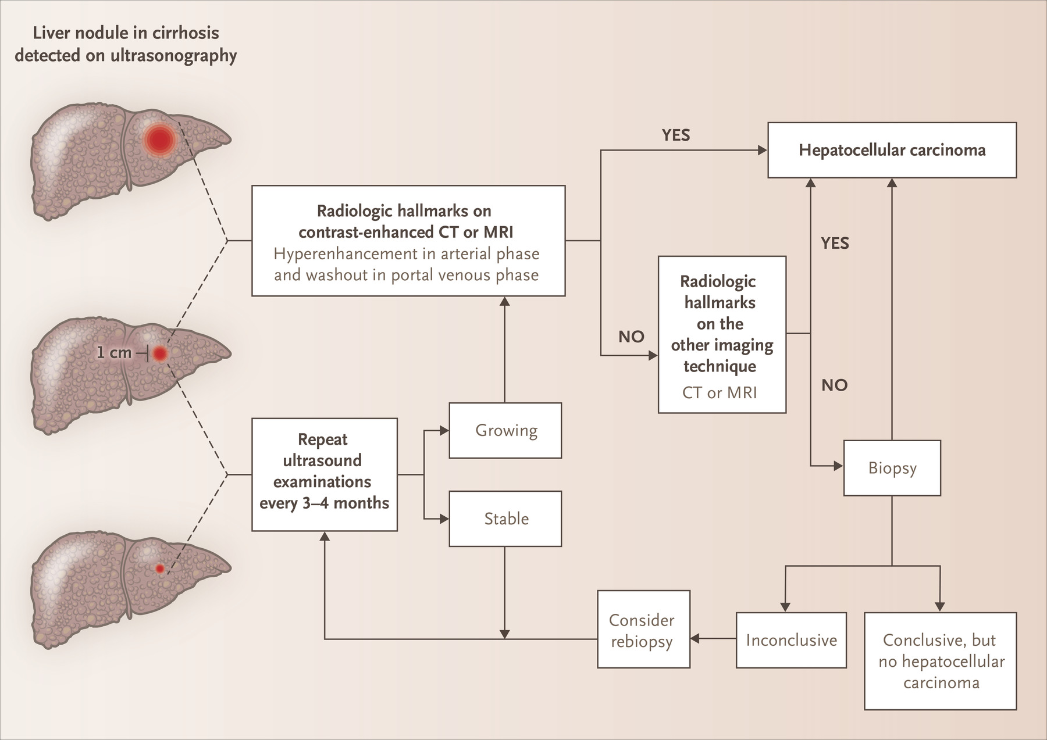
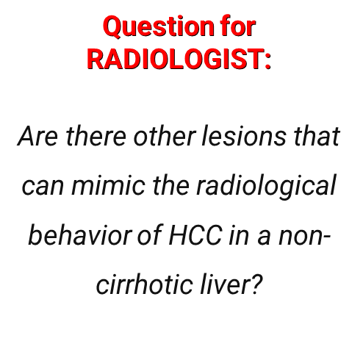
DIAGNOSTIC ALGHORITM FOR HEPATOCELLULAR CARCINOMA
Notes:
- a lesion under a centimeter in size should be followed up at 3 months;
- a lesion over a centimeter in size may be diagnosed with certainty if underlying cirrhosis is present and imaging appearances are typical (arterial hypervascularization with washout from the lesion in the portal and/or late phase) on CT and/or MRI (if either of these investigations is negative, the second should be performed).
Outside of these situations the diagnosis requires a needle biopsy for histological examination. If this is negative (no histological identification of the nodule), a further biopsy is required.

Slide 7
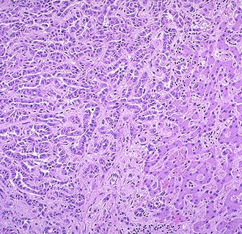
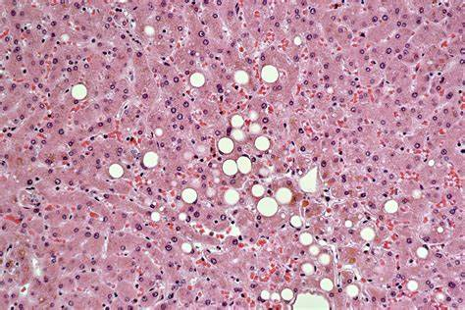
LESION AND EXTRALESIONAL PARENCHYMA BIOPSY
Moderately differentiated trabecular HCC
Extralesional parenchyma with preserved architecture, micro and macro vescicular steatosis (40%), light inflammatory infiltrate and minimal fibrosis in some portal spaces

Slide 8

WHAT THERAPY WOULD YOU PROPOSE TO THE PATIENT?
RESECTION
PERCUTANEOUS THERMAL ABLATION
CHEMOEMBOLIZATION
RADIOEMBOLIZATION
LIVER TRANSPLANTATION
WHAT IF THE PATIENT WAS 50 YEARS OLD?
RESECTION
PERCUTANEOUS THERMAL ABLATION
CHEMOEMBOLIZATION
RADIOEMBOLIZATION
LIVER TRANSPLANTATION

Slide 9
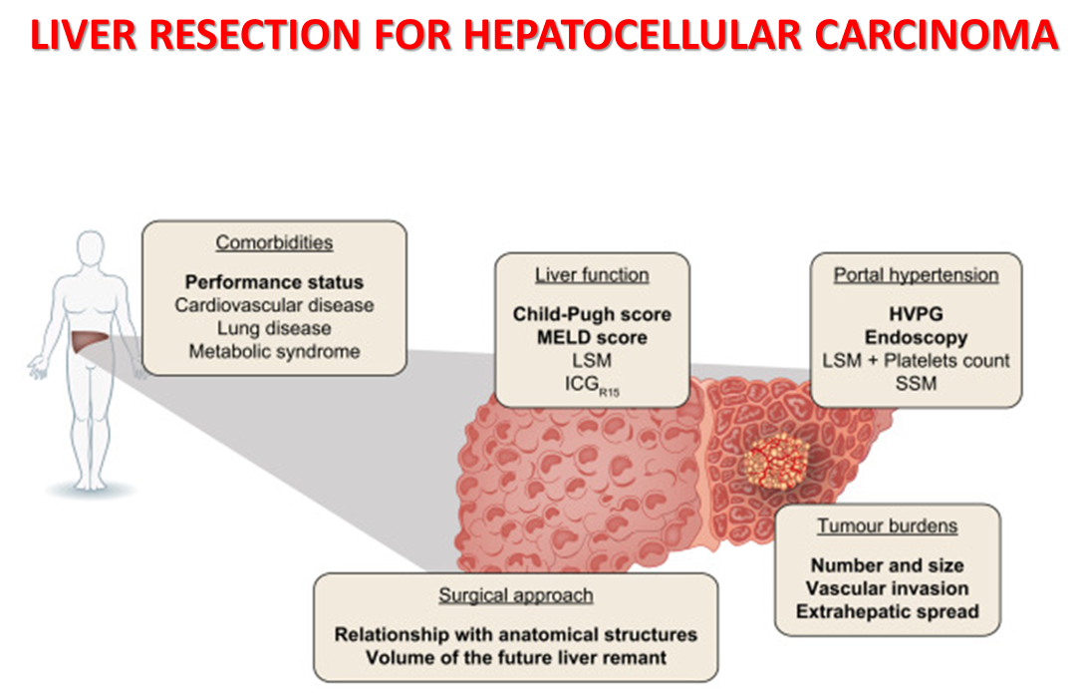

Slide 10
Scenario 2
At the visit, the abdomen appears globose for fat, treatable and slightly painful on palpation in the epigastrium. The liver appears poorly assessed, palpable about 3 cm from the sternal margin in epigastrium, of increased consistency. Spleen about 2 cm from the costal arch.
Not abdominal masses.
Some spider naevo on the trunk.
PLT | 132.000/mcl
AST/ALT | 56/45 U/L
Gamma GT | 114 U/L
Total Bilirubin | 2,1 mg/dL
PT-INR | 1,1
Albumin | 3,7 g/dL
Alfa-fetoprotein | 10 ng/mL
Ammonium | 15 µmol/L

Slide 11
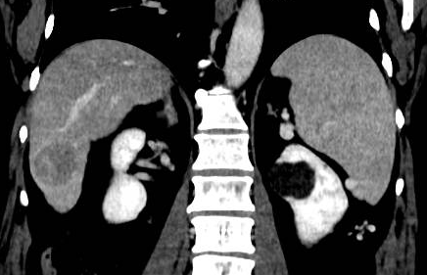
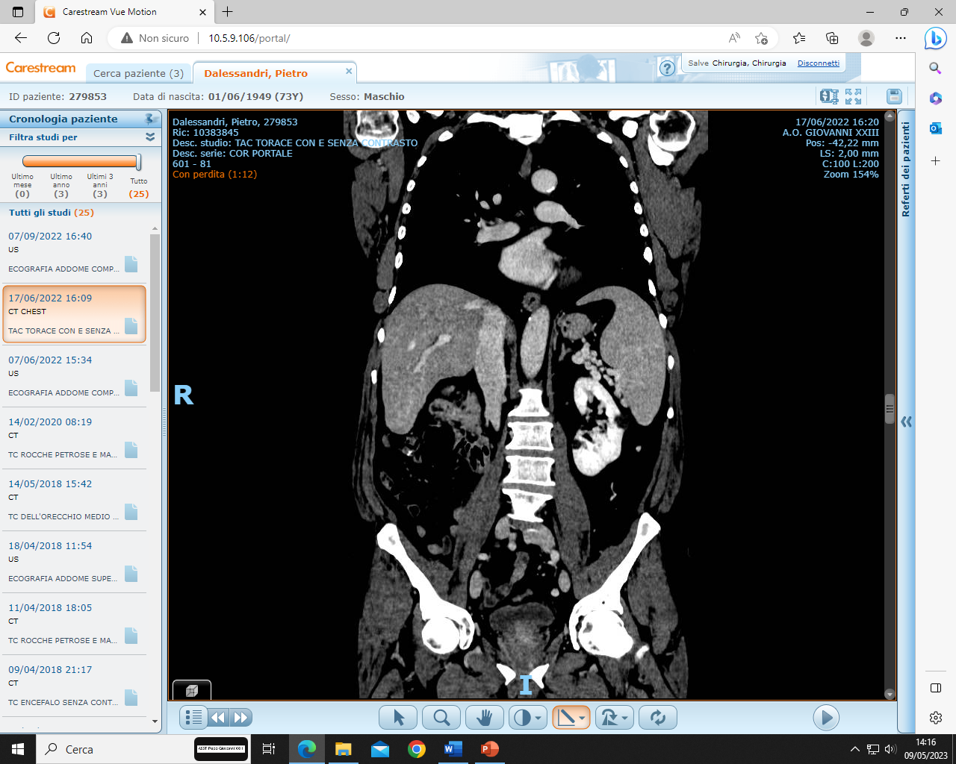
Contrast CT scan of the upper abdomen
13,6 cm

Slide 12
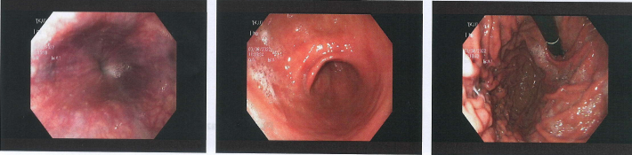
CAN YOU DIAGNOSE HEPATOCARCINOMA?
YES
NO
HOW DO YOU PROCEED?
Propose the case to the hepatobiliary surgeon
Propose the case to interventional radiologists
Request esophagus-gastroduodenoscopy to evaluate portal hypertension (possible varicose veins)
EGDS: Esophageal venous ectasias not gradable as varicose veins

Slide 13
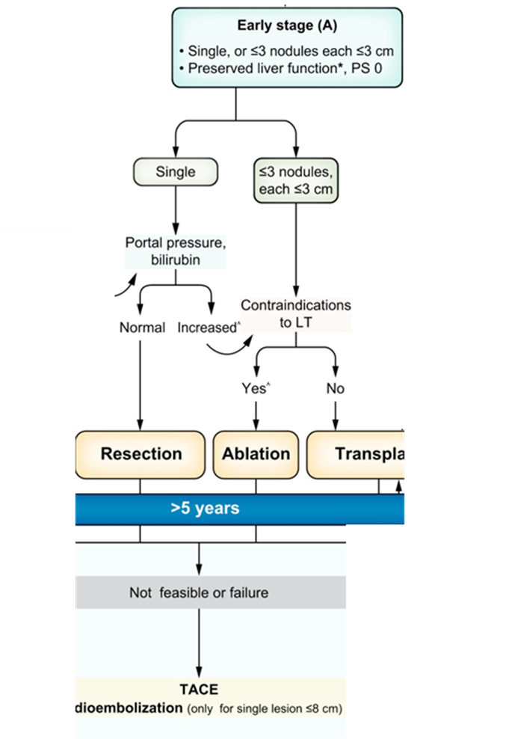
WHAT THERAPY WOULD YOU PROPOSE TO THE PATIENT?
RESECTION
PERCUTANEOUS THERMAL ABLATION
CHEMOEMBOLIZATION
RADIOEMBOLIZATION
LIVER TRANSPLANTATION

Slide 14
QUESTION FOR THE SURGEON
How much does portal hypertension impact surgical assessment?

Slide 15
BASIC GLOSSARY
How do you define portal hypertension?
How do you define the outcome of a liver resection?

Slide 16
BASIC GLOSSARY
How do you define portal hypertension?
DIRECT METHOD OF MEASUREMENT: The HVPG measurement is considered the gold standard for detecting PHT and identifying clinically significant portal hypertension (CSPH) when the HVPG is ≥ 10 mm Hg
INDIRECT METHODS OF MEASUREMENT: thrombocytopenia
<100.000 platelets/mm3) and splenomegaly > 120 mm
the presence of esophageal varices on endoscopy

Slide 17
BASIC GLOSSARY
How do you define portal hypertension?
How do you define the outcome of a liver resection?

Slide 18
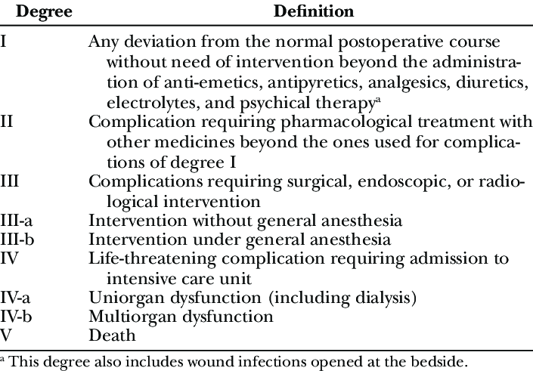
BASIC GLOSSARY
How do you define the outcome of a liver resection?
Oncologically radical, recurrence rate
Surgical complications: Clavien Dindo
Liver-related complications: Posthepatectomy liver failure (PHLF) (according to the International Study Group of Liver Surgery or the “50–50 criteria” and liver decompensation (defined as new onset of jaundice, ascites, or encephalopathy after surgery)
Overall survival

Slide 19
9 articles conducted in both Eastern (ie, China) and Western (ie, Spain, Italy, and France) centers.
5 studies used indirect criteria to consider the presence of PHT
4 used invasive measurement using the HVPG
The primary objective of this study was to assess the impact of PHT on the postoperative and survival outcomes of patients undergoing HCC resection
subgroup analysis based on 2 key factors
the method of PHT measurement comparing IS-PHT (patients diagnosed using indirect signs) with HVPG-PHT (diagnosed by measuring the HVPG)
The surgical approach used for resection, distinguishing between MILR and open LR (OLR).

Slide 20
LR in patients with PHT was significantly associated with a higher risk of overall complications (OR: 1.45; 95% CI: 1.116–1.888; P= 0.006)
Patients in the PHT group who underwent LR presented more than 3 times the risk of PHLF compared with matched patients in the non-PHT group (OR: 3.303; 95% CI: 1.511–7.219; P=0.003)
SUBGROUP ANALYSIS
Patients in the HVPG-PHT subgroup had a significantly increased risk of developing overall complications (OR: 2.72; 95% CI: 1.45–5.08) and of PHLF (OR: 7.25; 95% CI: 2.57–20.43) after LR compared with matched patients in the non-HVPH-PHT subgroup
Patients in the IS-PHT subgroup analysis, LR was not significantly associated with increased mortality (OR: 1.08; 95% CI: 0.42–2.76), overall complications (OR: 1.27; 95% CI: 0.95–1.70), major complications (OR: 1.42; 95% CI: 0.60–3.36), PHLF (OR: 1.17; 95% CI: 0.35–3.84)
Regarding the impact of the extent of resection on outcomes, both the risk of mortality (minor: OR: 2.57; 95% CI: 0.61–10.76; major: OR: 0.88; 95% CI: 0.31–2.45) and major complications (minor: OR: 1.21; 95% CI: 0.59–2.47; major: OR: 1.56; 95% CI: 0.42–5.87) were not significantly affected in either group

Slide 21
OVERALL SURVIVAL OF PATIENTS WITH HCC AND CSPH (HVPG ≥10 MM HG) AND WITHOUT CSPH (HVPG <10 MM HG).
In the subgroup CSPH, no significant differences in perioperative mortality and major complications were observed in CSPH

Slide 22
LR in the presence of indirect signs of PHT poses no increased risk of complications. Yet, in HVPG ≥ 10 mm Hg patients, LR increases overall morbidity and liver-related complications risk. Transjugular HVPG assessment is crucial for LR decisions.Minimally invasive approach seems to be vital for favorable outcomes, especially in HVPG ≥ 10 mm Hg patients.

Slide 23
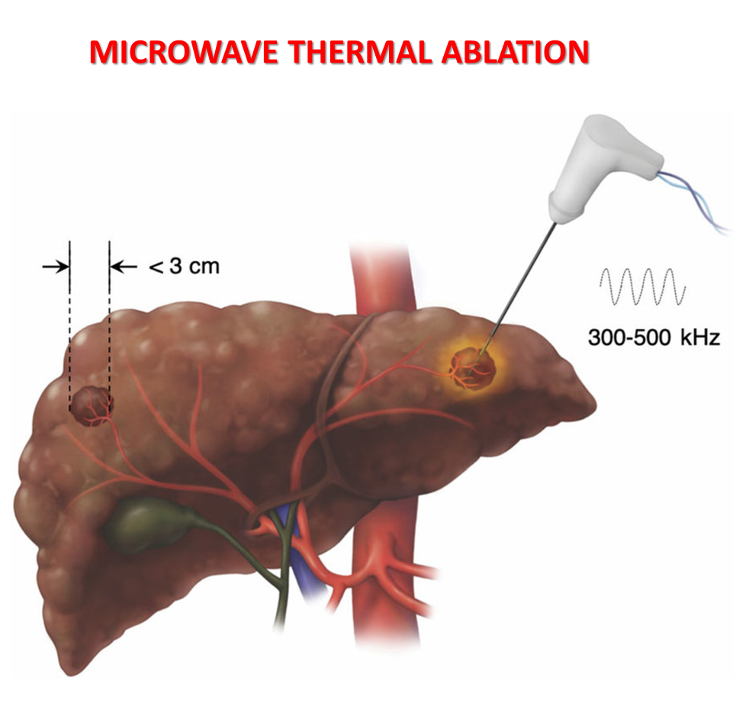
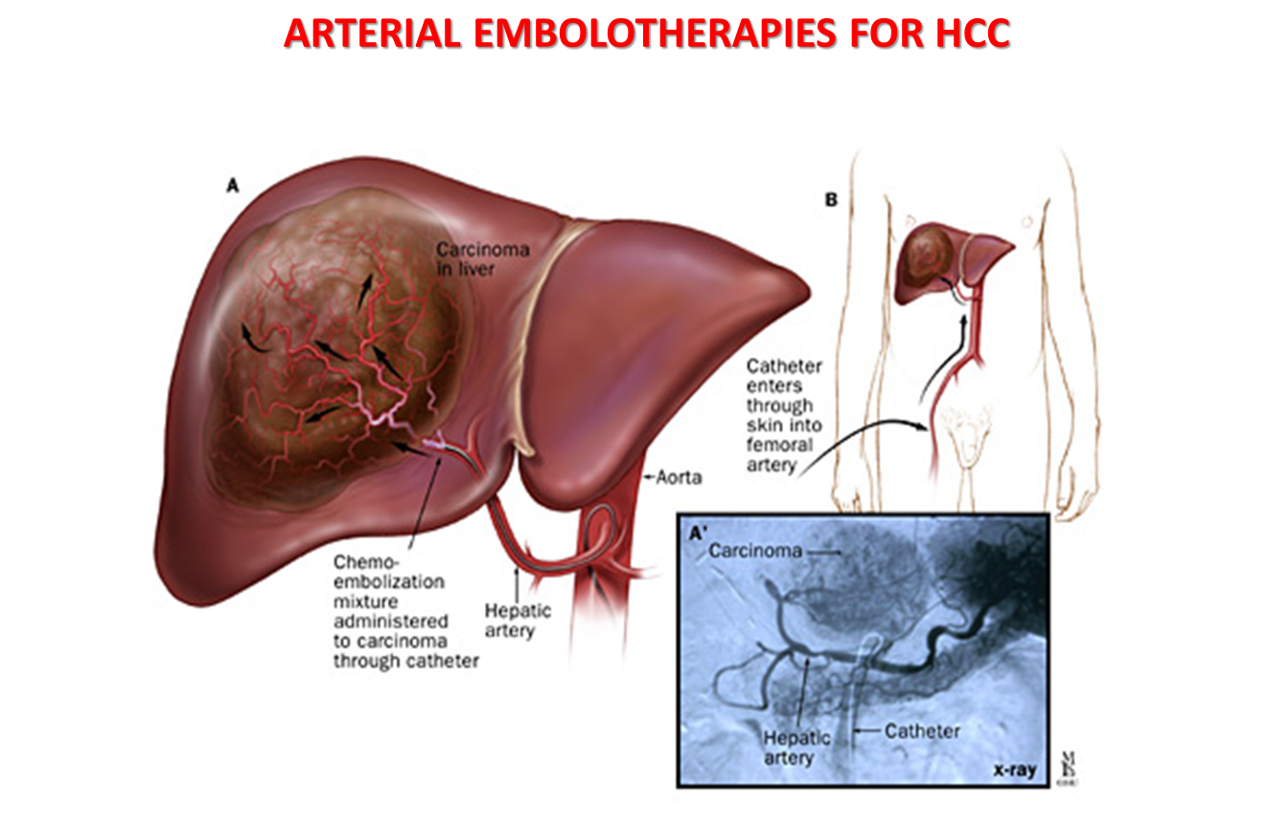
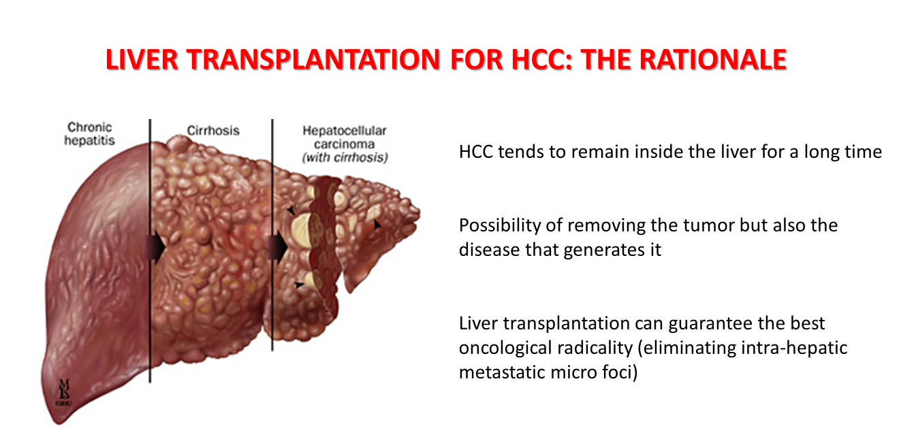
?

Slide 24

WHAT THERAPY IF THE PATIENT WAS 50 YEARS OLD?
RESECTION
PERCUTANEOUS THERMAL ABLATION
CHEMOEMBOLIZATION
RADIOEMBOLIZATION
LIVER TRANSPLANTATION

Slide 25
Scenario 3
At the visit the abdomen appears batracian, treatable and little pain on palpation in epigastrium. Evident superficial venous circulation type caput medusae. Palpable liver in epigastrium, of hard-wooden consistency and snappy margin, appreciable spleen about 3 cm from the costal arch . Non-ascites
Palmar erythrosis, scleral subittero, modest perimalleolar edema. Modest ideo-motor slowdown, no flapping tremor.
PLT | 46.000/mcl
AST/ALT | 48/26 U/L
Gamma GT | 84 U/L
Total Bilirubin | 4,2/2,8 mg/dL
PT-INR | 1,8
Albumin | 2,6 g/dL
Alfa-fetoprotein | 10 ng/mL
Ammonium | 48 µmol/L

Slide 26
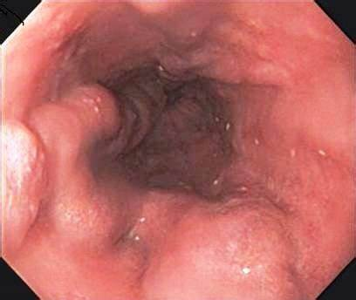
HOW DO YOU PROCEED?
Request esophagus-gastroduodenoscopy to evaluate any varicose veins (treatment depends on the degree of PH)
Propose the case to the hepatobiliary surgeon
Propose the case to interventional radiologists
EGDS: esophageal varices F2-3, Cb, Li, RWM-; Moderate congestive gastropathy

Slide 27
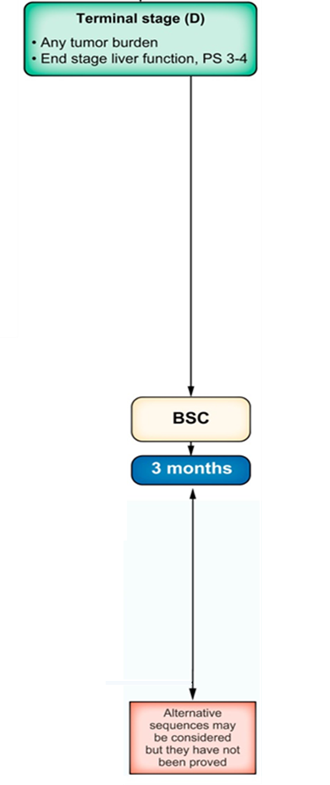
WHAT DO YOU DO NOW?
The patient should initiate beta blocker therapy before HCC treatment
The patient should undergo prophylactic ligation of varicose veins before HCC treatment
The patient can be evaluated for liver resection
Patient can be evaluated by TACE/TARE
The patient has no indication for HCC treatment

Slide 28
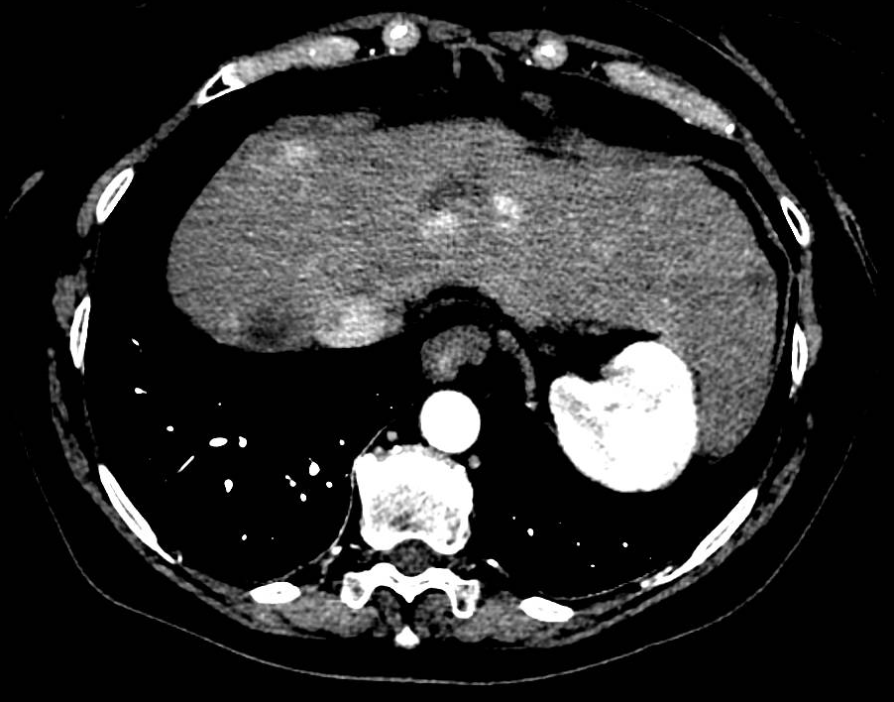
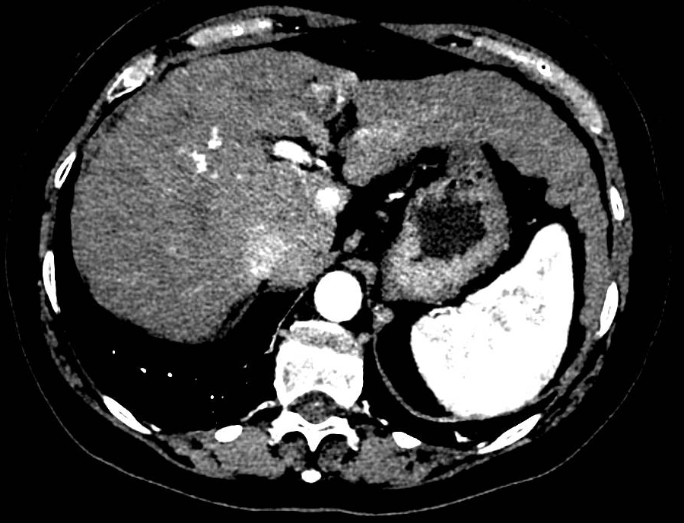
Female, 66 years
Sept. 2024: Sent by another Center for therapeutic process evaluation in:
- Recurrence of multifocal HCC, in total 4 liver lesions, after percutaneous thermal ablation treatment of 2 focal hepatic lesions of 2.5 in S VIII and 2 cm in S IV in April 2023
- HCV-related liver cirrhosis (undergoing HCV antiviral therapy in 2021 with virological response)
- Portal hypertension with esophageal varices undergoing endoscopic ligation in 2021; EGDS 2022: no varicose veins

Slide 29
Female , 66 years
Scenario 1
Summarizing
Past medical history
Liver cirrhosis in good functional compensation
Portal hypertension
Early recurrence of multifocal HCC (Up to 7 in)
No comorbidities
Appendectomy in adolescence
A caesarean delivery
PLT | 145.000/mcl
AST/ALT | 57 / 35 U/L
Gamma GT | 83 U/L
Total Bilirubin | 1,2 mg/dL
PT-INR | 1,10
Albumin | 3,9 g/dL
Creatinin | 0,92 mg/dL
Sodium | 138 mEq/L
What treatment would you propose?
LIVER TRANSPLANTATION
RESECTION
TACE
THERMAL ABLATION
SYSTEMIC THERAPY

Slide 30
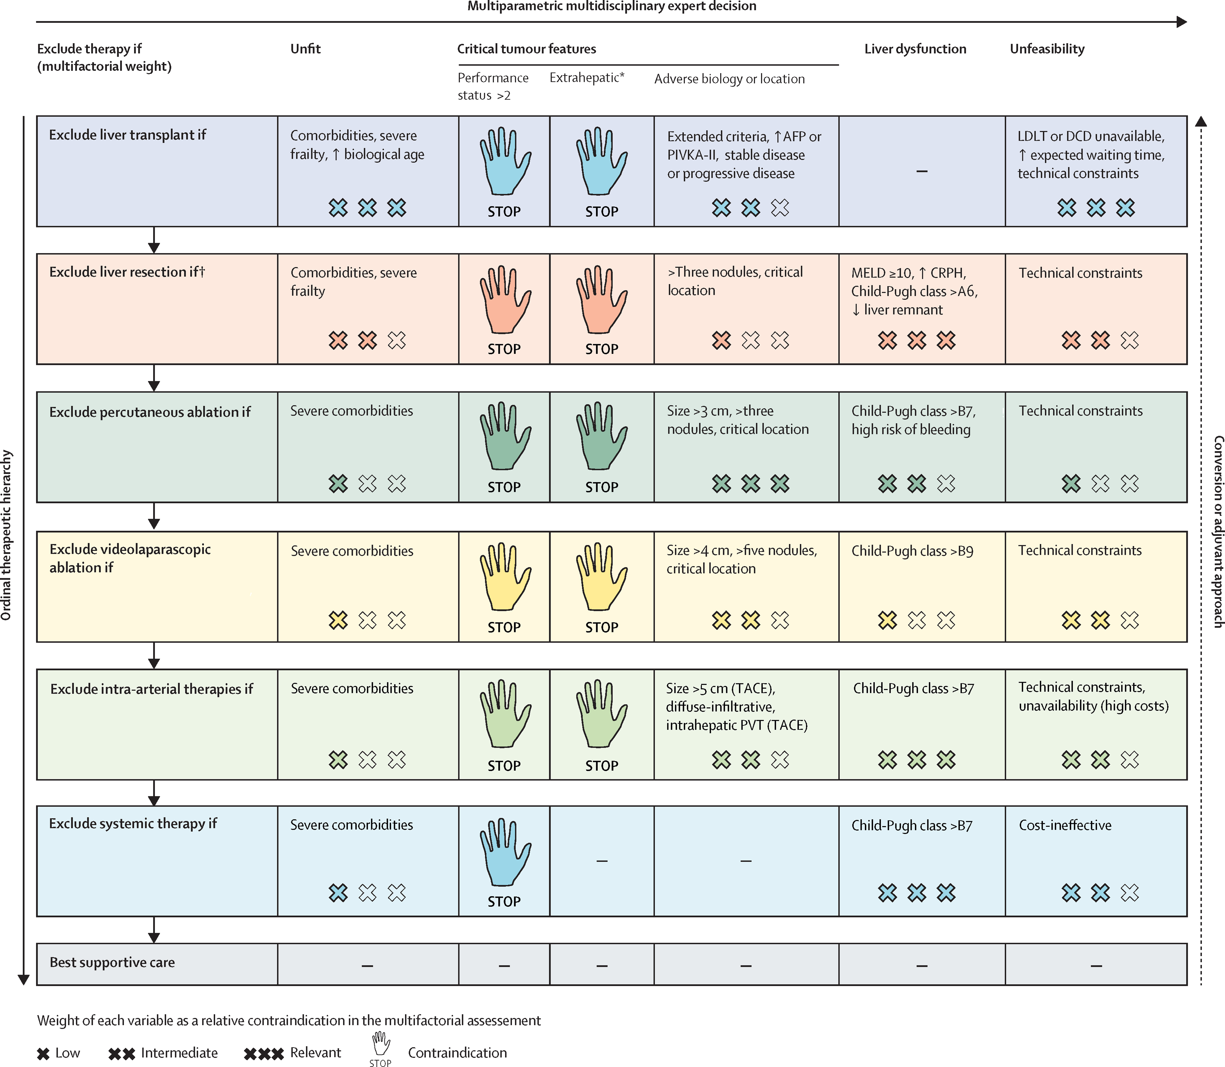
The concept of therapeutic hierarchy for patients with hepatocellular carcinoma

Slide 31
Female, 66 years
Scenario 2
Summarizing
Past medical history
Liver cirrhosis with preserved function
Portal hypertension
Early recurrence of multifocal HCC
Multiple comorbidities which represent a contraindication to liver transplantation
Diabetes mellitus with chronic renal failure
In 2022 breast cancer undergoing surgery + RT/CT
PLT | 145.000/mcl
AST/ALT | 81 / 44 U/L
Gamma GT | 102 U/L
Total Bilirubin | 1,1 mg/dL
PT-INR | 1,15
Albumin | 3,9 g/dL
Creatinin | 1,9 mg/dL
Sodium | 138 mEq/L
What treatment would you propose?
TACE
THERMAL ABLATION
SYSTEMIC THERAPY
BEST SUPPORTIVE CARE

Slide 32
The concept of therapeutic hierarchy for patients with hepatocellular carcinoma

Slide 33
Female, 66 years
Scenario 3
Summarizing
Past medical history
Liver cirrhosis in labile functional compensation
(CHILD A6)
Portal hypertension
Early recurrence of multifocal HCC
Multiple comorbidities which represent a contraindication to transplantation
Diabetes mellitus with chronic renal failure
In 2022 breast cancer undergoing surgery + RT/CT
AST/ALT | 81 / 44 U/L
Total bilirubin | 2,3 mg/dL
PT-INR | 1,4
Albumin | 2,9 g/dL
Creatinin | mg/dL
Sodium | 138 mEq/L
What treatment would you propose?
TACE
THERMAL ABLATION
SYSTEMIC THERAPY
BEST SUPPORTIVE CARE
After previous MWTA transient appearance of ascites

Slide 34
The concept of therapeutic hierarchy for patients with hepatocellular carcinoma

