Slide 1
Clinical case 1 C.D.
Male
Date of birth: June 10th 1969
Notes:
He is a 65 years old man.

Slide 2
PAST MEDICAL HISTORY?
Prostatic hypertophy
Arterial hypertension
Notes:
2

Slide 3
LIVER HISTORY:
November 2019: admitted to another hospital for first ascitic decompensation.
US abdomen and CT abdomen: LOS-free cirrhotic liver. Spenomegaly. Ascites. Cholelithiasis.
EGDS: no esophageal varices. Moderate congestive gastropathy.
HBsAg, HCVAb, HIV1-2Ab neg
Autoimmunity neg
Ferritin 450 ng/ml
Alcohol intake: 1,5 l per day
Notes:
3

Slide 4
Should the patient be a candidate for liver transplantation?
Yes
No
Maybe
WHY?????
Notes:
4

Slide 5
What other information do you need to answer correctly?

Slide 6
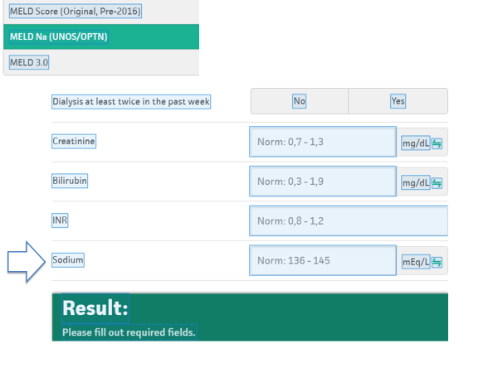
What other information do you need to answer correctly?
1,2
At discharge:
Creatinine 1,2mg/dl
bilirubin 1.8mg/dl
albumin 2.9 g/dl
INR 1.3
Na 136
1,8
1,3
136
14

Slide 7
Which other information do you need to properly answer?
Biochemical tests
and….???

Slide 8
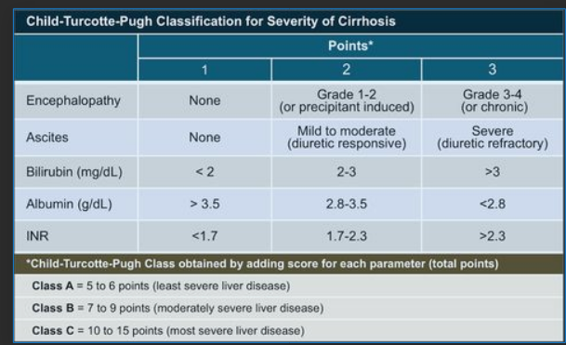
Which other information do you need to properly answer?
At discharge:
non-encephalopathy
minimal ascites in diuretic therapy
bilirubin 1.8mg/dl
albumin 2.9 g/dl
INR 1.3
Creatinine 1,2
Na 136
CHILD B7

Slide 9
Should the patient be a candidate for liver transplantation?
Yes
No
Maybe
Notes:
9

Slide 10
What is it the proper timing for referring the patient to the transplant center for LT evaluation?
Notes:
10

Slide 11
MINIMUM CRITERIA FOR REFERRING THE PATIENT TO THE TRANSPLANT CENTER
Child-Pugh score ≥7 (Child-Pugh class B or C)
MELDNa score ≥10
Bleeding from esophageal varices or single episode of PBS regardless of Child-Pugh or MELDNa score
Rare diseases and exceptions to MELD*
HCC
Toniutto P, Gerunda G. Indicazioni al trapianto epatico, Commissione AISF, 2008.

Slide 12
LIVER HISTORY:
The patient stopped drinking alcohol and continued his hepatological check-ups regularly
In January 2020 he admitted to the Infectious Diseases Unit of our Hospital for cholecystitis ascitic decompensation and HE.
Notes:
12

Slide 13
At discharge:
encephalopathy
minimal ascites in diuretic therapy
bilirubin 3.8mg/dl
albumin 2.9 g/dl
INR 1.6
Creatinine 1,2
Na 136
CHILD C10

Slide 14
1,2
At discharge:
Creatinine 1,5 mg/dl
bilirubin 3.8mg/dl
albumin 2.9 g/dl
INR 1.6
Na 136
1,8
1,3
136
22

Slide 15
Should the patient be a candidate for liver transplantation?
Notes:
15

Slide 16
Liver transplantation (OLT) - WHEN?
Evidence of liver dysfunction
(Child Pugh >7 / MELD > 15)
And/or
major complication (Ascites, SBP, HRS, Variceal Bleeding, HE, HCC)

Slide 17
How do you determine if a patient is eligible for liver transplantation?
Notes:
17

Slide 18
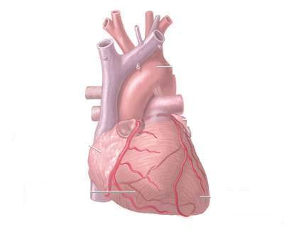
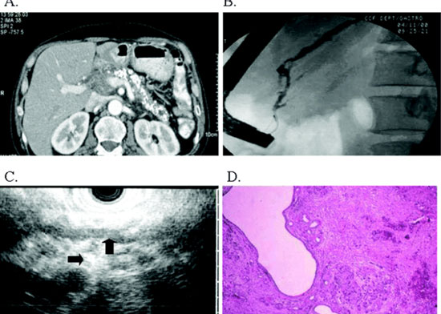
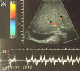
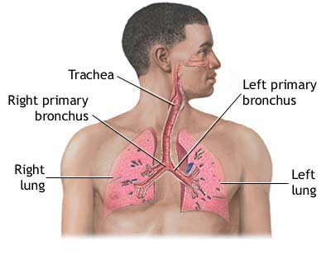


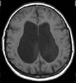
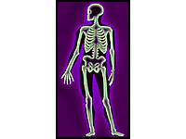
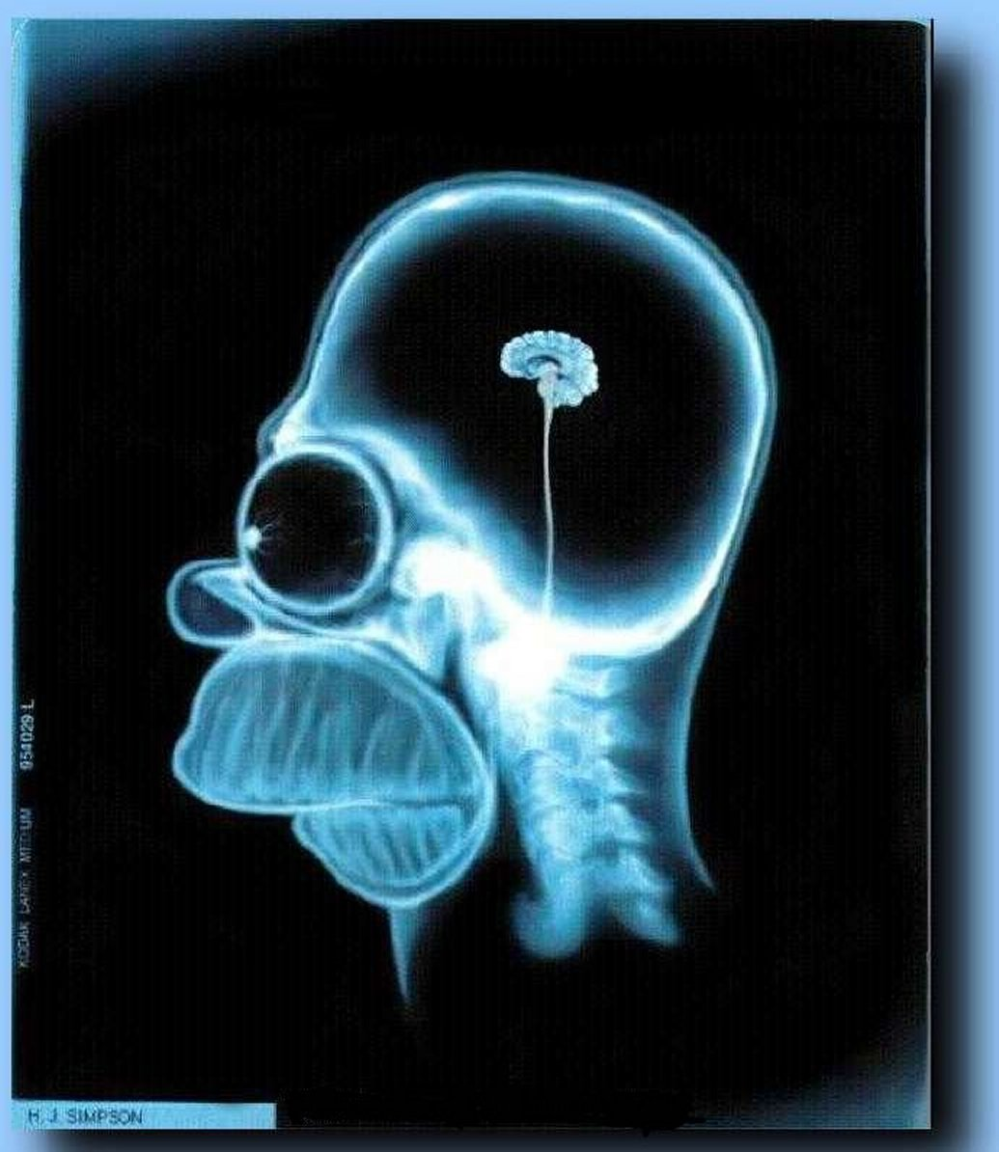
LIVER TRANSPLANTATION
HOW TO EVALUATE THE SUITABILITY FOR TRANSPLANTATION?
Splancnic-Abdominal
Ct Scan – NMR -
Miocardiopathy
Ecocardiography with EF
Arteriography (?)
Portal Hypertension
Evaluation
Doppler US
EGDS
Tumors
Lung
GI
Head Neck
Infections
Lung
Systemic
Pulmonary function
Spirometry
Haemogas analysis
Cerebral Atrophy
Neuropathy
Cerebral CT Scan
Osteoporosis
Dexa
CT
Rx paranasal sinuses
Orthopantomography

Slide 19
MEDICAL/SOCIAL HISTORY
Heavy smoker.
Previous drug addiction. Stop using major drugs (Cocaine) from 2010.
Stop alcohol intake and cannabinoid consumption from 11.2019
Notes:
19

Slide 20
DECISIONAL ALGHORITM IN PATIENTS
WITH HISTORY OF ALCOHOL CONSUMPTION
History of alcoholism
No
Yes
Non compliance-
Social problems?
Yes
Success of previous treatments?
No
No
Yes
Therapy and re-evaluate
Active psychosis?
Not candidate
No
Yes
No
Familiar support?
Yes
Psychiatric therapy terminated?
Yes
No
Not candidate
Yes
Social support available?
No
Reasonable candidate
Questionable candidate
Yowsey S. and Schneekloth T. In: Transplantation of the liver, 2nd edition. Elsevier and Saunders Ed. 2005.

Slide 21
MEDICAL HISTORY
Repeatedly negative hair test.
Addiction Centre report 21/6/22:
  Previous cocaine use disorder
  alcohol use and opioids in prolonged remission.
Notes:
21

Slide 22
On 28/02/2023 the patient underwent
ORTHOTOPIC WHOLE LIVER TRANSPLANT PROCEDURE
Notes:
22

Slide 23

RECIPIENT
DONOR
ORGAN PROCUREMENT
ORGAN PRESERVATION
LIVER TRANSPLANT
TRANSPLANTED “PATIENT”
Waiting List
Immunosuppressive Agents
Treatment of :
Cirrhosis
Tumors
HCV Infection
DBD
Donor following Brain Death
WHOLE LIVER
Infections
STATIC COLD
PRESERVATION
CONVENTIONAL
TECHNIQUES
Long Term Complications
Prioritization
DBD
MARGINALS DONORS
SPLIT LIVER
(Partial Organ)
CHALLENGING
CONDITION
(PV Thrombosis)
QOL
Adult/Pediatric
List
MELD
MACHINE PERFUSION
Hypot / Normot
COMBINED
TRANSPLANT
DCD
Donor following Cardiac Death
NRP
Normothermic Regional Perfusion
APPROACH TO
SURGICAL COMPLICATIONS
LDLT
Living Donor Liver Transplantation
Notes:
The success of liver transplantion depends on many factors spread over a long period of time.
At the beginning of the trip we have a recipient that met the listing criteria.
During the waiting list period, he must receive all possible treatments to maintain the best compensation.
The type of donor, the type of graft, the type of organ preservation and the type of surgical technique are all variables that can affect the transplant.
In the postoperative period, other important variables come into play: the type of immunosuppression, infections and long-term vascular complications

Slide 24
RECIPIENT
DONOR
ORGAN PROCUREMENT
ORGAN PRESERVATION
LIVER TRANSPLANT
TRANSPLANTED “PATIENT”
Waiting List
Immunosuppressive Agents
Treatment of :
Cirrhosis
WHOLE LIVER
NRP
Normothermic Regional Perfusion
+
Static cold
preservation
Infections
DCD
Donor following Cardiac Death
CONVENTIONAL
TECHNIQUES
No Prioritization
Long Term Complications
Adult
W.List
MELD=22
QOL
Notes:
The patient in the clinical case received a whole liver and the surgical technique was conventional but the type of donor and the type of preservation were different to the standard scenario

Slide 25
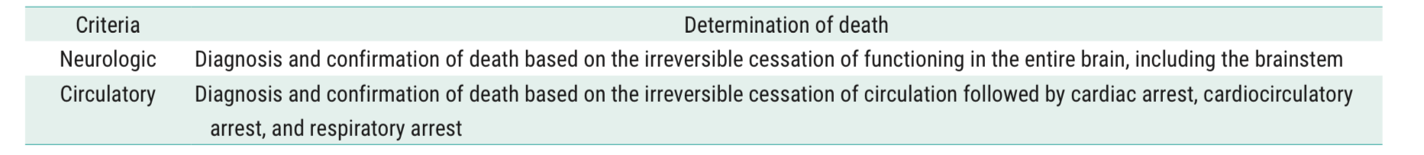
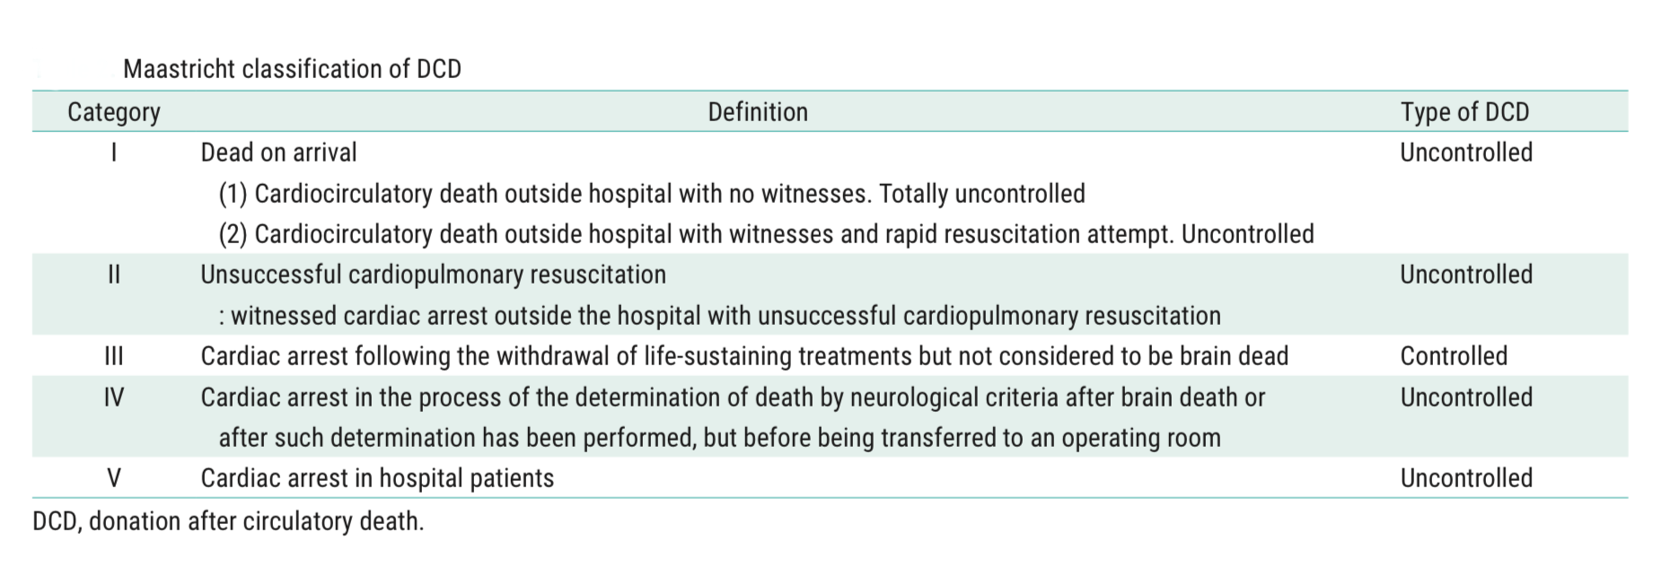
DCD
Notes:
In Italy today, there are three types of donation.
According to the most recent terminology we define:
-Donation after Circulatory Determination of Death (DCD);
-Donation after Neurological Determination of Death (DBD);
-Donation from a living donor.
The determination of death must follow precise Neurological or Circulatory criteria.
The Maastricht Classification defines the possible scenarios that can lead to DCD donation.
In DCD Category III- Cardiac Arrest is expected and the medical decision is taken in multi-disciplinary approach, where further treatment is considered futile.
the term “controlled” means that the ischaemia time was short enough to consider recovery of liver, kidneys, pancreas and lungs.

Slide 26
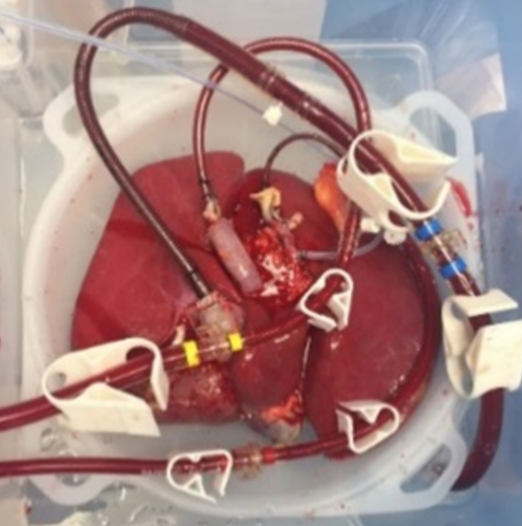
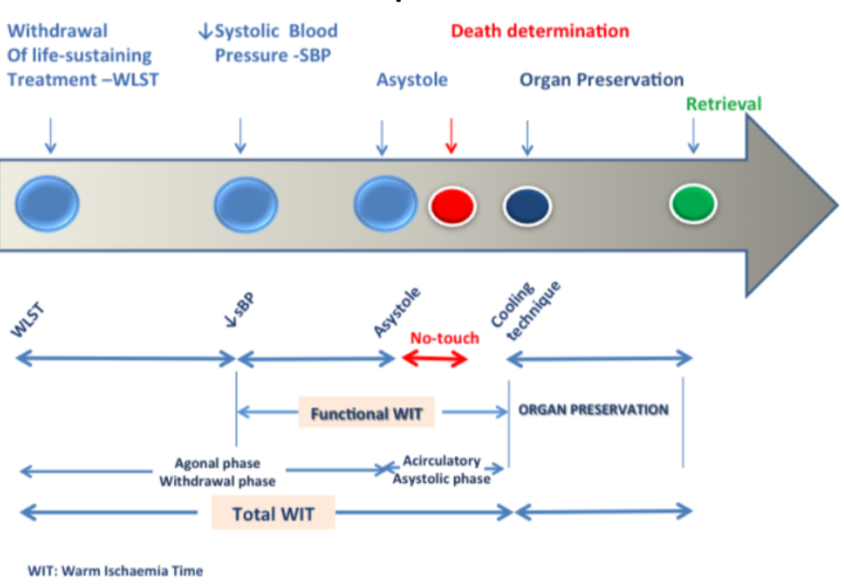
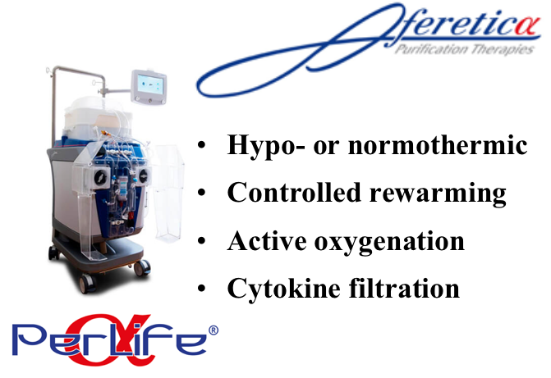
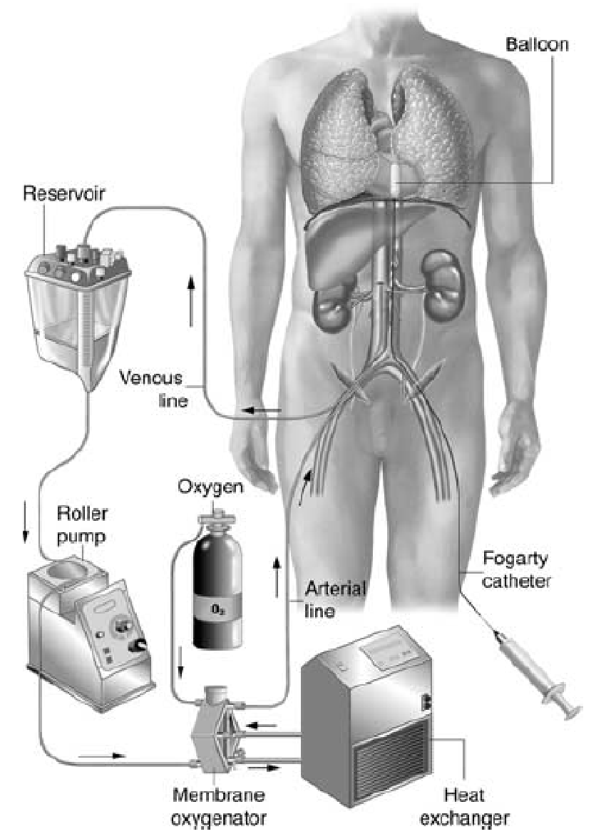
Controlled DCD process
Ex situ Machine Perfusion
Ex situ Machine Perfusion
NRP
Notes:
In Italy, 20 minutes of a continuous flat line on an electrocardiogram are required for declaration of death.
In the setting of donation after circulatory death (DCD), prolonged warm ischemia time prompted the introduction of abdominal normothermic regional perfusion (NRP) followed by post procurement use of Ex situ machine perfusion

Slide 27
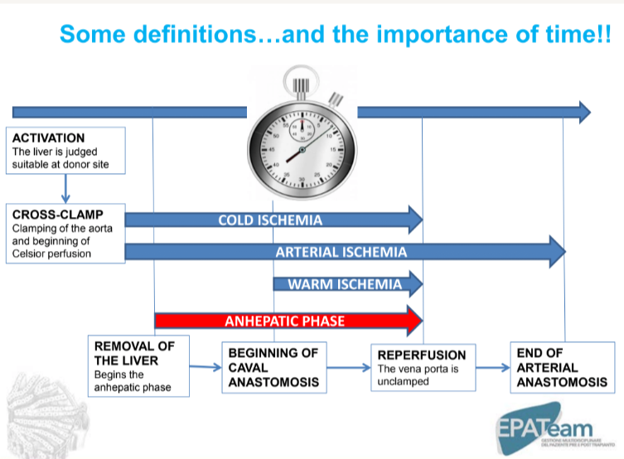
Notes:
We can say that in liver transplantation, surgery begins in the donor and ends in the recipient.
Time is an important factor in the process.
The length of cold ischaemia time and warm ischaemia time are the most important factors in determining ischaemic damage in the postoperative period.

Slide 28
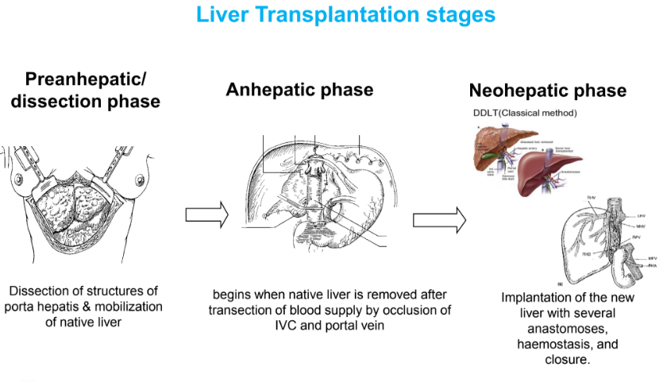
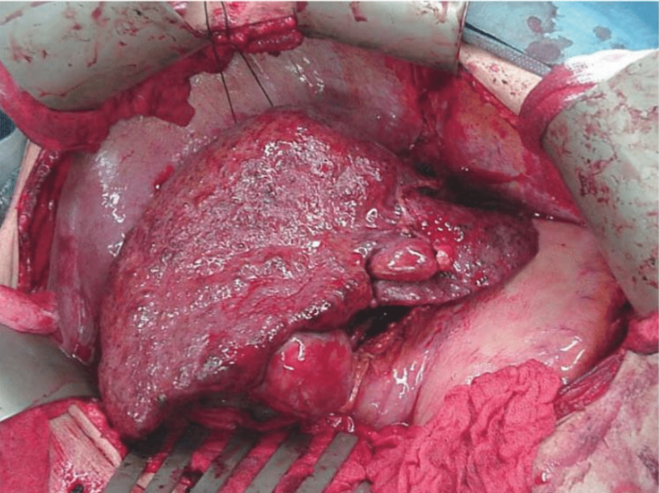
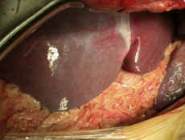
Notes:
Liver transplant surgery is divided into three stages:
-in the first stage, the liver is mobilised by dissecting the ligaments surrounding it and the vascular structures are isolated
-in the second stage, the hepatectomy is completed and the anastomoses of the vena cava and portal vein are made. This stage ends with reperfusion of the graft
-in the third period, arterial anastomosis and biliary anastomosis are performed.
Haemostasis is checked,
and the abdomen is closed.

Slide 29
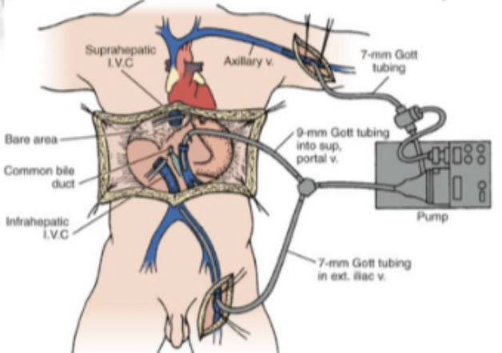
Notes:
The original technique includes the use of the venovenous bypass.
Venovenous bypass maintain the venous flow from the inferior and superior vena cava districts and shunts the portal system, draining the abdominal viscera into the systemic circulation
It is constructed with the Griffith circuit
A Bio-Pump collects the blood coming from one catheter inserted in the iliac vein (through
the saphenous or the femoral vein) and one catheter inserted into the portal vein trunk.
The blood is pumped to the superior vena cava circulation through the axillary vein or the internal jugular vein with a velocity ranging from 1 to 2–2.5 L/ min.
Today some groups routinely perform LT without bypass, which is required only exceptionally.
Avoidance of bypass is possible when the anesthesiology team is very experienced and able to maintain the
hemodynamic stability during the anhepatic phase through an accurate balance of intravenous fluid infusion and vasopressors.
Together with preservation of an adequate hemodynamic state, the venovenous bypass prevents from splanchnic and caval sequestration and renal failure

Slide 30
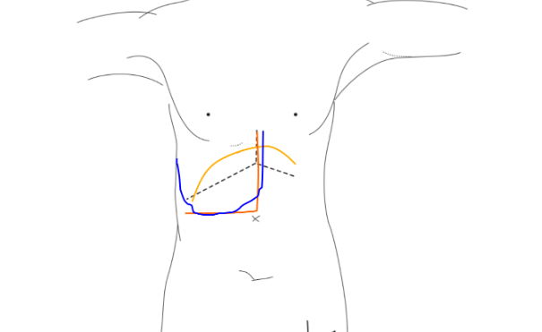
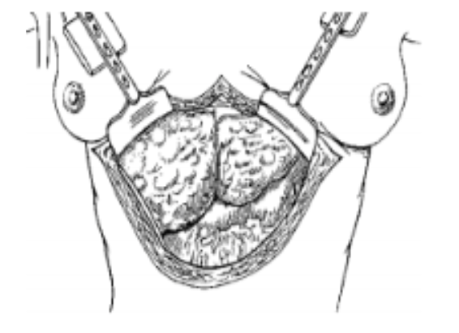
Notes:
A right subcostal incision extended to the median line up to xifoid incision (J -shaped incision) is performed. Alternatively this incision can be extended to the left subcostal line (mercedes incision). The right and left costal margin are retracted with a wide retractor. It is important obtain the optimal visceral exposure.

Slide 31
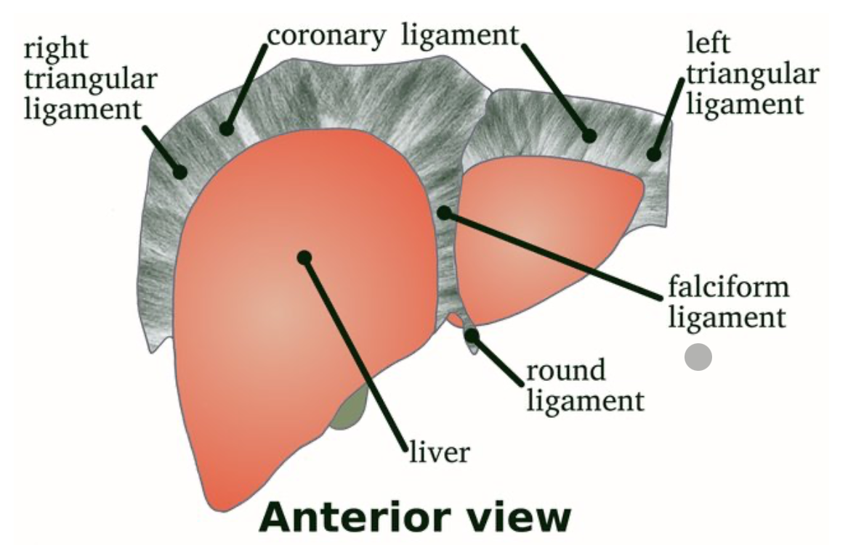
Notes:
The umbilical ligament is ligated and divided, paying attention to the frequent presence of a patent umbilical vein in cases of marked portal hypertension.
The falciform ligament is divided.

Slide 32
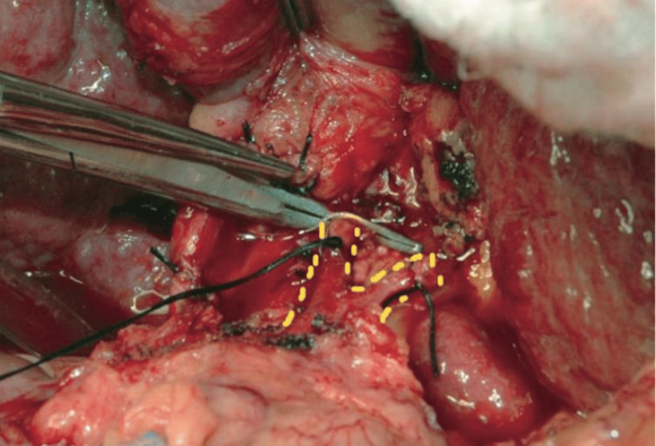
Notes:
The main bile duct is divided as you can see in the picture marked with the green arrow.
The hepatic artery marked with the yellow line is isolated and divided at the level of right and left branches in order to keep these vessels as long as possible for the subsequent anastomosis.

Slide 33
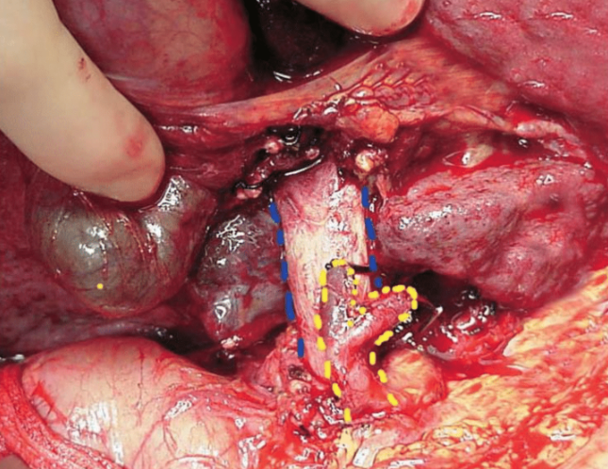
Notes:
The portal trunk marked with the blu line, is isolated by freeing it from the lymphatic tissue which surrounds the vessels

Slide 34
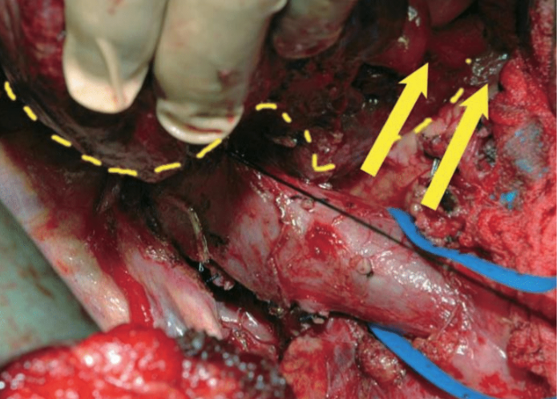
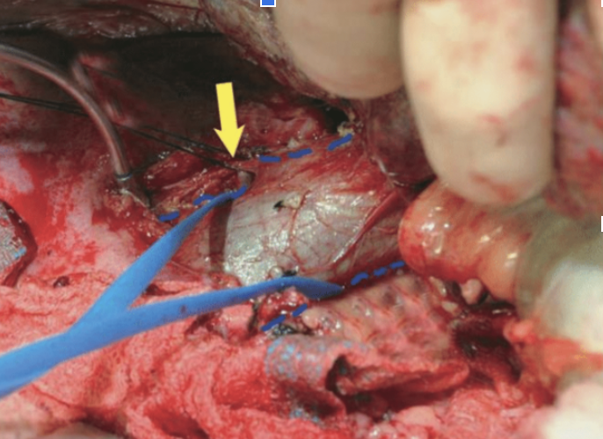
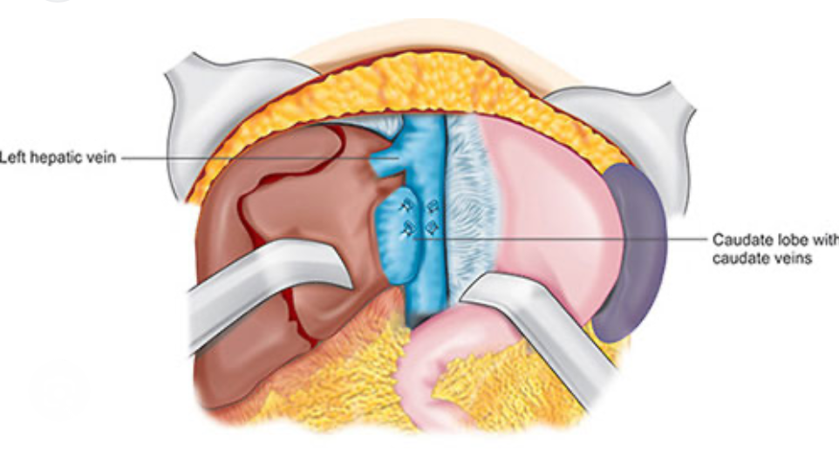
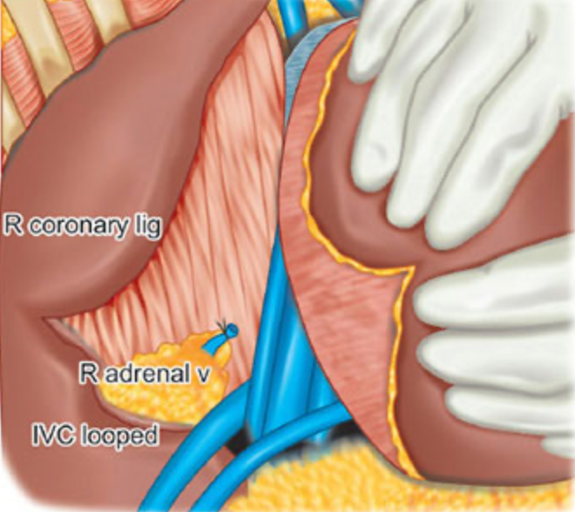
Right
Left
Notes:
The liver is then mobilized by dividing the left and right triangular ligaments. To the right, adrenal gland is detached from the posterior surface of the liver and the right adrenal vein is isolated and ligated.
On the left side the lesser sac is divided and the posterior peritoneal tissue covering the vena cava is opened below the caudate lobe. After this manouver is possible isolate the infra and suprahepatic inferior vena cava.

Slide 35
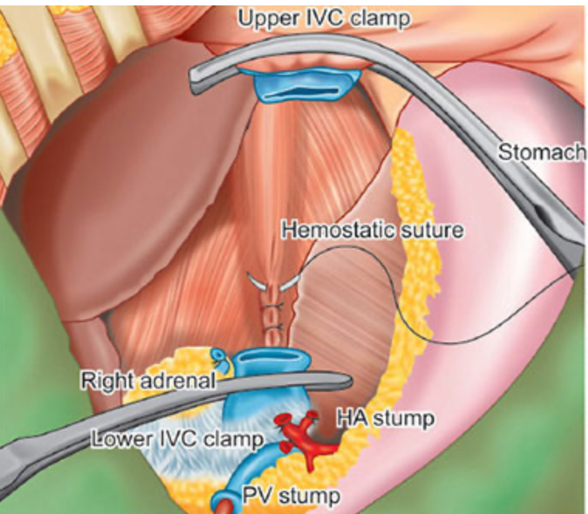
Conventional Caval Anastomosis
Notes:
The PV is clamped and divided.
The suprahepatic inferior vena cava is cross clamped below and above the liver with a large clamp.
Then the suprahepatic IVC is divided inside the liver, at the level of the stumps of the major hepatic veins.
The inferior caval stump is obtained by sectioning it around 1 cm above the inferior clamp.
The native liver is removed and hemostasis of the retrohepatic space is achieved with sutures.

Slide 36
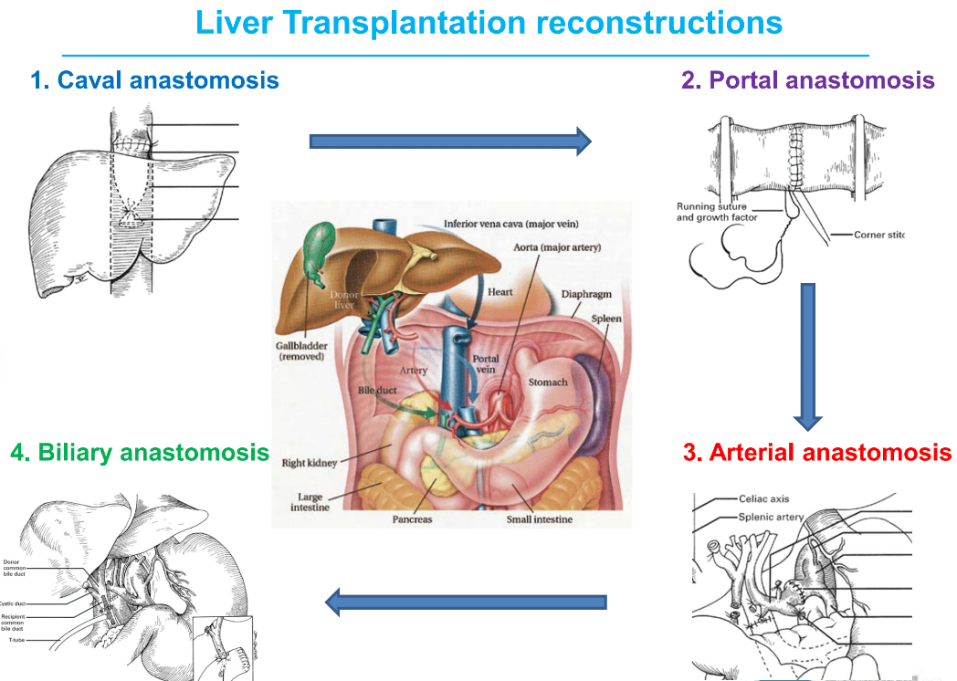
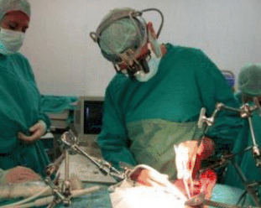
Notes:
After removal of the liver, the anhepatic phase begins.
The liver graft is placed in the abdomen and the vascular anastomoses begin.
First the caval anastomosis is performed, then the portal anastomosis.
On declamping the anhepatic phase ends.
After the haemostasis check, the operation is completed with the arterial and biliary anastomosis.

Slide 37
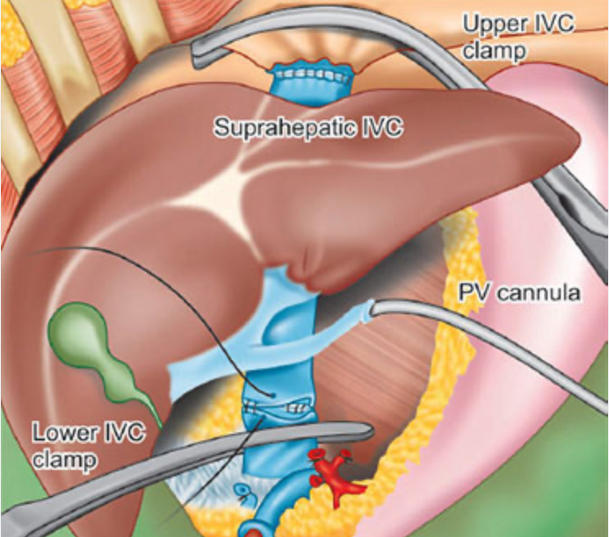
Conventional Caval Anastomosis
1
2
Notes:
The upper caval anastomosis is performed with a running 3/0 or 4/0 PROLENE suture.
The lower vena cava anastomosis is performed with a 4/0 PROLENE running suture.
Simultaneously the graft is washed with cold saline solution through the catheter placed in the portal vein during organ retrieval with the aim of eliminating the preservation solution contained in the liver and prevent air embolism.

Slide 38
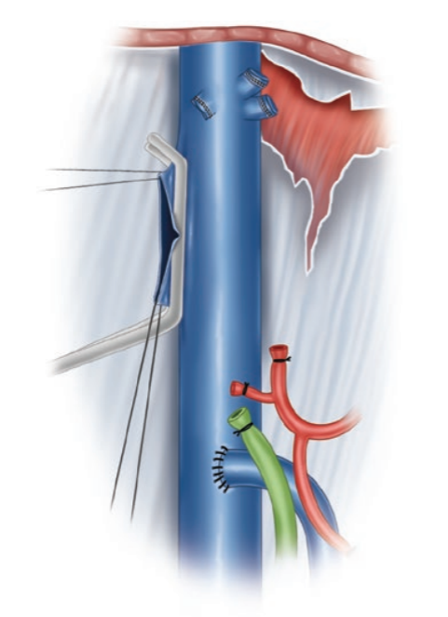
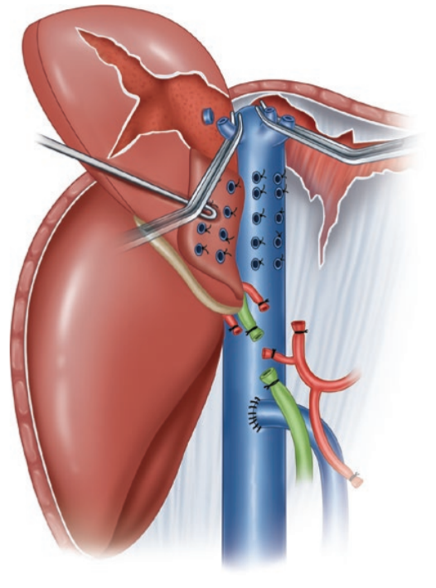
Preservation of the recipient vena cava
Notes:
LT with preservation of the recipient vena cava has been proposed as an alternative to the conventional LT technique with the main advantage of maintaining the caval flow avoiding the use of venovenous bypass.
The first stage of the procedure is identical to the conventional technique, with preparation of the hepatoduodenal ligament.
The infrahepatic vena cava is approached from both the right and the left sides.
On the left side, the peritoneum surrounding the infrahepatic vena cava is opened, and left-sided small accessory hepatic veins are ligated, o r sutured, and divided.The Spiegel lobe can be raised, and at least one large hepatic vein draining the caudate lobe is encountered.
On the right side, accessory hepatic veins are also divided in a caudo-cranial direction.
The dorsal ligament of the vena cava is taken down, so the entire anterior surface of the infrahepatic vena cava up to the outlet of the three major hepatic veins.

Slide 39
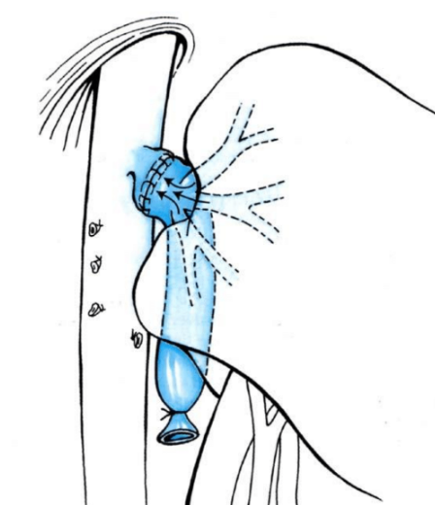
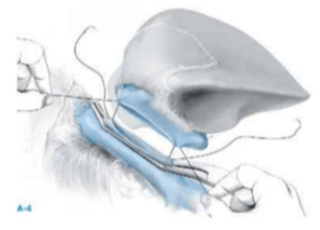
piggyback technique
cavocavostomy technique
Notes:
In this scenario, There are different techniques of caval anastomosis.
The one initially described in humans by Tzakis is known as the “piggyback technique” and consists in the division of the septa between the hepatic vein obtaining a single, wide orifice for the anastomosis with the suprahepatic vena cava of the liver graft.
Another technique of outflow reconstruction is represented by the cavo-caval anastomosis
On the recipient side, the caval orifice can be obtained by the longitudinal opening of the anterior caval wall
On the donor liver side, the stump can be formed by the longitudinal opening of the caval wall, after closure of the suprahepatic and infrahepatic vena cava orifices.
Therefore side-to-side or end-to-side cavo-cavostomy is performed.

Slide 40
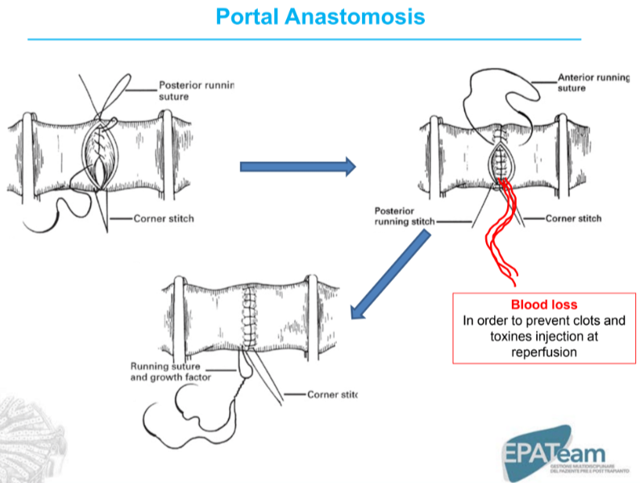
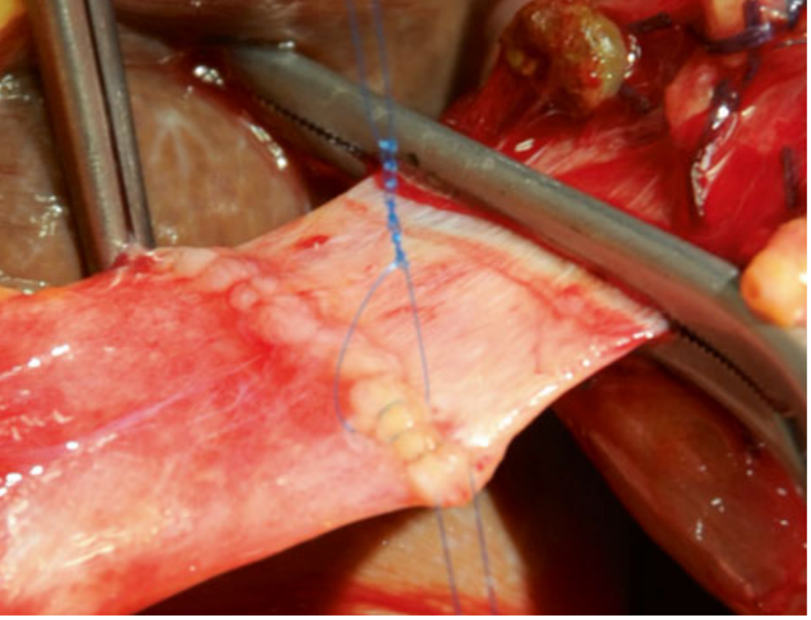
Notes:
Soon after the caval anastomosis are completed an end to end portal vein anastomosis is performed with an 6/0 PROLENE running suture. The running suture was not fully tied, leaving a loose tract of the thread (“growth factor”) to allow distension of the anastomosis after reperfusion, thus preventing portal vein stricture.
The sequence of vascular clamp release is variable.
Usually we unclamped the portal vein first, followed by the lower inferior vena cava and suprahepatic vena cava.
After the riperfusion of the graft the anestesiology team must keep the central pressure low in order to avoid an excessive cardiac preload.

Slide 41
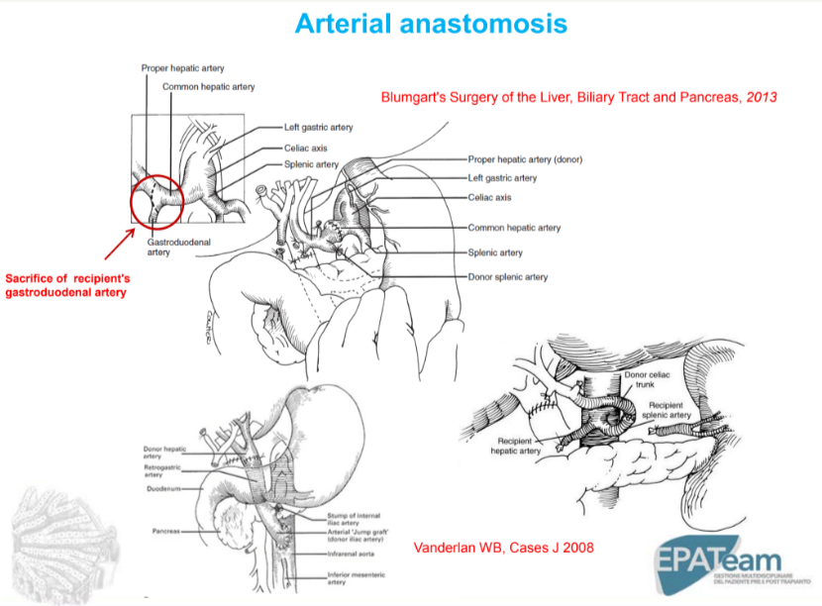
Notes:
The arterial anastomosis is usually performed in an end-to end fashion. Recipient sites for arterial reconstruction can be the proper hepatic artery, common hepatic artery or a branch patch obtained between the recipient CHA and the origin of the GDA or an accessory/replaced right hepatic artery (aRHA) from the superior mesenteric artery (SMA)

Slide 42
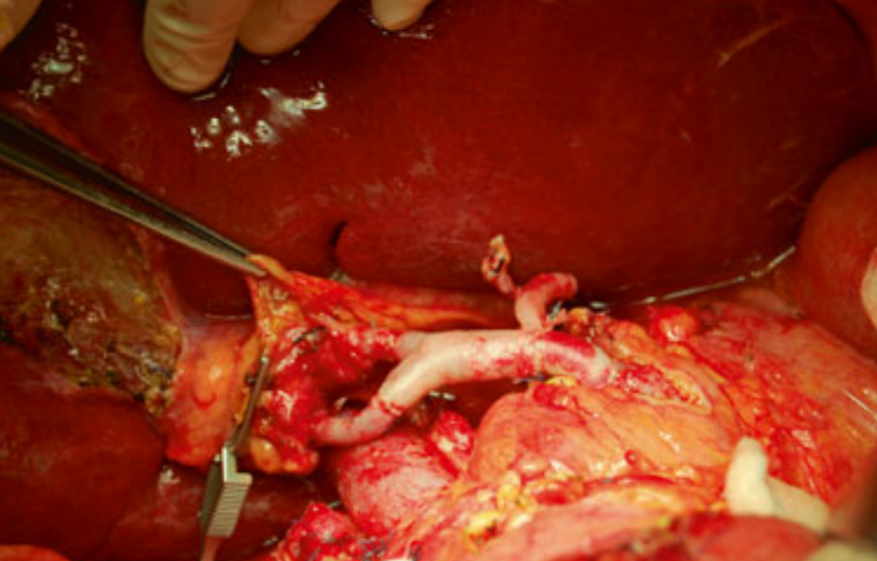
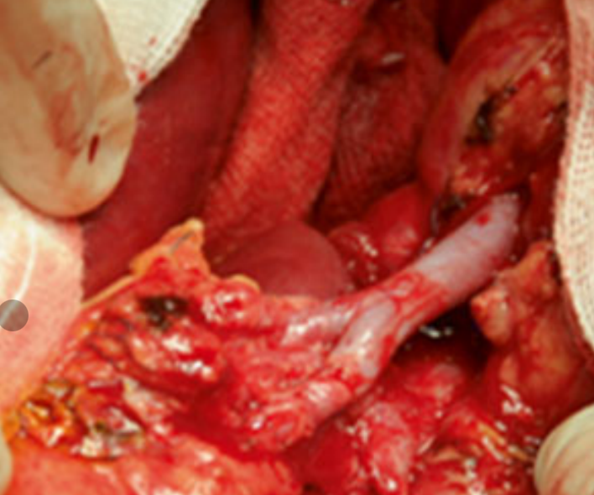
Notes:
Depending of the size of the arteries, the anastomosis is performed with 6/0, 7/0, 8/0 PROLENE sutures which can be a running or an interrupted one.
In around 20–30 % of cases, the liver graft presents with arterial anomalies, more frequently consisting in an aRHA from the SMA, an accessory left hepatic artery from the left gastric artery, or a combination of the above.
In the case of an aRHA, it is usually reconstructed in an end-to-end fashion with the donor GDA
In the case of an aLHA, its preservation requires a reconstruction between the recipient HA and the donor celiac artery, with a risk of kinking. In most cases, the aLHA is very small it and can simply be ligated

Slide 43
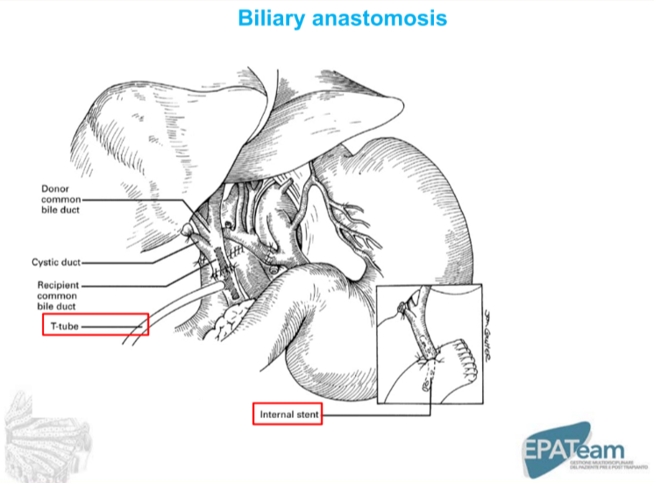
Notes:
The biliary reconstruction is usually performed between the donor and recipient main bile ducts in an end-to-end fashion, using a 5/0 or 6/0 PDS running or interrupted suture.
Ideally, the sectioning of the donor and recipient bile ducts is best performed above and below the junction of the cystic ducts, respectively, provided that the two bile duct stumps are long enough to be anastomosed without stretching.

