Slide 1
Clinical Cases MDT 5° yr
Lower GI

Slide 2
Lower GI Case N. 1
A 54 - year-old man with rectal bleeding
Mr Palak is a 54-year-old cab driver who presents to your outpatient clinic because of persistent bleeding from the anus.
This has been a problem for the last few months.
He has a friend who was recently diagnosed with colon cancer. He is very concerned that he may have cancer too. He has come to you for reassurance.

Slide 3
Lower GI Case N. 1
HISTORY
He refers he sees bright red blood on the toilet paper after wiping and in the lavatory. The stools are coated in blood and he thinks it is also mixed with feces.
He had a first episode 3 months ago and this has repeated itself every week or so since then. His stools have been usually hard and there is some tenesmus. Due to generalized perianal discomfort and burning he think about hemorrhoids because her mother and sister suffered of hemorrhoids, however is also afraid about the risk of cancer
His weight is stable and there are no other systemic symptoms.
He has a past medical history of irritable bowel syndrome diagnosed by his general practitioner a few years earlier, suffering from episodic abdominal cramps and diarrhea.
He takes ibuprofen occasionally for a frozen shoulder. Smokes 10 cigarettes/day. He drinks 10 units of alcohol per week.
His father had colon cancer aged 70 years.

Slide 4
Lower GI Case N. 1
What is your differential diagnosis at this stage?

Slide 5
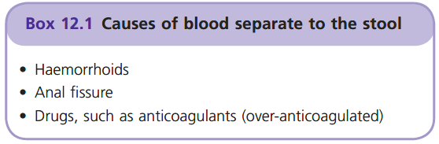
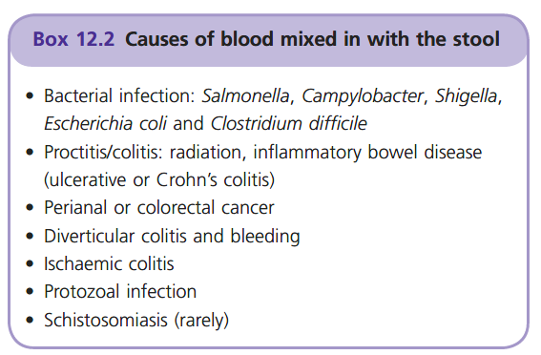

Slide 6
Case N.1
Examination
General and abdominal examinations were unremarkable.
On rectal exam his perianal area was erythematous. 2nd degree of hemorrhoids have been observed by the GP at the proctoscopy. There was good anal tone and no palpable masses or fissure. No blood was observed over the finger
(Rigid sigmoidoscopy to 15 cm showed normal healthy mucosa, which was biopsied)
There were small internal hemorrhoids at 12 o’clock and 3 o’clock which were not thrombosed or prolapsed

Slide 7
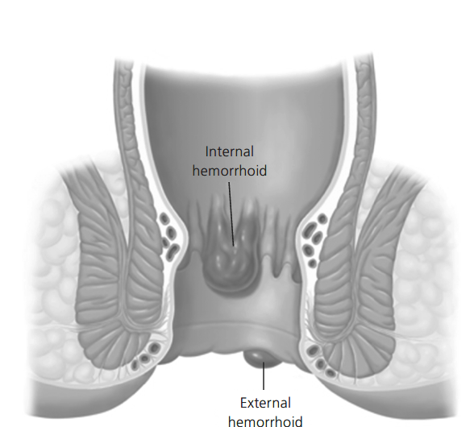

Slide 8
lower GI Case N.1
Findings
Blood tests were normal.
Colonoscopy (complete) showed diverticular disease of the sigmoid colon and confirmed internal haemorrhoids on retroversion of the scope. They were not thrombosed or actively bleeding.
Barium enema also demonstrated some right-sided colonic diverticular disease.
There were no colonic masses. He returns to your gastroenterology clinic 2 weeks later to discuss the results

Slide 9
Discussion

Slide 10
Lower GI Case N. 2
A 66-year-old woman with WEIGHT LOSS
Maria is a retired nurse, she consults her GP with a 4-month story of tiredness, slight breathlessness on exertion and loss of weight from 71 to 65 Kg. Her appetite is unchanged and normal. No nausea and vomiting.
Over the last 2 months she complaining of changes in bowel habit with some loose stools and increased frequency. Stools are sometimes thinner than usual.
She would not know if she had PR bleeding. She says she had some haemorrhoids in the past.
No relevant past or family history.
No chronic medications.
Smoked 20 cig/day for 48 years and drinks 20-28 U of alcohol/week.

Slide 11
Lower GI Case N.2
Examination
Slight pallor, but otherwise looks well.
No lymphadenopathy
Breast, thyroid, hearth, chest & abdomen are normal; the GP performed rectal examination but because of some patient discomfort he stopped early; no blood was observed
Blood pressure 148/90 mmHg

Slide 12
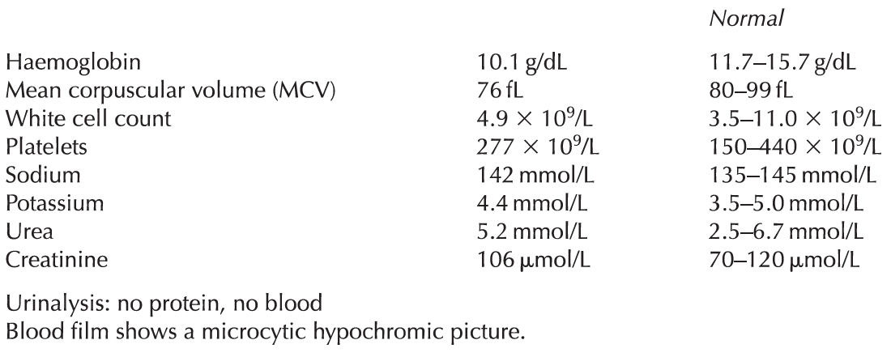
Lower GI Case N.2
Investigations

Slide 13
Lower GI Case N. 2
Differential diagnosis?
How would you investigate the patients ?

Slide 14
Lower GI Case N.2
Investigations
Colonoscopy: to the caecum; at 12 cm from the anal verge, a 3 cm ulcerated lesion was observed; biopsy was undertaken. A peduculated 2cm polyp was observed in the right colon; biopsies were taken.
Histology: infiltrative poorly differentiated adenocarcinoma of the rectum. The biopsy of the right colon polyp showed tubulovillous adenoma with low grade dysplasia
Chest and abdominal CT scan: no evidence of metastasis; thickening of the rectal wall; no nodes in the mesorectum

Slide 15
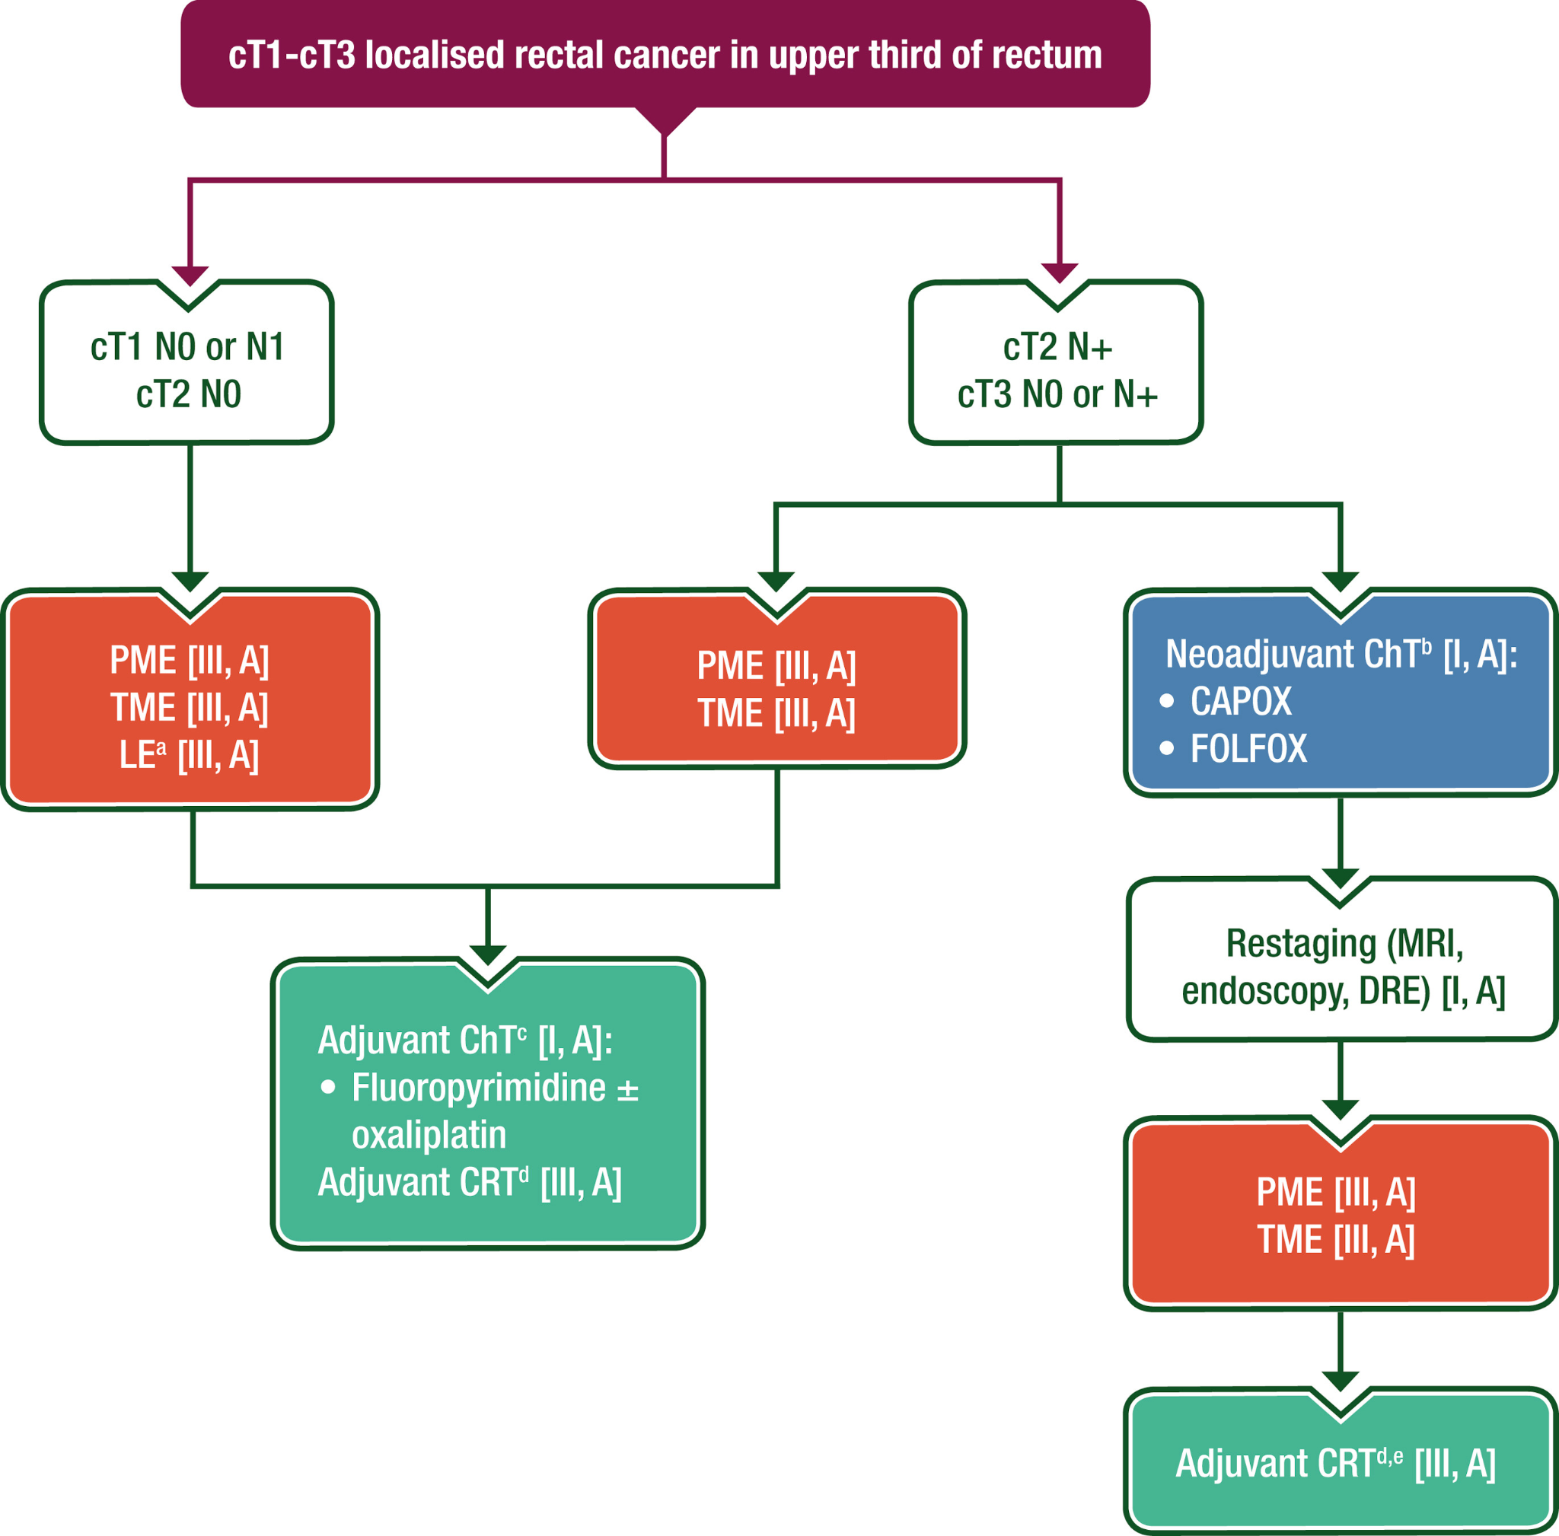
Upper Rectum

Slide 16
Upper Rectum

Slide 17
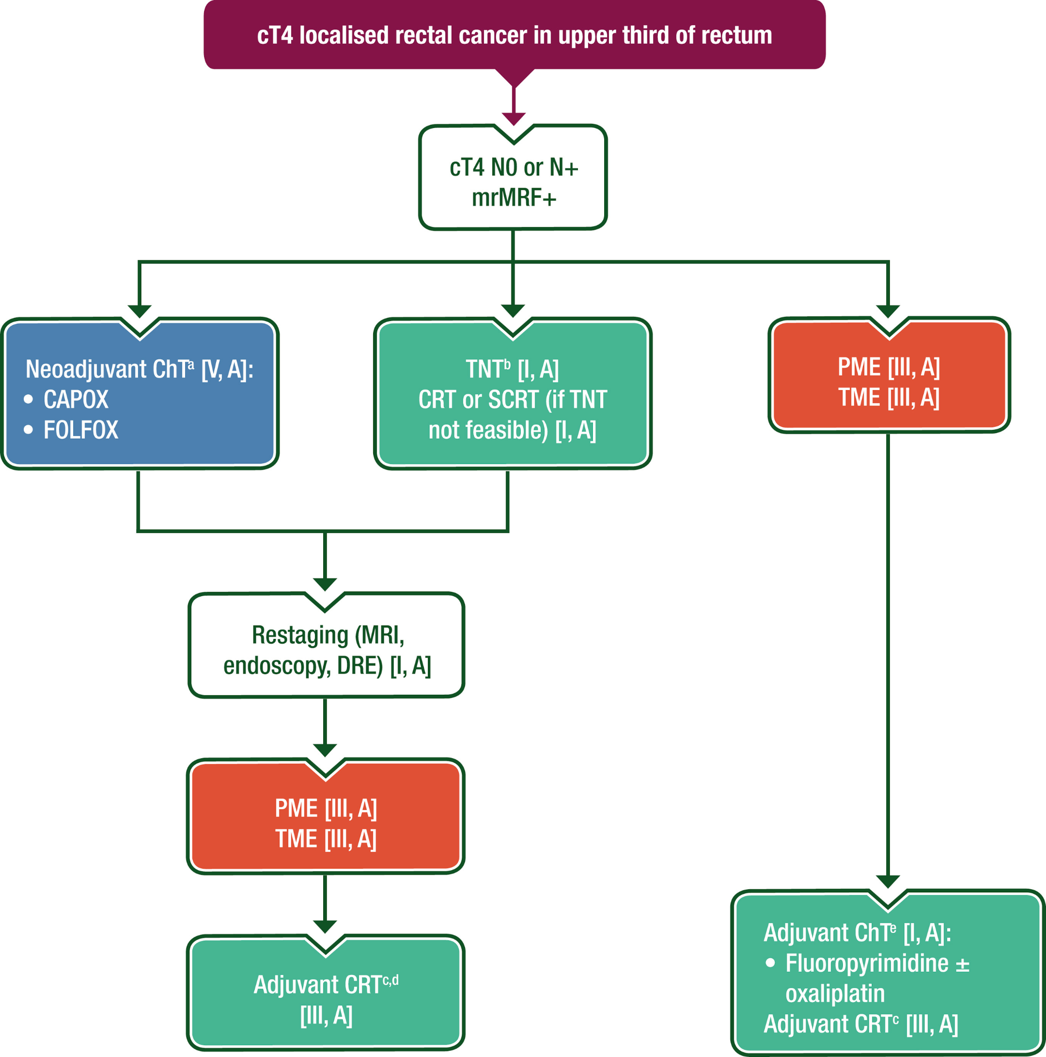
Upper Rectum

Slide 18
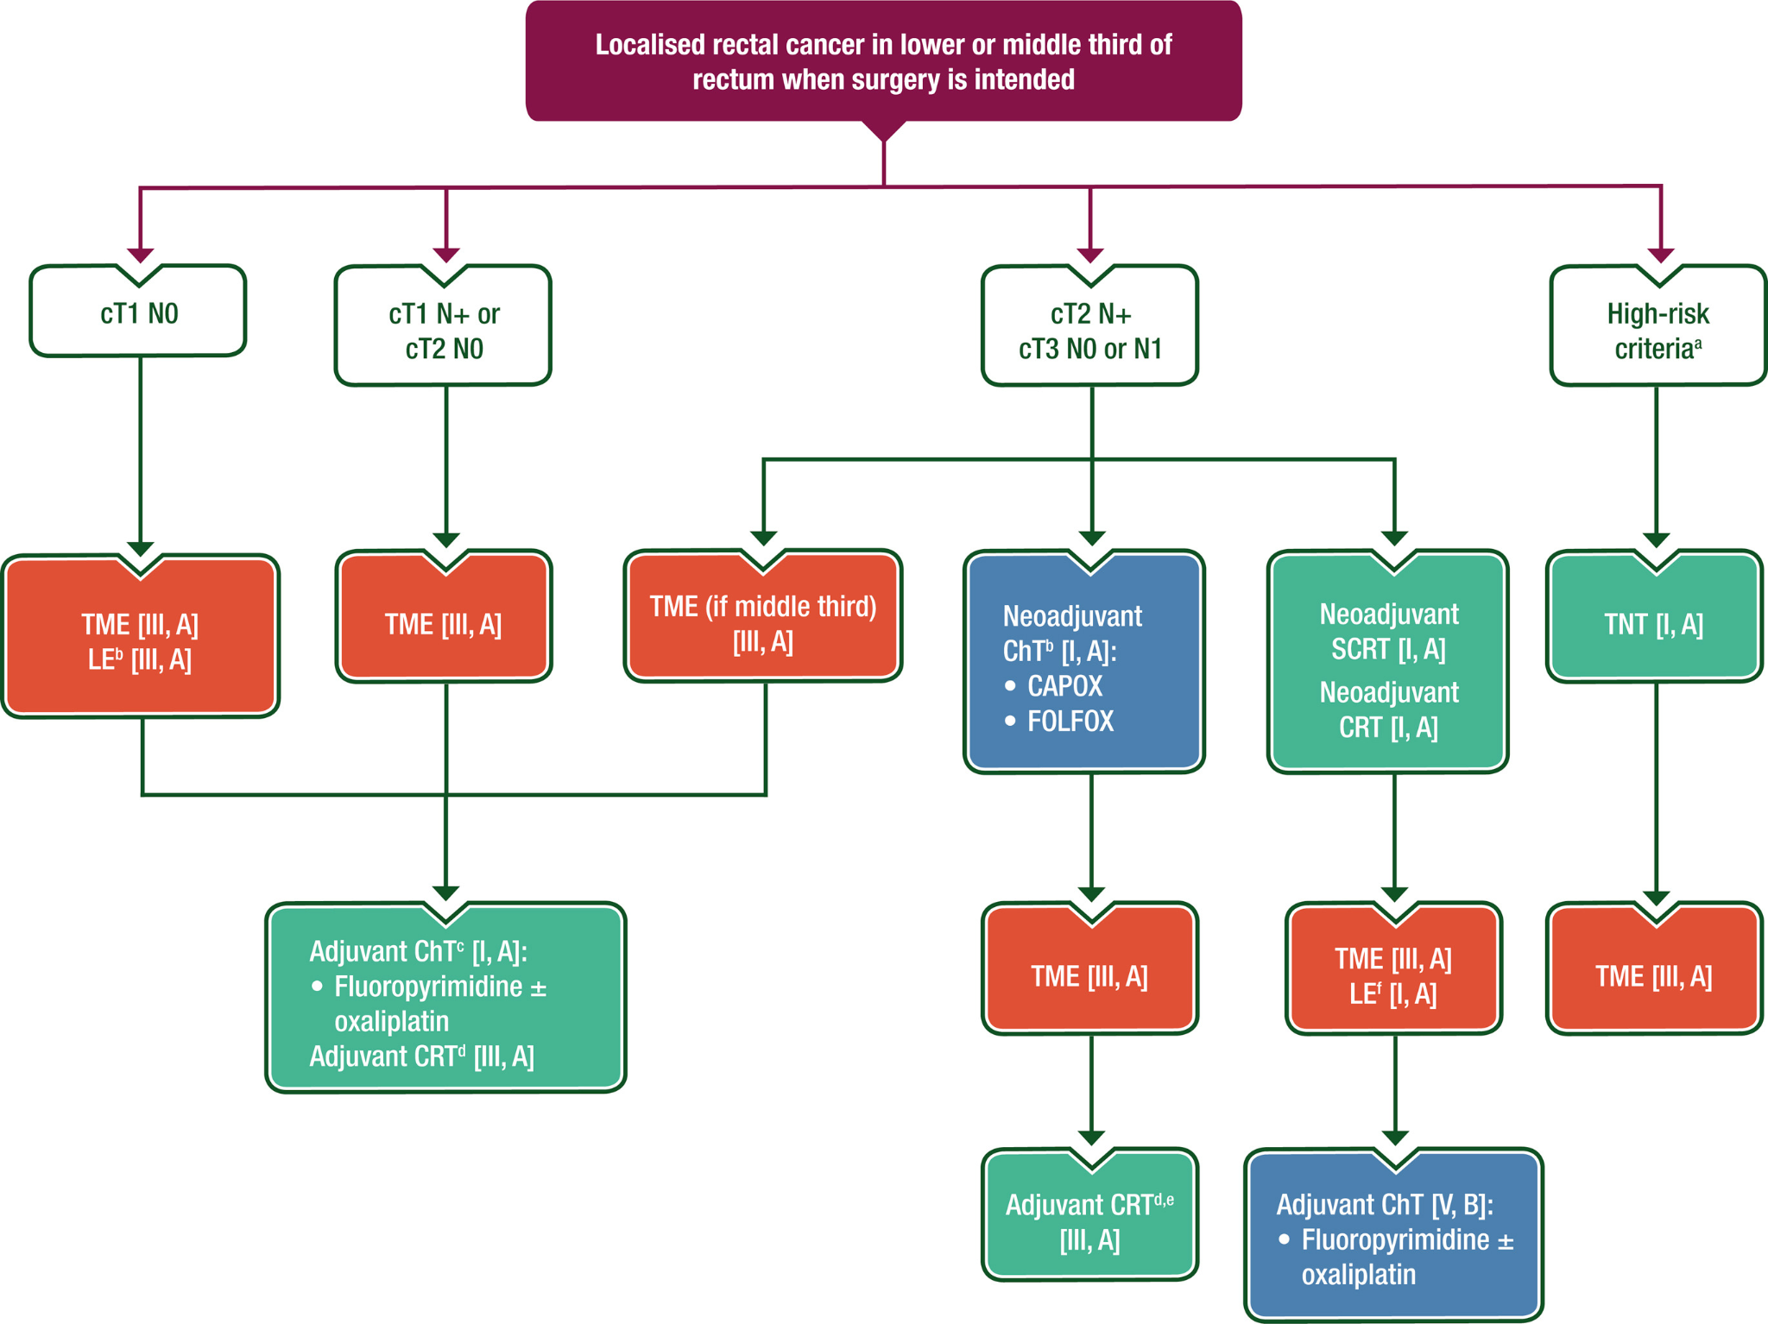
Lower Rectum

Slide 19
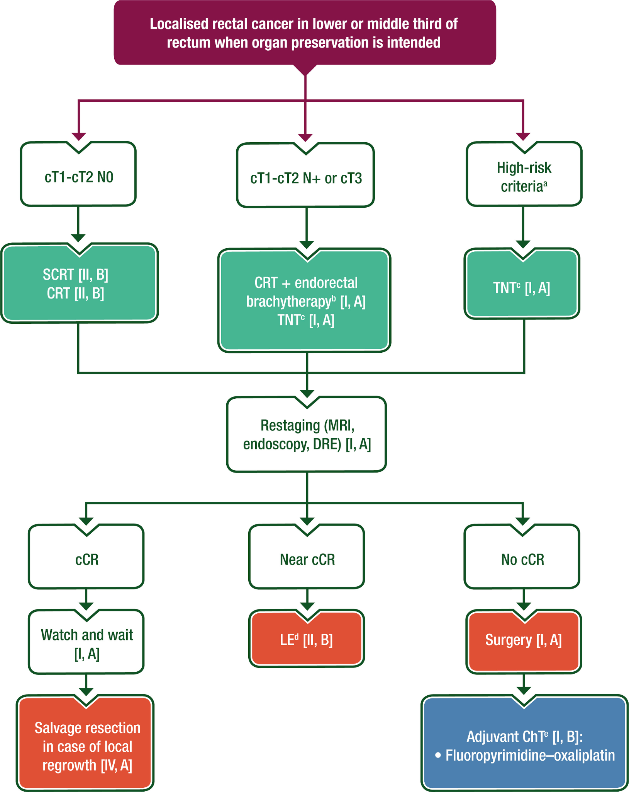
Lower Rectum

Slide 20
Lower GI Case N.2
Decision should be made: adijunctive investigation or Surgery?
MRI of the Pelvis: Thickening of the left lateral/anterior wall of the rectum, 10-12 cm from the anal verge, with involvement of the to the muscularis propria and likely involvement of the mesorectum with spiculated appearance of the lesion in the mesorectum <5mm; lymph nodes of 8 mm; mrT3a mrN0-1 mrTD- mrEMVI- mrMRF-.
Endoscopic ultrasound: confirmation of muscularis propria and mesorectum involvement; nodes are 9 mm uT3 N0-1; tumor location below the peritoneal reflection.

Slide 21
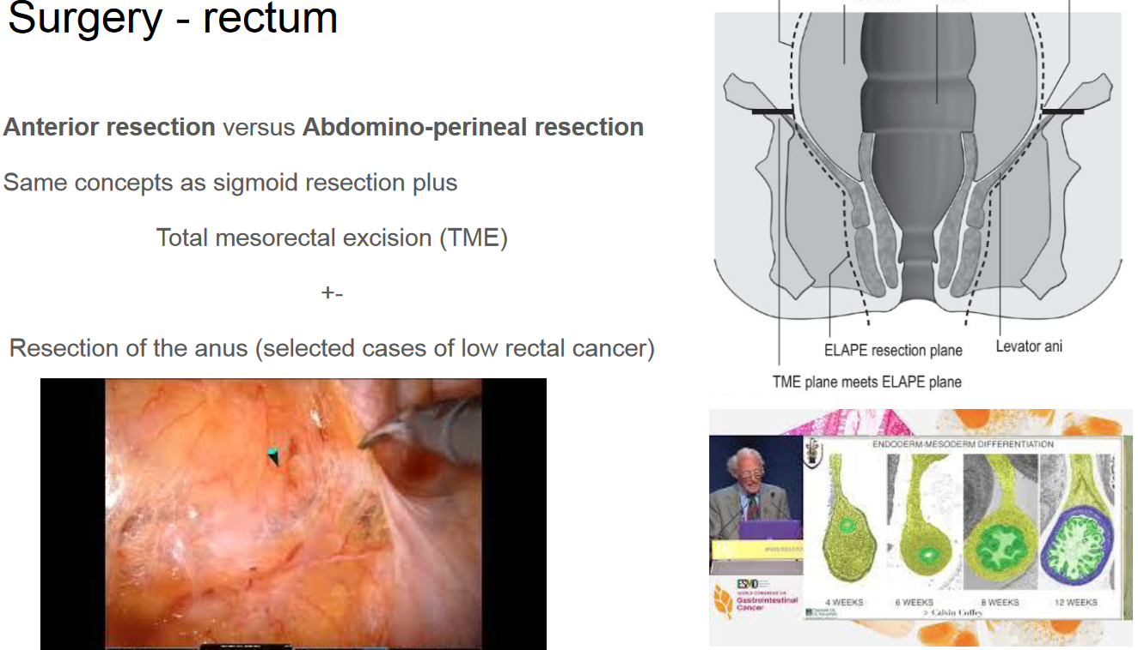
Decision should be made: adjunctive investigation or Surgery or …?

Slide 22
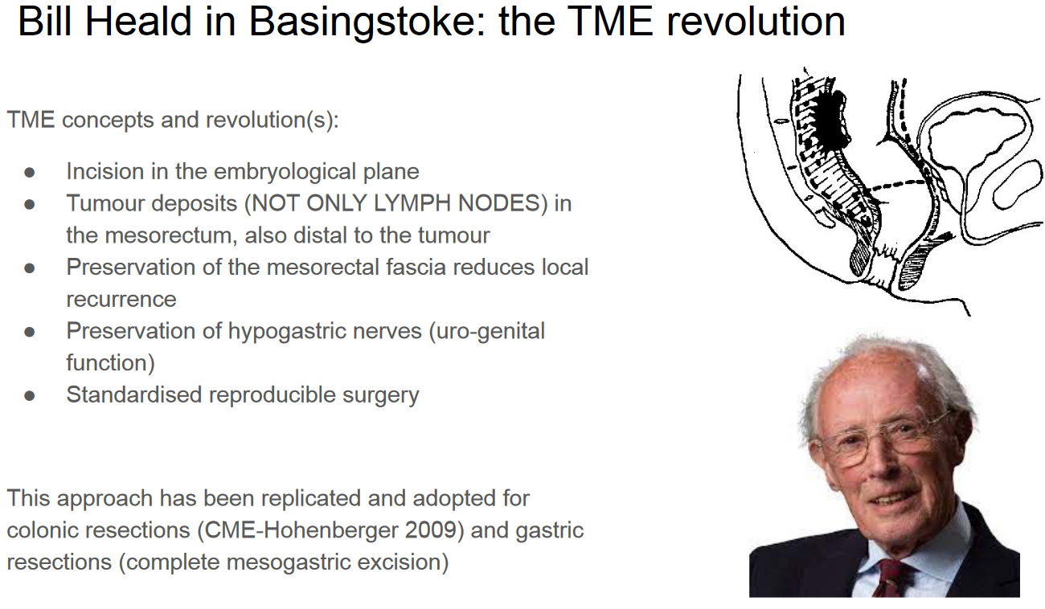

Slide 23
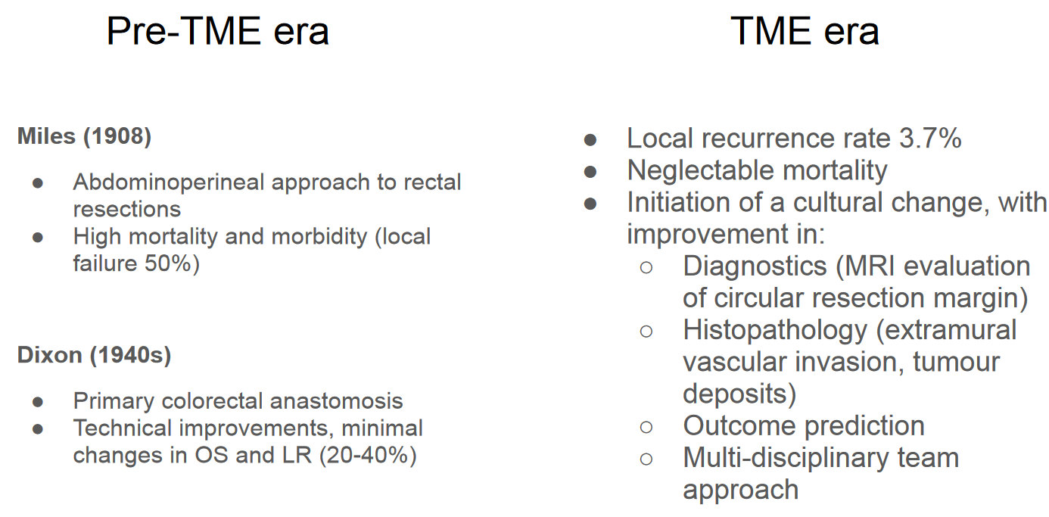

Slide 24
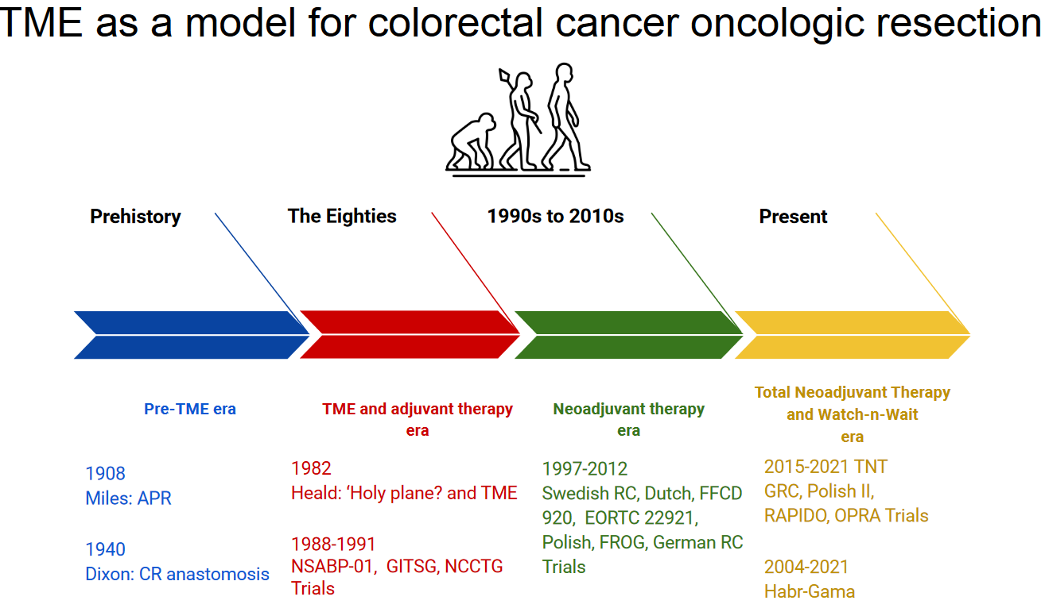

Slide 25
Lower GI Case N.2
Outcome
TNT plus Anterior resection with TME, colo rectal anastomosis and loop ileostomy
Do we forgot something?

Slide 26
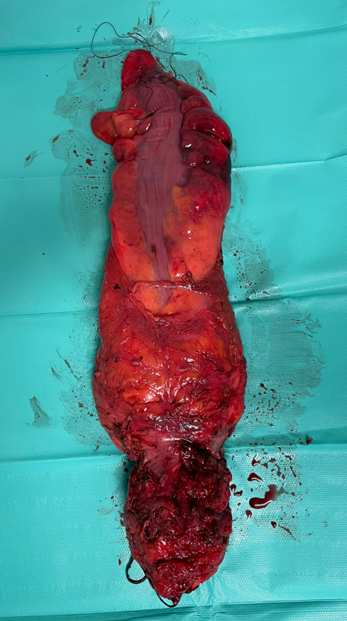
67 yo man
c/u T3 N1 rectal tumor at 4 cm from anal verge anterior wall
Neoadyuvant CT RT: refusal of TNT; low response at the restaging
At the surgery: very narrow pelvis, High BMI, hart adhesion to left
Prostatic vescicles
Andominal perineal resection, end colostomy
Post operative: uneventuful
Pathology: pT3 N1 (1out 20) R0

Slide 27
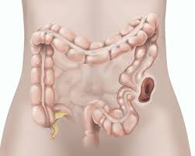
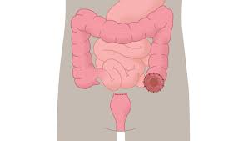

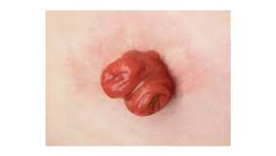
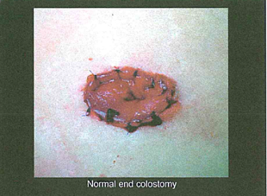
OOSTOMY

Slide 28
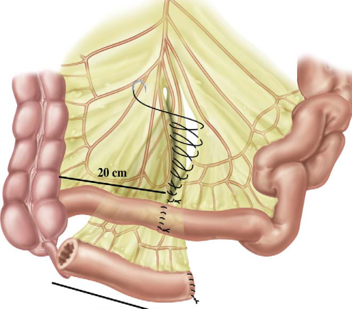
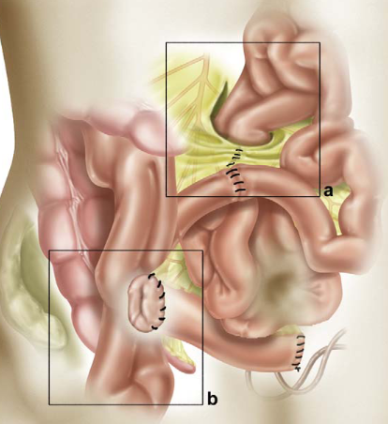
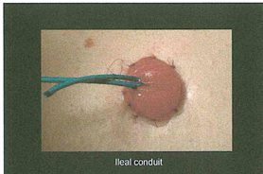
Types of oostomy

Slide 29
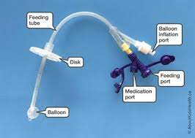
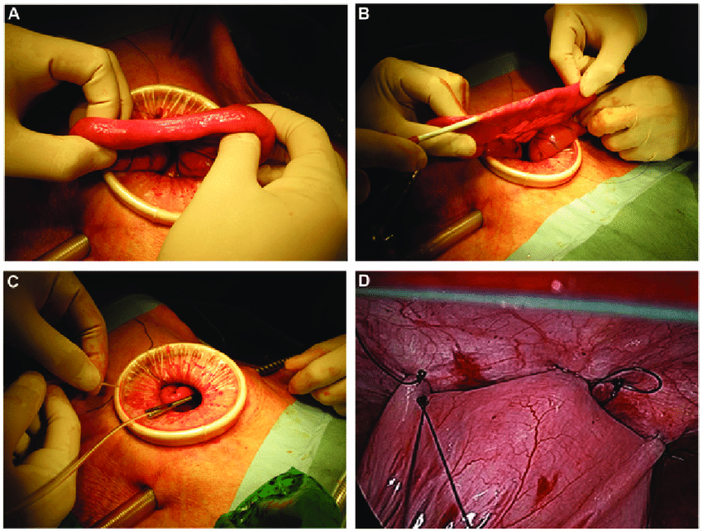
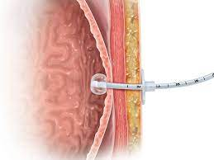
Types of oostomy

Slide 30
Lower GI Case N.2
Key Points
Blood per rectum should be fully investigated always:
-digital examination
-full colonoscopy
-screening programs
Multi Disciplinary Team Meeting
«Pay attention to details»

Slide 31
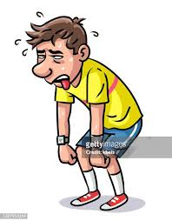
The End

Slide 32
Upper GI Case N. 1
Miss Villa is a 55-year-old lady who presents to her GP clinic with a long-standing history of tiredness
Her husband says that she used to eat a lot more in the past and that recently she has reduced her input as she feels full all the time.

Slide 33
Upper GI Case N. 1
HISTORY
PMH: Appendectomy, Chronic gastritis, Hysterectomy for multiple bleeding leiomyomas
HPC:
Tiredness: use to be very active, but now just a flight of stairs would make her breathless. She has stopped taking her evening walk.
Early satiety: after half of her normal meal she feels fulls
She has lost 5kg and she is not on a diet

Slide 34
Case N.1
Examination
Chest and heart examination: no pathological findings
Abdomen is soft non tender. Groins are free. Previous scars are well consolidated, no signs of incisional hernias.

Slide 35
Upper GI Case N. 1
What is your differential diagnosis at this stage?

Slide 36
Upper GI Case N.1
Findings
Blood tests: Hb 7g/dl, MCV 70, ALT-AST normal, Bili 1 (0.3)
Gastroscopy: ulcerated mass of the body of the stomach (biopsies); duodenum is normal.
Histology: Adenocarcinoma of the stomach, poorly adhaesive subtype with signet ring cell.
HER2/neu -, pMMR
Endoscopic ultrasound: Extension of the lesion through the gastric wall to the subserosal tissue, enlarged lymph nodes on the lesser curvature (uT4aN+)

Slide 37
Upper GI Case N.1
Findings
CT Chest-Abdomen: negative for metastatic lesions.
Diagnostic laparoscopy: Neoplasm is visible on the anterior gastric wall. Negative for peritoneal metastases. PCI:0. Negative peritoneal citology.

Slide 38
Case N.1
Treatment
Neoadjuvant therapy?
Upfront surgery?

Slide 39
Case N.1
Treatment
Neoadjuvant chemotherapy:
4 cycles of FLOT chemotherapy (Fluorouracil, Leucovorin, Oxaliplatin, Docetaxel)
Subtotal gastrectomy
Adjuvant chemotherapy:
4 cycles of FLOT chemotherapy (Fluorouracil, Leucovorin, Oxaliplatin, Docetaxel)

Slide 40
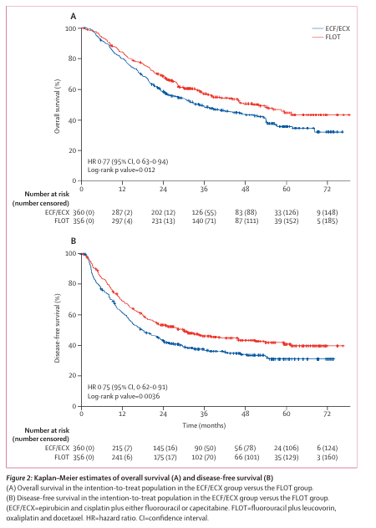
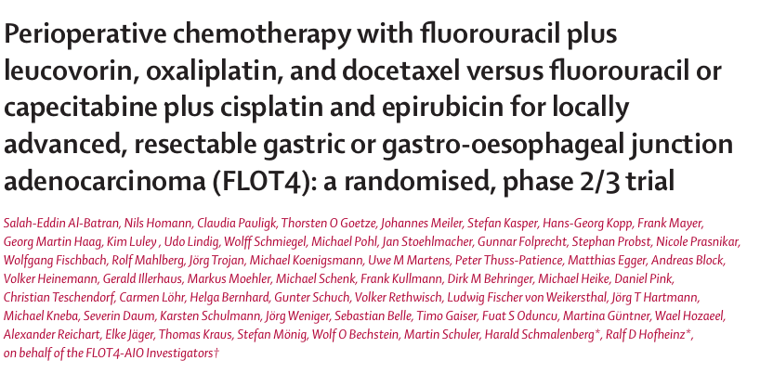

Slide 41
