Slide 1
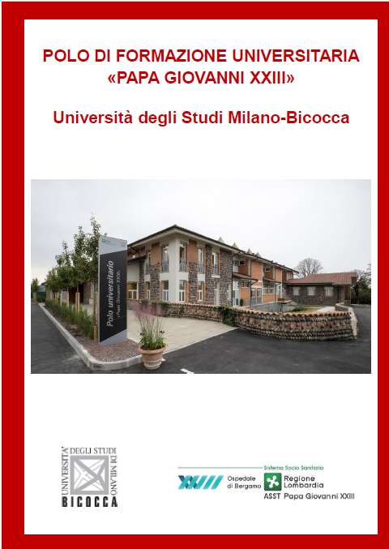
DIDATTICA Bergamo
Via NINI DA FANO 11 –Bergamo
pellegrini.edda@asst-pg23.it
laurea.ostetriciatutor@asst-pg23.it
laurea.ostetricia@asst-pg23.it

Slide 2
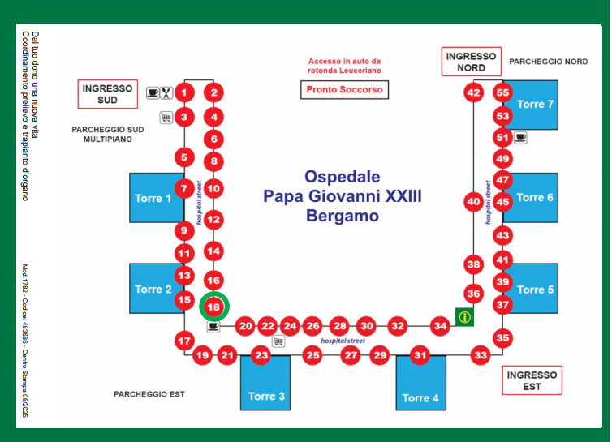
CLINICA Bergamo

