Slide 1
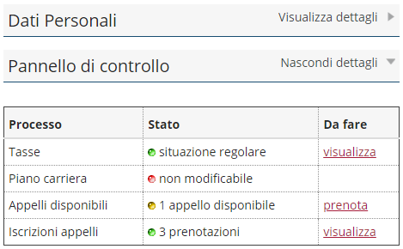
This figure illustrates the procedure for booking exams for free-choice activities.
To begin registering for the exam:
Click on the Prenota (Book) option in the Appelli Disponibili (Exams Available) section shown on your Online Student Registry homepage.
On the next screen listing available exams, select ricerca appelli (search for exams).
Select a free-choice activity
Proceed to registering for the exam.

