Slide 1

COMPANY’S PRESENTATION

Slide 2
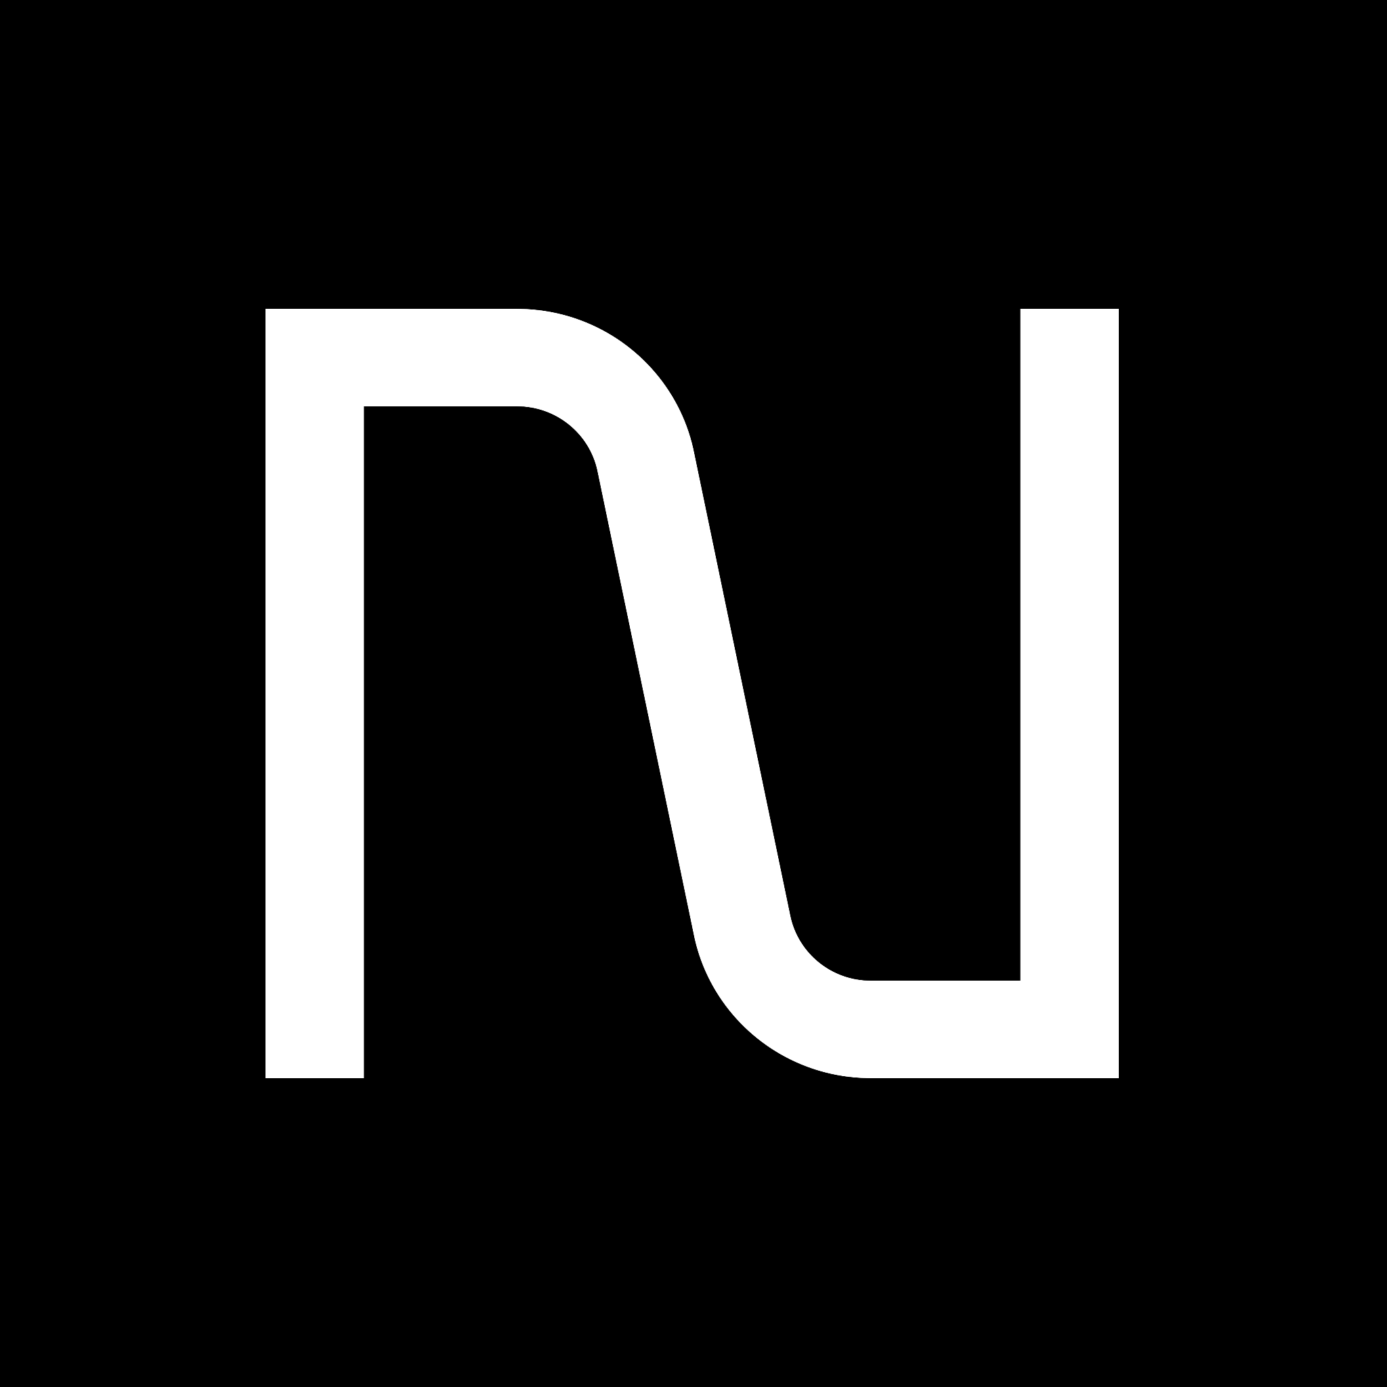
NEULABS IN A NUTSHELL
Digital group with 10 e-commerce brands and 30€M+ revenues in 2024
Neulabs operates 10 Direct To Consumer brands selling only online across several product categories, with Brand websites (Direct To Consumer) and marketplaces (Amazon, eBay, etc). From 0€ to 30€M+ in 3 years
Based in Milan, but with European footprint
70% of revenues outside Italy. 1/3 of the team remote based, abroad
English official language of the Company – No need to speak italian
With a young team, adding new talents to the team
65 people, 29 y.o. average age.
Very active in hiring people via internships (both «curriculare» and «extracurriculare» internships in Milan)
Driven by a senior management team
Founded by Mauro Giacobbe (former Facile CEO)
CFO from Percassi and Mondadori. CTO from Lastminute and MotorK. Business managers with strategic consulting and IB background (Bain, BCG, Oliver Wiman, Morgan Stanley, Deloitte, PWC)

Slide 3
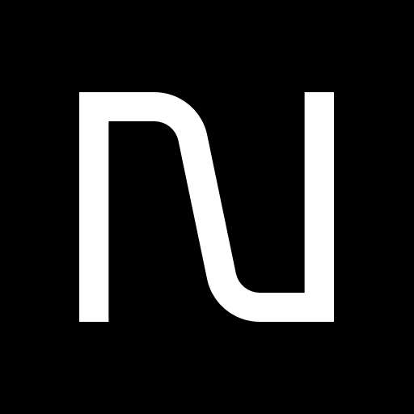
THE LIFECYCLE OF
OR OUR BUSINESS.
Phase 3: Growth
Boost the brands through various levers:
> channel activation
> international expansion
> new product launch
> process improvement
03
Phase 1: M&A
Using AI and proprietary algorithms, we’ve scouted and discovered high potential D2C brands. Executed the due-diligence, negotiation and acquisition of 100% of the brand.
01
02
Phase 2: Integration
Integration of the brand with the Neulabs platform and its central teams of business, technology, marketing, communication, marketplace and operations.

Slide 4
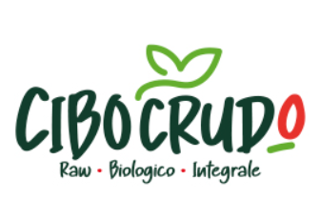

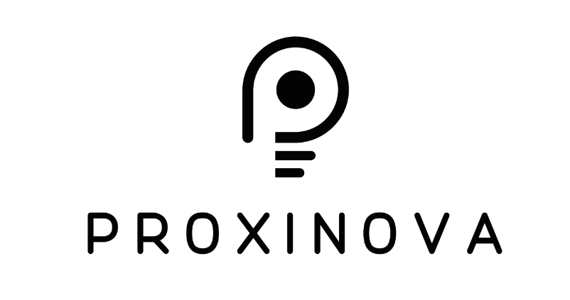

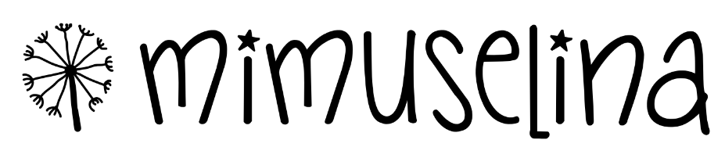





ACQUIRED BRANDS
Pet & animal control
Home Textile
Food
Baby & Toys
DIY

