Slide 1


Ph.D. course:
Advanced Distributed Systems Development with Multiagent Systems
Dott. Daniela Briola
Prof.ssa Viviana Mascardi
Prof. Rafael Bordini
Ph.D. Course: Advanced Distributed Systems Development with Multiagent Systems

Slide 2
Overview
Modeling a complex system as a MAS: main approaches, problems and solutions (with real examples presented) → “designing a MAS” skill
Main aspects of designing an OWL ontology, and implementation with Protegè
BDI paradigm (main features)
JASON modelling and programming skills
Introduction to MAS modelling using a formal approach (MOISE)
The JaCaMo platform
JADE modelling and programming skills, basic and advances aspects
JADE extensions:
  OntologyBeanGenerator (to integrate OWL ontologies)
  P2P platform (LEARN platform)

Slide 3
Assessment method
Students will be asked to perform one of two different assessment (to be decided with each students):
producing a detailed (and formal, where possible) design of a MAS, starting from a natural language description of a complex problem
producing a running MAS (in JADE or JaCaMo) starting from a simple specification of a problem

Slide 4
Lesson 1
MAS: an architectural view and some real examples
Daniela Briola
Daniela.briola@unimib.it
Ph.D. Course: Advanced Distributed Systems Development with Multiagent Systems

Slide 5

What is a MultiAgent System?
I’m a tennis teacher!
I am free!!
Sure! Let’s find a tennis court!
I want to learn tennis!
Cogito, ergo sum!
Can you teach me, please?
Intelligent Agents [AAMAS98]:
Autonomous
Proactive & Reactive
Social
Situated
Reserve
Notes:
Jennings, N.R., Sycara, K.P., Wooldridge

Slide 6
When a MAS is a good solution?
Multiagent paradigm as an Architecture problem/approach for complex systems (cognitive and rationale agents)
Emergent behaviour from reactive agents (simulations with MAS, not seen in this course)
Typical Features/requirements of systems to be implemented as a MAS
  Distribution (logical and/or physical)
  Autonomous entities with partial view/abilities
  [Asynchronous] interactions between entities
  Parallel multitasking
  Encapsulation
  Semantic interoperability
  Responsive/interactive Environment
  Dynamic creation of entities

Slide 7

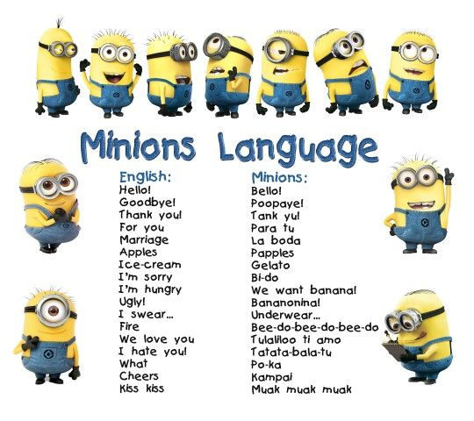



Multiagent Systems architectures: Main concerns
Have they Private or Shared goals?
Which language do they speak, how they communicate?
How do they perceive/modify the environment?
How do the agents relate each others?
VS

Slide 8

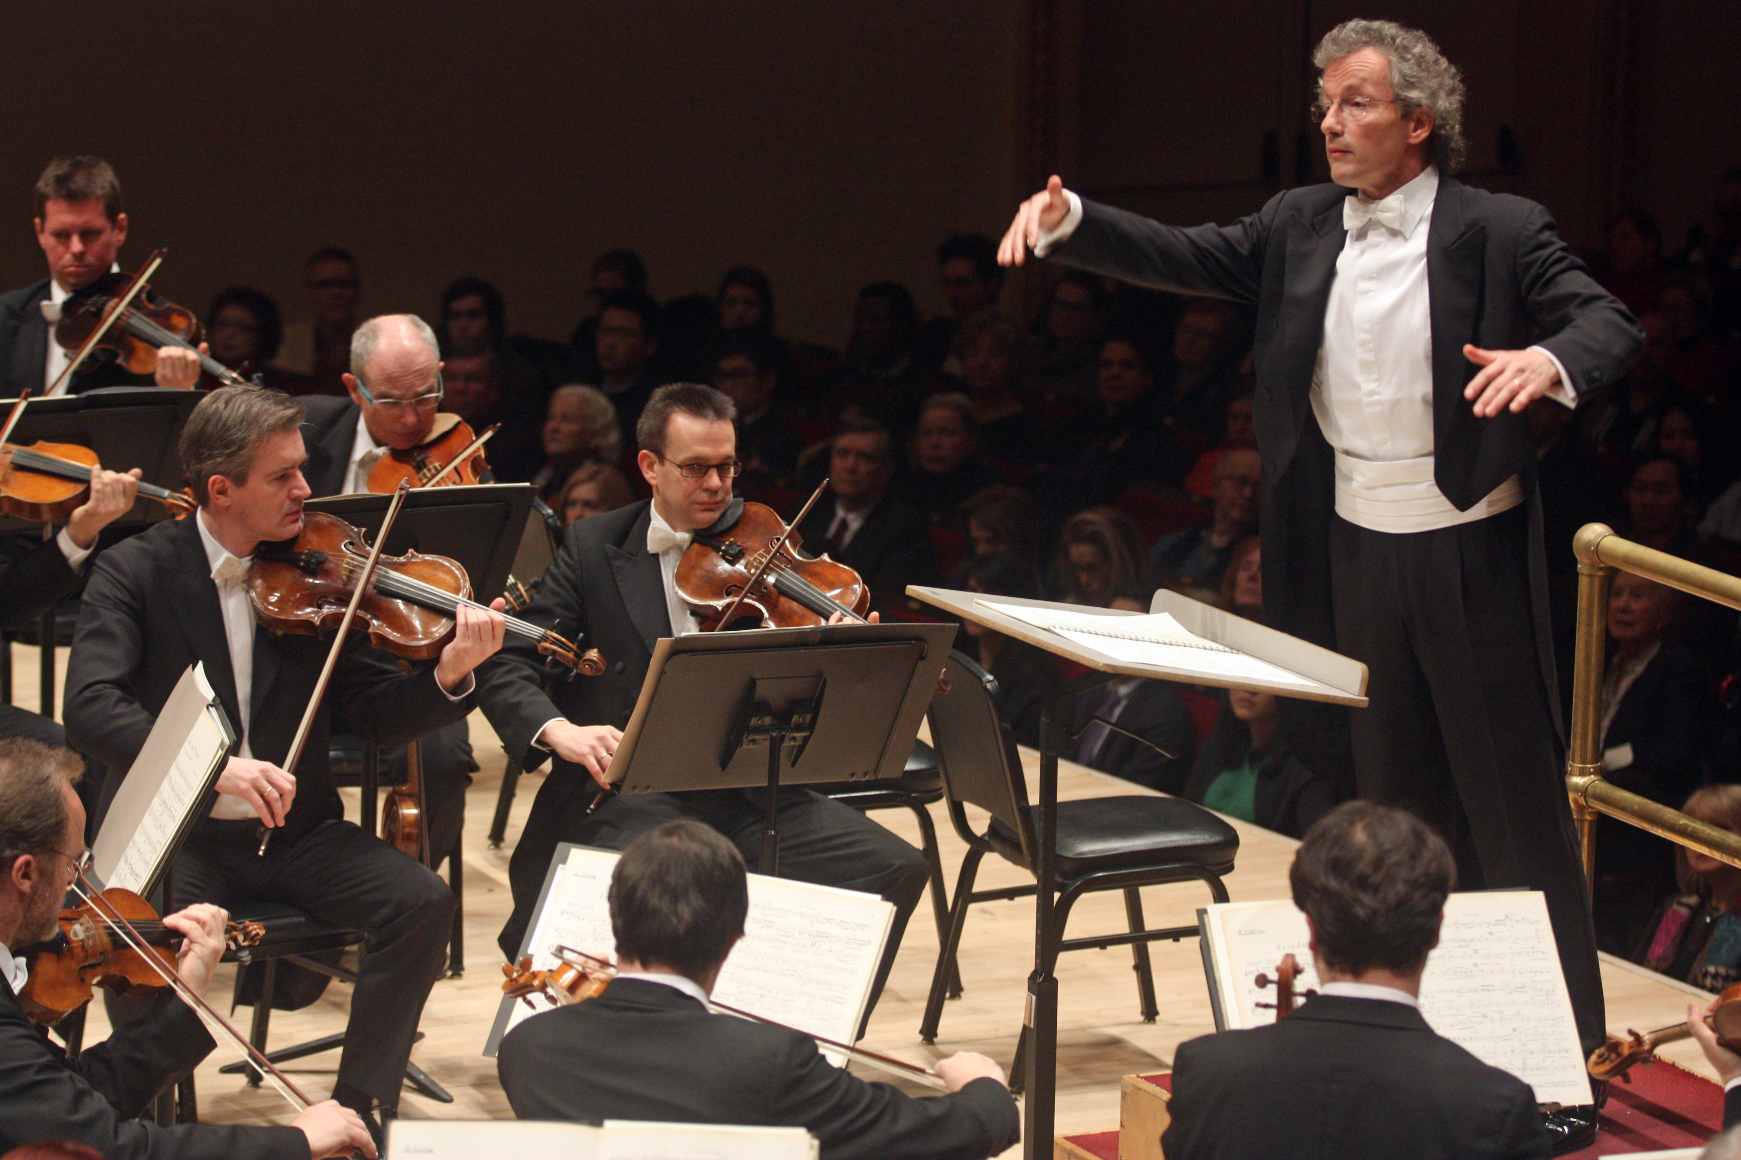


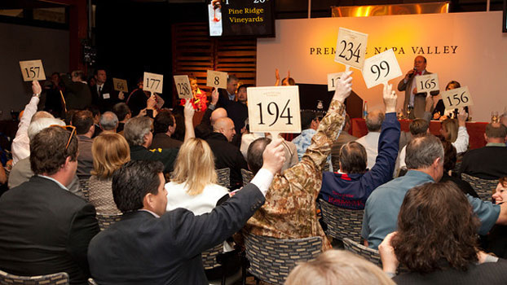
How do the agents relate each others?
Orchestration
Coordination
Negotiation
Auctions
Bio inspired
behaviours
Social structure and MAS control
  Normative Multiagent Systems
  Commitments
  Monitor/Sentinel agents
  Protocol Enforcer/Verification

Slide 9
How do they perceive/modify the environment?
Is the environment physical or software?
Can I perceive it directly?
Can I modify it directly?
Does it change?
Which tools can I use to interact with it?
Which services does it offer?
A&A paradigm
[Omicini2008]

Slide 10
Which language do they speak, how do they communicate?
Message exchange, or direct access to mental state?
Message with performative or other solutions?
Open MAS VS Close MAS
Open MAS problems:
  Semantic Interoperability (ontologies!)
  Agent as Black box
  Trust and reputation

Slide 11
Ontology and MAS: Semantic based interactions
“Calcio” ??
Ontology [GR93]
OK! (Calcio = Soccer subclass Football)
I’m a football teacher!
Sport
Subclass
Calcio?
Football
Tennis
Voglio imparare il calcio!
Soccer!
…
Soccer
Rugby
Mi insegni il calcio?
Properties or Labels
Calcio (IT)
Futbol (SP)

Slide 12
Private goals vs Global goals
Me or us...?
  Cooperative agents /Non cooperative/ Competitive agents
  Super-Power agents
  Cheating agents
Do WE have a goal/task?
Do we only coexist or do we share resources?
“Inner” goals and Global goals to manage

Slide 13

Open problems and questions
Sentences you should NEVER say to a MAS designer:
  I do not trust AI and intelligent agents... -__-
  An Agent is an object/component
  A MAS is a set of components
  A MAS architecture is like a SO architecture
Problems you may have
when dealing with a MAS:
Development Platform
Testing!
Open it to the world
Methodology

Slide 14
Platforms (Main)
JADE [Jade]
Jason (for BDI agents)
  JaCaMo (Jason + Cartago + Moise) [JaCaMo]
NetLogo (for simulations of groups) [NetLogo]

Slide 15
Jade (Java Agent DEvelopment Framework)
It does not specify an agent architecture
It follows the FIPA standard
Widely adopted in academia and industry
Jade Plugins
  [Protegè +] Ontology BeanGenerator (OWL ontologies into Java Classes) [OntoBeanBriola]
  Sniffer (GUI for real time visualization)
  WSIG Gateway (Interface with Web Services)
  Jess or Prolog support
  JADEX (BDI agents)

Slide 16
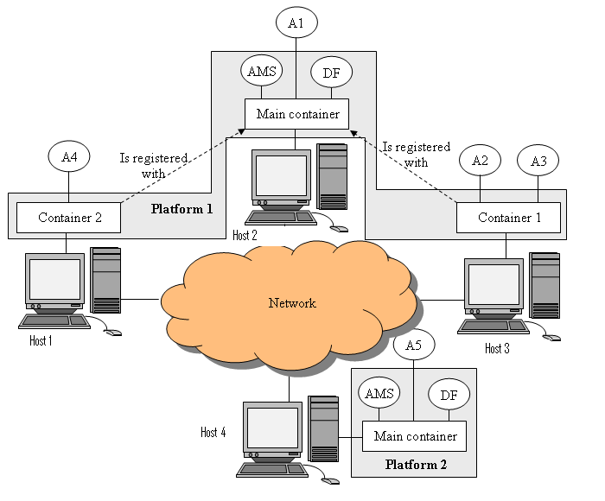
Jade Architecture

Slide 17
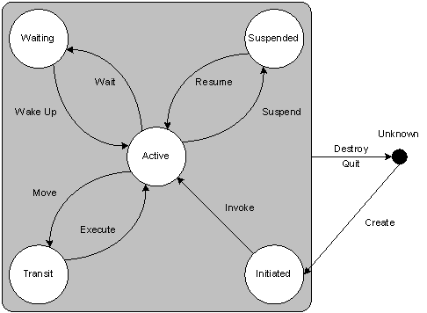
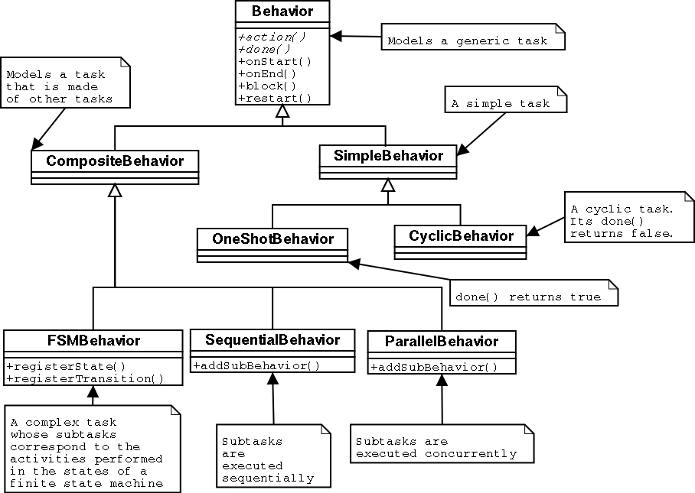
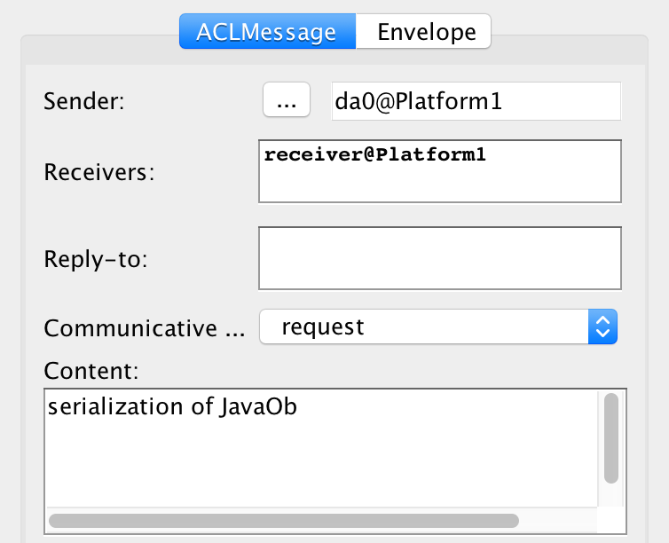
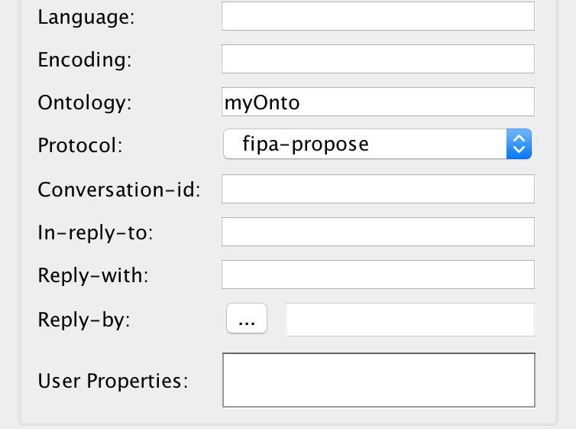
Jade (Java Agent DEvelopment Framework)
Jade it provides:
  a basic Agent class with a specific life cycle
  Behaviours
  FIPA ACL message, ontologies
  Platform Agents (DF and AMS)

Slide 18




Some real and running MASs
The FYPA System
IndianaMas

Slide 19

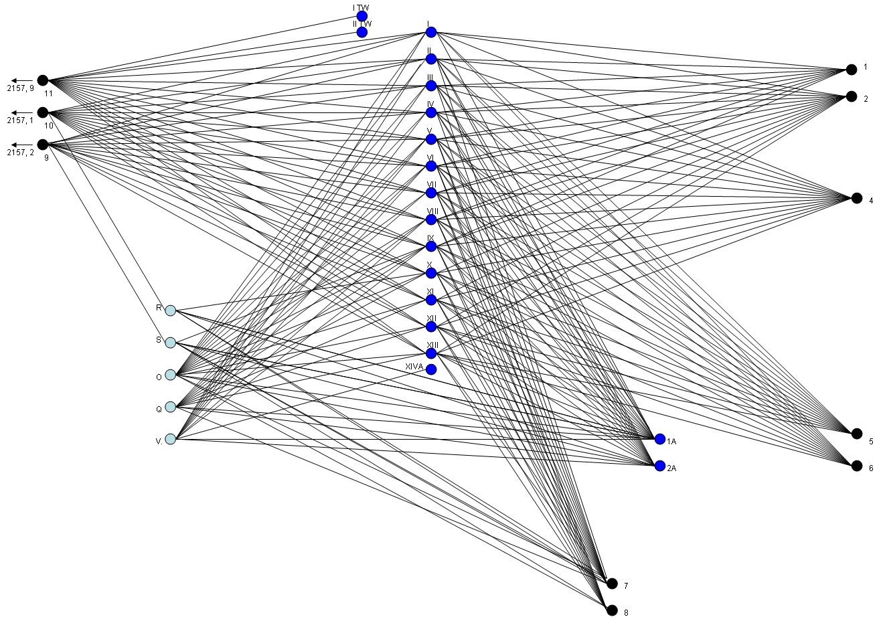

The FYPA System
Mestre station

Slide 20
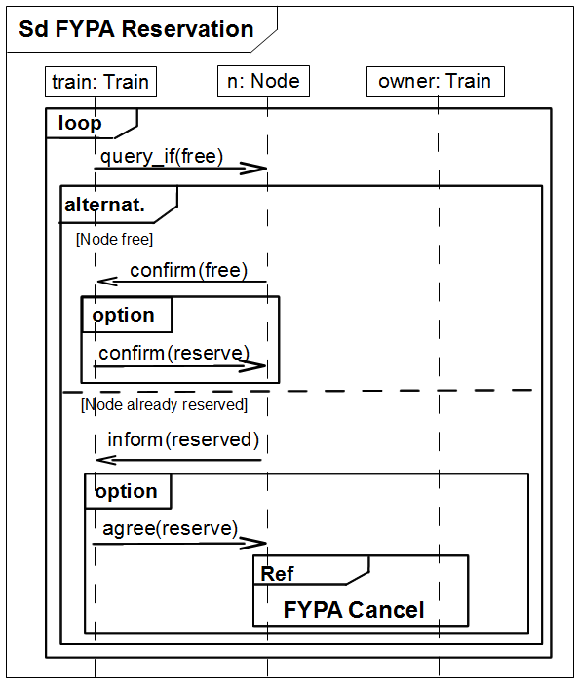
The model and the protocol
L
D
G
C
F
B
E
A
UA2 (REG)
UA1 (IC)

Slide 21
Example: incompatible arcs
 | T1 | T2 | T3 | T4 | T5 | T6 | T7 | T8 | T9
A | UA2 | UA1
B |  | UA2 | UA2
C |  |  |  | UA2
D |  |  |  |  | UA2
F |  |  |  | UA1
G |  |  |  |  | UA1 | UA1
E |  |  | UA1
L |  |  |  |  |  | UA2 | UA1
L
D
G
C
F
B
E
A
UA2 (REG)
UA1 (IC)

Slide 22
Wrong reservations
 | T1 | T2 | T3 | T4 | T5 | T6 | T7 | T8 | T9
A | UA2 | UA1
B |  | UA2 | UA2
C |  |  |  | UA2
D |  |  |  |  | UA2
F |  |  |  | UA1
G |  |  |  |  | UA1 | UA1
E |  |  | UA1
L |  |  |  |  |  | UA2 | UA1
L
D
G
C
F
UA2
UA1
B
E
A

Slide 23
Final reservations
 | T1 | T2 | T3 | T4 | T5 | T6 | T7 | T8 | T9
A | UA2 | UA1
B |  | UA2 | UA2
C |  |  |  | UA2 | UA2
D |  |  |  |  |  | UA2 | UA2
F |  |  |  | UA1
G |  |  |  |  | UA1 | UA1
E |  |  | UA1
L |  |  |  |  |  |  | UA1 | UA2
L
D
G
C
F
UA2
UA1
B
E
A

Slide 24
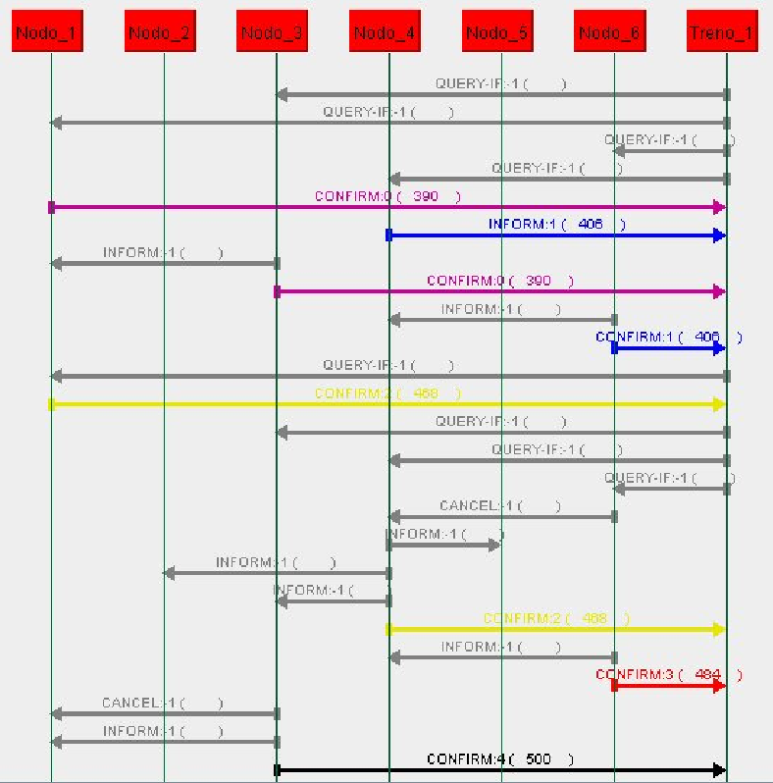
Sniffer view of exchanged messages

Slide 25
The IndianaMas System

Slide 26
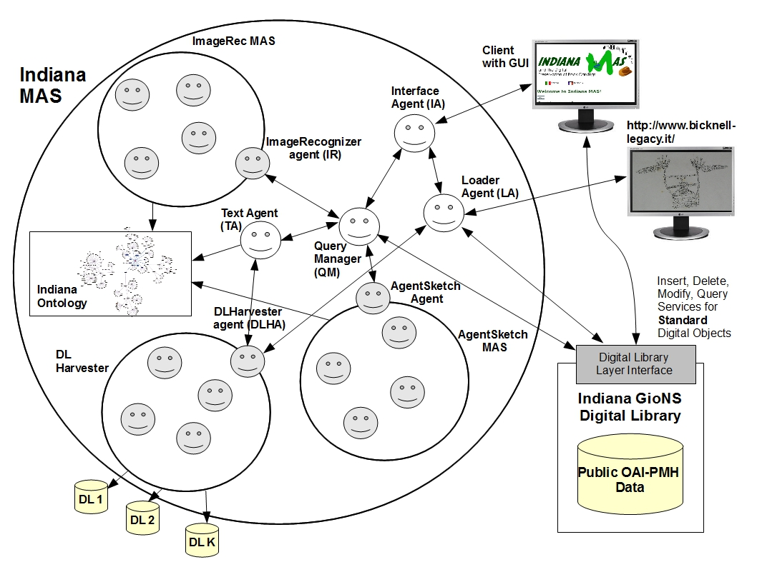
The IndianaMas System
Images
A subMas for each data type
Specific agents coordinate the subMass
Indiana Ontology: the core of the system
Data are stored as a Digital Library (DL)
c
Texts
Sketches
Digital Libraries
It manages Images, Manual Sketches and multilanguage Texts

Slide 27
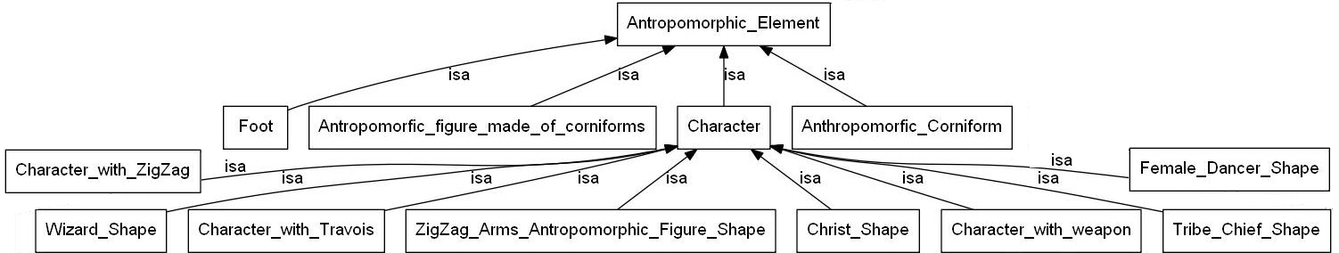
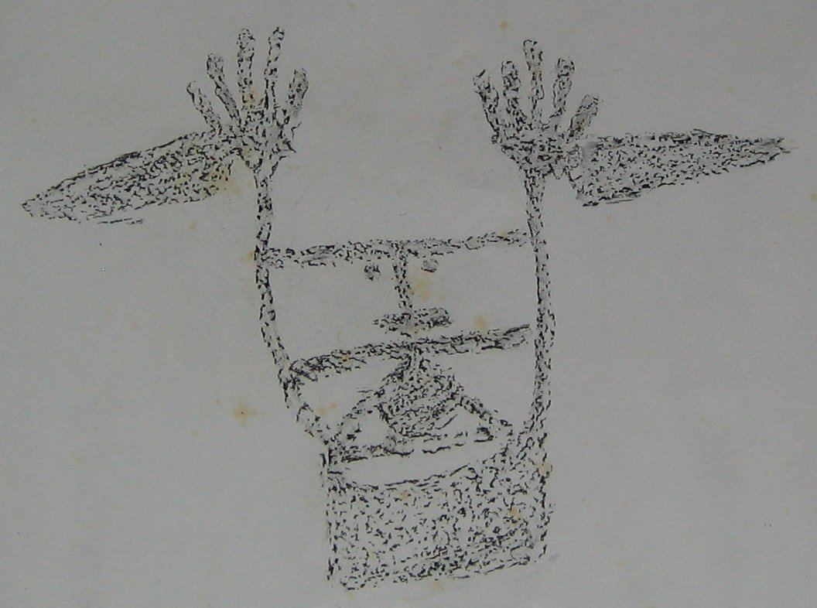
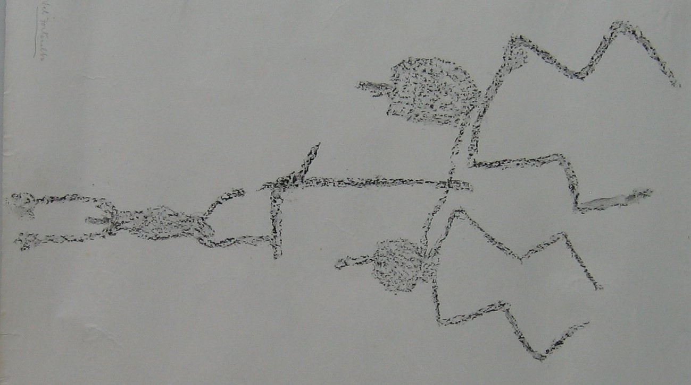
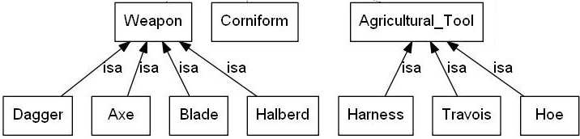
The Indiana Ontology
Tassonomy. Describes the Mont Bego rock art: carvings classifications (shapes) and interpretations (meaning).
  The classes are used as “controlled vocabulary” when classifying
Notes:
tassonomia

Slide 28
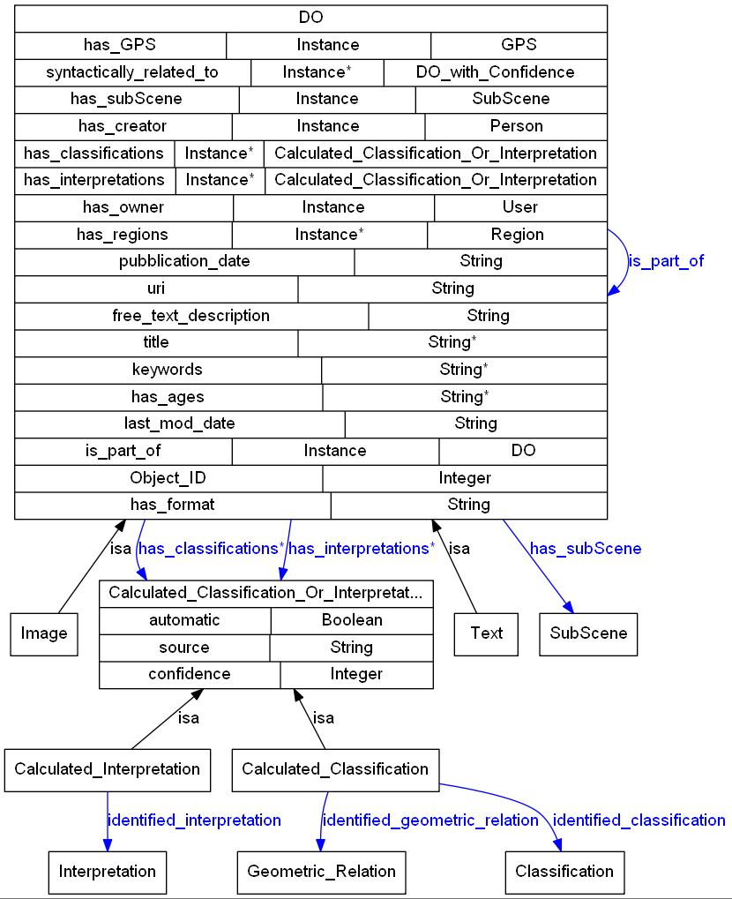
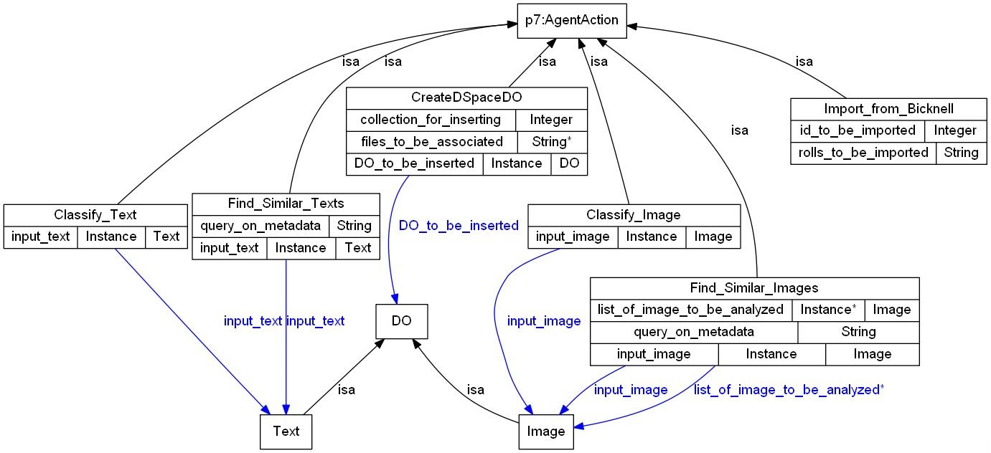
The Indiana Ontology
Models:
types of Digital objects managed by the IndianaMas
actions that the agents can perform

Slide 29
The Indiana Ontology
Models the actions that the agents can perform.

Slide 30
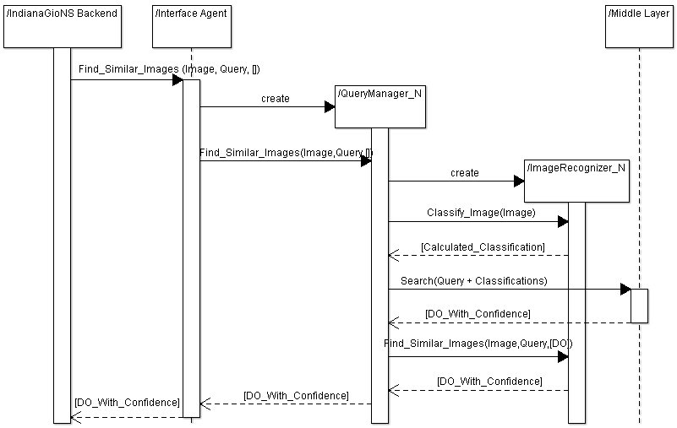
Find Similar Images action
A new QueryManager is
created for each new operation
It will create the subMas
for analyzing images

Slide 31
MAS Monitoring

Slide 32
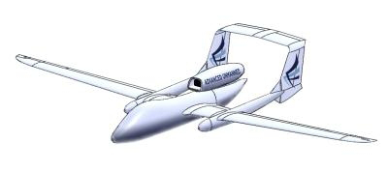

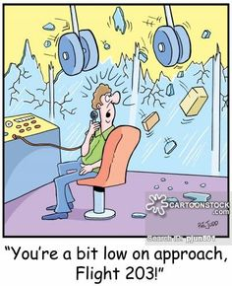
Monitoring MultiAgent Systems: Why?

Slide 33
Monitoring MultiAgent Systems: two of our approaches
Protocol compliance verification
Protocol Driven MAS

Slide 34
Protocol compliance verification [EMAS14, IDC14]
Generic Framework
Our Framework
Protocol Representation
Trace Expression (TE)
RT compliance Verification between interactions and
protocol
{
Protocol projection
Prolog Engine
Interface towards S
Jade Interface
Jason Interface
System under Monitoring (S)
JADE MAS
Jason MAS

Slide 35
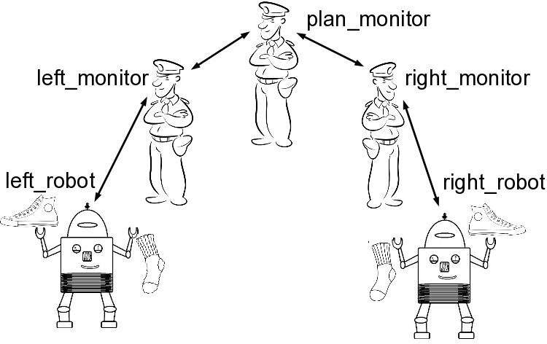
Trace Expression [Ferr15]
type(socks, SOCKS) :-
RIGHT =
((put_right_sock):(put_right_shoe):(ok_right):lambda) +
((put_right_shoe):(oblige_remove_right_shoe):
(removed_right_shoe):RIGHT),
LEFT = ((put_left_sock):(put_left_shoe):(ok_left):lambda) +
((put_left_shoe):(oblige_remove_left_shoe):
(removed_left_shoe):LEFT),
SOCKS = (RIGHT | LEFT).
Based on sending actions or perceivable events
Expressed as a (Cyclic) Prolog term
Main constructors:
λ empty sequence
α:τ sequence
τ1 + τ2 choice (union of the sequences of 1 and 2)
τ1 | τ2 fork (the set obtained by shuffling the sequences in 1 with the sequences in 2)
τ1 . τ2 concatenation (set of sequences obtained by concatenating the sequences of 1 with those of 2)
Constraints over message contents, message order etc…

Slide 36




The concrete steps
MAS + Monitor
TE Protocol Specification
STOP!
Prolog Engine
YES/NO

Slide 37
Monitoring MultiAgent Systems: approaches
Protocol compliance verification
Protocol Driven MAS

Slide 38



Protocol Driven MAS
… if you can lead?
Why monitoring…?

Slide 39


Protocol Driven MAS
If you have a formal protocol…?
(or a banana…)
Why programming…?

Slide 40
Protocol based agents [AAMAS15]
Standard MAS
Protocol Specification (in any language)
What can I do,
and when.
Not Why
Agents: Implement the
protocol, adding the “why”
Change simply at runtime
the agent protocol
New protocols need
no agent refactory!
Hard coded behavior. For each new protocol, or change, the agent
must be reprogrammed, hopefully in a correct way…
Sound by construction!
One unique agent template
Protocol driven MAS
Instantiated Agent
TE Protocol Specification
Load logic
“Why part”
Interpret
the protocol

Slide 41






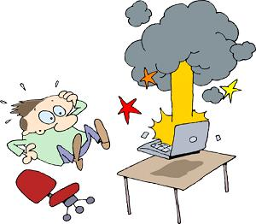
LEARN Project
LEARN platforms and services
Application under monitoring
Local collected data

Slide 42

LEARN Project
Foreseen Solution
  Decentralized LEARN platform
  Autonomous entities monitoring applications under analysis
  Collective sharing of collected data
  Collective analysis of collected data
  Specific nodes able to create the fixes
  Sharing of the fixes
  On the field testing

Slide 43
LEARN MAS [SPELEARN]
P2P style service invocation and data sharing
  JADE Extension needed!
Ontology formalization
  Application under monitoring
  Available Services
Services development
Testing and Simulation (SimJade Platform)

Slide 44




LEARN Layer (Distributed Application)
LEARN Services Layer (Middle Layer)
Logical
network
Physical Network (devices connected
to Internet with TCP/IP, or HTTP etc)

Slide 45
LEARN Layer (Distributed Application)
JADE
+
LEARN agents
SM &
Assistants
P2P AMS
LEARN Services Layer (Middle Layer)
Logical
network
Physical Network (devices connected
to Internet with TCP/IP, or HTTP etc)

Slide 46
P2P network creation in LEARN

Slide 47
Distributed Service Invocation
The P2PAMS creates and maintains the P2P network
The Service Manager Agent exploits the underlying P2P network to search for, and invoke, the requested services
P2PAMS, Service Manager and Assistant are new agents, cooperating with the standard JADE platform agents
JADE is unaltered, we only add new agents to offer P2P services

Slide 48
PlatformA
DF
9A Result
S
SourceNode
10 Results
P2PAMS
Agent7
5 Neighbor?
Agent5
P2PAMS
1 InvokeGroup (S,4)
3 Who do S?
8A DO S (FOR Assistant1@Platform1)
2 create
6A Look for 1 S
7A Who do S?
SM
Assistant1
6B Look for 1 S
SM
DF
4 DO S
7B Who do S?
4 DO S
9B Result
SM
DF
Agent9
4’ Result
4’ Result
8B DO S (FOR Assistant1@Platform1)
S
S
Agent1
Agent2
Agent3
P2PAMS
S
S
PlatformB
Platform1
Agent6
Agent4
Agents’s Legend
P2PAMS
SM (Service Manager)
DF (JADE Directory Facilitator)
Assistant
An Agent (offering
the S service)
S

Slide 49
Ongoing parts
Testing of the P2P network creation protocol
Service Manager + Application Agents Development
A new Platform for simulating generic JADE MASs
  Based on a P2P simulator
  Able to simulate thousand of
  JADE Platforms
  No need to modify the
  original MAS we are simulating
  Research Collaborations and
  support (thesis) are welcome!! ☺

Slide 50


Thank you!
Questions?
Ask please!
Daniela Briola
Daniela.briola@disco.unimib.it

Slide 51
General References
[AAMAS98] Jennings, N.R., Sycara, K.P., Wooldridge, M.: A roadmap of agent research and development. AAMAS Journal 1(1) (1998), pp. 7-38.
[GR93] Gruber, T.R.: A translation approach to portable ontology specifications. Knowledge Acquisition 5 (1993), pp. 199-220.
[Omicini2008] A. Omicini, A. Ricci, M. Viroli. Artifacts in the A&A meta-model for multi-agent systems. AAMAS 2008
[JADE] http://jade.tilab.com/
[OntoBeanBriola] Briola, D., Mascardi, V., Gioseffi, M. OntologyBeanGenerator 5.0: Extending ontology concepts with methods and exceptions. (2018) WOA 2018 Proceedings, 2215, pp. 116-123.
[NetLogo] https://ccl.northwestern.edu/netlogo/
[JaCaMo] http://jacamo.sourceforge.net/

Slide 52
References for IndianaMas & FYPA
[SPE2017] D Briola, V Deufemia, V Mascardi, L Paolino. Agent‐oriented and ontology‐driven digital libraries: the IndianaMAS experience. Software: Practice and Experience, 2017, vol 47(11), pp. 1773-1799
[IDC15] D. Briola. Agents and Ontologies for a Smart Management of Heterogeneous Data: The IndianaMas System. In “9th International Symposium on Intelligent Distributed Computing, IDC’2015”, P. Novais, D. Camacho, C. Analide, A. El Fallah Seghrouchni, C. Badica editors, Studies in Computational Intelligence, vol 616, pp 25-36.
[JIAS09] D. Briola, V. Mascardi and M. Martelli. Intelligent Agents that Monitor, Diagnose and Solve Problems: Two Success Stories of Industry-University Collaboration. Journal of Information Assurance and Security, Volume 4, Issue 2 (2009), pp. 106-116, Dynamic Publishers Inc., USA.
[AIIA13] V. Mascardi, D. Briola, D. Ancona. On the Expressiveness of Attribute Global Types: The Formalization of a Real Multiagent System Protocol. In “AI*IA 2013”, Proc., LNCS 8249, pp. 300-311, 2013

Slide 53
References for Monitoring and LEARN
[IA15] D. Ancona, D. Briola, A. Ferrando, V. Mascardi. Runtime verification of fail-uncontrolled and ambient intelligence systems: A uniform approach. Intelligenza Artificiale, vol. 9, no. 2, pp. 131-148, IOS Press, 2015.
[AAMAS15] D. Ancona, D. Briola, A. Ferrando, V. Mascardi. Global Protocols as First Class Entities for Self-Adaptive Agents. In “Proceedings of the 14th International Conference on Autonomous Agents and Multiagent Systems (AAMAS 2015)”, Bordini, Elkind, Weiss, Yolum (eds.), 2015, pp 1019-1029.
[EMAS14] D. Ancona, D. Briola, A. El Fallah Seghrouchni, V. Mascardi, and P. Taillibert. Efficient Verification of MASs with Projections. In F. Dalpiaz, J. Dix, B. van Riemsdijk, M. Birna editors, “Second International Workshop on Engineering Multi-Agent Systems (EMAS 2014)”, Selected and Revised Papers, LNCS 8758, 2014.
[IDC14] D. Briola, V. Mascardi, and D. Ancona. Distributed Runtime Verification of JADE Multiagent Systems. In D. Camacho, L. Braubach, S. Venticinque, and C. Badica, editors, “8th International Symposium on Intelligent Distributed Computing, IDC’2014”, volume 570 of Studies in Computational Intelligence, pages 81–91. Springer, 2014.
[Ferr15] A. Ferrando (Master Degree Thesis, Genoa University). Trace expressions for runtime verification and protocol-driven behaviour. Relators: V. Mascardi and D. Ancona. 2015
[SPELEARN] Briola, D., Micucci, D., Mariani, L. A platform for P2P agent-based collaborative applications (2018) Software - Practice and Experience, 49(3), 549-558. 2019

