Slide 1
1.What was tourism? Laboratorio 1 – 21 aprile 26 maggio 2021
Milano - Turismo
Ezio Marra
Università degli Studi di Milano-Bicocca

Slide 2
Serving Tourists, Pleasing Residents
Why tourism? Wellbeing of both residents and tourists in focus
■ Overview
■ Heritage and Tourism
■ Concluding Remarks

Slide 3
Serving Tourists, Pleasing Residents
Overview
■ As an industry
■ As a phenomenon
■ As a hospitality profession
Notes:
As a knowledge-based: education and training

Slide 4
Serving Tourists, Pleasing Residents
■ Culture
■ Morocco Conference (2018): Culture is the entangling web of symbols, sounds, rituals, rites and practices by which we become persons and by which we can grow. Culture is often the reason for travel. Today’s globalized tourism both enables and threatens culture and its practices. How to manage tourism instead of being managed by it!
■ Image
■ Which (cultural) images to project?

Slide 5
Serving Tourists, Pleasing Residents
Tourism’s Cultural Forms & Forces
■ Local (host) Culture
■ Tourist (guest) Culture
■ National (carry-on) Culture
■ Hospitality (professional) Culture
■ Corporate (company specific) Culture
■ Culture mix

Slide 6
Serving Tourists, Pleasing Residents
Tourism’s Cultural Forms & Forces
■ Local (host) Culture
■ Tourist (guest) Culture
■ National (carry-on) Culture
■ Hospitality (professional) Culture
■ Corporate (company specific) Culture

Slide 7
Serving Tourists, Pleasing Residents Tourism vs Heritage
Heritage Tourism
■ Not commercialized ■ Commercial
■ Broad social goals ■ Economic goals
■ Not for profit ■ For-profit
■ Public sector ■ Private operations
■ Conserves/protects ■ Consumes
■ Promotes values ■ Entertains
■ Supply driven ■ Demand driven
■ Home grown ■ Externally driven
■ For Local residents ■ For tourists
Adapted from Lee Jolliffe

Slide 8
Serving Tourists, Pleasing Residents
Tourism Development Perspectives
■ Viewed form within: Emic
■ Viewed from without: Etic
Notes:
Who owns local attractions? Survey for residents’ preferred image: what would you like to share/show people visiting you community? What you don’t you wish to be shared or shown.
Another question: what do’s do you recommend to prepare for tourism, and what don’ts? Actually the dos list should be prepared on the basis of don’ts.

Slide 9
Serving Tourists, Pleasing Residents Tourism vs Heritage
Tourism
■ Commercial
■ Economic goals
■ For-profit
■ Private operations
■ Consumes
■ Entertains
■ Demand driven
■ Externally driven
■ For tourists
Adapted from Lee Jolliffe
Heritage
■ Not commercialized
■ Broad social goals
■ Not for profit
■ Public sector
■ Conserves/protects
■ Promotes values
■ Supply driven
■ Home grown
■ For Local residents

Slide 10
Serving Tourists, Pleasing Residents Who Views Whom and through Whose Eyes
Stakeholders | Tourists (Guest) | Residents (Host) | Tourisiers (Employee)
Tourists | T☺T | T☺R | T☺Tr
Residents | R☺T | R☺R | R☺Tr
Tourisiers | Tr☺T | Tr☺R | Tr☺Tr
Notes:
Now add to this other stakeholders, religion(s), ethnic group(s), etc.

Slide 11
Serving Tourists, Pleasing Residents
Emic, sociocultural frameworks for development:
■ Understanding holistic cultural contexts
■ Nurturing host participation for a sense of
belonging/empowerment
■ Marking public/private spaces
■ Specifying attractions and their levels of use
■ Examining revitalization, authenticity,
commercialization, glocalization processes
■ Using culture to incubate innovative products
■ Developing emic (not etic) image for
promotion/branding
■ Limiting growth on the basis of host’s tolerance
Notes:
Tourism by invitation, not invasion. Invitation by the host, invasion through tourism actions.
Guest, Host, Hospitality: hijacked by tourism. In the past, tourism facilities were in certain areas of the destination. Today AirbnB is nesting it in deeper layer of the society, in the backstreets of residential area. People in by 22 hrs or after, but the sound of the luggage wheel 24 hours.

Slide 12
Serving Tourists, Pleasing Residents
■ Tourism by invitation, not invasion
■When the invitational voice of the
host, “wish you were here” is
transformed to “wish you weren’t here”,
then hospitality has been replaced by
hostility
■ Venice, we hear you!
Notes:
Venice 20 million tourists annually. Pop down to 50,000 and annually shrinking
Barcelona: 9 million tourists stayed in hotels in 2016, much larger second homes.
No mayor would speak against tourism, but yes in Barcelona:, the number of visitors affects not only the quality of life of Barcelonans, ​​but also their ability to live in the area. More than 30 million tourists arrived in Barcelona in 2016, according to official City Hall data.
Guess who is against restrictions in Barcelona: not the mayor, not residents, but the tourism industry.
Barcelona: It will also stop issuing permits to turn apartments into accommodation for servers, such as those of Airbnb. This the hotel sector would support.
The accommodation law limits the number of beds available and freezes the building of new hotels in some zones of the city
Dubrovnik: installed security cameras so that no more than 8,000 tourists stay in its Old City; similar measures Thai islands
When people can voice: casino plan voted down by the public in Madrid/Barcelona?

Slide 13
Notes:
Photo caption: Streets of Venice full of tourists during traditional venetian carnival.
Venice 28 million tourists annually. Pop down to 50,000 and annually shrinking

Slide 14
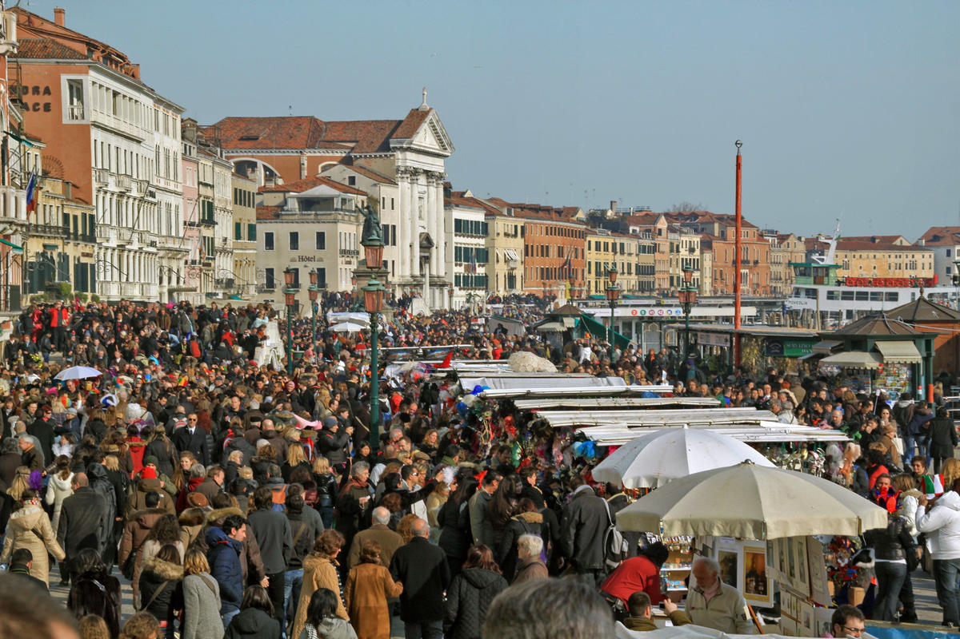

Slide 15
Serving Tourists, Pleasing Residents
■ Tourism by invitation, not invasion
■When the invitational voice of the
destination, “wish you were here”
transforms to “wish you weren’t here”,
then hospitality is replaced by
hostility
■ Venice, we hear you!
■ Dubrovnik, we hear you!

Slide 16
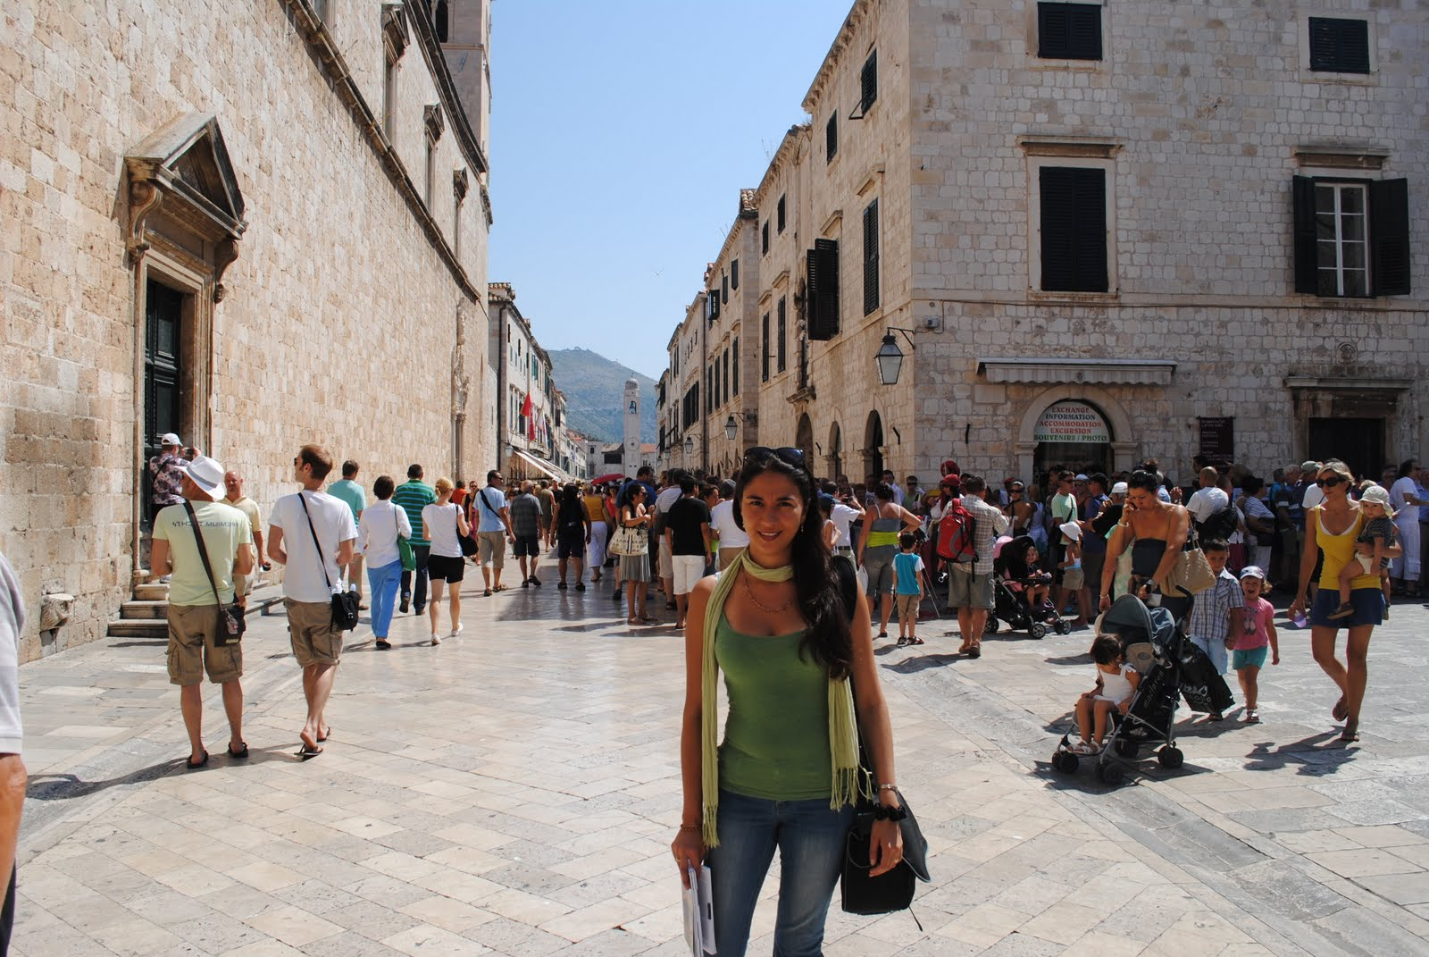
Notes:
Dubrovnik, 529 cruises brought tourists last year the, a figure that increases without stopping.

Slide 18
Serving Tourists, Pleasing Residents
■ Tourism by invitation, not invasion
■When the invitational voice of the
destination, “wish you were here”
transforms to “wish you weren’t here”,
then hospitality is replaced by
hostility
■ Venice, we hear you!
■ Dubrovnik, we hear you!
■ Barcelona, we hear you!
Notes:
Venice 20 million tourists annually. Pop down to 50,000 and annually shrinking
Barcelona: 9 million tourists stayed in hotels in 2016, much larger second homes.
No mayor would speak against tourism, but yes in Barcelona:, the number of visitors affects not only the quality of life of Barcelonans, ​​but also their ability to live in the area. More than 30 million tourists arrived in Barcelona in 2016, according to official City Hall data.
Guess who is against restrictions in Barcelona: not the mayor, not residents, but the tourism industry.
Barcelona: It will also stop issuing permits to turn apartments into accommodation for servers, such as those of Airbnb. This the hotel sector would support.
The accommodation law limits the number of beds available and freezes the building of new hotels in some zones of the city
Dubrovnik: installed security cameras so that no more than 8,000 tourists stay in its Old City; similar measures Thai islands
When people can voice: casino plan voted down by the public in Madrid/Barcelona?

Slide 19
Notes:
Photo caption: Huge crowds outside Barcelona’s La Boqueria market.
A figure record of 75 million foreign tourists visited Spain last year, 10 million more than in
2015.
With problems of security in places like Turkey, Egypt, and Tunisia, people decide to pass their vacations in surer countries.
Demonstrators' groups punctured the wheels of rent bicycles and of a tourist bus, and vandal incidents have taken place in hot destinations of Spain.
Back to Barcelona:
Last year, the city’s 1.6 million residents were outnumbered by an estimated 32 million visitors.
Tourism 17% of the GDP of Barcelona, generate 90.000 jobs.
No mayor would speak against tourism, but yes in Barcelona: the number of visitors affects not only the quality of life of Barcelonans, ​​but also their ability to live in the area. Again 32 million tourists arrivals in Barcelona
Restrictions to control in Barcelona not problem free:
The accommodation law limits the number of beds available and freezes the building of new hotels in some zones of the city. Who likes this restriction and not?
Barcelona will stop issuing permits to turn apartments into accommodation for tourists, such as those of Airbnb. But note: the hotel sector would support.
When people can voice: casino plan voted down by the public in Madrid/Barcelona?

Slide 20
Notes:
Photo caption A new regulation in Barcelona, a popular travel destination, prohibits the opening of new hotels in the city center. The city is experiencing a tourism crisis. The number of visitors is the second most serious problem for the city’s residents.
In Barcelona and other cities, services like Airbnb they have increased the rents in such a way that the residents have had to leave!
What happened to all we have published on empowerment? If the industry does not police itself, the resident will soon police the industry.

Slide 21
Serving Tourists, Pleasing Residents Who Views Whom and through Whose Eyes
Stakeholders | Tourists | Residents | Tourisiers
Tourists |  | T☺R | T☺Tr
Residents | R☺T | R☺R
Tourisiers
Notes:
Now add to this other stakeholders, religion(s), ethnic group(s), etc.

Slide 22
Serving Tourists, Pleasing Residents
■ Tourism by invitation, not invasion
■When the invitational voice of the
destination, “wish you were here”
transforms to “wish you weren’t here”,
then hospitality is replaced by
hostility
■ Venice, we hear you!
■ Dubrovnik, we hear you!
■ Barcelona, we hear you!
■ Next?
Notes:
Venice 20 million tourists annually. Pop down to 50,000 and annually shrinking
Barcelona: 9 million tourists stayed in hotels in 2016, much larger second homes.
No mayor would speak against tourism, but yes in Barcelona:, the number of visitors affects not only the quality of life of Barcelonans, ​​but also their ability to live in the area. More than 30 million tourists arrived in Barcelona in 2016, according to official City Hall data.
Guess who is against restrictions in Barcelona: not the mayor, not residents, but the tourism industry.
Barcelona: It will also stop issuing permits to turn apartments into accommodation for servers, such as those of Airbnb. This the hotel sector would support.
The accommodation law limits the number of beds available and freezes the building of new hotels in some zones of the city
Dubrovnik: installed security cameras so that no more than 8,000 tourists stay in its Old City; similar measures Thai islands
When people can voice: casino plan voted down by the public in Madrid/Barcelona?

Slide 23
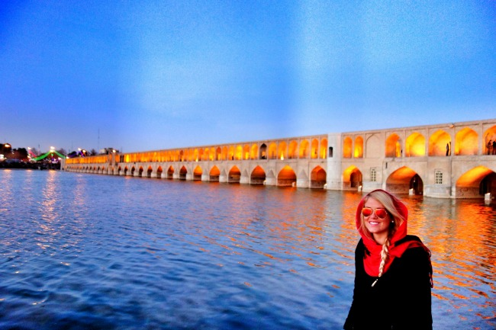

Slide 24
Notes:
Few tourists in Isfahan: they are loved. Message misunderstood.

Slide 25
Serving Tourists, Pleasing Residents
What happens if tourism is not limited on the basis of host’s tolerance?
Notes:
Tourism by invitation, not invasion. Invitation by the host, invasion through tourism actions.
Guest, Host, Hospitality: hijacked by tourism. In the past, tourism facilities were in certain areas of the destination. Today AirbnB is nesting it in deeper layer of the society, in the backstreets of residential area. People in by 22 hrs or after, but the sound of the luggage wheel 24 hours.

Slide 26
Serving Tourists, Pleasing Residents
What happens if tourism is not limited on the basis of host’s tolerance?
See for yourself:
Notes:
Tourism by invitation, not invasion. Invitation by the host, invasion through tourism actions.
Guest, Host, Hospitality: hijacked by tourism. In the past, tourism facilities were in certain areas of the destination. Today AirbnB is nesting it in deeper layer of the society, in the backstreets of residential area. People in by 22 hrs or after, but the sound of the luggage wheel 24 hours.

Slide 37
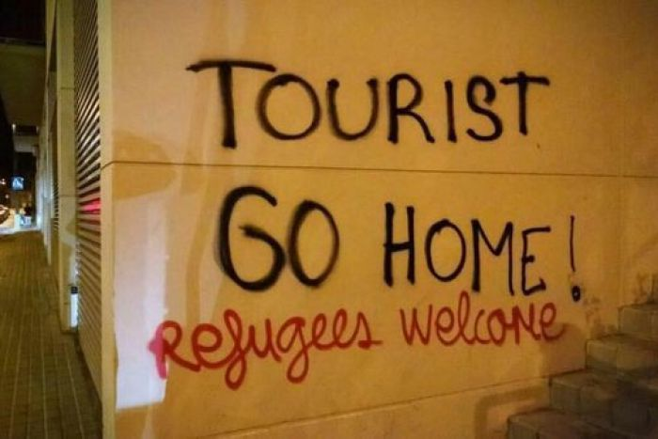

Slide 38
Serving Tourists, Pleasing Residents Concluding Remarks
Emic tourism strategy
■ Favors being proactive, avoiding unwanted
■ Is home-grown, is people’s tourism
■ Promotes local participation
■ Helps shortening seasonality
■ Benefits locals, directly and/or indirectly
■ Allows “escape” without leaving home
■ Nurtures sociocultural innovations
■ Facilitates heritage preservation
■ Is proactive—conflict resolution
■ Favors local materials, culturescape

Slide 39
Serving Tourists, Pleasing Residents Concluding Remarks
Emic tourism strategy, Cont’d
■ Results in less carbon footprint
■ Is in harmony with other development plans
■ Leads the industry, not led by it
■ Maximizes benefits and minimizes costs
■ Nurtures sustainable development
■ Responds to expectations of hosts and
guests alike
■ Is attractive to incoming tourists
■ Significantly, increases satisfaction of both tourists and residents with tourism
Notes:
This leads to a motto which I wish to promote>

Slide 40
Serving Tourists, Pleasing Residents
Proposition
■ A nice place to live is a nice place to visit!
So—emically developed tourism promotes:
■ Locals’ quality of life and
■ Tourists’ quality of experience
This is a win-win strategy!
And why?
Notes:
This lead to a motto which I have tried to promote in some other talks.

Slide 41
Serving Tourists, Pleasing Residents
A nice place to live is a nice place to visit!
Notes:
A nice place to live is a nice place to visit. Let’s first make all cities nice and creative places to live. Let’s begin with home community development and enrichment. Developing emically creative cities in which heritage tourism can be nested.

Slide 42
A nice place to visit
A nice place to live
A nice place to live
A nice place to visit
A nice place to live
A nice place to visit
is
is
is
is
is
is

Slide 43
A Nice
Community
A Nice
Destination
A Nice
Destination
A Nice
Community
A Nice
Destination
A Nice
Community
is
is
is
is
is
is
Notes:
In case of any dought about the sub-title of my talk, which image to project,my crystal clear answer is: the homegrown image.

Slide 44
Welcome to the field of Hospitality and Tourism
The future is yours
if you understand its sociocultural and operational parameters

Slide 46
TEN IMPORTANT WORLD TOURISM ISSUES FOR 2020
1. Maintaining a destination’s sustainable tourism development: economic, social, cultural, natural and built resources
2. Concern for safety and security remains an important issue to address within the global tourism industry
3. Responding to concerns for long-term impacts on the tourism industry of overtourism, climate change and global warming
4. Impact on the travel and tourism industry resulting from global economic, social, cultural and political directions

Slide 47
5. Necessity for increased local, regional, national, and Int’l leadership in tourism policy and strategic planning
6. Resolving barriers to travel: costs, visas, passports, immigration issues, airline services, fees, and delays
7. Educating travelers/businesses toward better management in the application of new technologies, in the tourism industry
8. Maintaining a sustainable, engaged, skilled and experienced workforce in order to deliver quality tourism experiences
9. Effect on travel from natural and human-induced disasters, health issues, humanitarian crises and political disruptions
10. Utilize tourism as a vehicle for bringing indigenous and rural populations out of their state of oppression and marginalization

Slide 48
Grazie per l’attenzione

