Slide 1
Milano come blue-green-city: I Navigli come futuro della città Laboratorio 1 – 21 aprile 26 maggio 2021
Milano - Turismo
Ezio Marra
Università degli Studi di Milano-Bicocca

Slide 2
The contemporary metropolis, dynamic and reticular (De Matteis, 1991), brings with it the dimension of competition between cities.
In fact, it is the post-industrial paradigm that proposes new interpretative models of the urban structure, favouring the affirmation of the concept of competition (Ciciotti, 2006).
Cities began to search for their own specialization in order to reposition themselves in a competitive market, in which the efficiency in terms of supply of resources was no longer sufficient and other elements became predominant.
These are the elements that determine what we define as the "urban distinction" and that allow cities to add specific hallmarks to their specialization.

Slide 3
Urban regimes and coalitions of power (adapted from Belligni and Ravazzi 2012)
1) The city as a growth machine (Logan & Molotch)
2) The fordist city (Gramsci, Americanismo e fordismo)
3) The polytechnic city (The creative city, Florida)
4) The pyrotechnic city (The City As an Entertainment Machine, Terry N. Clark) Urban tourism?
5) The blue-green city (David Owen, Robert C. Brears) Sustainable urban tourism ?

Slide 5
Postourism

Slide 6
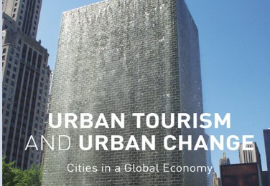

Slide 7
City no limits: city boundless is a metropolis
«These coming cities…will diffuse itself until it has taken up considerable areas and many of the characteristics of what is now country…The country will take itself many of the qualities of the city. The old antithesis… will cease the boundary lines will atogether disappear» (Wells, 1905 – 1967).
Of course boundless doesn’t mean infinite, but you don’t know where to put the boundaries

Slide 8
The fourth generation metropolis (readapted from Martinotti 1993)
 | LIVE | WORK | CONSUME Goods & Services | CONSUME Art, Amenities & Entertainment
Inhabitants | Y | Y/N | Y | Y
B) Commuters | N | Y | Y/N | Y/N
C) Short distance users | N | N | Y | Y/N
D) Metro businessmen or business tourists | N | Y | Y | Y/N
E)Leisure tourists | N | N | Y | Y

Slide 9
The fourth generation metropolis (readapted from Martinotti 1993) Venn diagrams
3) Second generation metropolis
1) Traditional city
5) Fourth generation metropolis
A
B
A
B
B
C
sustainable urban tourism
A
2) First generation metropolis
4) Third generation metropolis
D
A
C
B
B
E
A
D
C

Slide 10
From Fordism to Tourism Sharon Zukin: The culture of cities (1995)
Cities are often criticized because they represent the basest instincts of human society. They are built versions of Leviatan and Mammon, mapping the power of the bureaucratic machine or the social pressure of money. We who live in cities like to think of “culture” as the antidote to this crass vision. […]
With the disappearance of local manufacturing industries and periodic crises in government and finance, culture is more and more the business of cities – the basis of their tourist attractions and their unique, competitive edge.

Slide 11
Symbolic economy of Manhattan (Zukin)

Slide 12
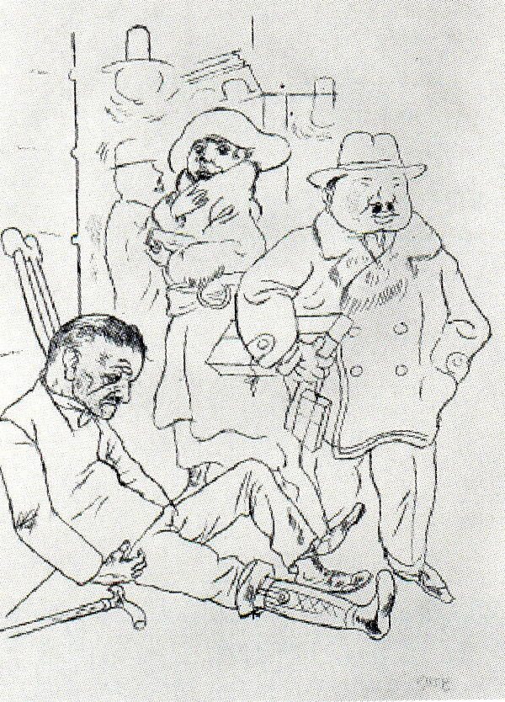
Grosz – Street scene – Recent book on FIAT
Notes:
Obviously this is not the place to enter into the merit of the eclipse of the centrality of the worker as typical of industrial society and in particular of the so-called Fordist period which is seen by some as the testing ground for class conflict.A few years on the typical figures of the current period are no longer those of the capitalist and of the worker, but have become that of the tourist and the vagabond (Bauman 1996) or of tourists and migrants (MacCannell 1992, Augè 2004). In some way tourists represent the affluent class, while migrants broadly represent the new proletariat (if we wish to reason with criteria which are largely obsolete) but which is very different from the previous version.

Slide 13
From Autos to Architecture

Slide 14
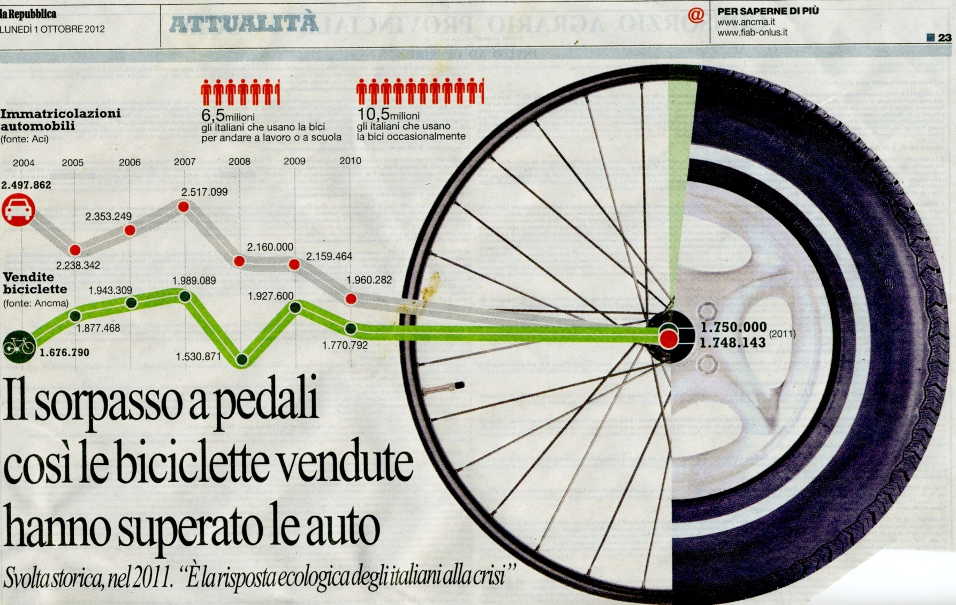
From fordism to cycling

Slide 15
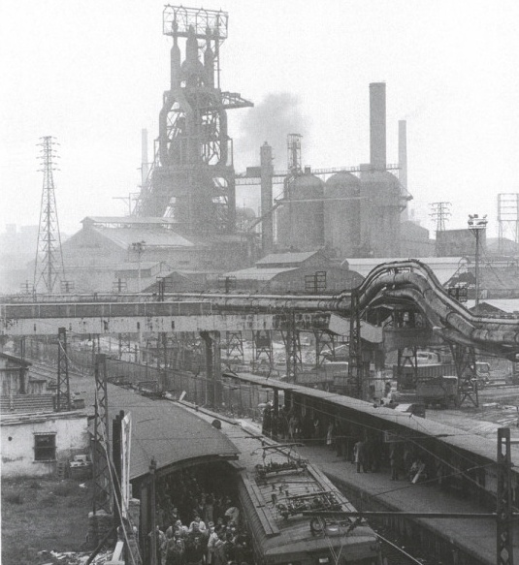
Fordism - Bilbao - 1930

Slide 16
Postfordism – Bilbao 2002
Notes:
Viaggio a Bilbao 2002

Slide 17
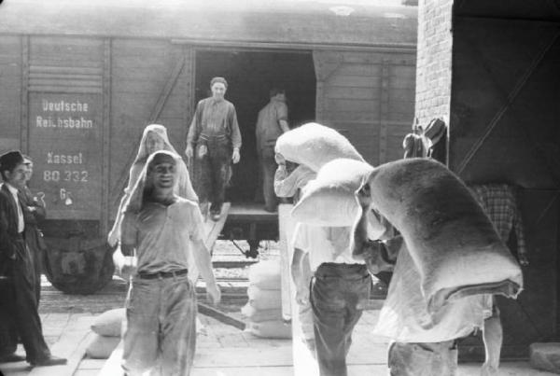
Fordism - Harbor of Genoa and Camalli (longshoremen, dockers)

Slide 18
Postfordism – Genoa: Bigo, Bolla, Magazzini del Cotone

Slide 19
Crollo del Ponte Morandi, 14 agosto 2018

Slide 20
Come gli alberi di una barca a vela: 43 lampioni (per ricordare il numero delle vittime) Renzo Piano

Slide 21
Fordismo – Ferriere Fiat

Slide 22
Fordismo – Il lingotto nel 1931

Slide 23
Postfordism The renewed Lingotto (ex-Fiat factory). (Source: Brochure ‘‘Always on the move’’, Turin City Hall, 2006)

Slide 24
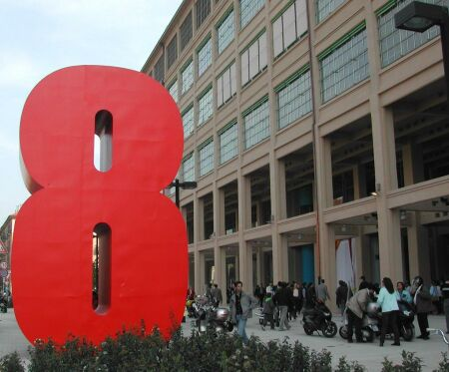
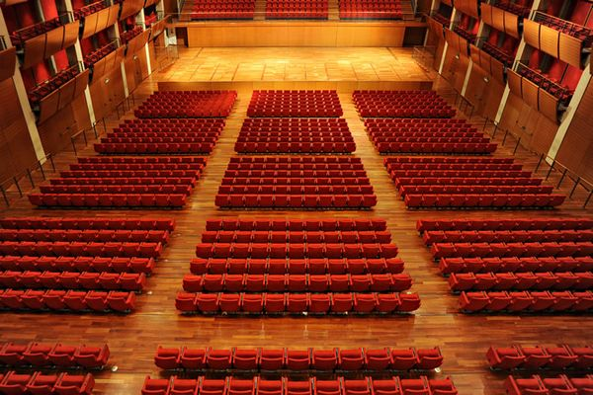
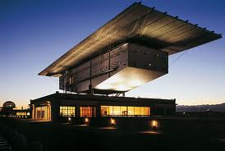
Posfordism – Lingotto: EATALY, Lingotto Gallery, Auditorium, Pinacoteca Agnelli

Slide 25
Posfordism – Lingotto: EATALY, Lingotto Gallery, Auditorium, Pinacoteca Agnelli

Slide 26
Fordism – Pirelli’s Workers

Slide 27
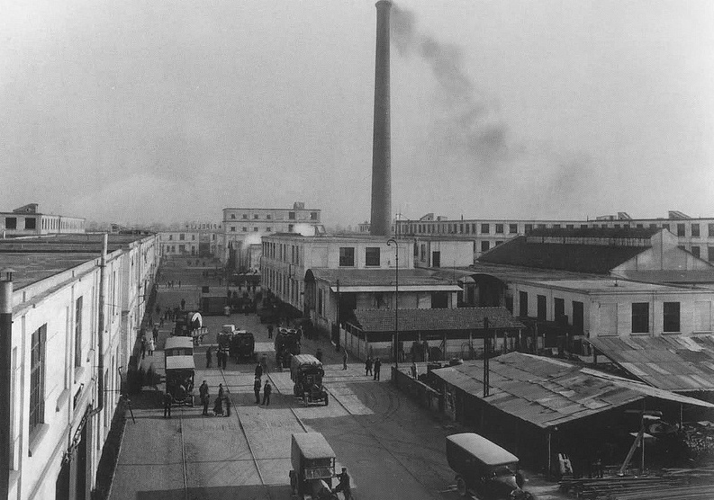
Fordism: Bicocca Pirelli 1922

Slide 28
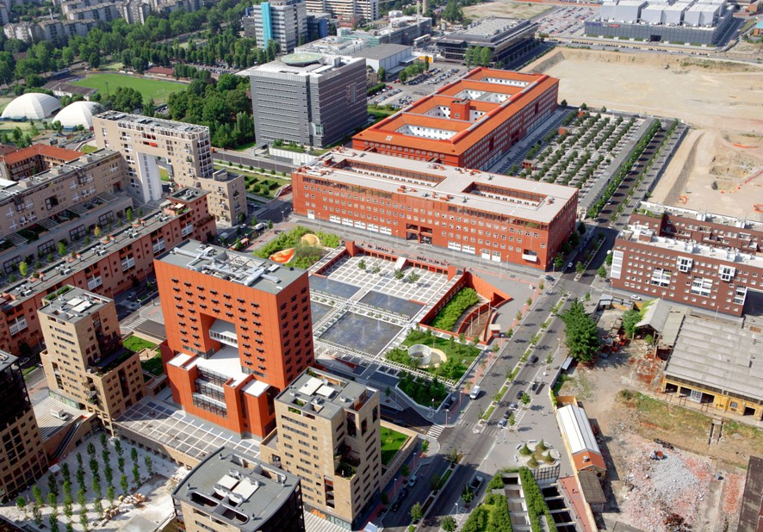
B Postfordism-Bicocca University 2010

Slide 29
Postfordism – Pirelli RE Meeting Tower

Slide 30
Postfordism: Milan Porta Nuova

Slide 31
The Sign of Ten
1) Film commission o City shaped by movies
2) Iconic Building & the Archistar (Beaubourg, Bilbao, Unicredit Tover, Vertical Forest)
3) Rediscovering the waterfront (Genova, Baltimora, Navigli etc.)
4) Mega Events (Olympic Games, Expo’, FIIFA World Cup, etc.)
5) Museums (vari tipi di musei e mostre rendono la città più attraente)
6) Cultural events, Festivalization (Settembre musica, Umbria Jazz, Maggio musicale fiorentino, Carnevale di Venezia, MITO Settembre musica, etc,)
7) Luci della città (Venezia da sempre le stesse luci, Torino, ecc,)
8) Wi-fi cities
9) Heritage cities
10) Green Cities

Slide 32
3.1) Rediscovering the waterfront (Genova, Baltimora, Navigli etc.)
Water has always been a fundamental element for cities, which are born near water, rivers and seas, because it was the prevailing transport system for transporting materials.
The first city in the world was born in Mesopotamia, which is the land between two rivers (Tigris and Euphrates) and was called UR. The first cities are mainly born in the East and mainly when we move from an agriculture of the rain, to an agriculture of the canals.
The canals are fundamental because they allow an irrigation agriculture, which increases the possibility of exploitation of the fields. With the intensive use of water the productive capacity increases, but the organization of the channels is fundamental. In Mesopotamia it was reserved for the temple.
The surplus of agricultural production allows capital to be invested and therefore cities to be built. With the introduction of technical, mechanical and technological means there has been a further leap in quality, when agriculture is industrialized productivity increases exponentially as well as profits.

Slide 33
3.2) Rediscovering the waterfront (Genova, Baltimora, Navigli etc.)
The cities especially those of port, when the ports change and are transformed and cranes and containers are introduced, there is the problem of recovering the old ports. Typical case: Genoa and the recovery of the port area (Renzo Piano), with the Aquarium of Genoa. The city is transformed by changing the ports. Some rivers in some cities are very neglected, in other contexts they are key places for local tourism...
Case Studies: Sidney, Boston, San Francisco, New York, Baltimore... examples in Europe: Barcelona, Valencia, London, Genoa, Athens, etc. Chicago (lake). Amsterdam & Milan (Canals), Bilbao, Rome, Turin, London, Paris, Berlin, Vienna, etc. (rivers)
LINK: https://iwa-network.org/programs/cities-of-the-future/
International water association

Slide 34
The long field and the First City: Primary and Secondary Urbanization and the Land of the Two Rivers
The word Mesopotamia means literally «between the rivers,»: the plain between the Tigris and Euphrates.
The centre and symbol of the first urbanization is the city of Uruk. In the Uruk period a characteristic irrigation system was developed: it consisted in network of pools and canals, and blocks of fields in the shape of elongated strips on both sides of a canal.
In contrast to the small squared fields in use in central Mesopotamia, watered by flooding, and arranged by family groups, the long fields were much bigger (c. 30 hectares vs. 1 o 2) of the other system. The system could be arranged only thanks to an action of a communal agency, together with the excavation of the canal.
Additional technological improvements include the introduction of the oxen-driven plough. The result was a per farmer productivity increase that can be estimated at least as doubling, with the consequent availability of a substantial surplus.
The blocks of long fields belonged to the temple that managed and organized their exploitation and appropriated their crops, only detracting the amount for ‘producers’ rations.
The «long fields» in Lower Mesopotamian rural landscape
Notes:
See Liverani 2009

Slide 35
Copenaghen & Curitiba

Slide 36
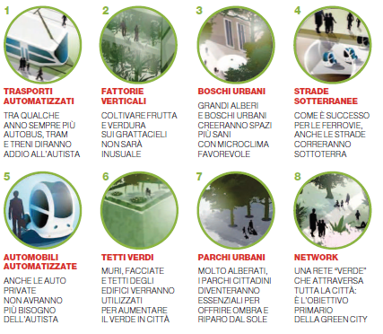
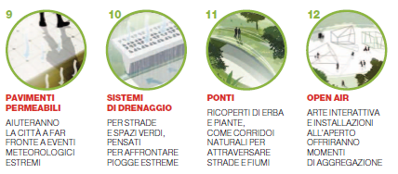
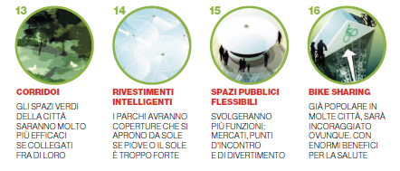
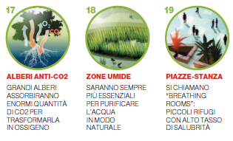

Slide 37
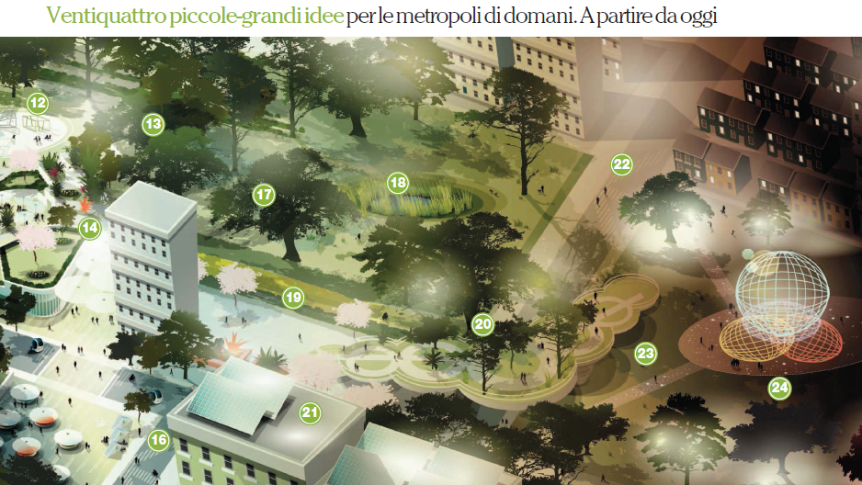
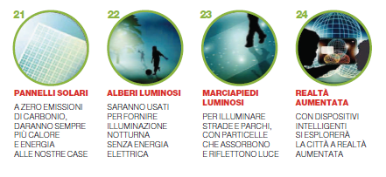

Slide 39
Collegamento LoVe

Slide 40
Sitting on the City Walls Quali modelli di città per il futuro ? Quale eredità e quale modello per Milano ?
1) Città policentrica (as a Growth Machine Harvey Molotch) come immobiliarismo e Real Estate
2) Città «fordista» (Grande industria – automobile)
3) Città politecnica (as a Creative City – Richard Florida - 2002) ICT – Fashion – Salone del mobile, design, ecc. SMART CITY?
4) Città pirotecnica (as an Entertainment Machine – S.Belligni e S.Ravazzi 2012 - Terry Clark - 2004) Spectacle – Mega events The Society of the spectacle – Guy Debord 1967
5) Metropoli Sostenibile (Green Metropolis – David Owen 2009) territorio urbano – regione metropolitana – regione urbana milanese ??? Superamento della contrapposizione città-campagna
6) Blue-green cities

Slide 41
Milan is without rivers ?
The first city was around two rivers.
All the cities are near the sea or near rivers

Slide 42
The long field and the First City: Primary and Secondary Urbanization and the Land of the Two Rivers
The word Mesopotamia means literally «between the rivers,»: the plain between the Tigris and Euphrates.
The centre and symbol of the first urbanization is the city of Uruk. In the Uruk period a characteristic irrigation system was developed: it consisted in network of pools and canals, and blocks of fields in the shape of elongated strips on both sides of a canal.
In contrast to the small squared fields in use in central Mesopotamia, watered by flooding, and arranged by family groups, the long fields were much bigger (c. 30 hectares vs. 1 o 2) of the other system. The system could be arranged only thanks to an action of a communal agency, together with the excavation of the canal.
Additional technological improvements include the introduction of the oxen-driven plough. The result was a per farmer productivity increase that can be estimated at least as doubling, with the consequent availability of a substantial surplus.
The blocks of long fields belonged to the temple that managed and organized their exploitation and appropriated their crops, only detracting the amount for ‘producers’ rations.
The «long fields» in Lower Mesopotamian rural landscape
Notes:
See Liverani 2009

Slide 43
Tag cloud: Milan for foreigners

Slide 44
Milano al tempo di Leonardo era già un grande sistema metropolitano basato sull’acqua e ‘centrato’ su un sistema ‘agromanageriale idraulico’ di canali artificiali che gestivano l’economia organizzando e facendo pagare i trasporti, l’irrigazione e il traffico delle merci (i dazi).
Il sistema richiedeva grande organizzazione e grandi capacità tecniche.
Poi Milano è ridiventata città. Adesso con il tema di EXPO 2015 ha avuto l’occasione per ritornare Metropoli
.

Slide 45
The improvement of canals
Lombardy underwent an agricultural revolution (and a connected process of general economic growth) in the fourteenth and fifteenth centuries. The basis for this transformation was a series of fundamental institutional changes. These latter—consisting most importantly of the transfer of control over the land into new hands—must in turn be attributed essentially to the policies of the Visconti and Sforza dukes who, through direct or indirect means, encouraged, initiated, facilitated, and acquiesced in the processes by which the change took place.
Dowd F.D.(1961), The Economic Expansion of Lombardy, 1300–1500, The Journal of Economic History / XXI:02,1961, pp. 143-160

Slide 46
Tag Cloud: Milan for its inhabitants

Slide 47
The Po Valley (source:G.Fantoni 2008)

Slide 48
Il sistema dei Navigli e Milano metropoli ante litteram

Slide 49
Pianta di Milano rinascimentale: i principali corsi d’acqua
1.Conca di Varenna 2.Conca di S.Ambrogio 3.Conca di P.ta Orientale
4.Conca di Borgonuovo 5.Conca di S.Marco 6.Conca dell’Incoronata

Slide 50
From fordism to cycling

Slide 51
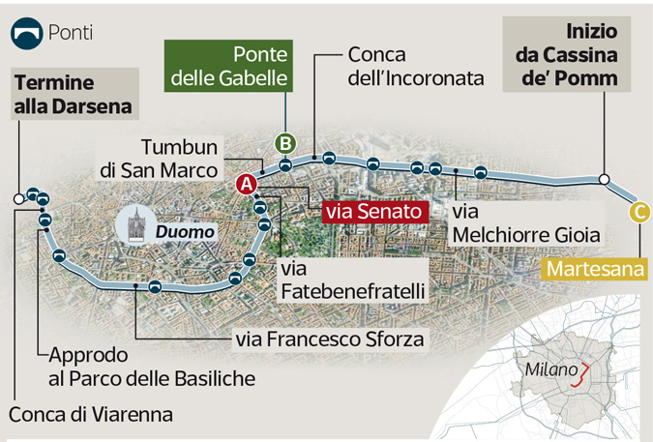
Riapertura dei Navigli interni a Milano

Slide 52
Riapertura dei Navigli
Prima fase consiste nel ricostituire l'antica connessione idraulica della città, attraverso tubazioni, per ricollegare le acque del Naviglio Martesana con la Darsena, la Vettabbia e il sistema dei canali irrigui del Sud Milano. Tracciato totale lungo 7,7 chilometri
La seconda fase vedrà invece la riapertura di cinque tratti di superficie per una lunghezza complessiva di poco più di due chilometri.

Slide 53
Riapertura seconda fase
Il primo tratto previsto è il prolungamento della Martesana in via Melchiorre Gioia, lungo 850 metri e largo 10,5;
Il secondo tratto, lungo 230 metri e largo 7, è in corrispondenza della Conca dell'Incoronata-San Marco.
Il terzo tratto, lungo 410 metri e largo 7, vicino alla futura fermata del metrò Sforza-Policlinico, potrà sfruttare i lavori in corso per la realizzazione della linea 4, proprio come
il quarto tratto, di 300 metri per 7 di larghezza, vicino a piazza Vetra.
Il quinto tratto infine sarà collegato alla Darsena, in corrispondenza della conca di Viarenna, per una lunghezza di 260 metri e una larghezza di 12

Slide 54
Riapertura tempi e costi
La riapertura delle 5 tratte avrà un costo di 150 milioni di euro. (mentre per la riapertura completa ne servirebbero altri 350). Risorse che andranno suddivise sui 5 anni di cantieri e che, considerando l'impatto positivo che possono generare in termini di riqualificazione urbana, sostegno irriguo al sistema agricolo, sostenibilità ambientale, valore degli immobili (solo per citare alcuni degli effetti più facilmente misurabili), si prestano ad attivare fondi non solo privati ma regionali, statali ed europei. I cantieri potrebbero partire già nel 2018 e concludersi nel 2022

Slide 55
Città-Metropolitana

Slide 56
Città Metropolitana di Milano

Slide 57
Milano verde

Slide 58
Milano Blue

Slide 60
Blue Green

Slide 61
Collegamento LoVe

Slide 62
Esercizi di Destination Management
Nell’ambito del progetto su ‘I percorsi di Leonardo’ un gruppo di 43 studenti del corso di Marketing Urbano (laurea Magistrale in Turismo Territorio e Sviluppo Locale) ha lavorato per individuare gli elementi complementari ed essenziali per rendere fruibili e accessibili i punti di interesse leonardesco presenti lungo i Navigli.

Slide 63
Il Gruppo di Lavoro
Gruppo di lavoro: 43 laureati triennali iscritti alla laurea Magistrale in Turismo Territorio e Sviluppo Locale (UNIMIB) del corso di Marketing Urbano (Prof .Ezio Marra).
24 lombardi (di cui 4 milanesi), 15 italiani di molte altre regioni italiane, 4 dall’estero (Cina, Libia, Spagna, Polonia).
14 provenienti da lauree triennali di UNIMIB (prevalentemente Scienze del Turismo e Comunità Locale). Altri provenienti da altre lauree di altri atenei italiani e stranieri (Archeologia, Scienze culturali, Bocconi, Scienze dell’ambiente, Geografia, ecc.).
1) Dalla Darsena ad Abbiategrasso (Grande1): Beatrice Bonetti, Silvia Campus, Roberta Cassina, Elena Colli, Elisa Colombo, Francesca Cortesi, Debora Fontana, Lezia Fusaro, Lizhou Li, Matteo Medzela, Andrés Pérez, Nesreenrande Ramadan
2) Da Abbiategrasso a Lonate Pozzolo (Grande2): Simone Avite, Luis Abad, Carolina Arena, Umberto Battello, Alessia Compagnoni, Federico Mandelli, Elena Paolini, Karem Tayseir
3) «Lontano dal rumore…inseguendo Leonardo» Da Milano a Pavia (Pavese): Irene Barbieri, Luca Bedogni, Gabriele Betteghella , Fabiana Bizzarro, Giusita Lory Cimminelli, Ester Colasante, Riccardo Corrati , Angela Floris, Giulia Pampararo
4) Il Naviglio di Bereguardo (Bereguardo): Letizia Badà, Elisa Galbiati, Elisa Grilli, Alessia Moretti, Ilaria Perico, Giulia Rinaldi
5) Naviglio della Martesana e Naviglio di Paderno (Martesana): Lia Bonaita, ,Jessica Buzzerio, Martina Carnelli, Lorenzo Corosu, Silvia Duchini, Francesca Garzetti, Cecilia Messina, Federico Raucci

Slide 64
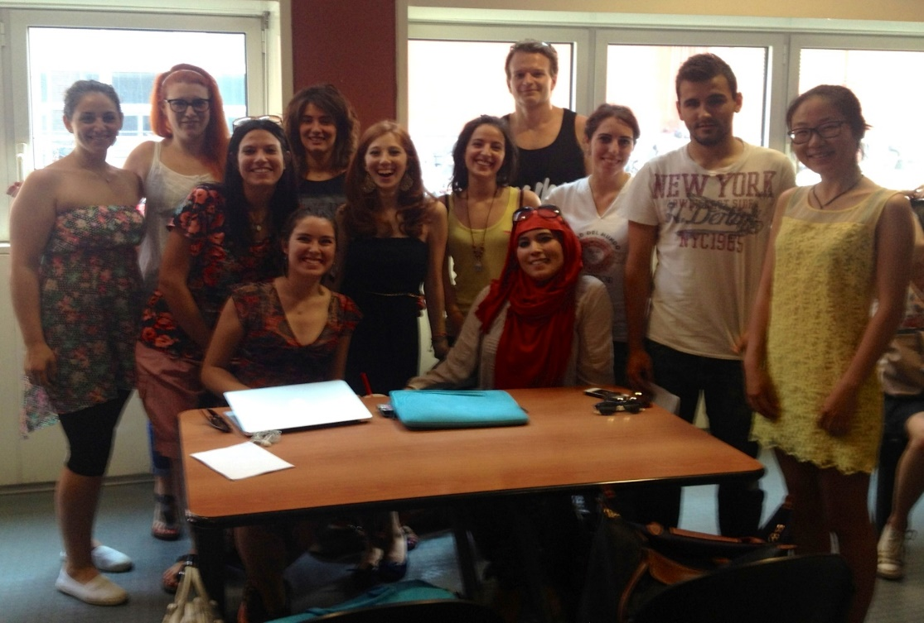
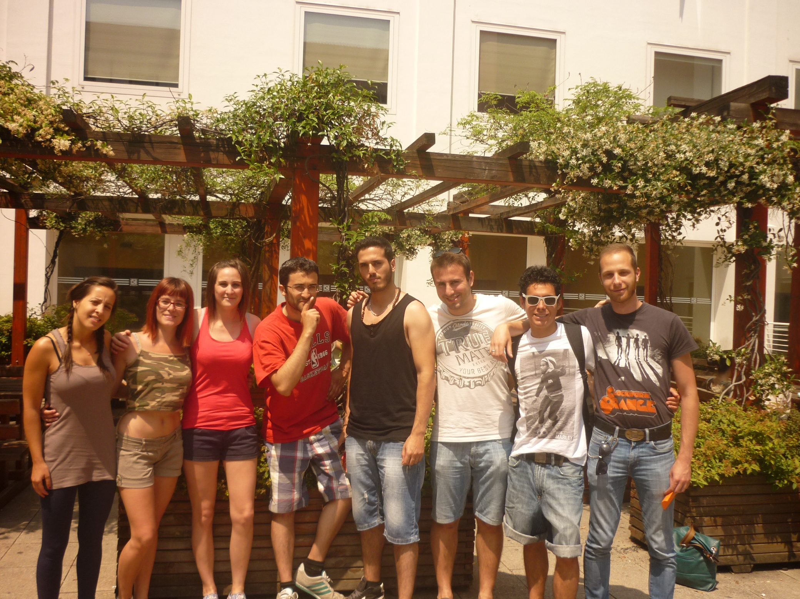
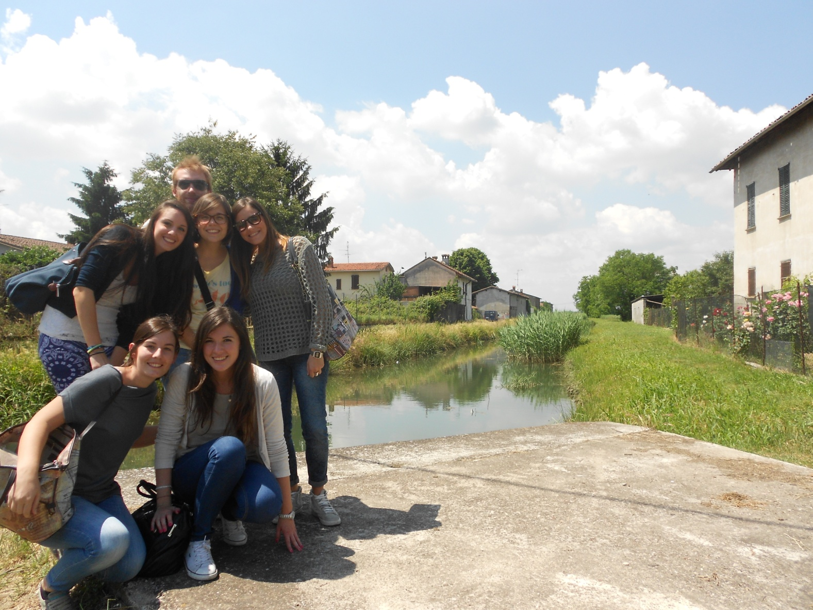
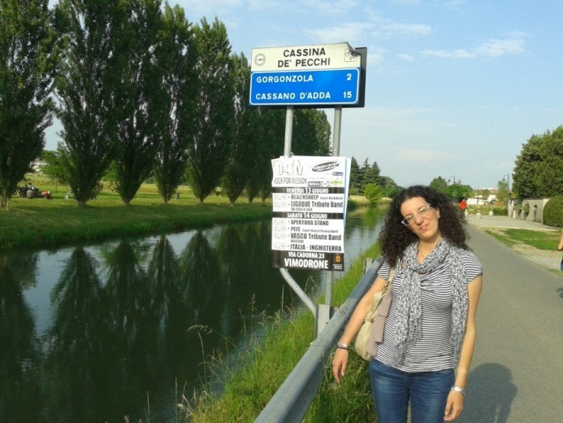
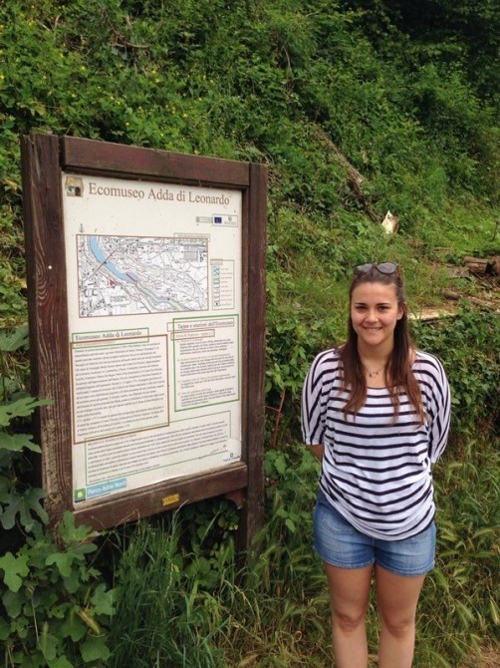
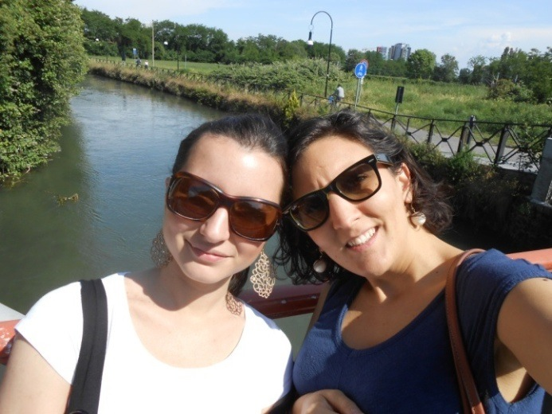
Grande 1
Grande 2
Bereguardo
Martesana
Pavese

Slide 65
I percorsi di Leonardo – Elementi Primari e Secondari

Slide 66
I percorsi di Leonardo – Elementi Aggiuntivi e Eventi

Slide 67
I percorsi di Leonardo – Comunità Locale e Narrazioni

Slide 68
Particolare di mappa su Google MAPSengine

Slide 69
I percorsi di Leonardo
I percorsi di Leonardo promossi dalla Navigli Scarl costituiscono, in sintonia con le tematiche di EXPO 2015, un’ottima occasione per ridare a Milano un’identità di
GREEN METROPOLIS
Come indicato nelle diapositive precedenti i milanesi conoscono bene i Navigli mentre i turisti stranieri ignorano in grandissima parte la loro esistenza.
A Milano i percorsi di Leonardo offrono un’ottima occasione per diventare un punto di attrazione e di riferimento turistico internazionale per il ‘turismo lento e sostenibile’ e per il ‘turismo culturale urbano’

Slide 70
Grazie per l’attenzione

